Slide 1

Flight PRICE PREDICTION
POWER POINT PRESENTATION

Slide 2
Problem Statement
Anyone who has booked a flight ticket knows how unexpectedly the prices vary. The cheapest available ticket on a given flight gets more and less expensive over time. This usually happens as an attempt to maximize revenue based on - 1. Time of purchase patterns (making sure last-minute purchases are expensive) 2. Keeping the flight as full as they want it (raising prices on a flight which is filling up in order to reduce sales and hold back inventory for those expensive last-minute expensive purchases) So, you have to work on a project where you collect data of flight fares with other features and work to make a model to predict fares of flights.

Slide 3
Domain Understanding
Domain Understanding :
• The terms ‘aviation industry’ and ‘airline industry’ are sometimes thought of as being interchangeable, but they do actually describe different things. An airline is a business offering air transportation services for people or cargo, with the airline industry being the collective term used to describe these companies.
The aviation industry has also been a key contributor to global economic prosperity, not only as a result of the tourism industry boosting local economies, but also because it has allowed for improvements to global trade.
Meanwhile, the aviation industry also directly provides millions of jobs for people around the world, with examples including everything from pilots and cabin crew, through to air traffic controllers and aerospace engineers. On top of this, the aviation industry has helped to create many jobs in the wider travel and tourism industry too.

Slide 4
Literature
The main steps in my research were the following.
• Exploratory Data Analysis (EDA): By conducting explanatory data analysis, we obtain a better understanding of our data. This yields insights that can be helpful later when building a model, as well as insights that are independently interesting.
• Feature Selection: We select the best features out of available features to bring out the best model for the problem using feature selection
• Modeling: We apply Decision Tree , Random Forest , Linear Regression , K-Neighbours,Decision Tree,Gradient Boost models for prediction of the sale price

Slide 5
EXPLORATORY DATA ANALYSIS
Data exploration is the first step in data analysis and typically involves summarizing the main characteristics of a data set, including its size, accuracy, initial patterns in the data and other attributes. It is commonly conducted by data analysts using visual analytics tools, but it can also be done in more advanced statistical software, Python. Before it can conduct analysis on data collected by multiple data sources and stored in data warehouses, an organization must know how many cases are in a data set, what variables are included, how many missing values there are and what general hypotheses the data is likely to support. An initial exploration of the data set can help answer these questions by familiarizing analysts with the data with which they are working.

Slide 6
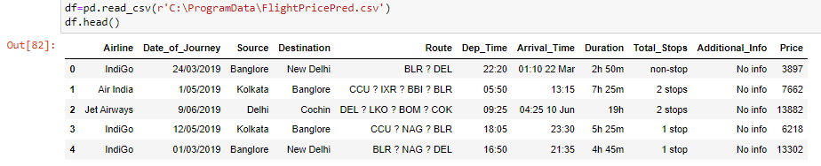
DATASET

Slide 7
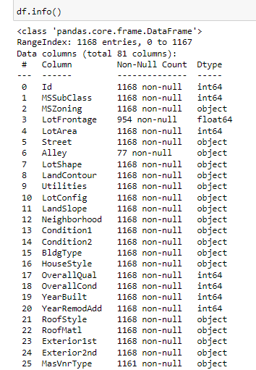
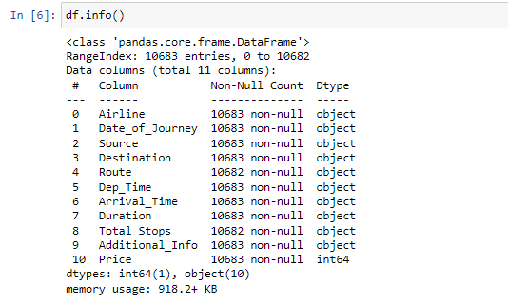

Slide 8
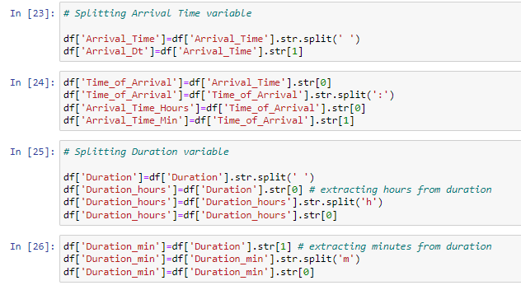
Splitting Variables

Slide 9
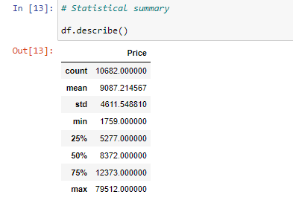
Statistical Summary

Slide 10
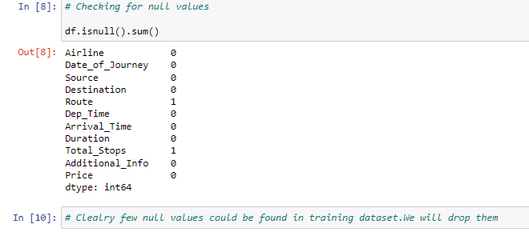
Checking null values in dataset

Slide 11
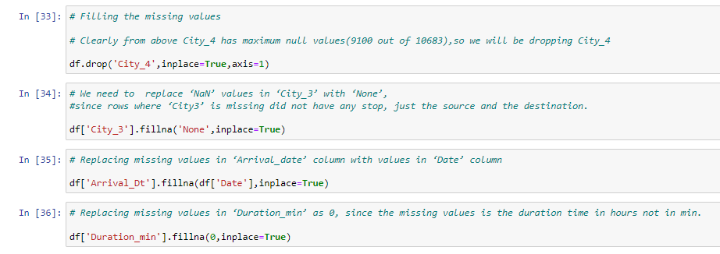
Filling null values in dataset

Slide 12
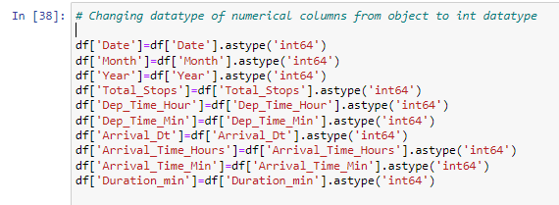
Changing datatype of numerical columns from object to int datatype

Slide 13
DATA VISUALIZATION
Data visualization is the graphical representation of information and data. By using visual elements like charts, graphs, and maps, data visualization tools provide an accessible way to see and understand trends, outliers, and patterns in data. In the world of Big Data, data visualization tools and technologies are essential to analyse massive amounts of information and make data-driven decisions.

Slide 14
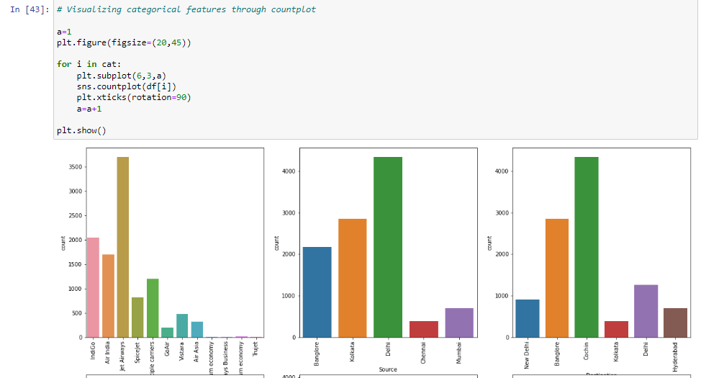
Histogram Plots

Slide 15
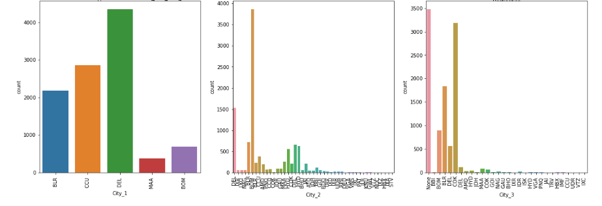
HISTOGRAM Plots

Slide 16
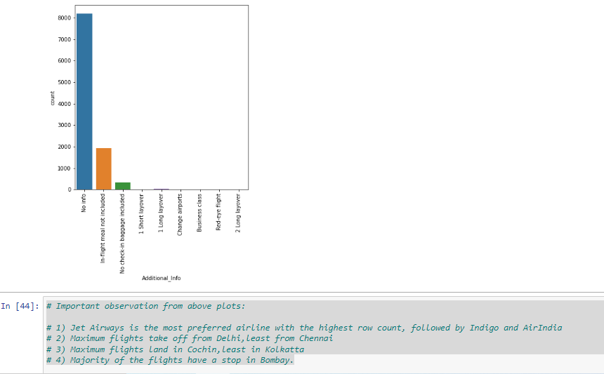
HISTOGRAM PLOTS

Slide 17
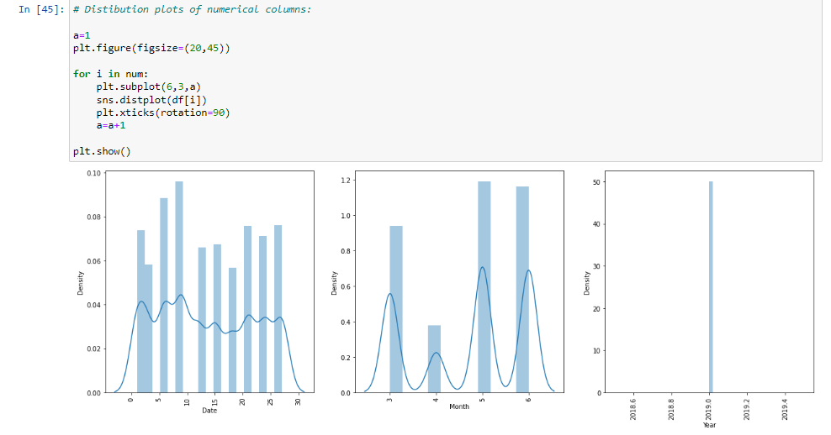
DISTRIBUTION PLOT

Slide 18
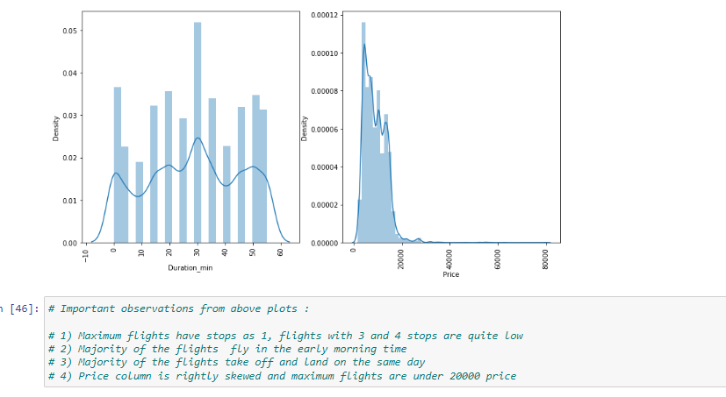
DISTRIBUTION PLOTS

Slide 19
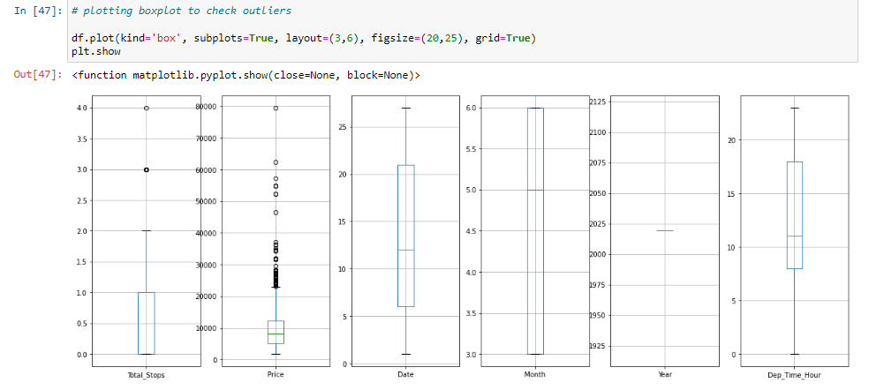
OUTLIERS

Slide 20
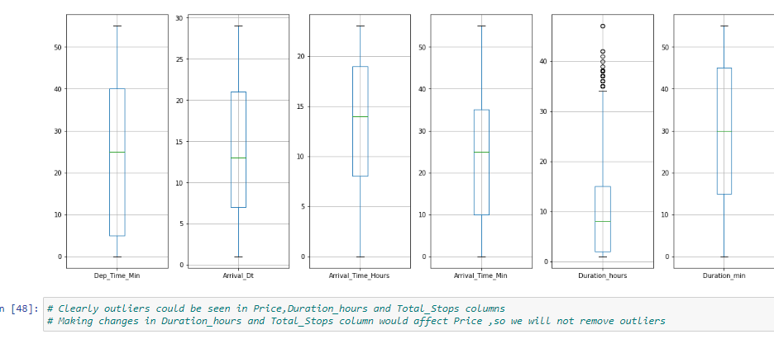
OUTLIERS

Slide 21
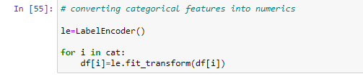
LABEL ENCODING

Slide 22
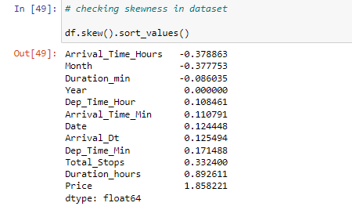
SKEWNESS

Slide 23

Splitting Dataset into X , Y

Slide 24
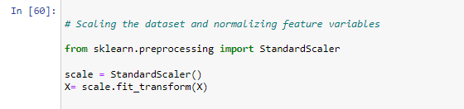
SCALING OF DATASET

Slide 25
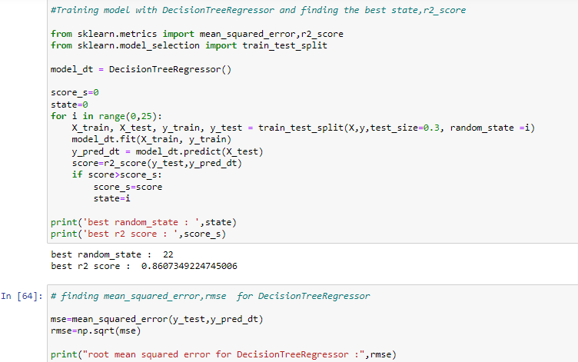
EVALUATION OF MODELS

Slide 26
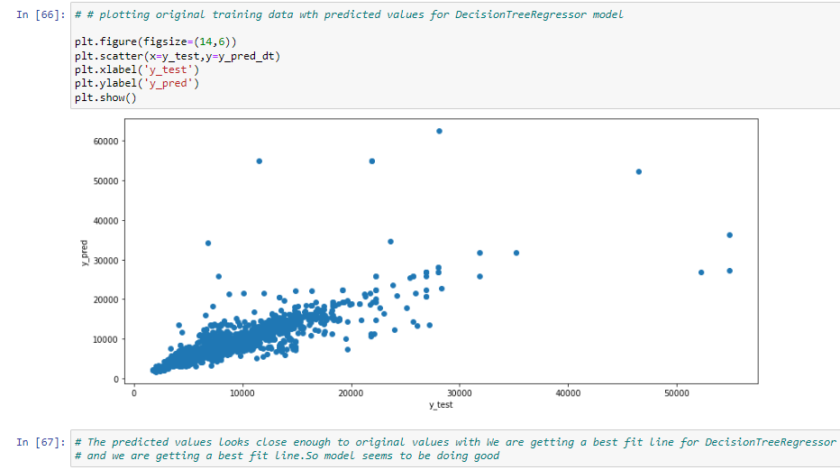

Slide 27
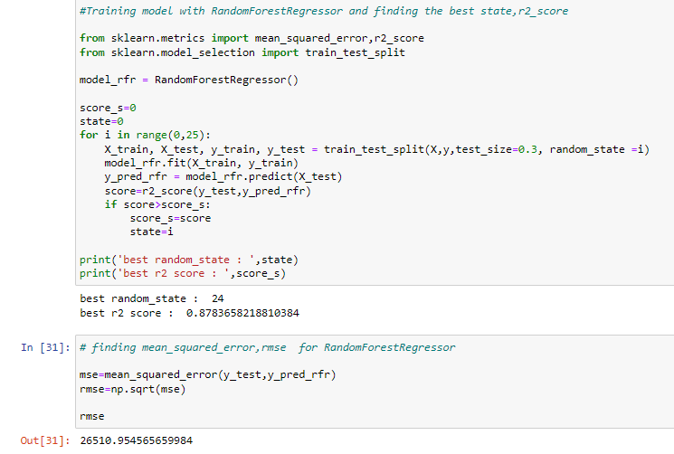
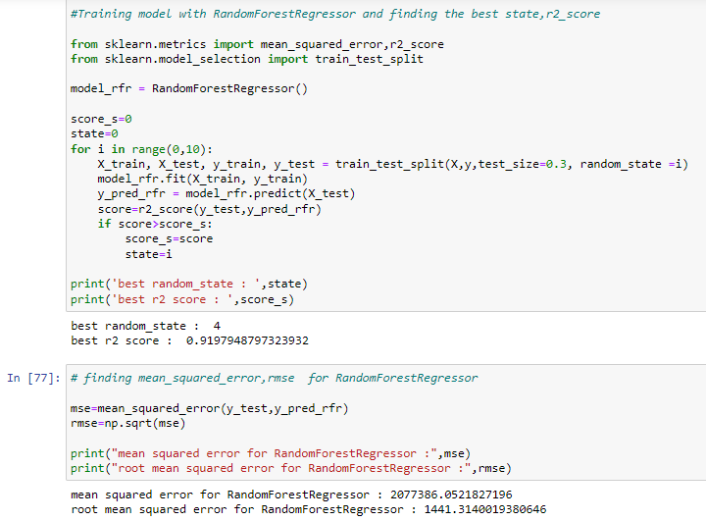

Slide 28
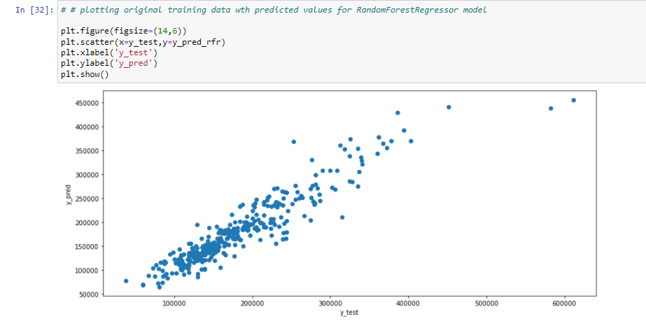
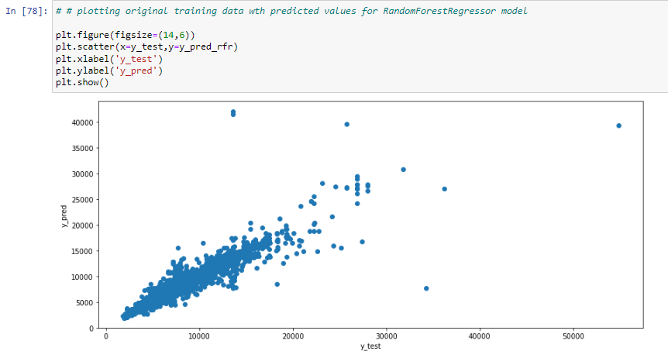

Slide 29
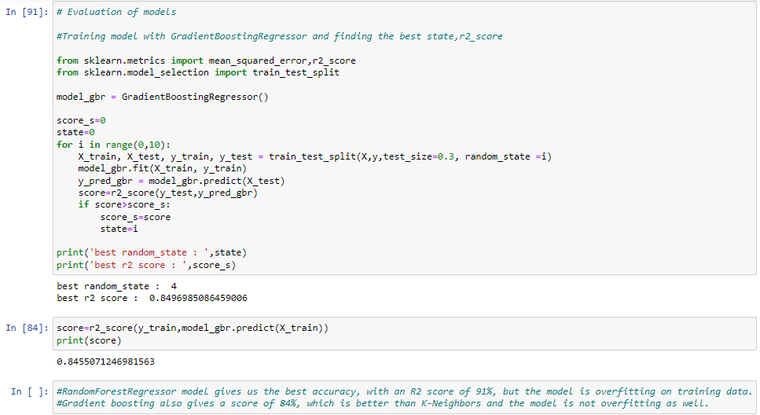
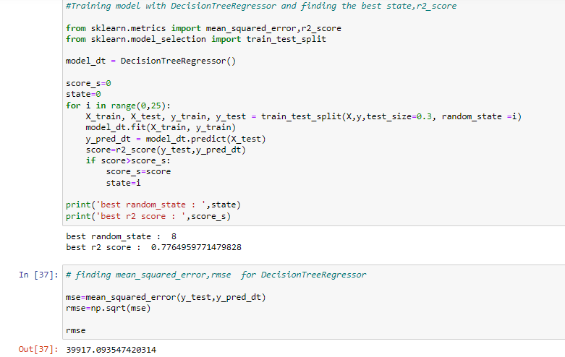

Slide 30
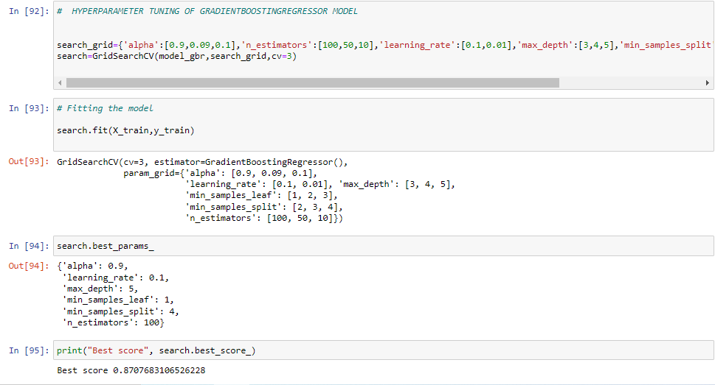
HYPERPARAMETER TUNING

Slide 31
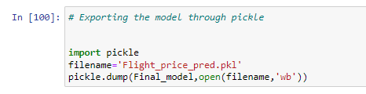
EXPORTING THE MODEL

Slide 32
CONCLUSION
# Clearly from above best score,we can conclude that Gradient Boosting Regression is a good choice for predicting Flight prices.

Slide 33


