Slide 1
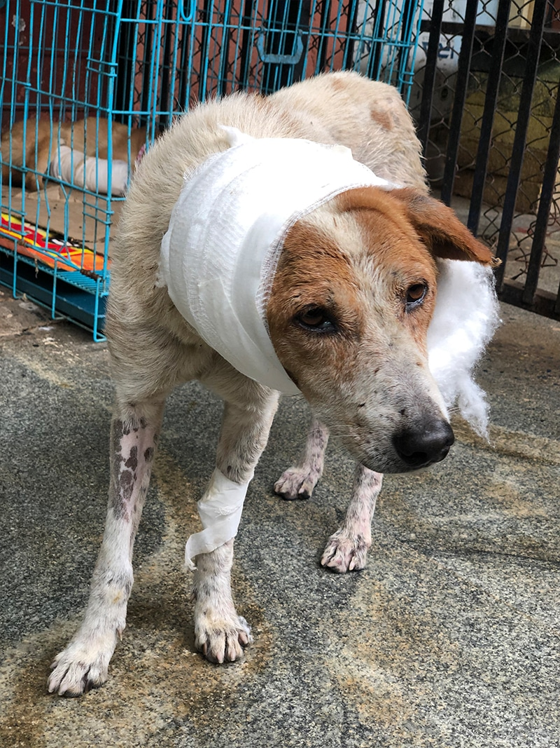
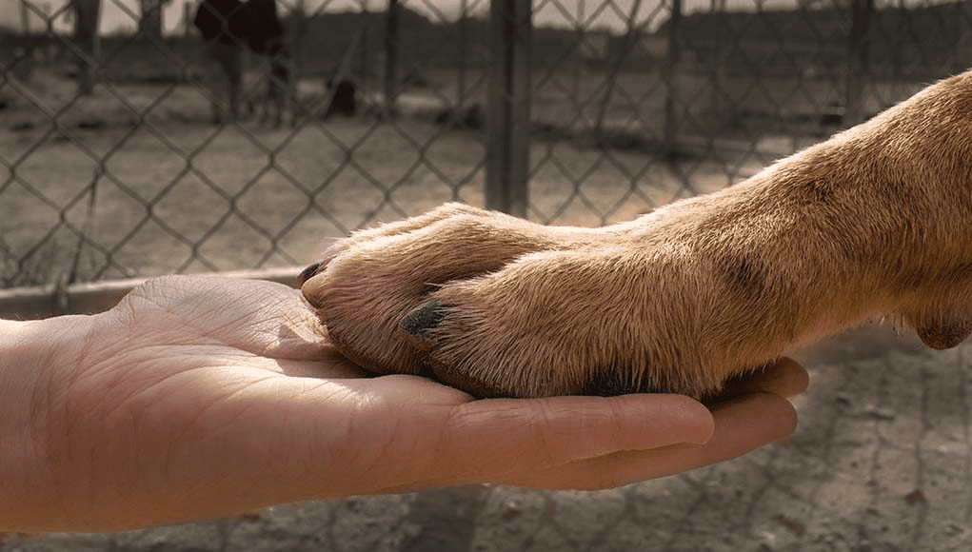
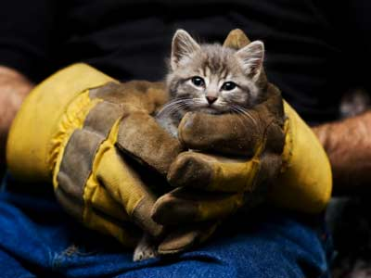
Animal Rescue Platform: Saving Lives Together
Welcome to our innovative animal rescue platform, designed to connect NGOs, animal lovers to provide critical care, and ultimately save lives.

Slide 2

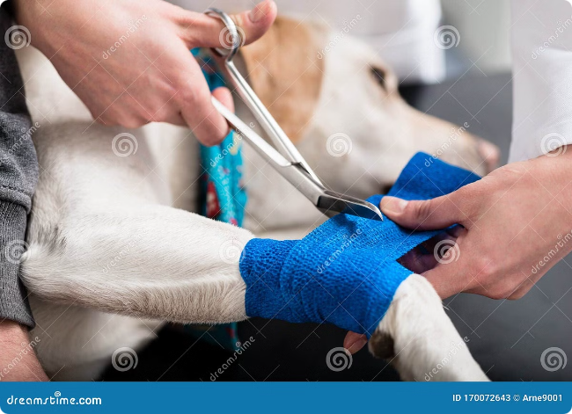
Problem Statement:
Every year, countless animals face life-threatening situations due to accidents, illness, and neglect. Many die because they lack timely first aid and access to veterinary care. Our platform tackles this critical problem by providing a network of rescuers, vets, and adopters.
Lack of Resources
Time is Critical
Limited availability of animal shelters and veterinary clinics, especially in remote areas.
Prompt first aid and veterinary care are crucial for survival, but access is often limited.
Lack of Coordination
A disconnect between rescuers, vets, and potential adopters hampers efficient rescue efforts.

Slide 3
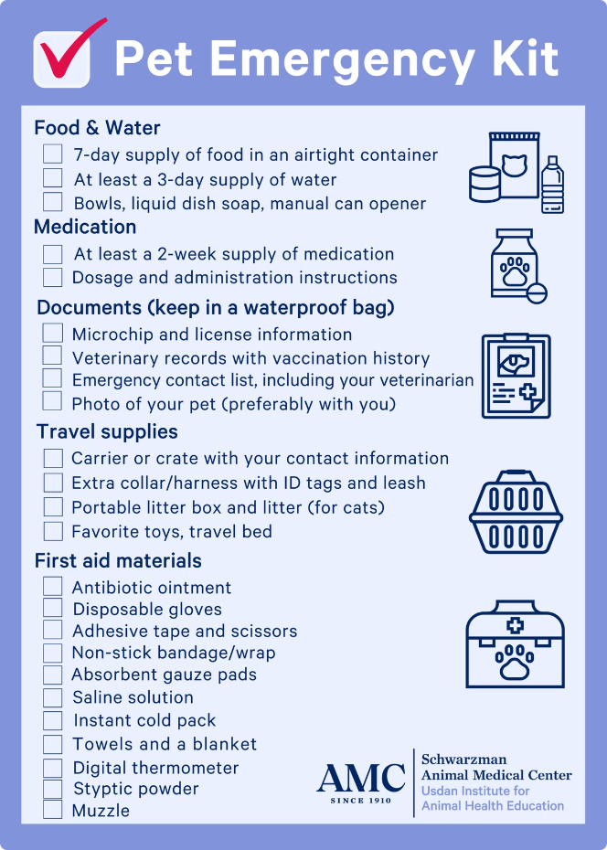



How Our Platform Works: A Seamless Solution
Our platform streamlines animal rescue by connecting rescuers, veterinarians, and adopters through a user-friendly interface. Rescuers can quickly report emergencies, find nearby vets, and connect with potential adopters.
Emergency Reporting
Rescuers can easily submit details about the animal by uploading photo,
Tagging location, and describing condition so rescuers have an idea and
Necessary information.
Vet Locator & First aid info:
The platform identifies the nearest available veterinarians based on the reported location.and also guide people who present on ground to provide basic first-aid.
Adoption Network
Potential adopters can browse profiles of animals in need and connect
with rescuers.

Slide 4
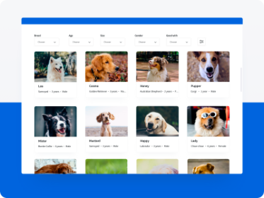
Basic Front-End Website Development: User-Friendly Interface
Our platform features a user-friendly interface designed for seamless navigation. Rescuers, vets, and adopters can easily access information, report emergencies, and connect with each other.
1
Intuitive Design
2
Mobile Responsive
3
Secure and Reliable
The website is designed with clear navigation and easy-to-understand features.
The platform is accessible on all devices, including smartphones and tablets.
The website is built on a secure platform to ensure data privacy and reliability.

Slide 5
Google Locator API: Guiding Rescuers and Vets
Our platform leverages Google's Location API to provide precise locations of animal shelters, veterinary clinics, and potential rescuers in the vicinity of an emergency.
Rescuers
2) Veterinarians
3) Adopters
4) Navigate to the rescue location efficiently.
5) Find animals in need within their area.
6) Locate nearby vets and shelters.

Slide 6
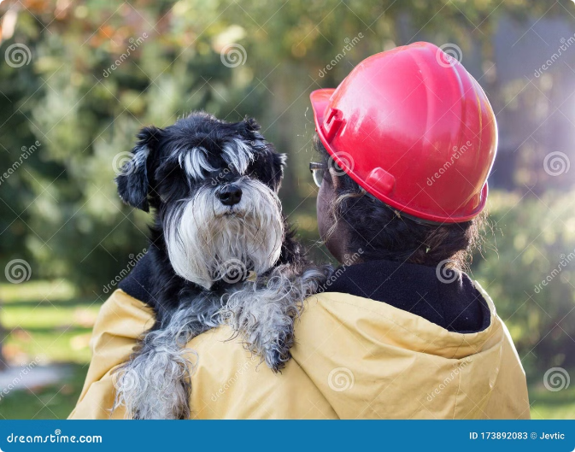



Connecting Rescuers, Veterinarians, and Adopters: A Unified Network
Our platform fosters collaboration and communication between rescuers, veterinarians, and potential adopters. This unified network streamlines rescue efforts and improves the chances of survival for animals in need.
Compassionate Community
Connect with like-minded individuals who share a passion for animal welfare.
Efficient Collaboration
Streamline rescue efforts through communication and coordinated action.
Forever Homes
Find loving homes for rescued animals through a dedicated adoption network.

Slide 7
Conclusion and Next Steps: Building a Brighter Future for Animals
By combining innovative technology, compassionate individuals, and a commitment to animal welfare, our platform has the potential to transform animal rescue. We are committed to continually improving and expanding our services to create a brighter future for animals in need.
1
Phase 1: Pilot Launch
Test the platform with a select group of rescuers, vets, and adopters in a specific region.
2
Phase 2: National Expansion
Expand the platform's reach to a wider audience across the country.
3
Phase 3: Global Impact
Develop partnerships and resources to make the platform accessible globally.

Slide 8

Technical Approach:
Python Streamlit
Machine Learning Model
Google Locator API
We utilize Python Streamlit, a powerful framework for creating interactive web applications. This enables a user-friendly interface and intuitive data visualization.
Our core AI component is a sophisticated machine learning model trained to accurately diagnose animal diseases based on user input.
Seamless integration with the Google Locator API allows users to easily pinpoint animal locations, facilitating efficient rescue efforts.
Gemini API:
These APIs would be used for tasks
like data processing,or integrating AI
capabilities such as handling user authentication
messaging or integrating external services.

Slide 9
Target Audience: Empowering Animal Lovers
Animal Shelters Organizations (NGOs)
2
Veterinarians
3
Individual Animal Lovers
1
Veterinarians can utilize the platform for second opinions and access to advanced disease diagnostic capabilities.
Animal lovers can contribute to rescue efforts by reporting animal sightings and accessing critical information on animal welfare.
Animal rescue shelters can streamline their operations, enhancing disease diagnosis and resource allocation.

Slide 10
Feasibility & Scalability: A Sustainable Solution
1
Development
The platform is built on a scalable infrastructure, ensuring smooth operation and efficient data handling.
2
Deployment
We offer flexible deployment options, enabling seamless integration with existing systems and accessibility for diverse stakeholders.
3
Expansion
The platform is designed for continuous growth, accommodating future expansion and integration of new features.

Slide 11




Impact: Transforming Animal Rescue
Improved Diagnosis
The AI model empowers rescue organizations with faster and more accurate disease diagnoses, leading to timely and effective treatment.
Enhanced Rescue Operations
Real-time location tracking facilitates prompt and efficient rescue efforts, increasing the chances of successful animal recovery.
Increased Awareness
The platform promotes awareness about animal welfare and encourages active participation from the public in rescue initiatives.

