Slide 1
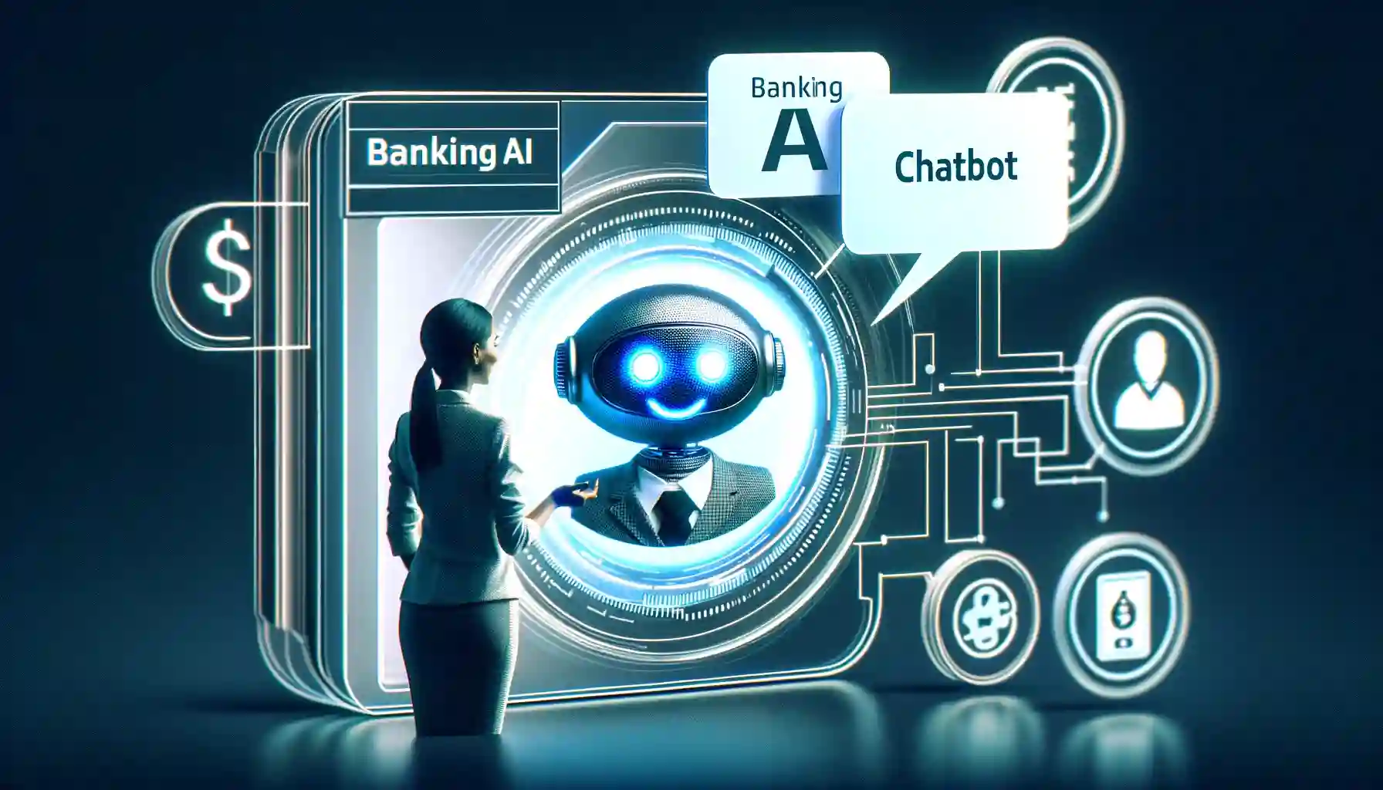


BANKBOT
AI CHATBOT FOR BANKING QUESTIONS
Bank Bot
AI Chatbot For Banking FAQs

Slide 2

⚠️ Problem Statement
⏱️ Customers face delays in getting banking support
💰 Manual customer service is costly and slow
⏰ 24/7 availability is critical for customer satisfaction
📞 Repetitive queries consume significant resources

Slide 3

✨ Solution: Intelligent Chatbot
🧠 AI-powered NLU for intent & entity recognition
🌐 Web interface built with Streamlit
💾 SQLite backend for account & knowledge base
🔄 Supports both rule-based & ML approaches

Slide 4



🧠 Module 1: Intent & Entity Recognition
📋 Define key intents: balance check, transfer money, card block , find atm, loan inquiry
🔍 Extract entities: amount , account number , location, account type, recipient
🤖 NLU model using spaCy or Rasa for classification
📦 Slot filling for structured data collection

Slide 5

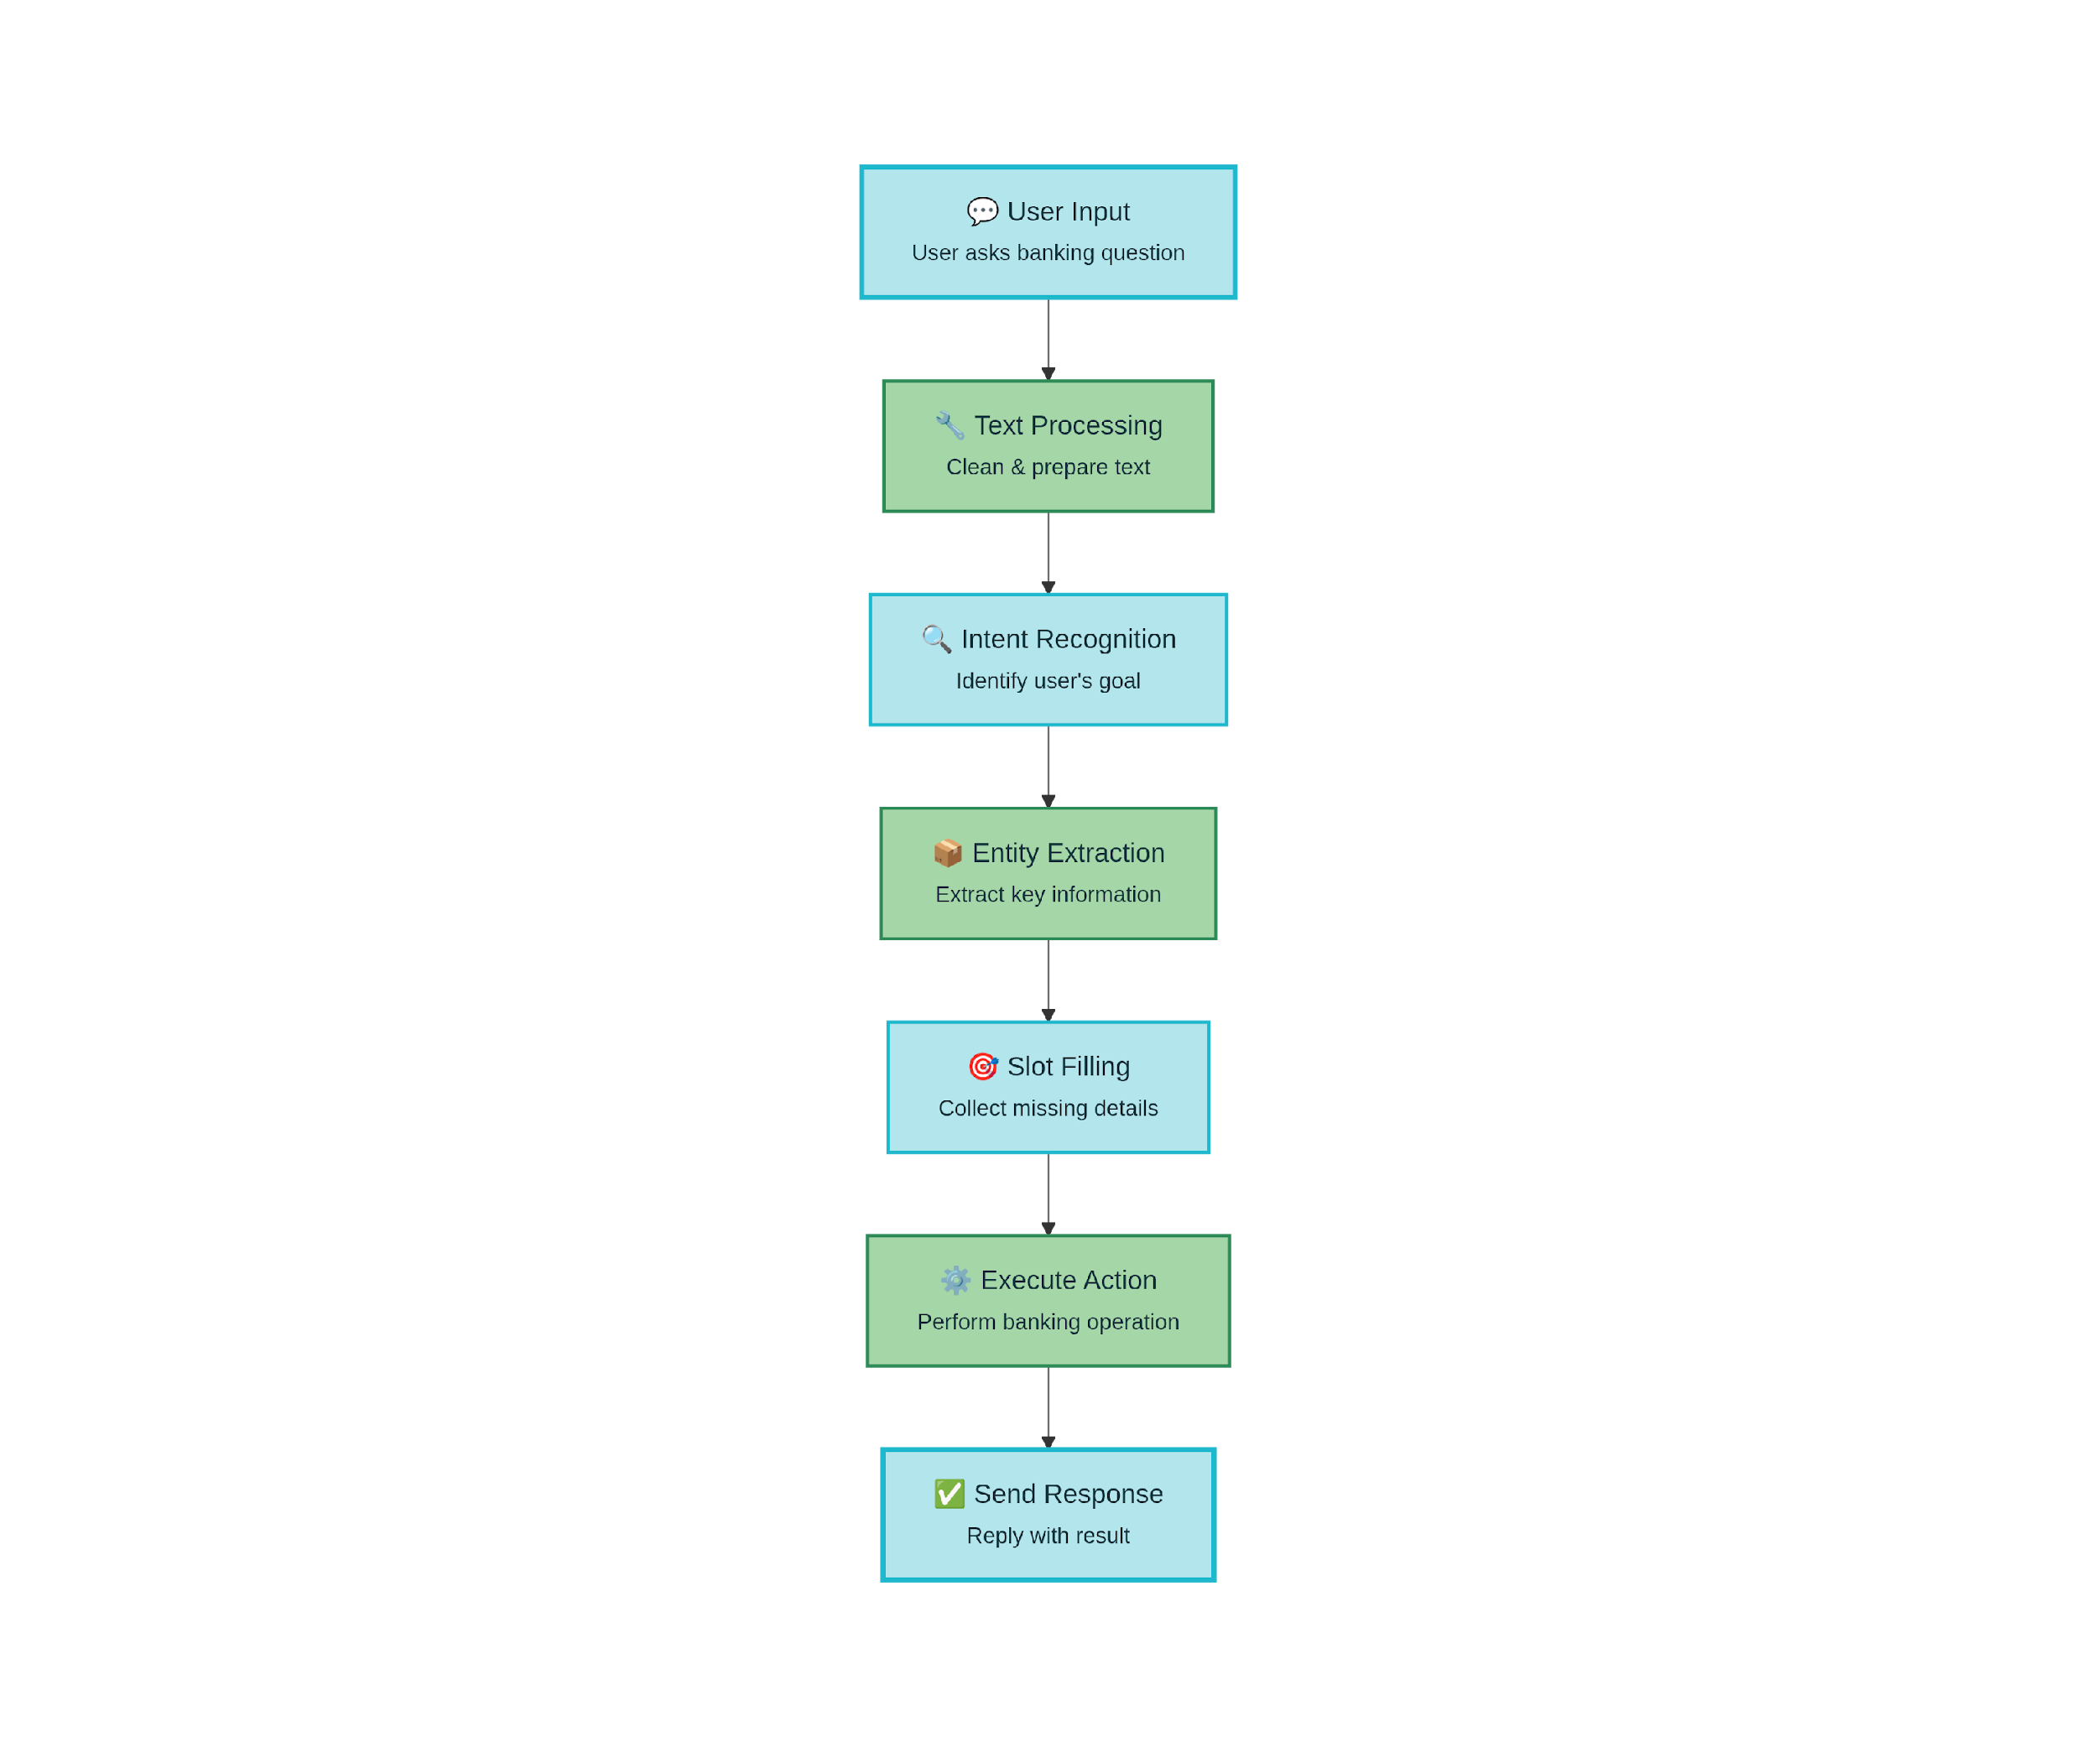
Natural Language Understanding Pipeline

Slide 6
TECHNOLOGIES USED
TECHNOLOGIES USED
Intent & Entity Engine:
spaCy for NER, tokenization, POS tagging and basic intent/entity experiments.
BERT Transformers (Hugging Face) for intent classification and sentence embeddings.
Rasa NLU for combined intent and entity recognition with training data in YAML.
Python 3.9+ with libraries like NumPy/Pandas for data prep and experimentation.
Intent & Entity Engine:
spaCy for NER, tokenization, POS tagging and basic intent/entity experiments.
BERT Transformers (Hugging Face) for intent classification and sentence embeddings.
Rasa NLU for combined intent and entity recognition with training data in YAML.
Python 3.9+ with libraries like NumPy/Pandas for data prep and experimentation.
Dialogue & Responses
Rasa (core/dialogue policies) or custom Python state machine for dialogue flow and slot filling.
FastAPI for REST APIs to connect NLU engine with frontend and database.
SQLite 3 for storing user accounts, session data, and FAQs/knowledge base.
Template-based response generation in Python (Jinja-style or f-strings) for clear, context-aware replies.

Slide 7
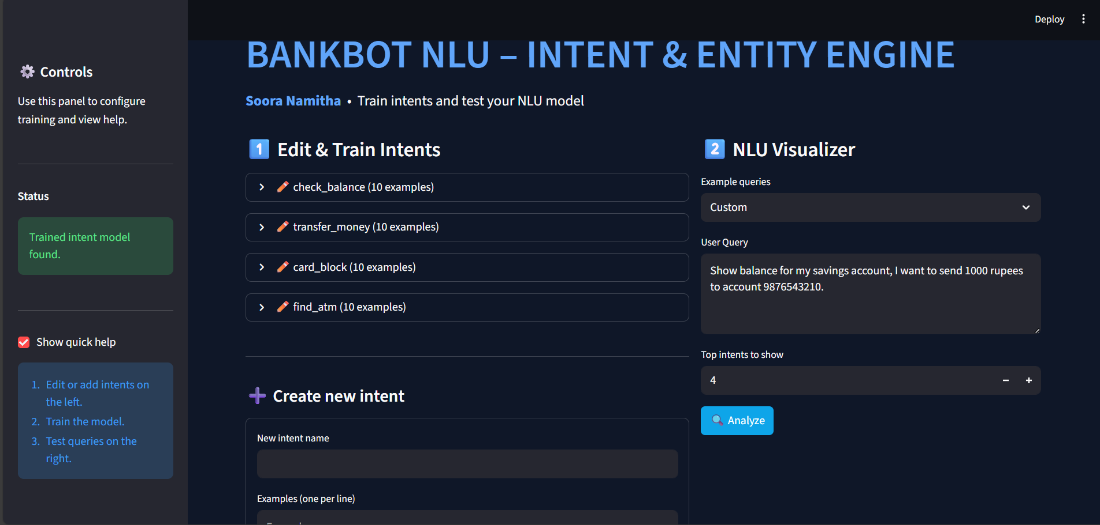
Outcome:

Slide 8

💬 Module 2: Dialogue Management
🔀 Manage conversation flow and context
❓ Handle clarifications and follow-up questions
📝 Maintain conversation history
⚡ Gracefully handle out-of-scope queries
🗄️ Query backend database for relevant information
📄 Generate context-aware natural language responses
✨ Format responses for clarity and accuracy
🎯 Support multiple response templates for variety

Slide 9
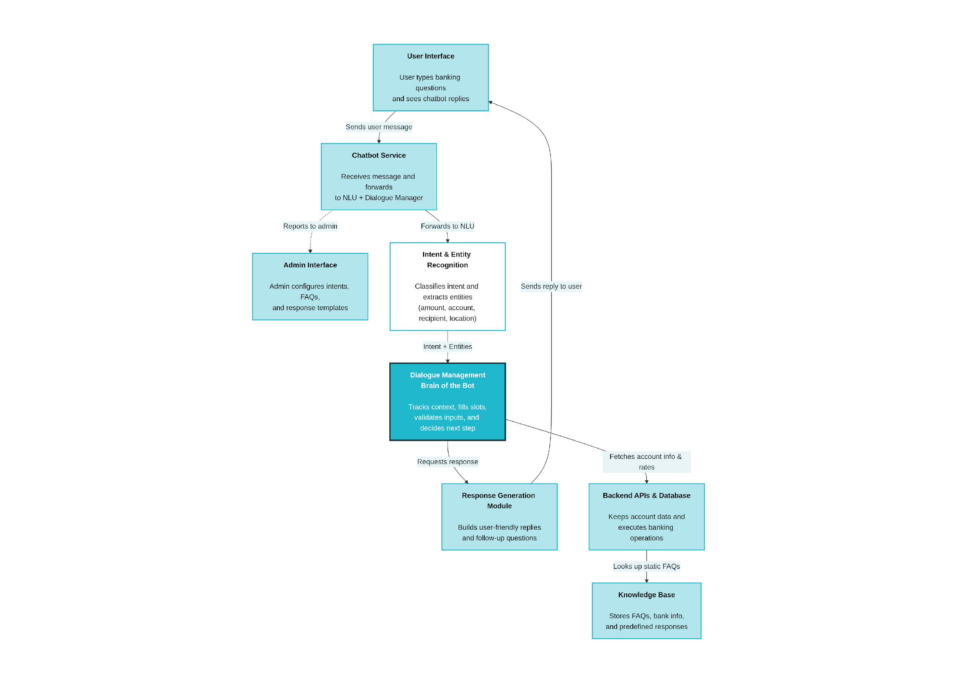

Dialogue Manager Architecture & Workflow

Slide 10

TECHNOLOGIES USED
Dialogue & Responses
Rasa (core/dialogue policies) or custom Python state machine for dialogue flow and slot filling.
FastAPI for REST APIs to connect NLU engine with frontend and database.
SQLite 3 for storing user accounts, session data, and FAQs/knowledge base.
Template-based response generation in Python (Jinja-style or f-strings) for clear, context-aware replies.

Slide 11
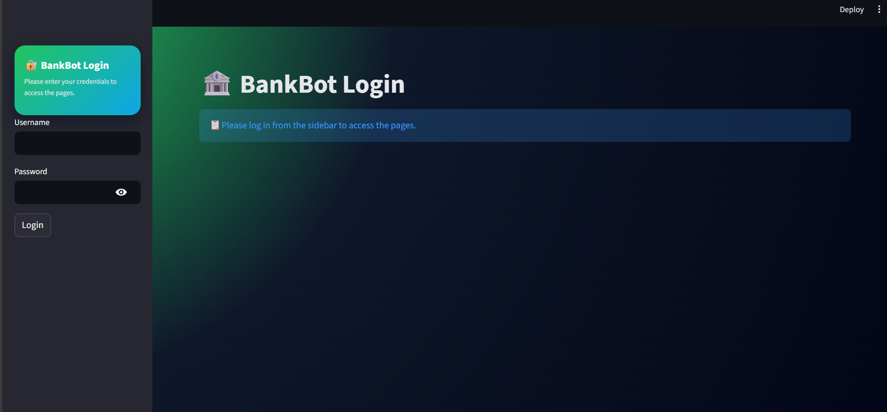
Outcome:

Slide 12

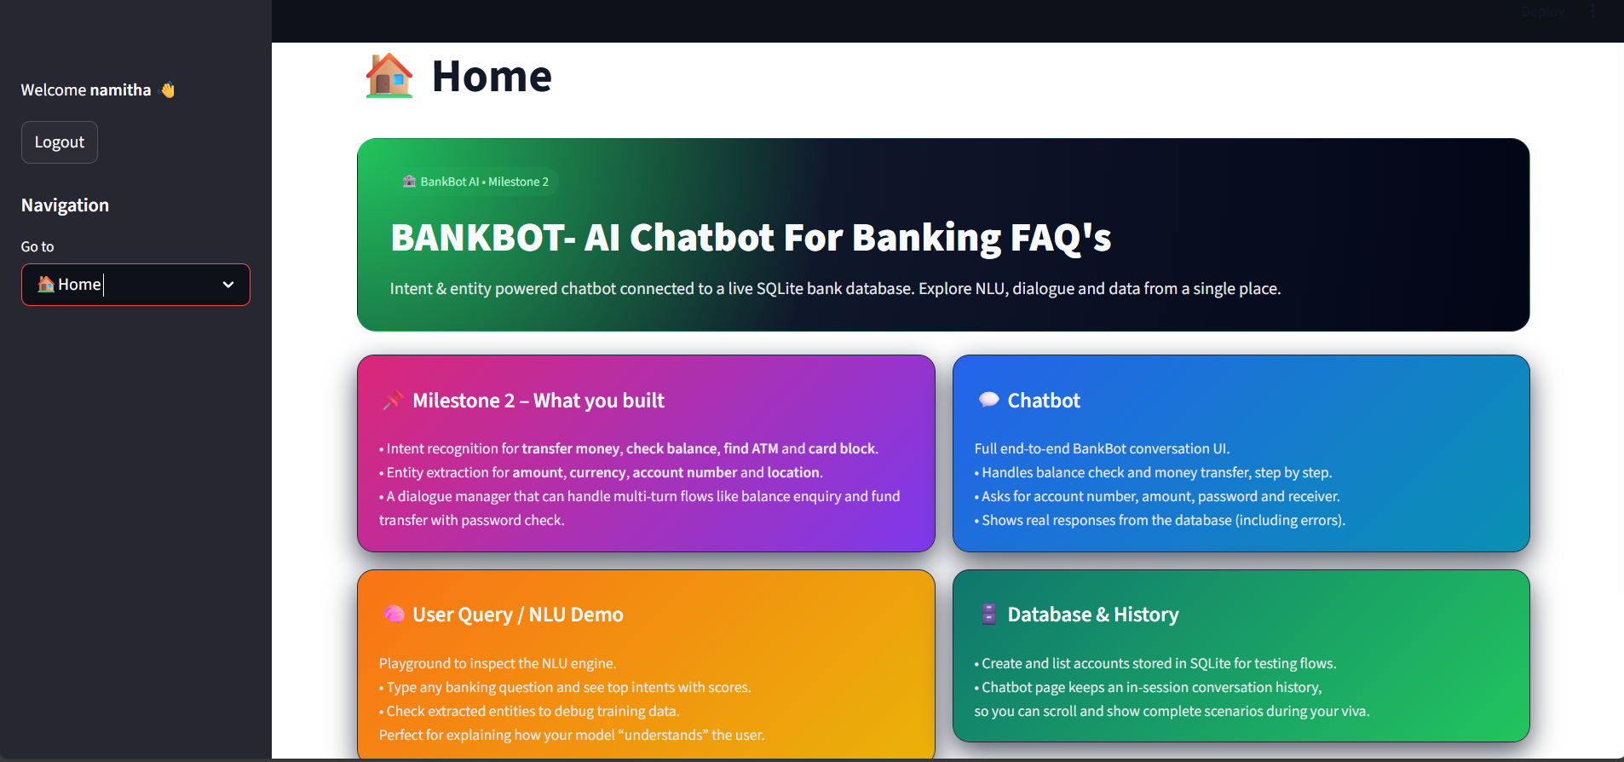
⚙️
Rasa NLU
Intent & entity recognition

Slide 13
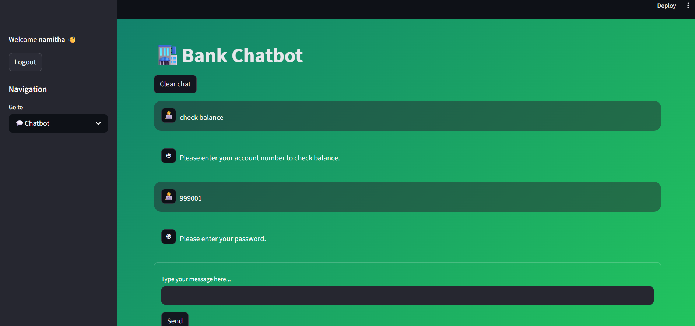
⚡
FastAPI
REST APIs, async processing

Slide 14
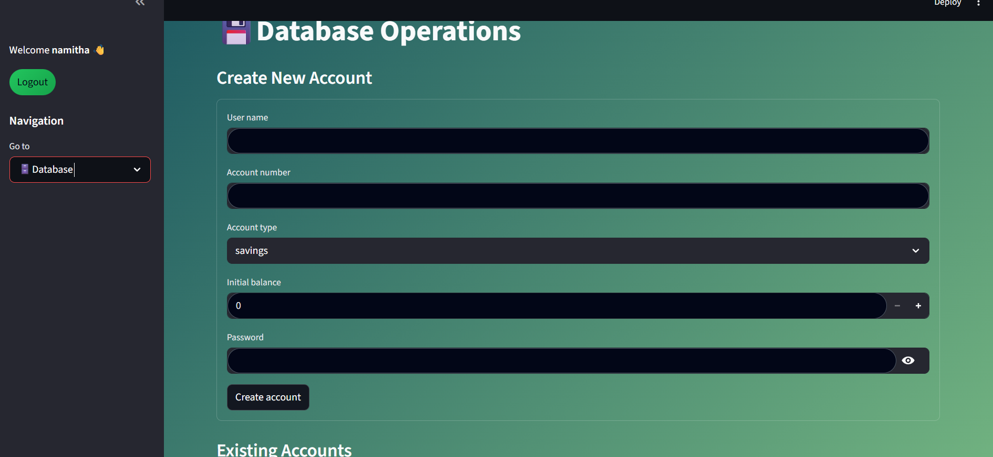
Git & Docker
Version control, containerization

Slide 15

Module-3 : UI Integration & LLM Implementation
🎯 Overview
Build a production-ready banking chatbot by integrating a beautiful Streamlit web UI with an advanced LLM (Groq/Llama) to provide intelligent, conversational banking services.
📋 Key Objectives
Web UI Development → Interactive Streamlit chat interface with real-time messaging
LLM Integration → Connect Groq API or Local Llama for enhanced responses
Backend Wiring → Connect UI to Dialogue Manager (M2) & SQLite database
Error Handling → Graceful failure handling and user-friendly messages
Production Ready → User authentication, transaction logging, performance optimization

Slide 16

⚙️ Main Components
Hybrid Dialogue Engine – Rule-based flows + LLM-powered responses
LLM Integration Layer – Groq/Llama with fallback mechanisms
Secure Database – SQLite with authentication & transaction logging
Streamlit Chat UI – Multi-page app with chat, history, settings
Error Management – Exception handling, logging, graceful degradation

Slide 17

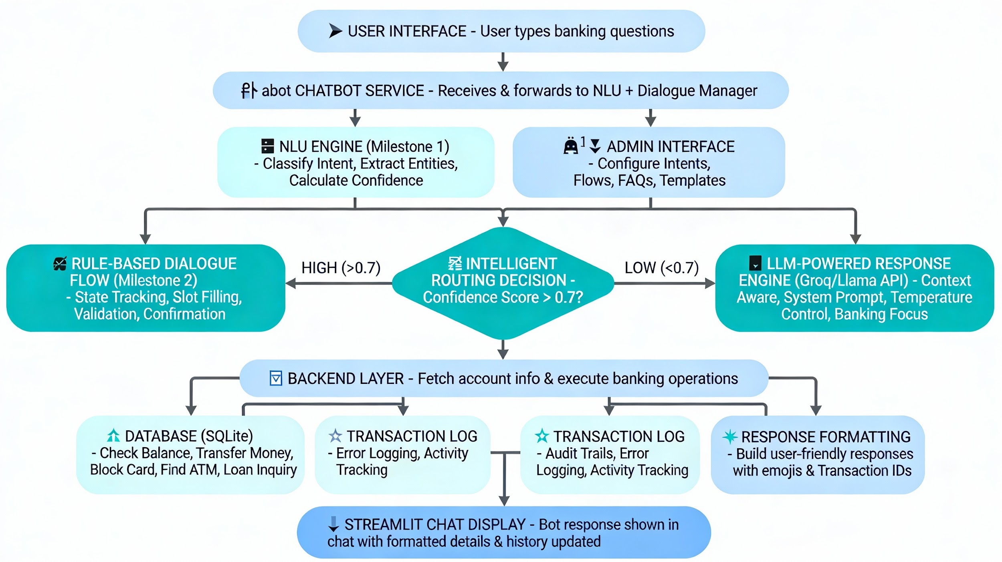
UI Integration & LLM-Powered Response Engine

Slide 18

TECHNOLOGIES USED
Component | Technology
Frontend | Streamlit
NLU | spaCy / Transformers
Dialogue Manager | Custom DialogueManager
LLM | Groq API / Local Llama
Database | SQLite + Python sqlite3
Language | Python 3.8+

Slide 19

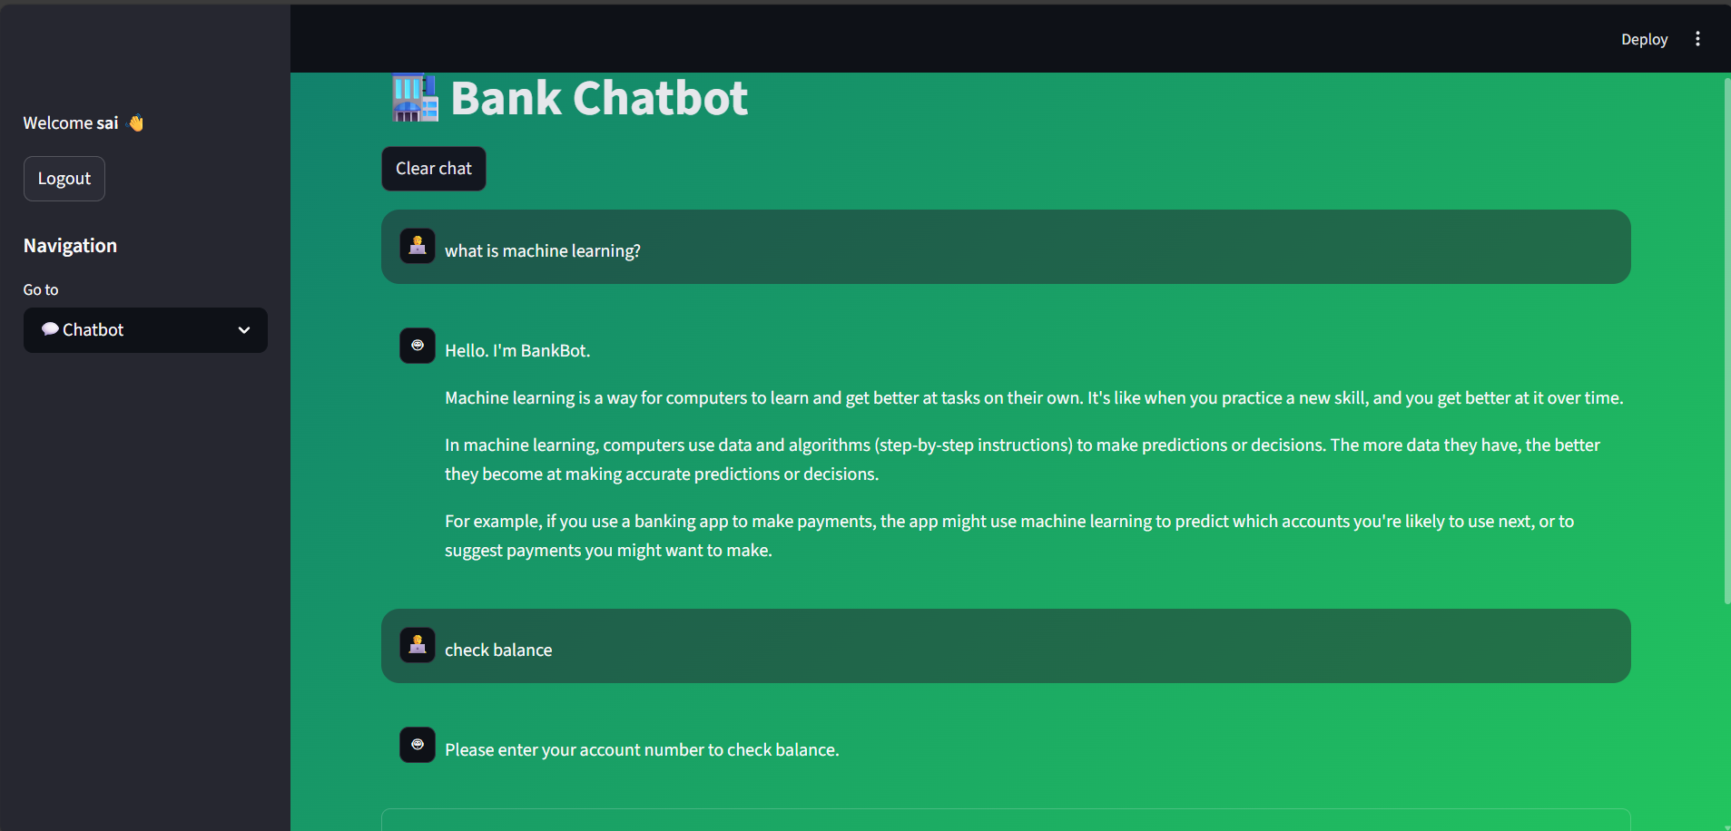
OUTCOME

Slide 20

KEY CHALLENGES AND SOLUTIONS
🎯 Handling varied queries, slang, spelling mistakes → Robust NLU with spell-correction & synonym mapping
📊 Limited labelled banking data → Transfer learning + data augmentation techniques
🔒 Secure & privacy-compliant access → Encryption, role-based access, audit logging
💬 Multi-turn context management → DialogueManager with advanced state tracking
🔗 Integration with banking systems → Secure APIs, transaction logging, error handling
🤝 Building user trust → Transparent responses, explicit confirmations, detailed receipts

Slide 21

Milestone-4: Admin Panel & Knowledge Base
🎯 Overview
Build a comprehensive admin control center with dashboard, training data management, and dynamic knowledge base for continuous chatbot improvement.
📋 Key Objectives
☑️ Admin Dashboard → Real-time query monitoring, success rates, and performance metrics visualization
☑️ Training Data Manager → Create and edit intents, entities, and training samples for model retraining
☑️ Knowledge Base System → Dynamic FAQ management and knowledge base updates
☑️ Query Analytics → Detailed logging with confidence scores and intent recognition accuracy tracking
☑️ Data Export → CSV export for logs, analytics, and compliance reporting

Slide 22

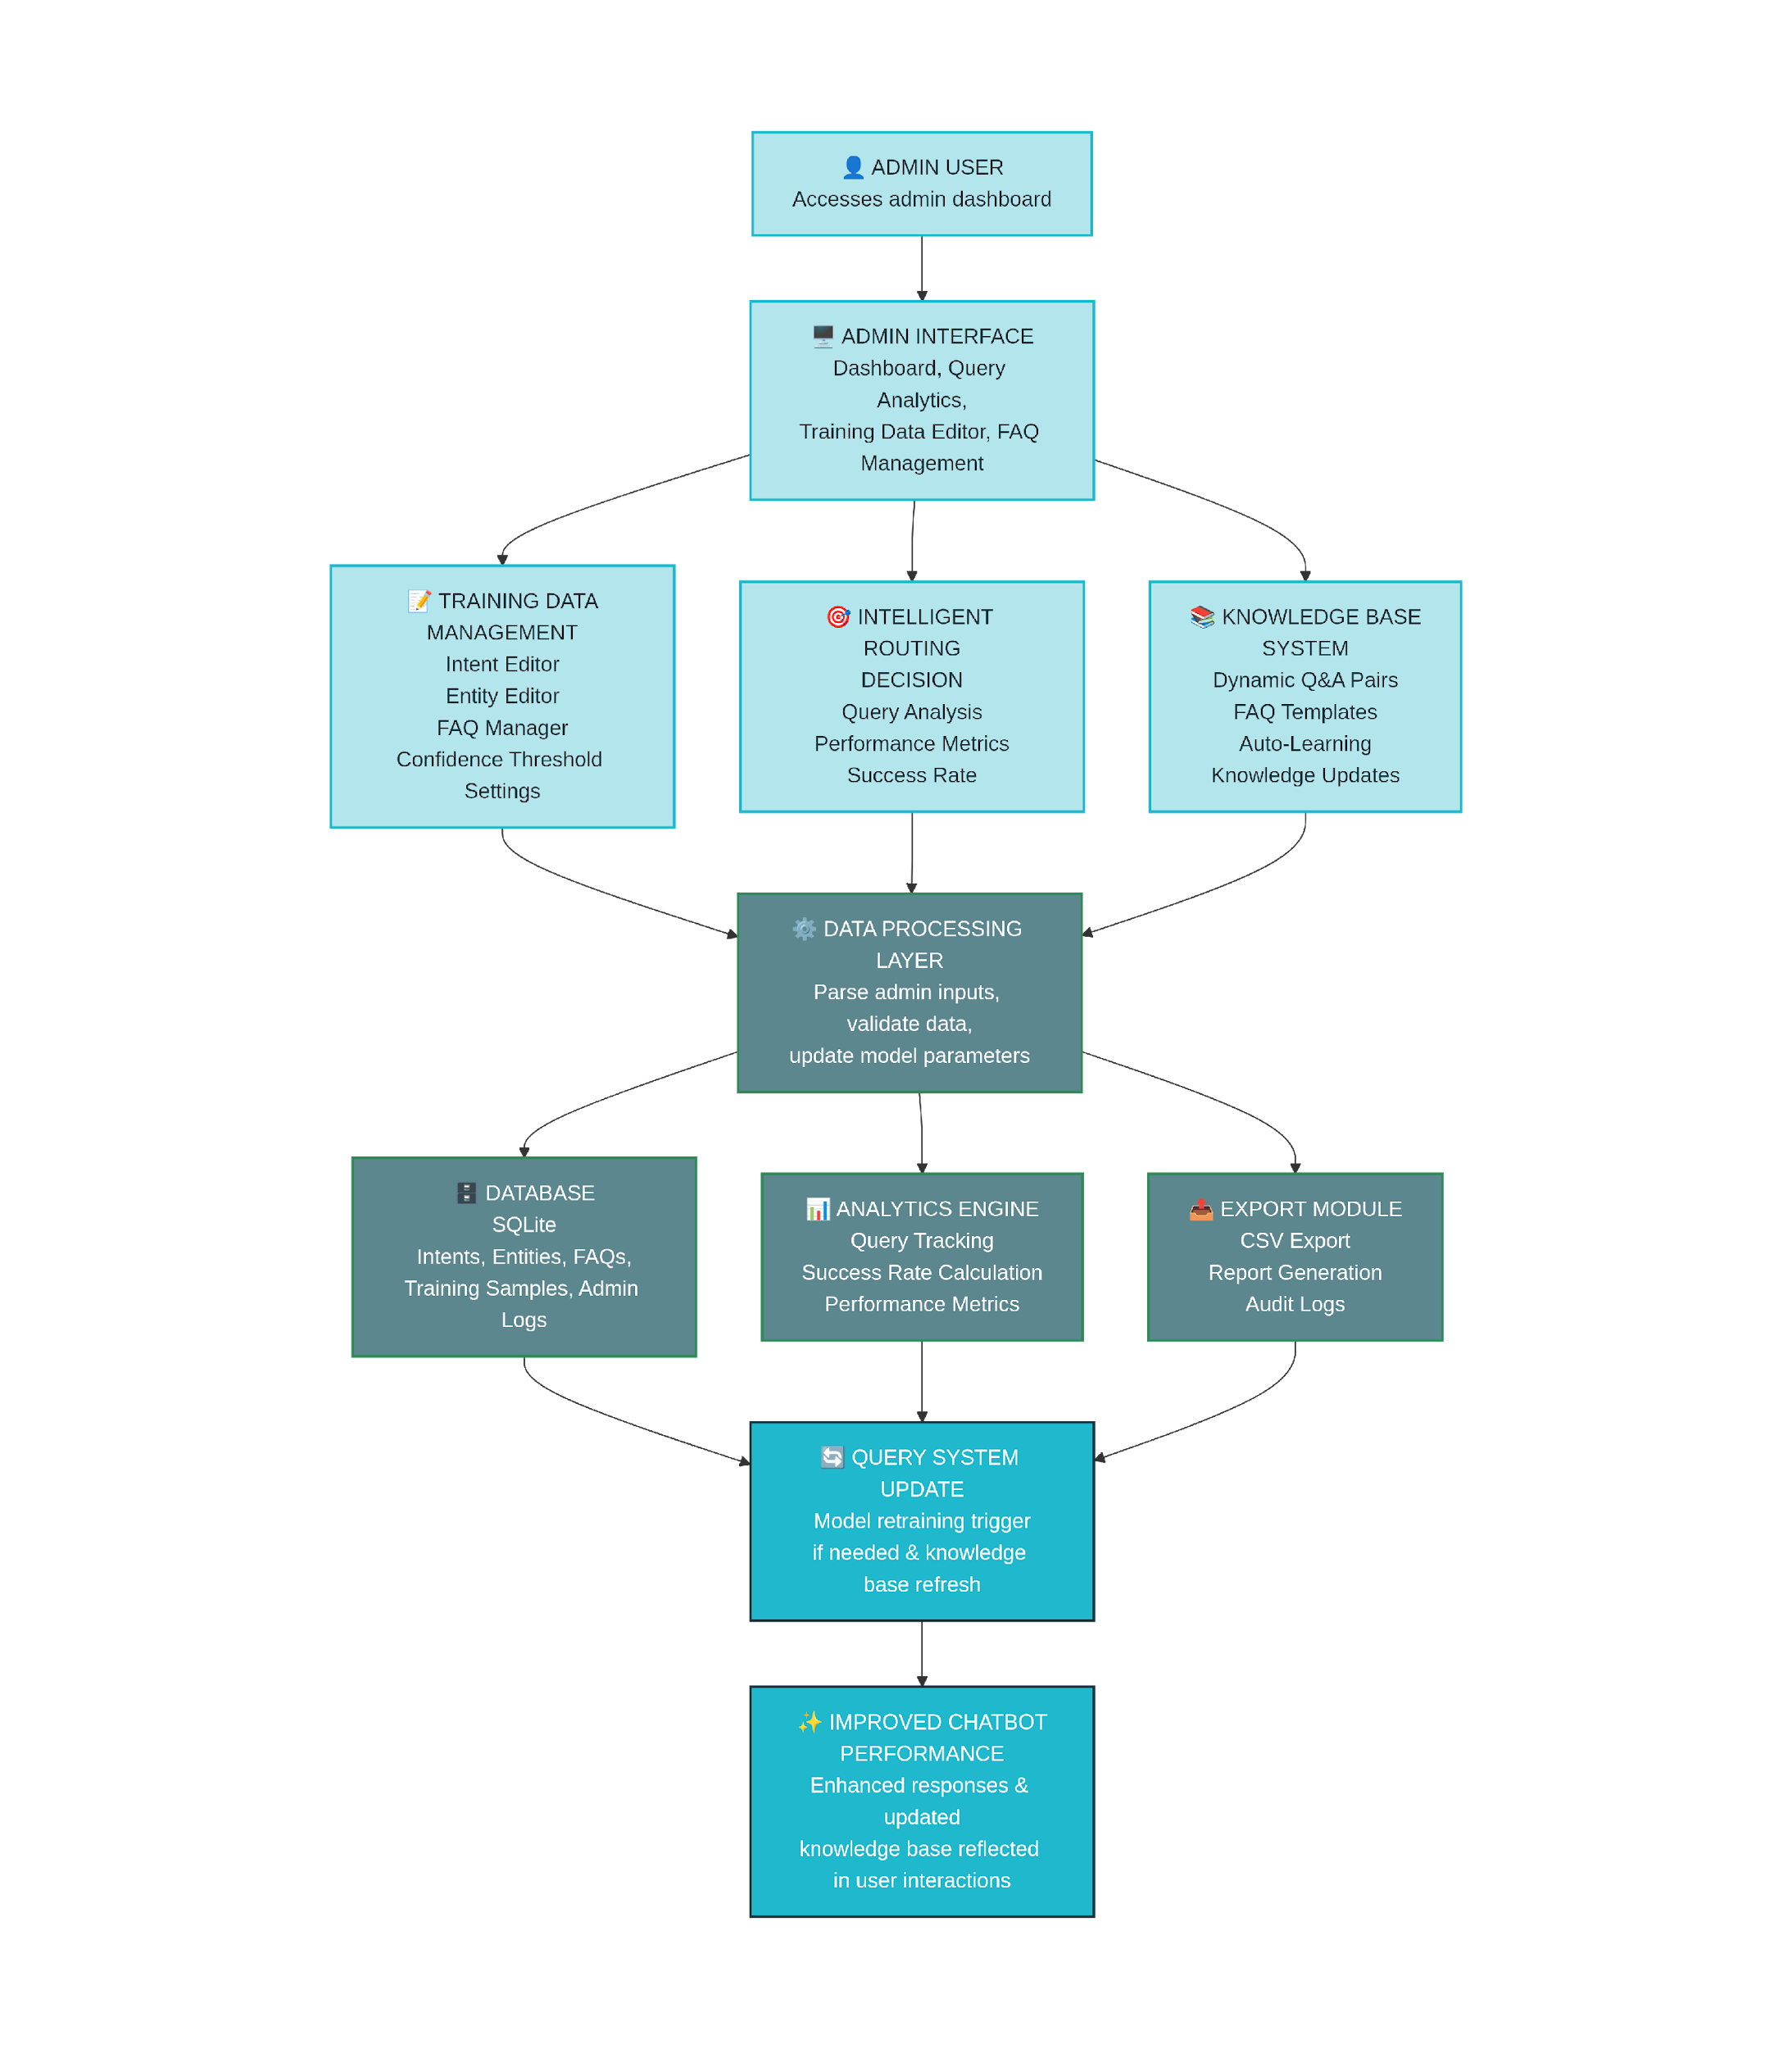
analytics, and compliance reporting
Flow:

Slide 23

Technologies Used:
Frontend: Streamlit, Python, HTML/CSS
Backend: Python, SQLite, FastAPI/Flask
NLP & ML: spaCy, NLTK, scikit-learn
Analytics: Plotly, Pandas, Logging Module
Security: JWT, Bcrypt/Hashlib
Data Export: CSV, openpyxl
Tools: Git, VS Code

Slide 24

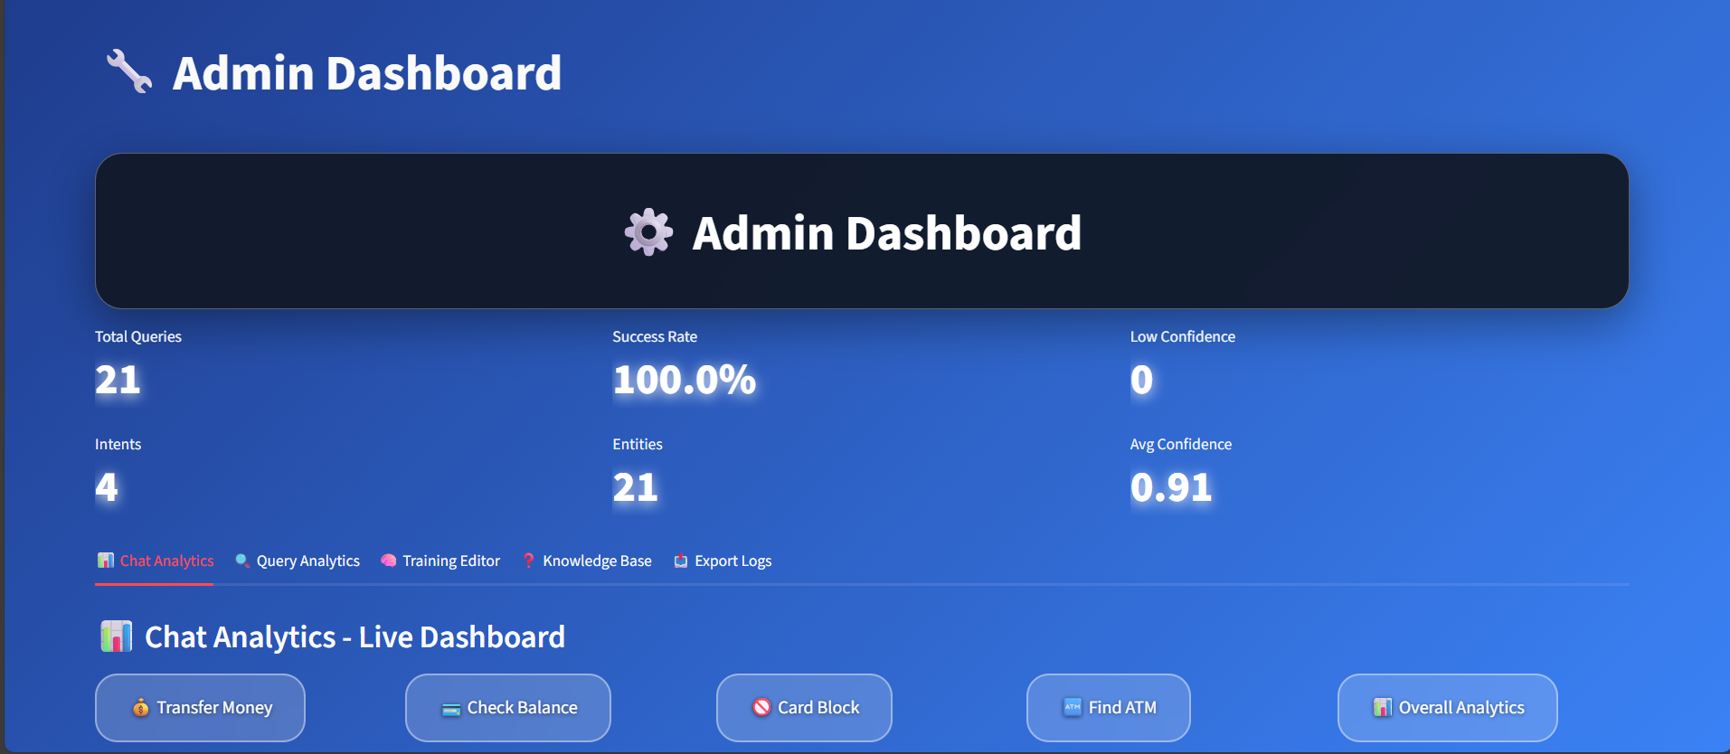

Slide 25

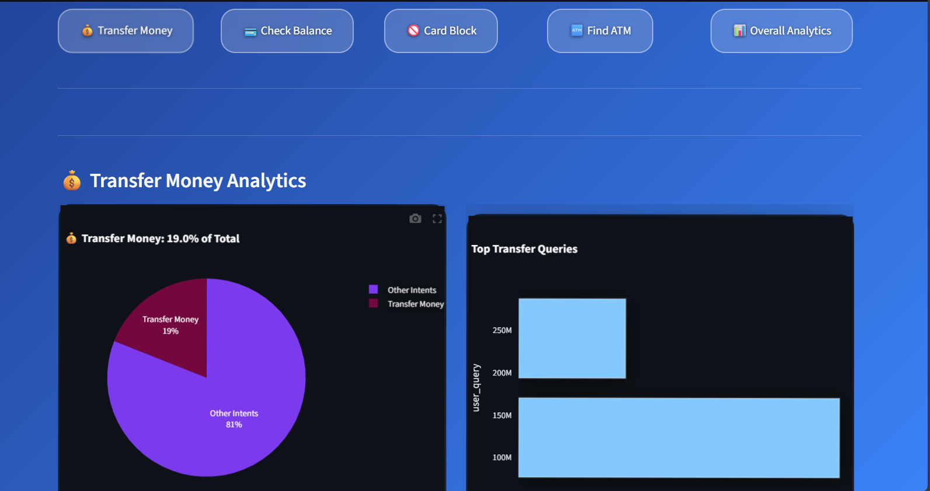

Slide 26

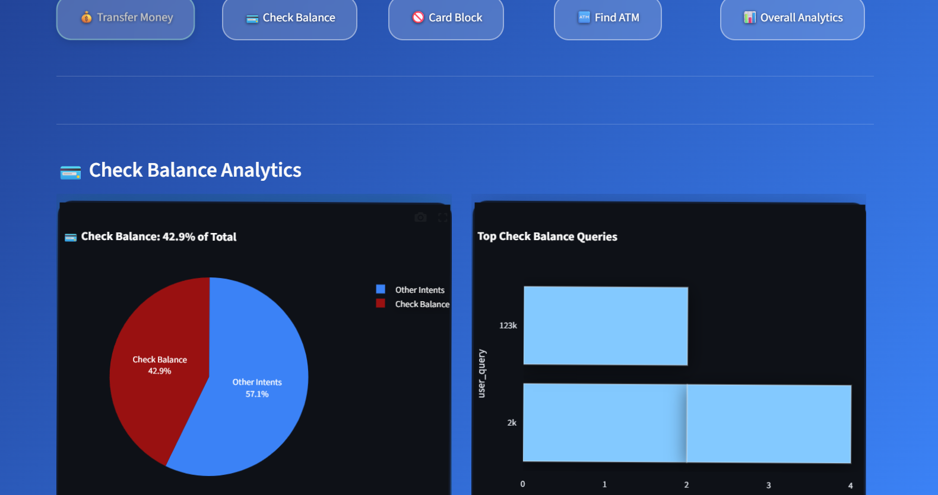

Slide 27

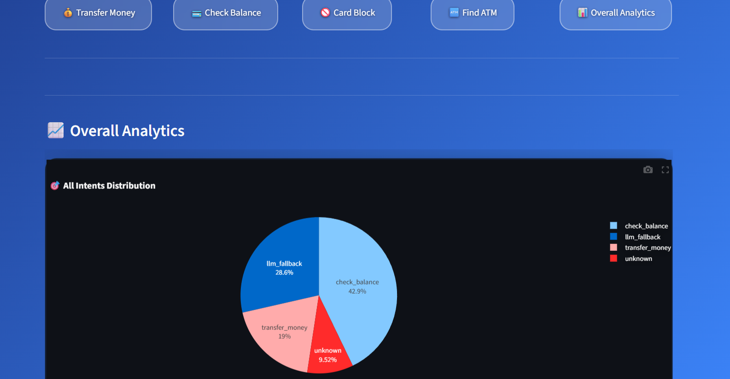

Slide 28
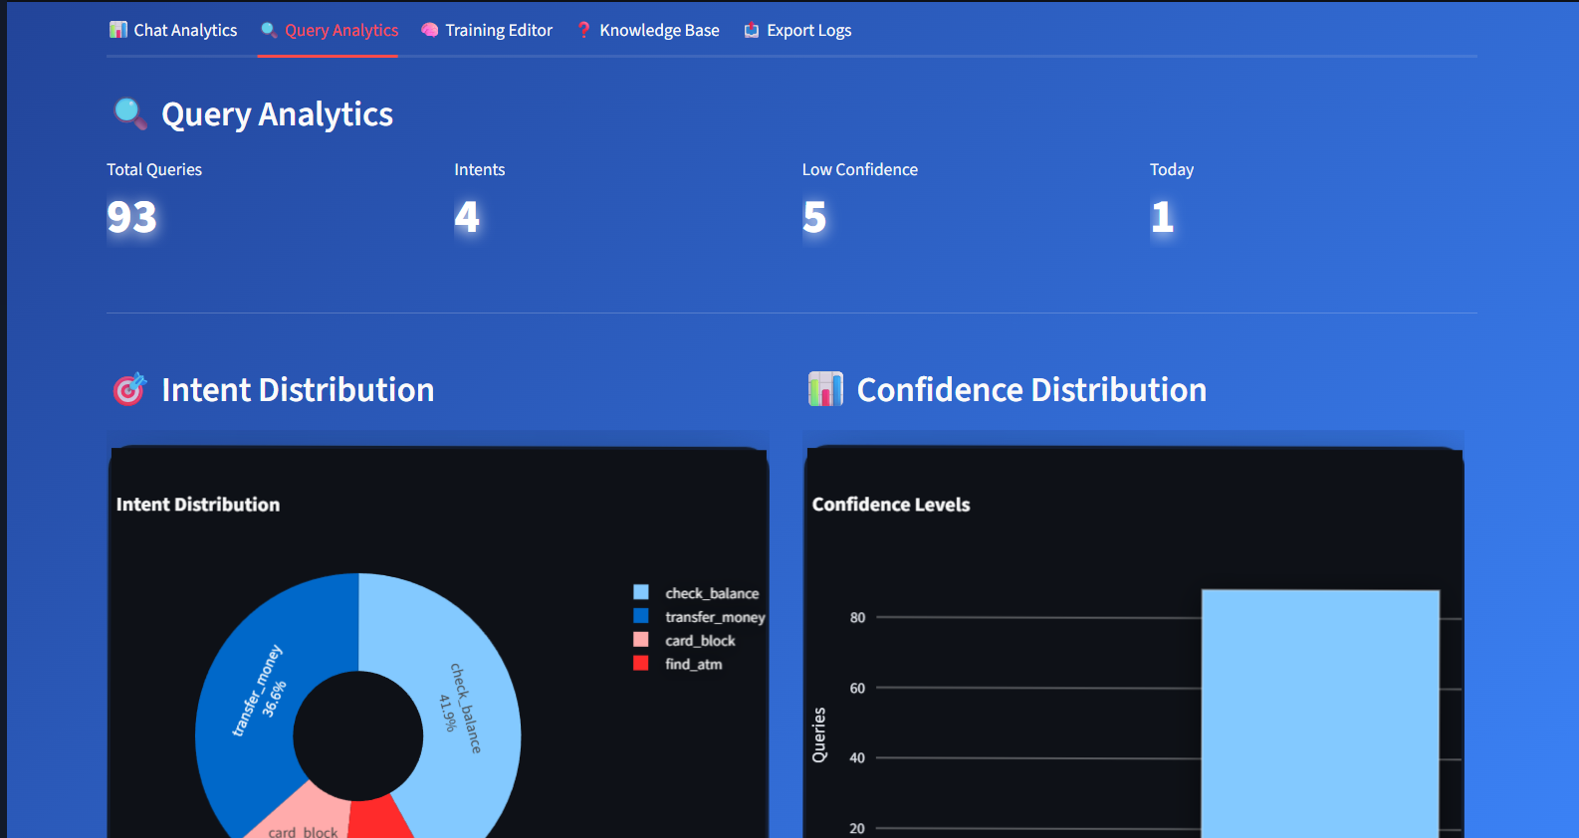

Slide 29


