Slide 1
Programming Refresher
Notes:
Let's start with a quick refresher on Python programming basics.

Slide 2
Conditional Statements and Loops
Notes:
Learn how to control the flow of your Python programs using conditional statements and loops.

Slide 3
Apply decision control structures to solve problems in Python
Identify and use different types of loops to manage repetitive tasks in Python
Implement and manage loop control statements effectively in Python programs to enhance code efficiency and control flow
Utilize the range function to create sequences and control loops in Python
Notes:
Read the learning objectives

Slide 4
Business Scenario
ABC is an e-commerce organization that lists online products based on purchases, reviews, and availability. Users filter these products based on multiple factors. The products are listed only if they match certain criteria; otherwise, an error is displayed.
The organization needs to develop this module using control structures, implement range functions to filter based on ranges, and use looping control statements.
Notes:
Elaborate the scenario and discuss with the class.

Slide 5
Decision Control Structures in Python
Notes:
Let's explore how to make decisions in your Python programs using control structures like if-else statements

Slide 6
Decision Control Structures: Decision-Making
Decision-making is the process of making choices or performing tasks based on conditions. Decision control structures evaluate variables or expressions that return either True or False.
Start
Condition
Expression
Statement in if branch
Statement in else branch
Action/task
Stop
Notes:
Trainer Notes:
Decision-making is the process of making choices or performing tasks based on conditions.

Slide 7
Decision Control Structures: Scenario
Start
Rain
Rains tomorrow
morning?
Based on the weather, I can choose my activities for the day.
IF it rains tomorrow morning, I will clean my room and do chores.
ELSE, I will go swimming.
Condition
True
False
Clean room and do chores
Swimming
Stop
Notes:
Trainer Notes:
Explain the scenario and then flowchart to explain the conditions.

Slide 8
Decision Control Structures
Python offers four types of decision control structures, they are:
If statement
If-else statement
Nested-if statement
If-elif-else statement
Notes:
Trainer Notes:
Explain Decision control structures
Decision control structures evaluate variables or expressions that return either True or False as an outcome. Four types of decision control structures are available in Python.

Slide 9
If Statement
Python uses the if statement to change the program's control flow.
The indentation marks the block of code.
Syntax
if condition:
statement
statement
…….
A colon indicates the beginning of the block.
The block is usually indented by four spaces.
Each statement within the block must have the same indentation.
Notes:
This slide is self explanatory

Slide 10


If Statement: Example
Example
Notes:
This slide is self explanatory

Slide 11
If-Else Statement
The if-else statement evaluates the condition and executes the if block only when the test condition is True. Otherwise, it executes the else block.
Syntax
if condition:
statement 1
statement 2
else:
statement 3
statement 4
The else statement is optional in the if-else construct.
Notes:
Trainer Notes:
The else block defines the statements to be executed when the condition specified in the preceding if statement is evaluated as False.

Slide 12

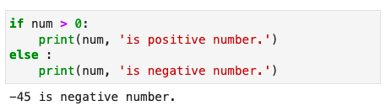
If-Else Statement: Example
Example
Notes:
This slide is self explanatory

Slide 13
If-Elif-Else Statement
The if-elif-else statement allows checking multiple conditions. If the if condition is False, it checks the next elif condition, and so on.
Syntax
if condition 1:
statement
elif condition 2:
statement
elif condition 3:
statement
else:
statement
Only one block among the if-elif-else blocks is executed. If all conditions are False, the else block is executed.
Notes:
Trainer Notes:
elif statement is short for else if statement. elif statements allow checking for multiple conditions.
If the condition for if is False, it checks the condition of the next elif block and so on.
The else block defines the statements to be executed when the condition specified in the preceding if statement is evaluated as False.

Slide 14
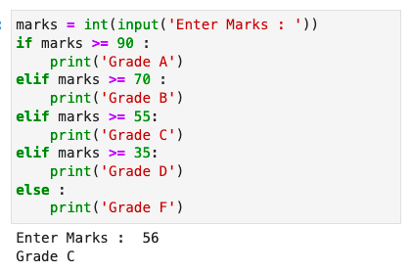
If-Elif-Else Statement: Example
Example
Notes:
This slide is self explanatory

Slide 15
Nested-If
Python allows an if statement inside another if statement.
Syntax
if (condition 1):
statement
# Executes when condition 1 is True
if (condition 2):
# Executes when condition 2 is also True
# inner if Block ends here
# outer if Block ends here
This format is called nesting.
Indentation defines the level of nesting.
Notes:
This slide is self explanatory

Slide 16
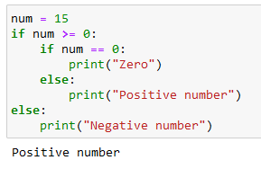
Nested-If: Example
Example
Notes:
This slide is self explanatory

Slide 17
True or False
Python evaluates the following objects as False:
Numerical zero values
Boolean value False
Empty strings
Empty list, tuples, and dictionaries
None
All other values are considered True in Python.
Notes:
This slide is self explanatory

Slide 18
Loops
Notes:
Let's explore the different types of loops in Python.

Slide 19
Loops
A loop statement allows the repeated execution of a statement or group of statements.
Start
Tidy up the cellar and
paint the walls
Condition
End
Swimming
Some
time left?
True
Execute Statement
Do tax declaration
Notes:
This slide is self explanatory

Slide 20
Types of Loops
The following types of loops handle looping requirements:
Count
controlled loop
Condition controlled loop
Collection controlled loop
Notes:
This slide is self explanatory

Slide 21
Count Controlled Loop
It is a method of repeating a loop a predetermined number of times.
Syntax
for <num> in <range>:
body of loop
Notes:
This slide is self explanatory

Slide 22
Condition Controlled Loop
A loop is repeated until a given condition changes from True to False or False to True, depending on the type of loop.
Syntax
while <condition is true>:
body of loop
Notes:
This slide is self explanatory

Slide 23
Collection Controlled Loop
This special construct allows looping through the elements of a collection, which can be an array, list, or other ordered sequences.
Syntax
for <item> in <list>:
body of loop
Notes:
This slide is self explanatory

Slide 24
Loops in Python
Python supports for and while loop.
Start
Start
Tidy up the cellar and
paint the walls
Tidy up the cellar and
paint the walls
Yes
False
Last item reached?
Exit loop
Condition
Exit loop
Swimming
Swimming
No
True
Execute Statement
Execute Statement
Do tax declaration
Do tax declaration
For loop
While loop
Notes:
This slide is self explanatory

Slide 25
Loops in Python
for loop
while loop
The for loop iterates over a sequence list, tuple, string, or other objects. Its syntax is:
for a in iteration_object:
Body
of
loop
The while loop iterates over a block of code if the test expression is true. Its syntax is:
while test_expression:
Body
of
loop
Notes:
This slide is self explanatory

Slide 26
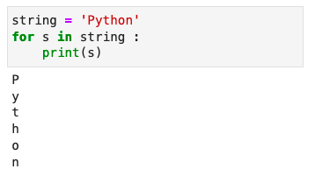
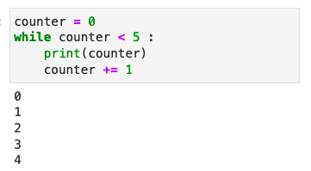
Loops in Python: Example
for loop
while loop
Notes:
This slide is self explanatory

Slide 27
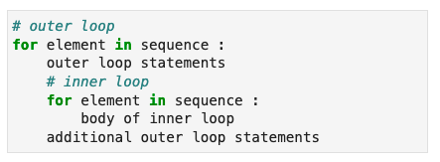
Nested Loops
A nested loop is a loop inside the body of the outer loop.
Syntax
The inner and outer loops can be of different or the same type.
Notes:
This slide is self explanatory

Slide 28
Nested Loops: Flowchart
A nested loop is demonstrated in the following flowchart:
For each element
in the sequence
Yes
Is this the last
element of
outer loop?
Yes
End of outer loop
No
Is this the last
element of
inner loop?
No
No
Inner loop
statements
Notes:
This slide is self explanatory

Slide 29
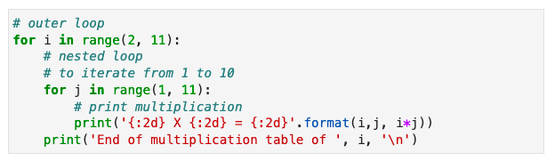
Nested Loops: Example
Here is the code to print the multiplication table from 2 to 10:
Notes:
This slide is self explanatory

Slide 30
Loops Control Statements
Notes:
Let's explore Loops control statements.

Slide 31


Loops Control Statements
Loop control statements alter the flow of execution in loops. Python supports two such statements.
Break
Continue
Notes:
This slide is self explanatory

Slide 32
Loops Control Statements: Break
The break statement exits the innermost enclosing for or while loop.
It terminates the nearest enclosing loop and skips the optional else block.
If a loop is terminated by a break, the loop variable retains its current value.
Syntax
break
Notes:
This slide is self explanatory

Slide 33
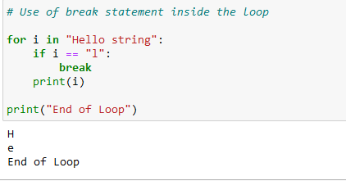
Break: Example
Example
Notes:
This slide is self explanatory

Slide 34
Loops Control Statements: Continue
The continue statement skips the current iteration and proceeds with the next one.
It does not terminate the loop but moves control to the next iteration.
As a result, the optional else block of the loop still executes.
Syntax
continue
Notes:
This slide is self explanatory

Slide 35
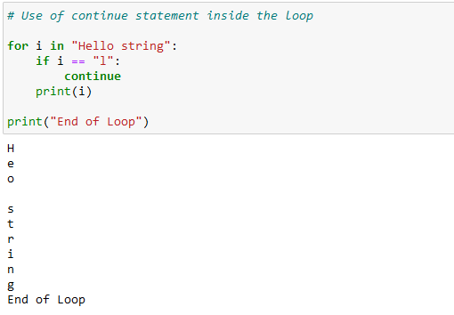
Continue: Example
Example
Notes:
This slide is self explanatory

Slide 36
Loop Else Statements
Notes:
Let’s understand Loop Else statements with examples.

Slide 37
Loop Else Statement
Python allows the else keyword to be used with both the for and while loops.
The statements of the else block are executed after all the iterations are completed.
Plan
The else clause is defined after the body of the loop.
The program exits the loop only after the else block is executed.
Notes:
Image source : https://blog.finxter.com/for-else-and-while-else-in-python-a-helpful-guide/
This slide is self explanatory

Slide 38
Loop Else Statement
The loop else statement does not execute if the loop terminates due to a break statement.
Normal Loop
Loop with Else
Start
Start
Condition
False
Exit
Loop
Condition
False
Execute else statement
True
True
Execute statement
Execute statement
Notes:
Image source : https://blog.finxter.com/for-else-and-while-else-in-python-a-helpful-guide/
This slide is self explanatory

Slide 39
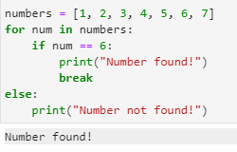
For Else Statement: Example
Example
Notes:
In this example, the for loop iterates through the numbers list. If the value of num becomes 6,
the loop is terminated using break, and "Number found!" is printed. If the loop completes without
encountering a break, the else block is executed, and "Number not found!" is printed.

Slide 40
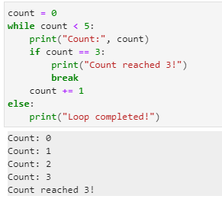
While Else Statement: Example
Example
Notes:
In this example, the while loop continues until count reaches 5. If count becomes 3, the loop is
terminated using break, and "Count reached 3!" is printed. If the loop completes without
encountering a break, the else block is executed, and "Loop completed!" is printed.

Slide 41
Range Function
The built-in range function can be used with loops to iterate over a sequence of numbers. It generates an iterator of arithmetic progressions.
range(n)
range() syntax
range(start, stop)
The range object can be converted to a sequence collection using functions such as list and tuple.
Notes:
This slide is self explanatory

Slide 42

Range(n) Function
It generates a sequence of n integer numbers starting from 0 and ending with (n-1).
Example
Notes:
This slide is self explanatory

Slide 43

Range(start, stop) Function
It generates a sequence of integers starting with the start value and ending with
(stop-1).
Example
Notes:
This slide is self explanatory

Slide 44
Step in Range
The range() function has an optional step argument that specifies the increment of the sequence.
Syntax
range(start, stop, step)
The default increment is 1. The increment can be positive or negative, but not zero.
Notes:
This slide is self explanatory

Slide 45


Step in Range: Example
A positive step value creates a forward sequence.
A negative step value creates a reverse sequence.
Example
Example
Notes:
This slide is self explanatory

Slide 46
Assisted Practice: Conditional Statements and Loops
Duration: 10 mins
Objective: In this demonstration, you will learn to use the conditional statements and loops
Steps to perform:
Step 1: Demonstrate conditional statements using if, elif, and else
Step 2: Demonstrate loops using for and while
Note
Please refer to the Reference Material section to download the Jupyter Notebook files for the mentioned topic.
Notes:
Trainer Notes:
Perform each step along with the learner.

Slide 47
If-else conditional constructs control the program's flow.
For and while loops repeatedly execute statements.
The break and continue statements skip certain statements inside the loop or terminate the loop immediately without checking the condition.
Python supports the else clause with for and while loops.
The range function in Python generates a range of numbers and works with the for loop.

Slide 49
Which of the following is used to terminate a loop early in Python?
1
break
end
stop
exit

Slide 50
Which of the following is used to terminate a loop early in Python?
1
break
end
stop
exit
A
In Python, the break statement is used to exit a loop early when a certain condition is met.

Slide 51
Which one of the following is a valid Python if statement?
2
if a>=2 :
if (a>=2)
if a>=22
if a=>22

Slide 52
Which one of the following is a valid Python if statement?
2
if a>=2 :
if (a>=2)
if a>=22
if a=>22
A
In Python, an if statement always ends with a colon.

Slide 53
Where can the continue statement be used?
3
while loop
for loop
do-while loop
Both A and B

Slide 54
Where can the continue statement be used?
3
while loop
for loop
do-while loop
Both A and B
D
The continue statement can be used in both while and for loops.

Slide 55
Thank You!
Notes:
Thank you

