Slide 1
HOUSING: PRICE PREDICTION
By- Ashish chand

Slide 2
Housing price prediction problem statement
Houses are one of the necessary need of each and every person around the globe and therefore housing and real estate market is one of the markets which is one of the major contributors in the world’s economy.
A US-based housing company named Surprise Housing has decided to enter the Australian market. The company uses data analytics to purchase houses at a price below their actual values and flip them at a higher price. For the same purpose, the company has collected a data set from the sale of houses in Australia.
Which variables are important to predict the price of variable?
How do these variables describe the price of the house?

Slide 3
Solution
The company is looking at prospective properties to buy houses to enter the market. We are required to build a model using Machine Learning in order to predict the actual value of the prospective properties and decide whether to invest in them or not. For this company wants to know:
We are required to model the price of houses with the available independent variables. This model will then be used by the management to understand how exactly the prices vary with the variables. They can accordingly manipulate the strategy of the firm and concentrate on areas that will yield high returns.
Further, the model will be a good way for the management to understand the pricing dynamics of a new market

Slide 4
EXPLORATORY DATA ANALYSIS
Exploratory Data Analysis(EDA) is an approach of analyzing data sets to summarize their main characteristics, often using statistical graphics and other data visualization methods.
Here we check our data and understand what kind of data is present to us, it is supervised or unsupervised and then check the output/ target column is continuous or categorical.
Then visualize our data with the help of different plots with the help of python libraries such as Matplotlib as Seaborn.

Slide 5
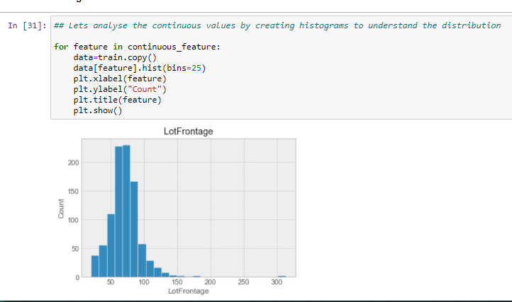
EDA contd..
The plots we used are:
1 A histogram is representation of the distribution of numerical data, where the data are binned and the count for each bin is represented. Here histogram is used to check the distribution of data among the different numerical features.

Slide 6
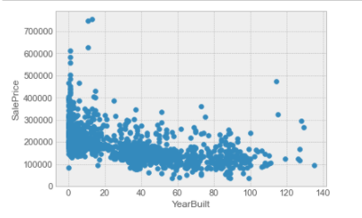
Visualization..
2.Scatterplot to see the distribution of data among two columns. Scatter plots are used to observe relationship between variables and uses dots to represent the relationship between them.

Slide 7
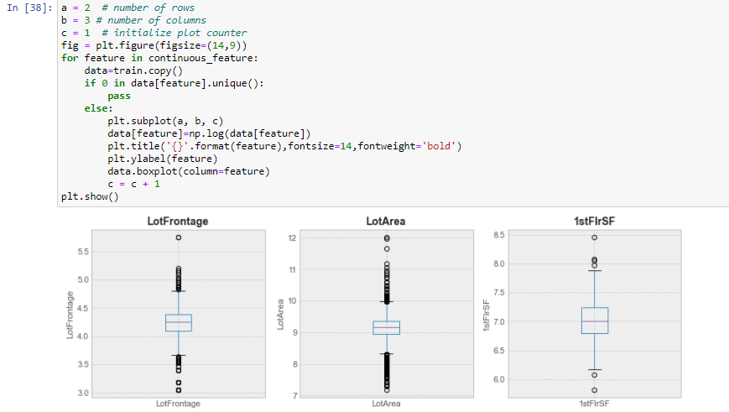
Eda contt..
Box plot : A Box Plot is also known as Whisker plot is created to display the summary of the set of data values having properties like minimum, first quartile, median, third quartile and maximum.

Slide 8
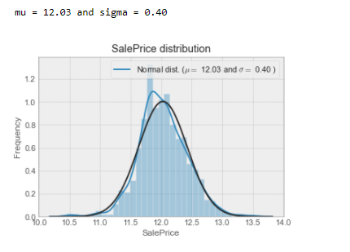
EDA..
Distribution plot : The seaborn.distplot() function is used to plot the distplot. The distplot represents the univariate distribution of data i.e. data distribution of a variable against the density distribution.

Slide 9
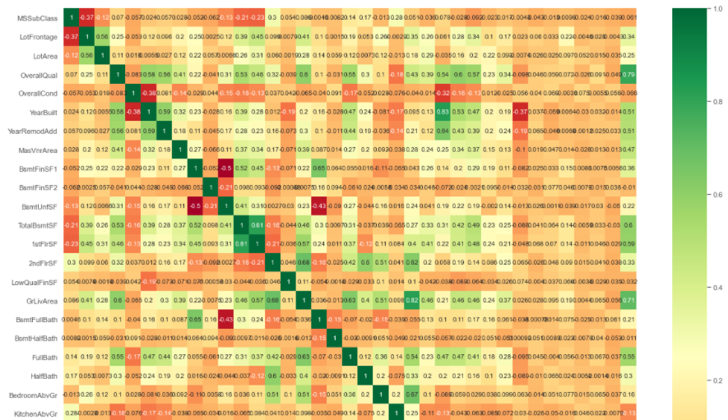
EDA..
5. Heatmap is used to see the correlation of columns.

Slide 10
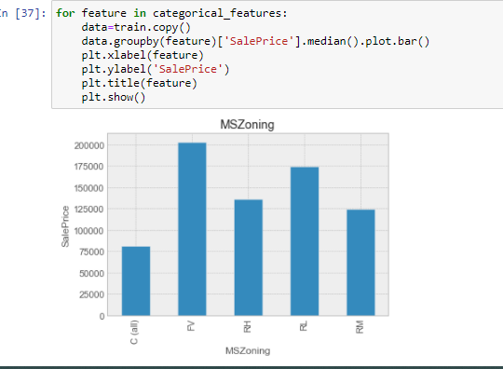
Eda..
Bar Plot : A bar plot or bar chart is a graph that represents the category of data with rectangular bars with lengths and heights that is proportional to the values which they represent.

Slide 11
Data Preprocessing
Step 1: Dropping unnecessary variables
remove those which are not actually related to our prediction like One Id number.
Step 2: Checking the correlation
Now check the column which are highly correlated with the target column i.e. Target column.
Overall quality and living area in ground are highly positively correlated with the Sales Price.

Slide 12
Cont..
Step 3 : Split the numerical and categorical columns.
Split the categorical and numerical columns and visualize it with the help of matplotlib and seaborn library.
1. Discrete Variables
If distinct values in numeric variable is <25, those are considered as discrete, else its continuous.
Bar Plot used for discrete variable.
2. Continuous variable
Histogram Plot used for Continuous variable.

Slide 13
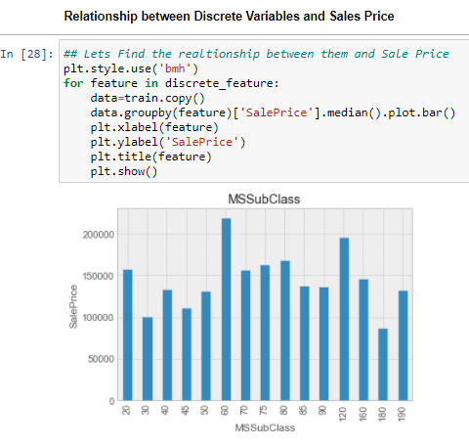
Cont.
Step 4 : Checking the relationship with features and Sale price graphically.
Using the scatter plot to check the relationship between the different columns and the target column ( i.e. Sale Price).

Slide 14
Cont..
Step 5 : Checking outliers, not removing now.

Slide 15
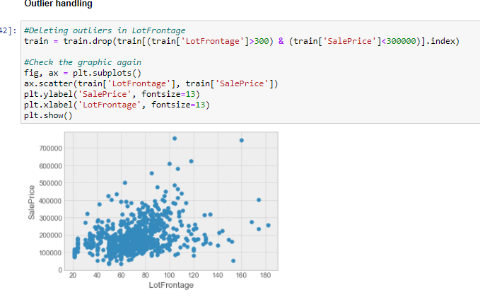

Feature Engineering
Outliers Handling: Outliers removal is not always safe. We decided to delete these two as they are very huge and really bad ( extremely large areas for very low prices).

Slide 16
CONT..
Filling the missing columns values.
PoolQC : data description says NA means "No Pool". That make sense, given the huge ratio of missing value (+99%) and majority of houses have no Pool at all in general.
- MiscFeature : data description says NA means "no misc feature"
- Alley : data description says NA means "no alley access"
- Fence : data description says NA means "no fence"
- FireplaceQu : data description says NA means "no fireplace"
- GarageType, GarageFinish, GarageQual and GarageCond : Replacing missing data with None/Missing value
- GarageYrBlt, GarageArea and GarageCars : Replacing missing data with 0 (Since No garage = no cars in such garage.)
- BsmtFinSF1, BsmtFinSF2, BsmtUnfSF, TotalBsmtSF, BsmtFullBath and BsmtHalfBath : missing values are likely zero for having no basement
- BsmtQual, BsmtCond, BsmtExposure, BsmtFinType1 and BsmtFinType2 : For all these categorical basement-related features, NaN means that there is no basement.
- MasVnrArea and MasVnrType : NA most likely means no masonry veneer for these houses. We can fill 0 for the area and None for the type.
- MSZoning (The general zoning classification) : 'RL' is by far the most common value. So we can fill in missing values with 'RL

Slide 17
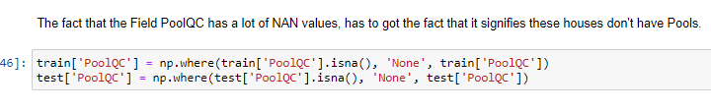
Cont..
Filling the missing values of columns with the “None”.

Slide 18
FE contt..
Checking the SalePrice column which is the target column:
Shows that the data is not normally distributed.
Performing the log transformation
Storing the value in actual column.
Checking the correlated column GrLivArea and check the distribution
The data is not normally distributed, it is rightly skewed
Performing the Boxcox1p and Boxcox_normmax method.

Slide 19
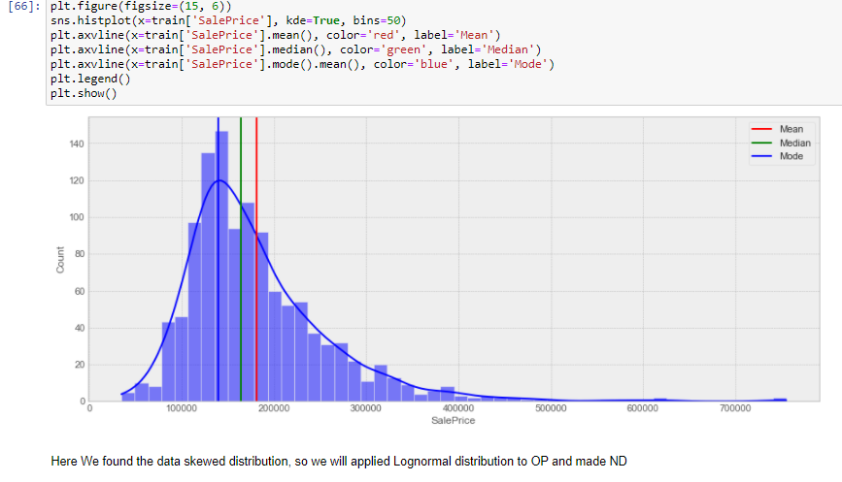
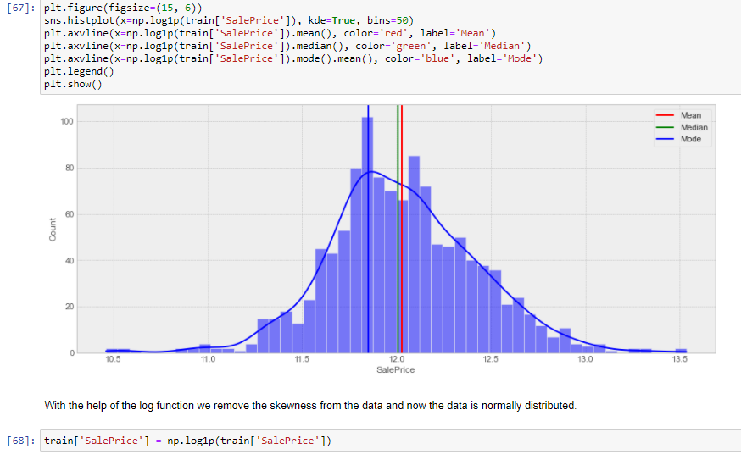
FE cont..
Representation of last steps.
First fig. is before the log transformation in sales price.
Second fig. is after the log transformation in Sales price.

Slide 20
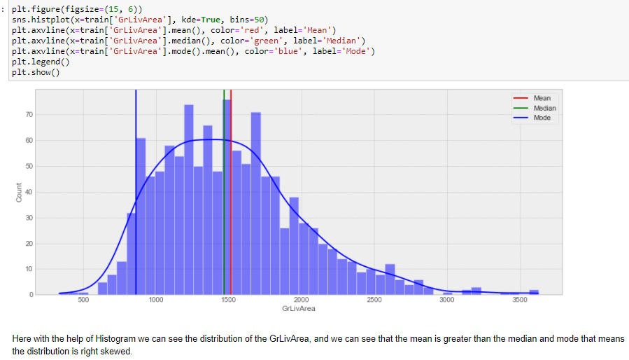
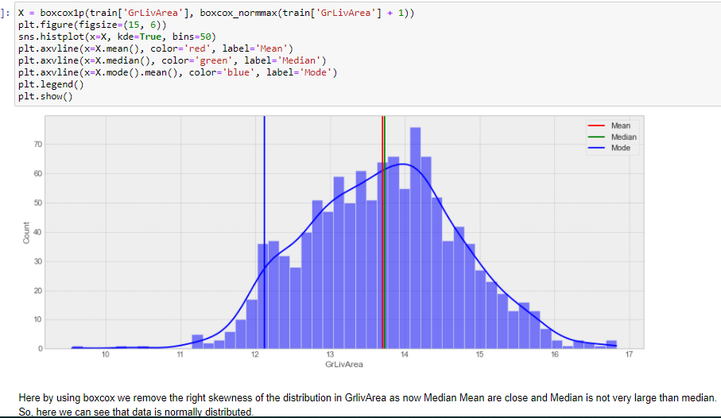
FE cont.
Similarly for the GrLivArea(Ground Living Area)
Fig 1 shows the right skewed data in column GrlivArea while fig.2 shows distribution of data in GrLivArea after using the boxcox1p and boxcox_normmax methods.

Slide 21
FE contt.
Converting the categorical columns into numerical with the help of the preprocessing technique i.e. OneHotencoder.
Concating the train and test data but dropping the target column and storing into a variable.
Removing the skewness from the dataframe, by using boxcox1p and boxcox_normmax methods.
Splitting the dataset into x and y for the model training and predicting.
Where x variable contain all the dependent columns except target column. While y contains only Target column i.e. Sale Price.

Slide 22
MODEL SELECTION
Step 1: Splitting the dataset into Training and Testing for the model prediction.
Step 2: Using Machine learning Algorithm:
1. Linear Regression
2. Lasso
3. Ridge
4. Decision Tree Regressor
5. Random Forest Regressor

Slide 23
Model Evaluation Metrics
Mean absolute error : (MAE) represents the difference between the original and predicted values extracted by averaged the absolute difference over the data set.
Mean squared error: (MSE) represents the difference between the original and predicted values extracted by squared the average difference over the data set.
Root Mean squared error: (RMSE) is the error rate by the square root of MSE.
R2 score : R-squared (Coefficient of determination) represents the coefficient of how well the values fit compared to the original values. The value from 0 to 1 interpreted as percentages. The higher the value is, the better the model is.
Cross-validation is a technique that is used for the assessment of how the results of statistical analysis generalize to an independent data set. Cross-validation is largely used in settings where the target is prediction and it is necessary to estimate the accuracy of the performance of a predictive model.

Slide 24
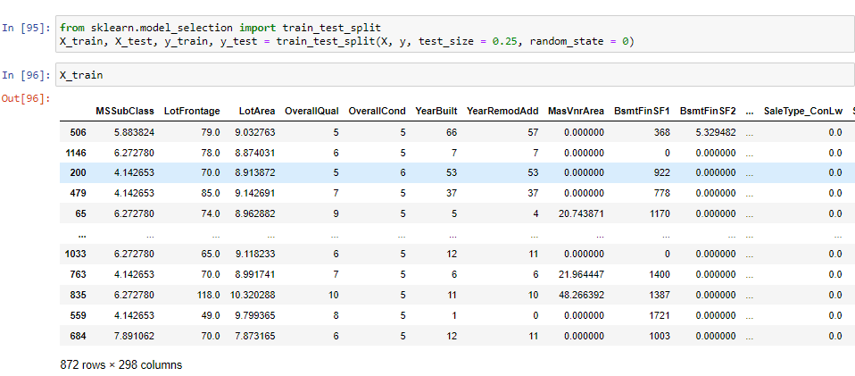
Cont.
Step 1 : Splitting the data into the train test dataset.

Slide 25
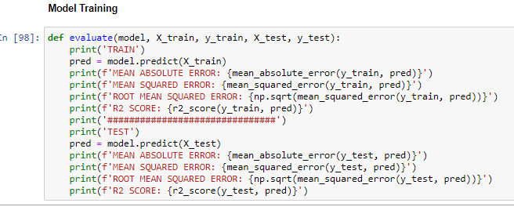
Cont.
Step 2: Model Training
Creating a function and run all the models on it.

Slide 26
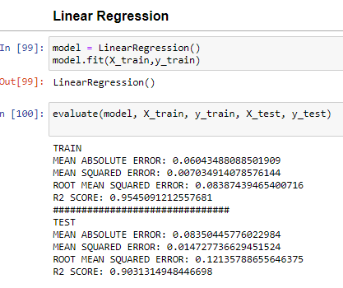
Model training
1 . Linear Regression : Linear regression analysis is used to predict the value of a variable based on the value of another variable. The variable you want to predict is called the dependent variable. The variable you are using to predict the other variable's value is called the independent variable.

Slide 27
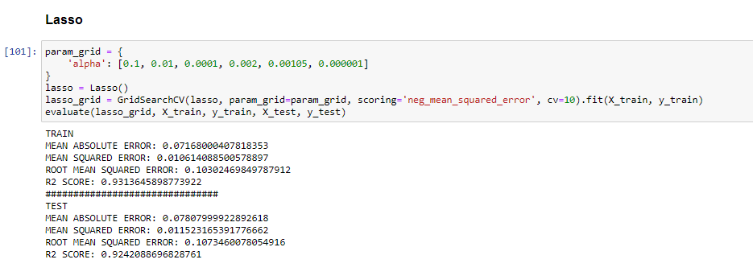
Contt.
2. Lasso : Lasso regression is a regularization technique. Lasso Regression uses L1 regularization. It is used when we have more number of features because it automatically performs feature selection.

Slide 28
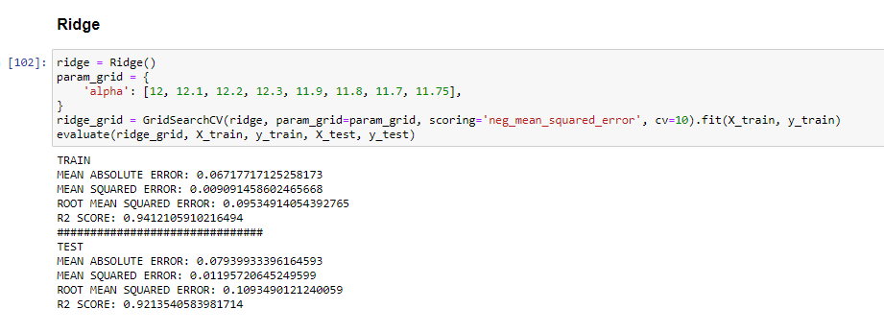
Cont.
Ridge: Ridge regression is a model tuning method that is used to analyse any data that suffers from multicollinearity. This method performs L2 regularization. When the issue of multicollinearity occurs, least-squares are unbiased, and variances are large, this results in predicted values to be far away from the actual values.

Slide 29
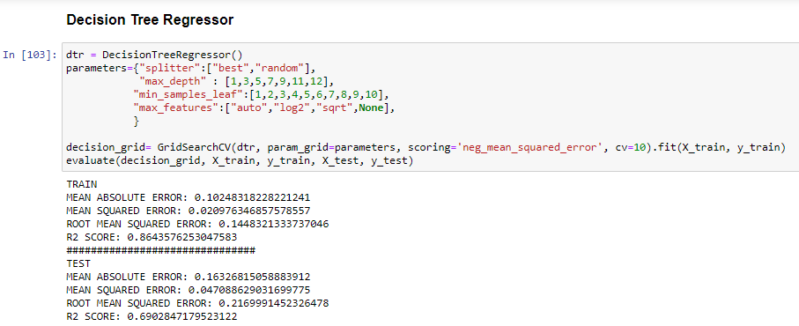
Cont..
Decision Tree Regressor: Decision tree builds regression or classification models in the form of a tree structure. It breaks down a dataset into smaller and smaller subsets while at the same time an associated decision tree is incrementally developed. The topmost decision node in a tree which corresponds to the best predictor called root node. Decision trees can handle both categorical and numerical data.

Slide 30
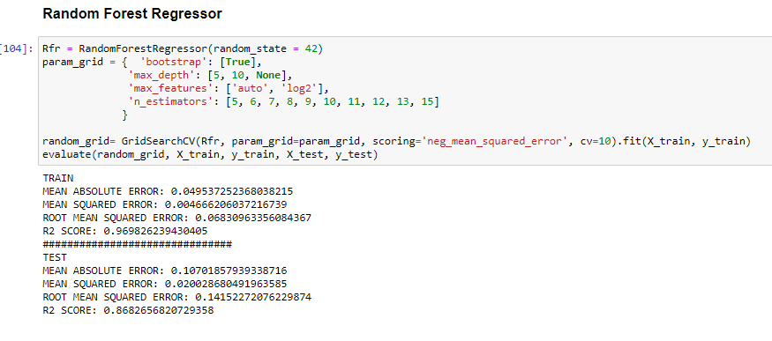
Cont..
Random Forest Regressor: Random forest is a supervised learning algorithm. The "forest" it builds, is an ensemble of decision trees, usually trained with the “bagging” method. The general idea of the bagging method is that a combination of learning models increases the overall result. Random Forest Regression is a supervised learning algorithm that uses ensemble learning method for regression. A Random Forest operates by constructing several decision trees during training time and outputting the mean of the classes as the prediction of all the trees.

Slide 31
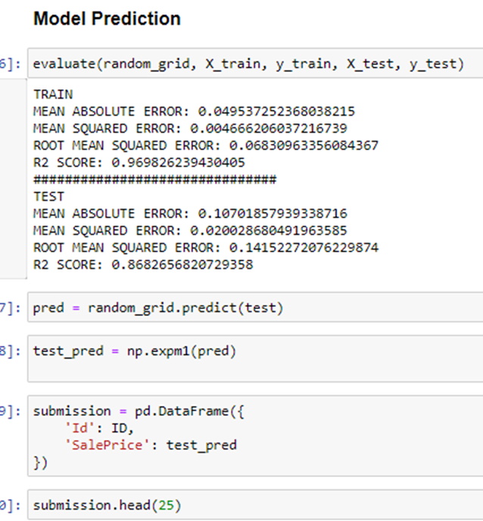
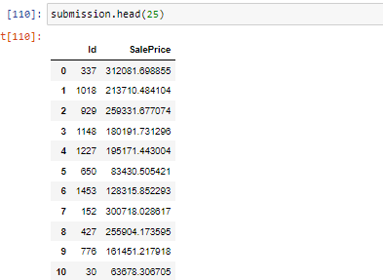
Prediction
Model prediction: Output:

Slide 32
Conclusion
The prediction of House price we find out that the Sales Price is highly dependent on the
1. OverallQual(Overall material and finish quality) and
2. GrLivArea( Above grade (ground) living area square feet)
That Means if the Overall Quality of the Material and Finishing of the Home is good , it's Sale Price will be high and Similarly, if the Ground living area square feet is high, Price will increase accordingily.
PoolQc(PoolQuality), MiscFeature(Miscellaneous feature not covered in other categories) and Alley have the highest number of missing values, as many homes have no pools.
In this project we use different models like Linear Regression, Lasso, Ridge, DecisionTree Regression and Random Forest Regression.
Here we select the RandomForestRegressor model for our final model training and testing as it gives the very less root mean squared error value and also its R2 score is highest among the all models we choose.

