Slide 1


JSPM’s
Bhivarabai Sawant Institute of Technology & Research Accredited with NBA & ‘A+’ Grade by NAAC
Department of Information Technology
Project Review 2 “Legal-Advice Web Agent”
Presented By :
Mr.Nitesh Ranjankar (BE2539)
Mr.Ashish Deshmukh (BE2508)
Ms.Prachi Janjire ( BE2515)
Ms.Sakshi Kokate (BE2519)
Guided By : Dr. Vinod Wadne

Slide 2
Content
Introduction
Motivation
Problem Statement
Literature Survey
Objectives
Existing System vs Proposed system
Methodologies
Block Diagram/ System Architecture
Requirements(Software/ Hardware)
DFD Diagrams
UML Diagram(Use case, Class dig, Activity dig, Sequence dig)
Project Plan
Conclusion
References

Slide 3
Introduction
This project is about a web-based legal advice assistant.
It uses AI trained on Indian court judgments.
A user can write their case summary, and the system will:
1. Classify the case (civil, criminal, etc.)
2. Predict possible outcomes
3. Show similar past judgments with reasoning

Slide 4
Motivation
Many people don’t know their legal rights.
Legal research is time-consuming and needs expert knowledge.
Lawyers need quick references from past cases.
Common people need a simple tool to understand if they have a strong case.

Slide 5
Problem Statement
To simplify legal understanding in India, the Legal-Advice Web Agent powered by INLegalLlama classifies cases, predicts possible outcomes, and provides past judgment references with clear explanations.

Slide 6
Literature Survey
Sr. No. | Paper Name | Authors | Publication Year | Conclusion
01 | Fine-Tuning a Large Language Model for the Indian Legal System | Rishabh T. A., Ramit Salunke, Rahul R., Ritvik N. V., Dr. Sujatha R. Upadhyaya | 2025 | This paper presents a fine-tuned legal AI system based on LLaMA 3.1 8B, specifically designed for the Indian legal domain. The researchers employed advanced optimization methods such as Low-Rank Adaptation (LoRA), Quantized LoRA (QLoRA), Retrieval-Augmented Generation (RAG), and pruning to enhance model efficiency, reduce hallucinations, and improve context-based legal understanding
02 | ChatKanoon: A Novel Approach to Legal Assistance | Ayan J. Shaikh, Zainab Mirza, Fazal J. Parkar | 2024 | This paper introduces ChatKanoon, a multilingual AI chatbot leveraging GPT-4 and Llama2 70B via instructional prompting. It delivers context-sensitive legal advice using rich legal datasets and a user-friendly interface.

Slide 7
Literature Survey
Sr. No. | Paper Name | Authors | Publication Year | Conclusion
03 | Aalap: AI Assistant for Legal & Paralegal Functions in India | Aman Tiwari, Prathamesh Kalamkar, Atreyo Banerjee. | 2024 | Aalap is a fine-tuned version of Mistral 7B trained specifically for Indian legal tasks. It outperforms GPT-3.5-turbo on 31%.
04 | NYAYAANUMANA and INLEGALLLAMA: The Largest Indian Legal Judgment Prediction Dataset | Shubham Kumar Nigam, Balaramamahanthi Deepak Patnaik, Shivam Mishra, Noel Shallum, Kripabandhu Ghosh, | 2024 | This study introduces NyayaAnumana, the largest dataset of Indian legal cases (over 7 lakh cases), and INLegalLlama, a specialized LLM trained for legal judgment prediction and explanation.
05 | Unveiling the Future: Exploring AI Applications in the Indian Judicial System | Rashmi Singh Rana; Sneha Singh; Megha Aggarwal; Manish Badoni | 2023 | The paper concludes that AI has significant potential to improve the efficiency, effectiveness, and accessibility of India’s judicial system.

Slide 8
Objectives
To classify user cases into categories (civil, criminal, etc.).
To predict possible outcomes based on past judgments..
To show past judgments as references.
To explain predictions using Explainable AI (XAI).
To make this tool free and easy to use for both lawyers and common people.

Slide 9
Existing System vs Proposed System
Feature / Criteria | Existing Systems (CaseMine, Manupatra, SUVAS, GPT Bots) | Proposed System (Legal-Advice Web Agent)
Focus Area | Mainly legal search engines or document repositories | Judgment prediction + legal advice
Indian Law Support | Limited / Paid access | Trained on Indian dataset (NyayaAnumana)
Prediction of Outcomes | Not available | Provides likely outcomes
Case References | Only search results, no prediction link | Relevant past cases with citations
Explainability (XAI) | No explanation of results | Explains reasoning + confidence score
User Friendly for Laypersons | Requires legal background to use | Simple chatbot-style interface
Cost | Paid or subscription-based | Free and open-source MVP
Innovation | Traditional search or translation tools | Combines LLM, case retrieval, and XAI

Slide 10
Methodologies
The user submits a case summary.
The system first cleans and processes the text.
Then it classifies the type of case.
After that, the AI predicts the possible outcome.
The system also retrieves similar past judgments from a dataset.
Finally, it explains the result with reasoning and references

Slide 11
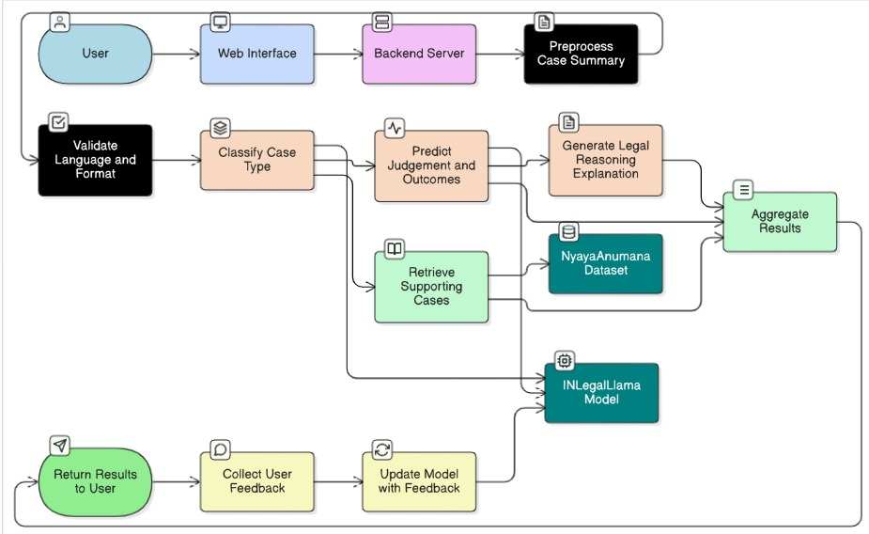
System Architecture:

Slide 12
Hardware/Software Requirements
Hardware Requirements :
Normal PC/Laptop for development
Internet connection
Optional: Free GPU via Google Colab (for heavy testing)
Software Requirements :
Frontend → Next.js, Tailwind CSS
Backend → Flask (Python)
AI/ML → HuggingFace Transformers
Database → MongoDB / PostgreSQL

Slide 13

DFD Diagrams
Provides possible outcome, Past References, suggested actions, legal Disclaimers
Case
Summary
Legal Advice
Web Agent
(System)
User
User
Fig. DFD Level 0

Slide 14
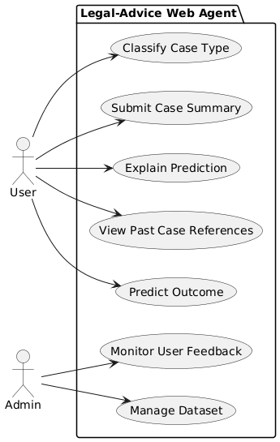
UML Use Case Diagrams
Submit Case

Slide 15
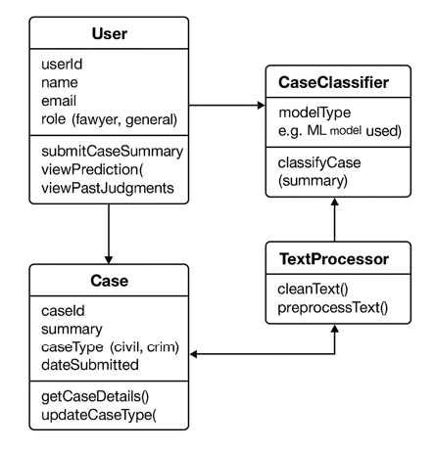
Class Diagram

Slide 16
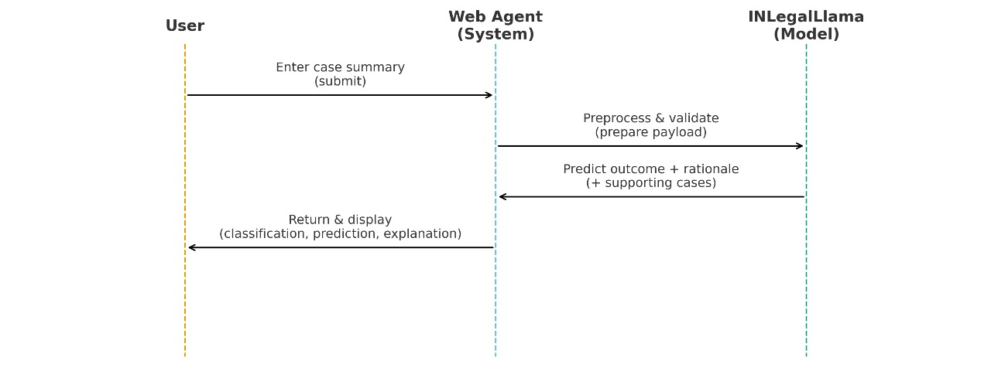
Sequence Diagram:-

Slide 17
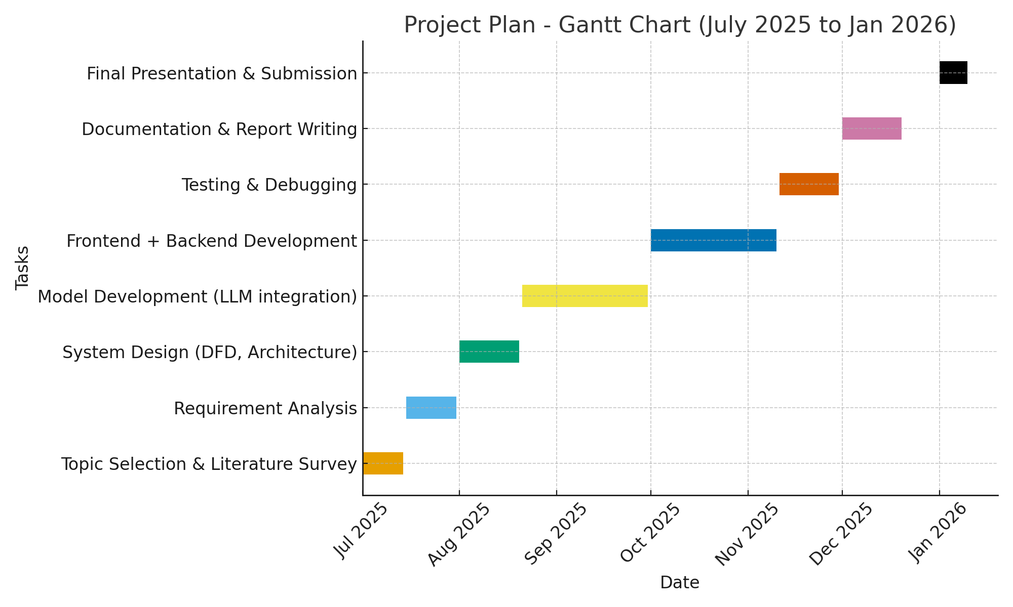
Project Plan(Gannt Chart)

Slide 18
Conclusion
In conclusion, the Legal-Advice Web Agent bridges the gap between law and technology by using AI-powered judgment prediction with explainable reasoning. Legal-Advice Web Agent makes legal knowledge simple and accessible for everyone.By using AI to predict judgments, provide clear explanations, and show past case references, the system helps people understand their cases better and take informed legal decisions.

Slide 19
References
Sil, Riya, Alpana, and Abhishek Roy. "A review on applications of artificial intelligence over Indian legal system." IETE Journal of Research 69.9 (2023): 6029-6038.
Holmes, Oliver Wendell. "The Path of the Law Harvard Law Review Vol. 110." (1997): 991-1009.
Naveed, H., Khan, A.U., Qiu, S., Saqib, M., Anwar, S., Usman, M., Akhtar, N., Barnes, N. and Mian, A., 2023. A comprehensive overview of large language models. arXiv preprint arXiv:2307.06435.
Vaswani, A., 2017. Attention is all you need. Advances in Neural Information Processing Systems.
Charlotin, D., 2023. Large language models and the future of law. Available at SSRN 4548258.
Dettmers, T., Pagnoni, A., Holtzman, A. and Zettlemoyer, L., 2024. Qlora: Efficient finetuning of quantized llms. Advances in Neural Information Processing Systems, 36.

Slide 20
…Thank You !!!

