Slide 1

SIGNOS™
Adaptive Input for Windows
Control Windows entirely with Indian Sign Language and hand gestures — no keyboard, no mouse, no touchpad.
SNAPDRAGON® AI LAB BUILD & PRESENT CHALLENGE · QUALCOMM × HP

Slide 2
THE MISSION
A daily-life idea, not a lab exercise
Sign language shouldn't be limited to communication between people. It can be how someone operates a computer, too.
SignOS was built around one goal: make it genuinely easier to offer good hospitality and everyday computer access to differently-abled people — people whose hands, voice, or mobility don't fit the mouse-and-keyboard mold everyone else designed around.
This is a bold accessibility position, offered in a soft tone: SignOS is not against any other accessory, switch, or assistive device on the market. It's another door into the same room — one more way for someone to be independent at a computer, on their own terms.
02 / 13

Slide 3
THE GAP
Every existing category solves half the problem
Sign → text tools
Translate signs into text. Never touch the operating system.
Fixed gesture macros
One gesture, one hardcoded action — identical everywhere.
Chatbot assistants
Wait for a typed prompt. Don't act on your live workflow.
Cloud accessibility tools
Need constant internet, send audio/video off-device.
SignOS replaces physical input entirely — and the same gesture means a different real action, depending on context.
03 / 13

Slide 4
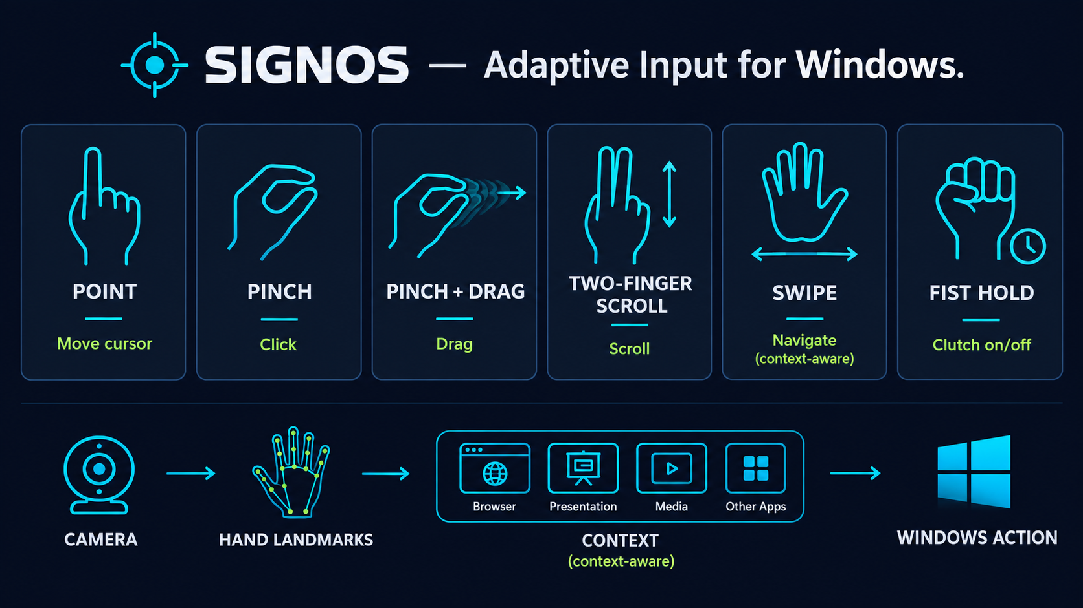
THE GESTURE VOCABULARY
One camera. Six gestures. Every Windows action.
04 / 13

Slide 5
HOW IT WORKS
From camera frame to Windows action
CAMERA
→
HAND
LANDMARKS
→
GESTURE / ISL
RECOGNITION
→
WINDOWS
CONTEXT
→
RISK-GATED
ACTION BROKER
→
REAL WINDOWS
ACTION
Every gesture is confirmed over multiple frames before it fires — never a single-frame guess. Direct gestures (mouse-replacement) and ISL commands are two separate recognition layers that never get confused with each other.
Destructive actions (e.g. closing a window) require a second, distinct gesture within 5 seconds to confirm — never the same gesture repeated. This is the same discipline as a physical “confirm delete” dialog, expressed in gesture.
05 / 13

Slide 6
THE ACTUAL INNOVATION
Same gesture. Different action. Every time.
GESTURE
DESKTOP
BROWSER
PRESENTATION
MEDIA
SWIPE RIGHT
Next virtual desktop
Forward
Next slide
Next track
SWIPE LEFT
Previous desktop
Back
Previous slide
Previous track
PINCH
Click
Click
Advance slide
Play / pause
SCROLL
Scroll page
Scroll page
—
Volume
Mode resolution is deterministic — read from the actual foreground app and window state, not a guess from a large model.
06 / 13

Slide 7
SAFETY BY DESIGN
Not every action deserves the same trust
R0
Scroll, hover, click
Fires immediately
R1
Navigate, change slide/track, play/pause
Fires immediately
R2
Change a system setting (reserved for future use)
Fires immediately, logged prominently
R3
Close a window, destructive actions
Requires a second, DISTINCT gesture to confirm — the same gesture repeated never confirms itself
07 / 13

Slide 8
UNDER THE HOOD
Local-first. NPU-accelerated. Nothing leaves the device.
Hexagon NPU
No cloud dependency
Perception (landmarks, gesture/ISL classification) runs on-device, accelerated via ONNX Runtime with the QNN execution provider.
The core control path works fully offline — demonstrable with Wi-Fi disabled.
Raw video never persisted
Full transparency
Only structured intent events are written locally. No camera frames, no video history, ever.
A live Mission Control dashboard shows exactly what the system sees, what it inferred, and what it did — never a black box.
08 / 13

Slide 9
LIVE PRESENTATION SURFACE
Mission Control — built for judges, not just developers
▸ Live embedded camera feed — no separate popup window
▸ Current mode badge, resolved in real time from the focused app
▸ Event timeline proving the differentiator: same gesture, different logged action, per mode
▸ Self-documenting gesture library, read live from the mapping config — can never go stale
▸ Local routine panel (Observe + Suggest) — shows patterns without ever auto-acting on them
▸ Explicit privacy footer: camera local, raw video off, network AI off
09 / 13

Slide 10
WHERE WE ARE — HONESTLY
Working today, measured, not claimed
PERCEPTION LOOP
CAMERA → LANDMARK LATENCY
~19.5–19.9 fps, live camera
~12–19 ms
AUTOMATED TESTS
HANDEDNESS DETECTION
65 / 65 passing
Verified correct on real hardware
LIVE GESTURES CONFIRMED
CONTEXT MODE SWITCHING
Pinch, drag, scroll, palm hold, clutch — firing correctly
Verified live across real Windows apps
Every number here was actually measured on this build — nothing projected is presented as fact.
10 / 13

Slide 11
WHAT'S NEXT
The honest path to the full vision
Confirm the ISL command vocabulary against ISLRTC, then record and train it
1
Sign-language text entry — open Windows search, type, and launch apps hands-free
2
Full Snapdragon NPU profiling via Qualcomm AI Hub — real, measured on-device latency
3
TEXT mode via UI Automation focused-control detection
4
Deeper routine learning that quietly adapts to how each person actually works
5
11 / 13

Slide 12
WHY SIGNOS
This is a product, not a demo
Technical Implementation
A full working pipeline, live on real hardware — not slideware.
Innovation
A context-aware intent layer, not another sign-to-text tool.
Deployment & Accessibility
Local-first, private by default, runs headless in the background.
Presentation
A live Mission Control dashboard that shows exactly what's happening, in real time.
12 / 13

Slide 13
Hands should be enough.
SignOS replaces physical input with sign and gesture, reads Windows context to interpret intent, and stays private and local by design — so that anyone, regardless of how they can move or speak, can sit down and use a computer with dignity.
BUILT FOR
Snapdragon® AI Lab Build & Present Challenge — Qualcomm × HP
GITHUB
github.com/ashish-doing/SignOS

