Slide 1
PoP 2.0 / TRICKLE UP INDIA FOUNDATION
TECHNICAL PROPOSAL OVERVIEW
PoP 2.0
Offline-first field workflows. Clear programme oversight.
Flutter mobile + web / Node.js services / TUIF AWS target
Prepared for Trickle Up India Foundation · 06 November 2026

Slide 2
PoP 2.0
THE CHALLENGE
Built for field conditions
TECHNICAL
OVERVIEW
Simple daily work for participants and Sakhis; timely oversight for programme teams.
01
FIELD MOBILE
PROGRAMME PORTAL
INCLUSIVE DESIGN
Capture essential work with low connectivity. Use familiar labels, review steps and visible sync status.
Review scoped reports, follow activity and administer access from a separate web workspace.
Five languages, voice assistance and accessible workflows are production requirements; validation is part of design and UAT.
PROPOSAL
DEMO
FICTIONAL
DATA
TOR §§2, 2.1–2.2, 4 · 02 / 11

Slide 3
PoP 2.0
PROPOSED ARCHITECTURE
Keep the field app useful offline
TECHNICAL
OVERVIEW
Target stack follows the ToR. Final production design is subject to TUIF review.
02
01
Flutter clients
Android mobile + web portal
02
Secure sync API
Node.js services and versioned contracts
03
Programme data
Approved AWS environment and recovery plan
04
Identity + providers
Firebase or Cognito; speech/AI integrations as approved
PROPOSAL
DEMO
FICTIONAL
DATA
CURRENT DEMO: local services, prototype storage and synthetic records. No AWS tenant or production identity is configured.
TOR §§6.1–6.3, 6.8–6.9 · 03 / 11

Slide 4
PoP 2.0
PHASE 1 SCOPE
Five modules. One connected programme view.
TECHNICAL
OVERVIEW
Module boundaries and business rules are baselined with TUIF before development.
03
01
02
03
Registration & profiling
SHG management
SHG financial management
04
05
Enterprise management
Smart Sakhi monitoring
PROPOSAL
DEMO
FICTIONAL
DATA
AI Voice Assistant and AI Chatbot are common modules across phases. Phase 1 capability and language acceptance must be agreed and priced.
TOR §5 · 04 / 11

Slide 5
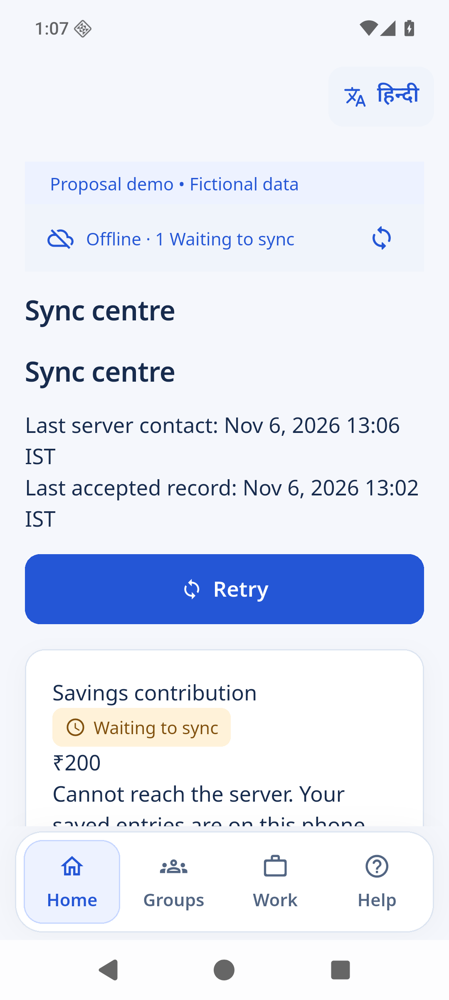
PoP 2.0
CORE FIELD WORKFLOW
Save once. Recover. Sync. Verify.
TECHNICAL
OVERVIEW
The demo records user intent durably and keeps pending money separate from confirmed balances.
04
Review member and group
1
2
Enter and review contribution
3
Save offline; restart safely
4
Sync the same operation; verify one receipt
PROPOSAL
DEMO
FICTIONAL
DATA
Verified synthetic example: ₹200 saved offline; after restart, one server transaction and receipt; confirmed savings moved ₹1,600 → ₹1,800; pending queue cleared.
TOR §2.1 · Local prototype evidence; not field-scale acceptance · 05 / 11

Slide 6
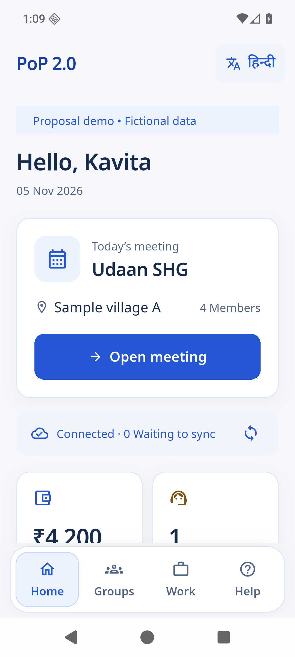
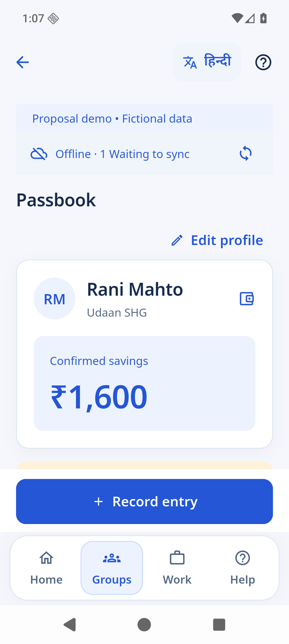

PoP 2.0
MOBILE INTERFACES
A task-led field experience
TECHNICAL
OVERVIEW
Home, passbook and visible connection state use the current blue-and-white interface.
05
PROPOSAL
DEMO
FICTIONAL
DATA
Start the day
Review pending
Confirm the receipt
Current prototype screenshots · synthetic participant data · English interface · 06 / 11

Slide 7
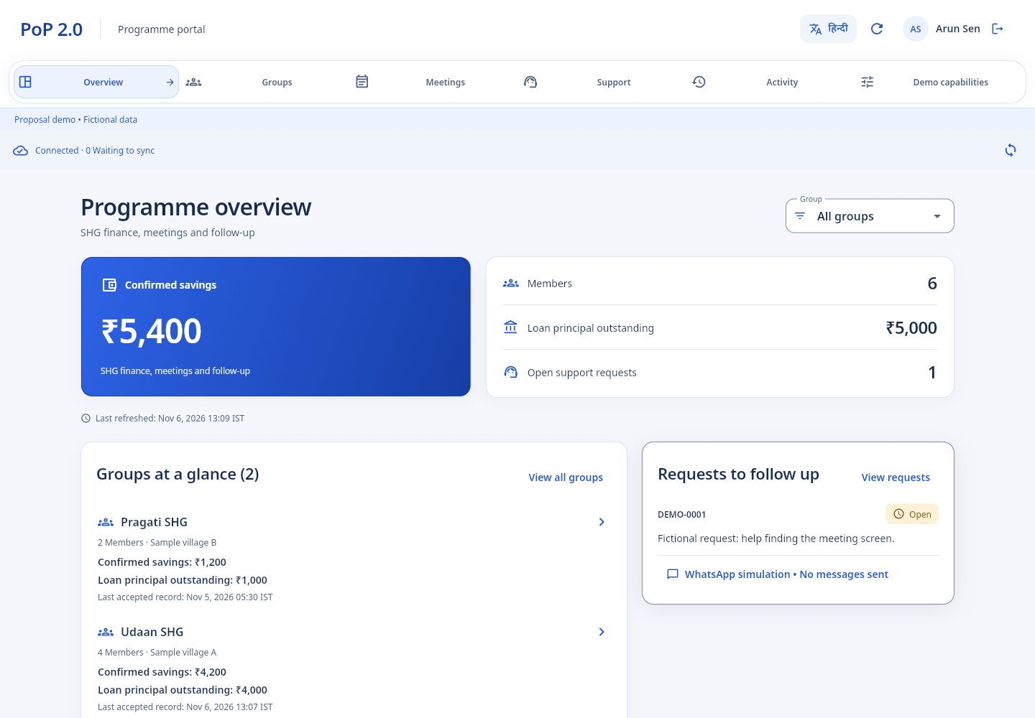
PoP 2.0
PROGRAMME PORTAL
Trace totals to their records
TECHNICAL
OVERVIEW
Separate programme workspace for scoped oversight and administration.
06
1
Five scoped snapshot reports with CSV exports
2
Group and member activity views with clear freshness
3
Access administration, reviewed imports and versioned help
PROPOSAL
DEMO
FICTIONAL
DATA
Current prototype screenshot · synthetic programme data · 07 / 11

Slide 8
PoP 2.0
COMMON AI MODULES
Assist with clear limits
TECHNICAL
OVERVIEW
The proposal includes bounded voice assistance and grounded help, with review before action.
07
VOICE
CHAT
LANGUAGES
Navigation and supported input drafts; user reviews recognized text before opening or saving.
Answers grounded in approved TUIF content, with citations and human escalation.
English, Hindi, Odia, Ho and Santhali content and relevant audio are planned production deliverables.
DEMO TODAY: cited offline help and bounded navigation paths. No live AI provider call or five-language audio acceptance is claimed.
PROPOSAL
DEMO
FICTIONAL
DATA
TOR §§2.2, 4–5 · 08 / 11

Slide 9
PoP 2.0
ENGINEERING EVIDENCE
Verified locally. Production gates remain.
TECHNICAL
OVERVIEW
The evidence pack records what was exercised and where acceptance still requires TUIF or field validation.
08
51
12
18
0
API tests
domain tests
UI tests¹
npm audit advisories²
The emulator’s latest full-start observations (2.766 s, 2.309 s and 2.632 s) exceed the 2-second target. TalkBack spoken output, representative devices, live identity and security assessment remain open.
PROPOSAL
DEMO
FICTIONAL
DATA
¹ One existing visual-preview skip. ² Saved local audit result; not a penetration test. See NON_AWS_COMPLETION.md. · 09 / 11

Slide 10
PoP 2.0
DELIVERY & ACCEPTANCE
Demonstrate each gate with evidence
TECHNICAL
OVERVIEW
Proposed work packages map to the ToR milestone schedule; timing and staffing are finalized with TUIF.
09
20%
20%
30%
20%
10%
Discovery + approved requirements
UX/UI + data/API architecture
Agreed Phase 1 module demonstrations
Testing + UAT + deployment readiness
Source, documentation + knowledge transfer
Acceptance includes agreed scenarios, test results, closure of release blockers and written TUIF approval.
PROPOSAL
DEMO
FICTIONAL
DATA
TOR §§6.4, 6.7, 6.10–6.11, 14 · 10 / 11

Slide 11
PoP 2.0
READY FOR JOINT DESIGN
Confirm these inputs at inception
TECHNICAL
OVERVIEW
They determine architecture, effort, production acceptance and the final commercial proposal.
10
PLATFORM
IDENTITY + DATA
LANGUAGE + UAT
TUIF AWS account, region, repository and operating ownership
Choose Cognito/Firebase; approve roles, migration sources and financial rules
Set scripts/dialects, reviewers, recording scope, devices and participant acceptance
Demo data is synthetic. This presentation describes a proposed production delivery; it is not a deployment or TUIF acceptance record.
PROPOSAL
DEMO
FICTIONAL
DATA
TOR §§6.1–6.3, 6.8–6.11 · 11 / 11

