Slide 1
SPADE on Android
http://data-provenance.googlecode.com/

Slide 2
What is Provenance?
Origin or history of objects.
In computing terms, data provenance → history of data or computation.
Represented as a graph, modeled using OPM¹.
Vertices show objects (data, users, processes).
Edges show transformations or relationships between objects.
[1] Open Provenance Model – http://openprovenance.org/

Slide 3
Provenance – Uses
Analyze, debug applications
Optimize, re-execute workflows
Intrusion detection
Malware analysis

Slide 4
SPADE – Overview
Software infrastructure for collection, management, analysis of data provenance.
Cross-platform with a domain agnostic kernel.
Extendible, can dynamically load modules for particular environments or needs.

Slide 5
SPADE – Android
Reporting: strace – system calls used to generate data provenance.
Monitor zygote, DalvikVM, radio, system processes.
Storage: Graphviz DOT format.

Slide 6
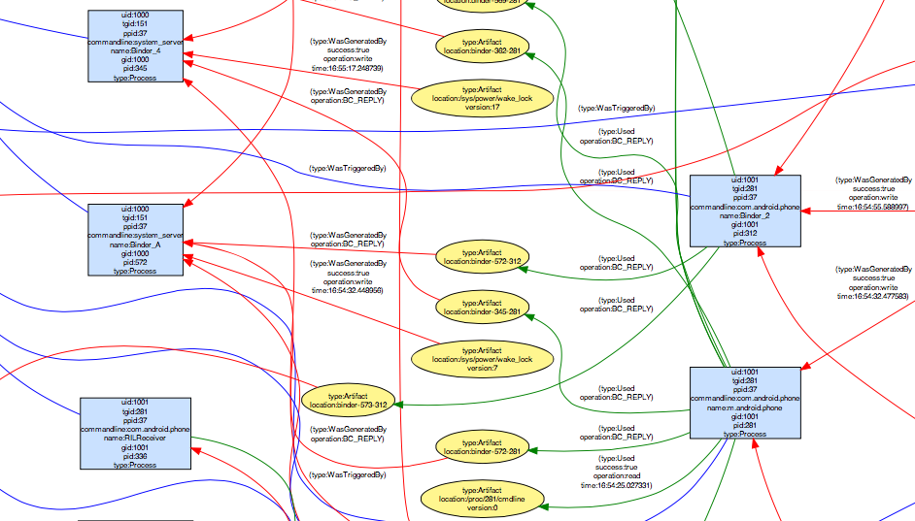
Provenance Graph

Slide 7
Analysis of Captured Provenance
Import graph inside query tool.
Ability to ask for the following information using query commands:
Vertices that match a given expression
Lineage (ancestors or descendants)
Paths between vertices

Slide 8
Demo

Slide 9
Questions?

