Slide 1


Project ID: 2022-24MCAPID007
Online Voting System
By
Sanjay Saini(2202900140037)
Prabhat Singh Chauhan(2202900140027)
Pranjul Awasthi(2202900140028)
Prashant Kumar(2202900140030)
Prateek Yadav(2202900140031)
Under the Supervision
Of
Mrs. Deepshikha Rai
(Assistant Professor)
Department of Master Of Computer Application
ABES INSTITUTE OF TECHNOLOGY,GHAZIABAD
Affiliated to
DR. A.P.J. ABDUL KALAM TECHNICAL UNIVERSITY
LUCKNOW,UTTAR PRADESH
(ODD SEM, 2023-24)

Slide 2
ABSTRACT
The Online Voting System is a web based application. The system has a centralized database to keep records of all the Voters and Candidates and Final Results. This Online Voting System is based on SMS sending to voters, to confirmation of Vote. This web based system is time saving, work load reduced information available at time and it provide security for the data. During the election, the election commission of India has introduced a new method of polling by online voting system (OVS). The election commission will maintain this website. This is a simple, safe and secure method that takes minimum of time.
The word VOTE means to choose from a list, to elect or to determine. The main goal of voting (in a scenario involving the citizens of a given country) is to come up with leaders of the people’s choice. Most countries, India not an exception have problems when it comes to voting. Some of the problems involved include ridging votes during election, insecure or inaccessible polling stations, inadequate polling materials and also inexperienced personnel.
Notes:
Insert a map of your country.

Slide 3

introduction
The existing manual Voting system consumes more time for Vote Casting. Voter has to wait for vote polling station to vote for a right candidate. The election officers has to be check the voter , this voter can vote in this booth then chek voterID present in voters list of booth those are information will be present then the voter can vote in that booth. The voter had to stand in the queue to cast his vote. All the work is done in paper ballot so it is very hard to locate a particular candidates, some voters cast their votes for all candidates. To overcome of all these problems we have to implement a web application, which is helpful for Voting from any where.
Notes:
Insert a picture of one of the geographic features of your country.

Slide 4
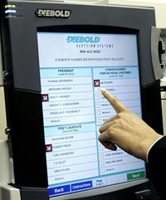
About project
The objective of the system is a replacement of the traditional system that is in existence. This smart system reduces the time for voting and also the system is reliable, and faster. In this system the voter username and password will be sent through SMS. The voter cast their vote enter the confirmation OTP sent their mobile number . Database maintained by this system usually contains the Voters information, Candidate information, The final Result of total votes
Notes:
Insert a picture illustrating a season in your country.

Slide 5
Literature Review
This is a system that can be used by user to cast vote in an election. All the voters have to login and click on cast vote to his/her chosen candidates to submit his/her vote. The research development and testing are done on LAN. On other hand online voting software is been in research for many years, researched cases of wrong implementations reported in recent years. These factors are need to be resolved so public can cast their vote in a secured and fitting environment. online voting is a voting software in which any user can use his/her voting rights from anywhere. Online voting application contains:
a) users details
b) users Names with ID and password.
c) users vote in a database.
d) sum of total number of votes.
e) result panel
f) a unique user id given my administration
The user interface at the server's end enables creating the election on behalf of the users. The users must login with id and password then they can access the election module where they can cast their vote with such ease and comfort and their response will be saved and after that result will be displayed.
Notes:
Insert a picture of an animal and or plant found in your country.

Slide 6
Problem with the existing system
The problems of the existing manual system of voting include among others the following:
1. Expensive and Time Consuming:
The process of collecting data and entering this data into the database takes too much time and is expensive to conduct, for example, time and money is spent in printing data capture forms, in preparing registration stations together with human resources, and there after advertising the days set for registration process including sensitizing voters on the need for registration, as well as time spent on entering this data to the database.
2. Too much paper work:
The process involves too much paper work and paper storage which is difficult as papers become bulky with the population size.
3. Error during data entry:
Errors are part of all human beings; it is very unlikely for humans to be 100 percent efficiency in data entry.
4. Loss of Registration Forms:
Some times, registration forms get lost after being filled in with voter’s details, in most cases these are difficult to follow-up and therefore many remain unregistered even though they are voting age nationals and interested in exercising their right to vote.
5. Short time provided to view the voter register:
This is very big problem since not all people have free time during the given short period of time to check and update the voter register
Notes:
Add key points in the history of your country to the timeline.

Slide 7
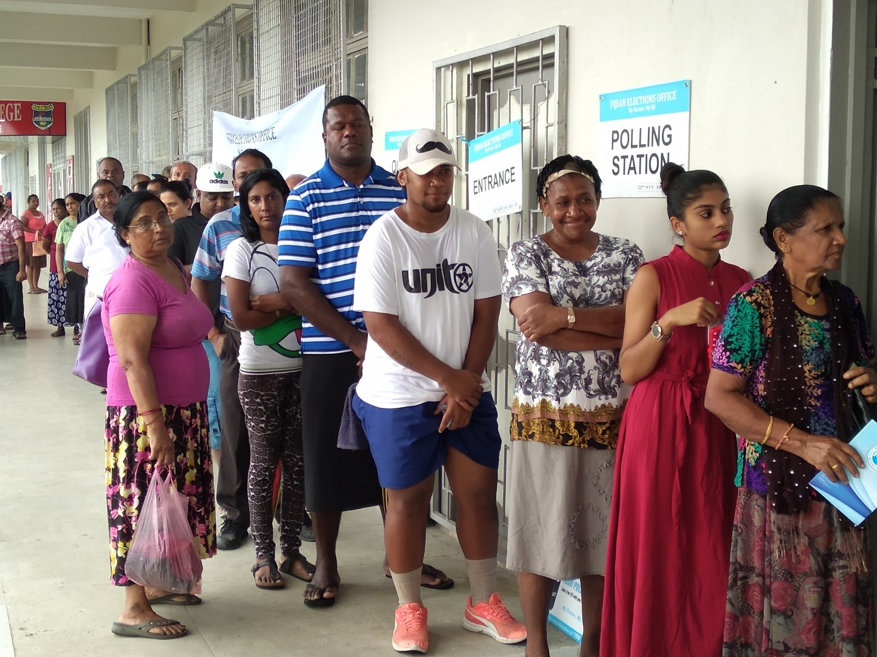
Online voting system
The ONLINE VOTING SYSTEM-BHARAT shall reduce the time spend making long queues at the polling stations during voting. It shall also enable the voters to vote from any part of the globe as explained since this is an online application available on the internet. Cases of vote miscount shall also be solved since at the backend of this system resides well developed database MySQL that can be provide the correct data once it correctly queried. Since the voting process shall be open as early as possible, the voter shall have an ample time decide when and whom to vote for.
This is system is used to demolish this type of voting system.
Notes:
Insert a picture illustrating a custom or tradition here.

Slide 8
System requirement
HARDWARE REQUIREMENT:
• Processor – Intel Pentium G6405 2.2GHz or Above/AMD
• RAM- 512MB or Above
• Harddisk – 10GB Or Above
SOFTWARE REQIREMENT:
• Front-End- HTML, CSS, Bootstrap
• Back-End – JAVASCRIPT, SQL SERVER SYSTEM
• Operating System- WINDOWS XP or Above
• Browser- Any latest Browser
Notes:
Insert a picture of the head leader of your country.

Slide 9

COnclusion
This online Voting system will manage the Voter’s information by which voter can login and use his voting rights. The system will incorporate all features of voting system. It provides the tools for maintaining voter’s vote to every party and it count total no. of every party. There is a DATABASE which is maintained by the ELECTION COMMISION OF INDIA in which all the names of voter with complete information is stored.
The traditional method of manual voting system has few drawbacks. This method is obviously not efficient as it wastes the voter’s energy and quite slow in term of completion. This smart system involves the voter’s can cast their vote easily, and can be implemented to the entire India.
Data can be managed on cloud so that it will be secured and managed efficiently. We have developed the online system for only one particular booth , this should be extended to all the polling booths in India .
Notes:
Insert a picture that illustrates some part of your country’s economy.

Slide 10
REferences
[1] https://www.w3schools.com
[2] https://www.electionsonline.com/online-votingsystem/
[3] https://en.wikipedia.org/wiki/Electronic_voting
[4]. K. P. Kaliyamurthie, R. Udayakumar, D. Parameswari and S. N. Mugunthan, “Highly Secured Online Voting System over Network,” in Indian Journal of Science and Technology | Print ISSN: 0974-6846 | Online ISSN: 0974-5645
[5]. Ankit Anand, Pallavi Divya, An Efficient Online Voting System, Vol.2, Issue.4, July-Aug. 2019, pp2631-2634. [6]. Drew Springall, Travis Finkenauer, Zakir Durumeric, Jason Kitcat, Harri Hursti Margaret MacAlpine J. Alex Halderman, November 3–7, 2014, “Security Analysis of the Estonian Internet Voting System,” in CCS‟14, Scottsdale, Arizona, USA. ACM 978-1-4503-2957-6/14/11.
Notes:
Insert a picture of one of the points of interest for your country.

Slide 11


