Slide 1
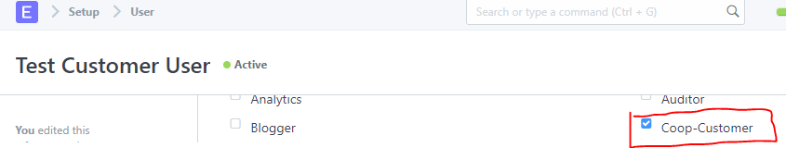
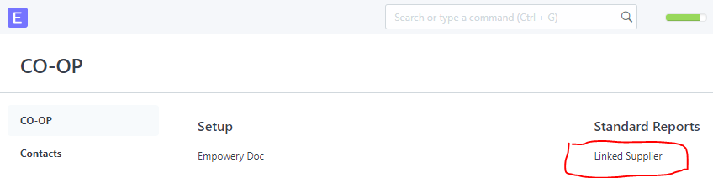

Create Customer
Create Primary User contact
Assign Coop-Customer Role to the User
Login with that user, You should go to desk > Empowery app icon > Linked Supplier

Slide 2
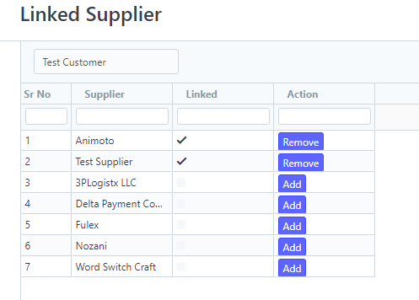

Slide 3
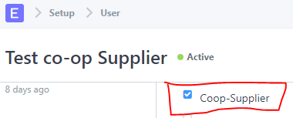
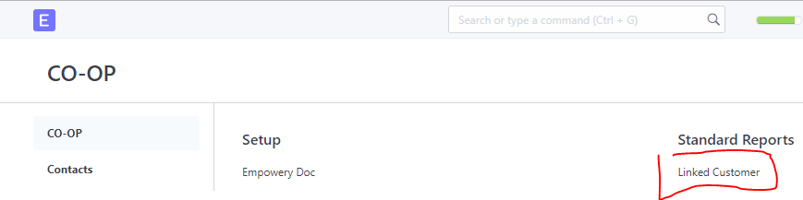
Create Supplier
Create Primary User contact
Assign Coop-Supplier Role to the User
Login with that user, You should go to desk > Empowery app icon > Linked Customer

Slide 4
