Slide 1

INTERMEDIATE CODE GENERATION (ICG)
Himadri Vaidya

Slide 2
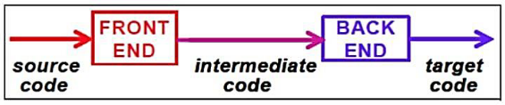
Introduction
In compiler, the front-end translates a source program into an intermediate representation from which the back end generates target code.
C Generation process should not be very complex
It shouldn’t be difficult to produce the target program from the intermediate code

Slide 3
Need For ICG
If a compiler translates the source language to its target machine language without generating IC, then for each new machine, a full native compiler is required.
IC eliminates the need of a new full compiler for every machine by keeping the analysis portion for all the compilers.
Synthesis part of back end depends on the target machine.

Slide 4
Contt..
A source program can be translated directly into the target language, but some benefits of using intermediate form are:
Re-targeting is facilitated: a compiler for a different machine can be created by attaching a Back-end (which generate Target Code) for the new machine to an existing Front-end (which generate Intermediate Code).
A machine Independent Code-Optimizer can be applied to the Intermediate Representation.

Slide 5
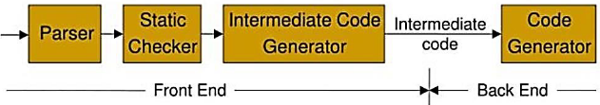
Logical Structure of a Compiler Front End

Slide 6
INTERMEDIATE LANGUAGES
The most commonly used intermediate representations were:-
Syntax Tree
DAG (Direct Acyclic Graph)
Postfix Notation
3 Address Code

Slide 7
GRAPHICAL REPRESENTATION
Includes both
Syntax Tree
DAG (Direct Acyclic Graph)

Slide 8
Syntax Tree Or Abstract Syntax Tree (AST)
Graphical Intermediate Representation
Syntax Tree depicts the hierarchical structure of a source program.
Syntax tree is a condensed form of parse tree useful for representing language constructs.

Slide 9
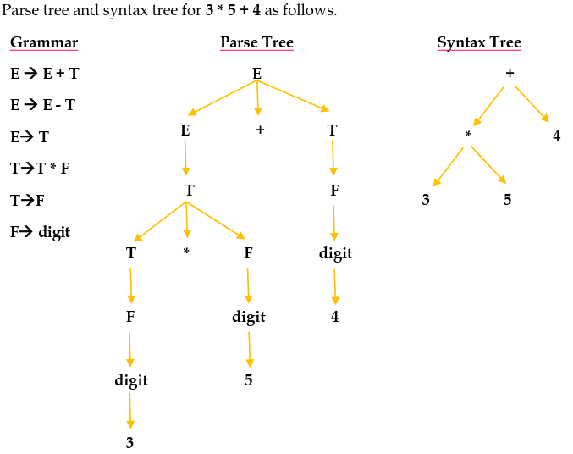
EXAMPLE

Slide 10
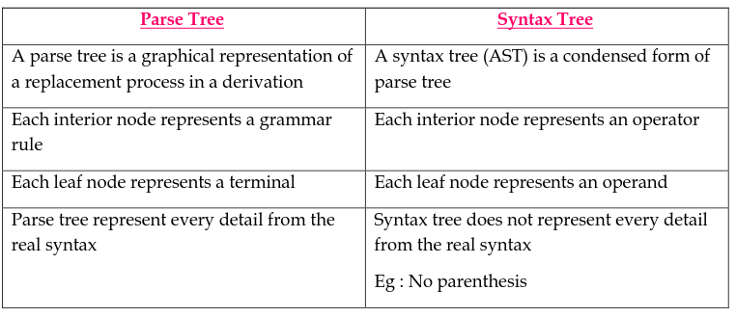
Parse Tree VS Syntax Tree

Slide 11
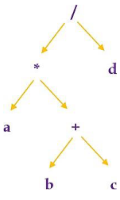
Syntax tree for a * (b + c) /d

Slide 12
Constructing Syntax Tree For Expression
Each node in a syntax tree can be implemented in are cord with several fields.
In the node of an operator, one field contains operator and remaining field contains pointer to the nodes for the operands.
When used for translation, the nodes in a syntax tree may contain addition of fields to hold the values of attributes attached to the node.
Following functions are used to create syntax tree
1. mknode(op,left,right): creates an operator node with label op and two fields containing pointers to left and right.
2. mkleaf(id,entry): creates an identifier node with label id and a field containing entry, a pointer to the symbol table entry for identifier
3. mkleaf(num,val): creates a number node with label num and a field containing val, the value of the number.
Such functions return a pointer to a newly created node.

Slide 13
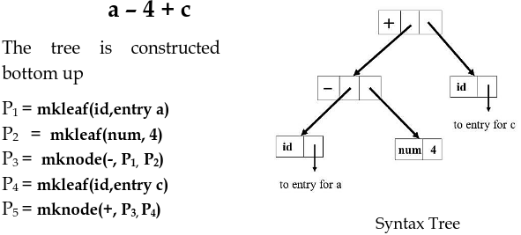
EXAMPLE

Slide 14
Syntax directed definition
Syntax trees for assignment statements are produced by the syntax-directed definition.
Non terminal S generates an assignment statement.
The two binary operators + and * are examples of the full operator set in a typical language.
Operator associates and precedences are the usual ones, even though they have not been put into the grammar. This definition constructs the tree from the input
a:=b* -c + b* -c
The token id has an attribute place that points to the symbol-table entry for the identifier.
A symbol-table entry can be found from an attribute id.name, representing the lexeme associated with that occurrence of id.
If the lexical analyser holds all lexemes in a single array of characters, then attribute name might be the index of the first character of the lexeme.

Slide 15
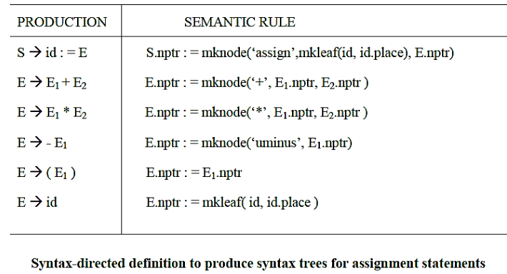
Contt...

Slide 16
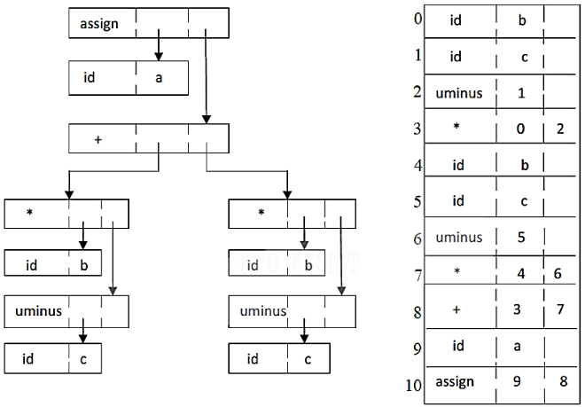
Two representations of the syntax tree

Slide 17
Contt..
In previous figure, each node is represented as a record with a field for its operator and additional fields for pointers to its children.
In the previous table, nodes are allocated from an array of records and the index or position of the node serves as the pointer to the node.
All the nodes in the syntax tree can be visited by following winters, starting from the root at position 10.

Slide 18
Direct Acyclic Graph (DAG)
Graphical Intermediate Representation
Dag also gives the hierarchical structure of source program but in a more compact way because common sub expressions are identified.

Slide 19
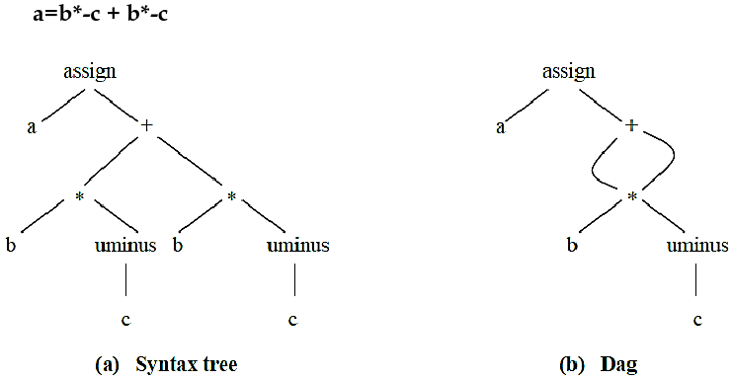
EXAMPLE

Slide 20
Postfix Notation
Linearized representation of syntax tree
In postfix notation, each operator appears immediately after its last operand.
Operators can be evaluated in the order in which they appear in the string.
EXAMPLE
Source String : a := b * -c + b * -c
Postfix String: a b c uminus * b c uminus * + assign

Slide 21
Postfix Rules
1. If E is a variable or constant, then the postfix notation for E is E itself.
2. If E is an expression of the form E1 op E2 then postfix notation for E is E1’ E2’ op, here E1’ and E2’ are the postfix notations for E1and E2, respectively
3. If E is an expression of the form (E), then the postfix notation for E is the same as the postfix notation for E.
4. For unary operation –E the postfix is E-
Ex: postfix notation for 9- (5+2) is 952+-
Postfix notation of an infix expression can be obtained using stack

Slide 22
THREE-ADDRESS CODE
In Three address statement, at most 3 addresses are used to represent any statement.
The reason for the term “three address code” is that each statement contains 3 addresses at most.
Two for the operands and one for the result.

Slide 23
General Form Of 3 Address Code
a = b op c
where,
a, b, c are the operands that can be names, constants or compiler generated temporaries.
op represents operator, such as fixed or floating point arithmetic operator or a logical operator on Boolean valued data.
Thus a source language expression like x + y * z might be translated into a sequence
t1 := y*z
t2 := x+t1
where, t1 and t2 are compiler generated temporary names.

Slide 24
Advantages Of Three Address Code
The unraveling of complicated arithmetic expressions and of nested flow-of-control statements makes three-address code desirable for target code generation and optimization.
The use of names for the intermediate values computed by a program allows three-address code to be easily rearranged - unlike postfix notation.
Three-address code is a linearized representation of a syntax tree or a DAG in which explicit names correspond to the interior nodes of the graph.

Slide 25
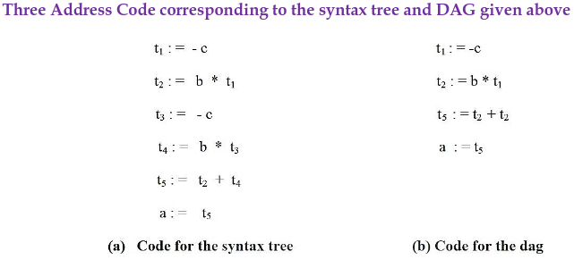
Three Address Code

Slide 26
Types of Three-Address Statements
1. Assignment statements
x := y op z, where op is a binary arithmetic or logical operation.
2. Assignment instructions
x : = op y, where op is a unary operation .
Essential unary operations include unary minus, logical negation, shift operators, and conversion operators that for example, convert a fixed-point number to a floating-point number.
3. Copy statements
x : = y where the value of y is assigned to x.
4. Unconditional jump
goto L The three-address statement with label L is the next to be executed
5. Conditional jump
if x relop y goto L This instruction applies a relational operator ( <, =, =, etc,) to x and y, and executes the statement with label L next if x stands in relation relop to y.
If not, the three-address statement following if x relop y goto L is executed next, as in the usual sequence.
6. Procedural call and return
param x and call p, n for procedure calls and return y, where y representing a returned value is optional.
Their typical use is as the sequence of three-address statements
param x1
param x2
..........
param xncall p,n
generated as part of the call procedure p( xl , x2, . . . , xn ) . The integer n indicating the number of actual-parameters in ''call p , n" is not redundant because calls can be nested.
7. Indexed Assignments
Indexed assignments of the form x = y[i] or x[i] = y
8. Address and pointer assignments
Address and pointer operator of the form x := &y, x := *y and *x := y

Slide 27
Syntax-Directed Translation Into Three-Address Code
When three-address code is generated, temporary names are made up for the interior nodes of a syntax tree. for example id : = E consists of code to evaluate E into some temporary t, followed by the assignment id.place : = t.
Given input a:= b * - c + b + - c, it produces the three address code in given above
The synthesized attribute S.code represents the three address code for the assignment S. The nonterminal E has two attributes:
1. E.place the name that will hold the value of E, and
2. E.code. the sequence of three-address statements evaluating E.

Slide 28
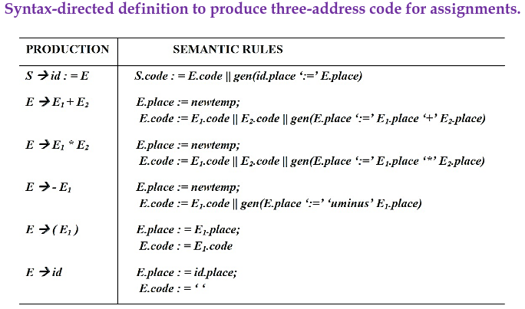
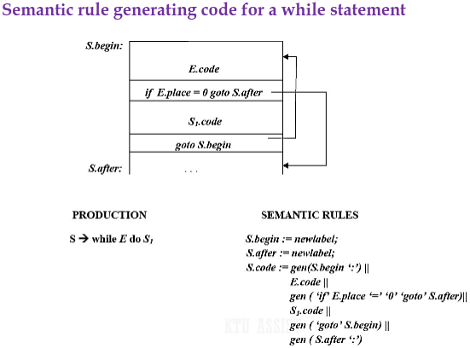
Contt..

Slide 29
Contt.
The function newtemp returns a sequence of distinct names t1, t2,......... in respose of successive calls.
Notation gen(x ‘:= ‘y ‘+’ z is used to represent the three address statement x := y + z.
Expressions appearing instead of variables like x, y and z are evaluated when passed to gen, and quoted operators or operand, like ‘+’ are taken literally.
Flow of control statements can be added to the language of assignments.
The code for S→ while E do S1 is generated using new attributes S.begin and S.after to mark the first statement in the code for E and the statement following the code for S, respectively.
The function new label returns a new label every time is called.
We assume that a nonzero expression represents true; that is when the value of E becomes zero, control laves the while statement

Slide 30
Implementation Of Three-Address Statements
A three address statement is an abstract form of intermediate code.
In a compiler, these statements can be implemented as records with fields for the operator and the operands.
Three such, representations are
Quadruples
Triples
Indirect triples

Slide 31
QUADRUPLES
A quadruple is a record structure with four fields, which are op, ag1, arg2 and result
The op field contains an internal code for the operator.
The three address statement
x:= y op z is represented by placing y in arg1, z in arg2 and x in result.
The contents of arg1, arg2, and result are normally pointers to the symbol table entries for the names represented by these fields.
If so temporary names must be entered into the symbol table as they are created.

Slide 32
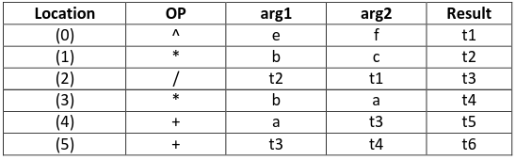
EXAMPLE
Translate the following expression to quadruple triple and indirect triple
a + b * c | e ^ f + b * a
For the first construct the three address code for the expression
t1 = e ^ f
t2 = b * c
t3 = t2 / t1
t4 = b * a
t5 = a + t3
t6 = t5 + t4

Slide 33
Exceptions
The statement x := op y, where op is a unary operator is represented by placing op in the operator field, y in the argument field & n in the result field.
The arg2 is not used
A statement like param t1 is represented by placing param in the operator field and t1 in the arg1 field.
Neither arg2 not result field is used
Unconditional & Conditional jump statements are represented by placing the target in the result field.

Slide 34
TRIPLES
In triples representation, the use of temporary variables is avoided & instead reference to instructions are made
So three address statements can be represented by records with only there fields OP, arg1 & arg2.
Since, there fields are used this intermediate code format is known as triples.

Slide 35
Contt..
Advantages
No need to use temporary variable which saves memory as well as time
Disadvantages
Triple representation is difficult to use for optimizing compilers because for optimization statements need to be shuffled
for e.g. statement 1 can be come down or statement 2 can go up etc.
So the reference we used in their representation will change.

Slide 36
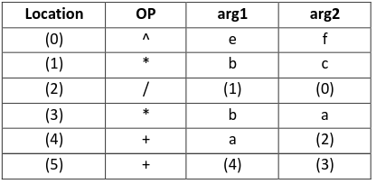
EXAMPLE
a + b * c | e ^ f + b * a
t1 = e ^ f
t2 = b * c
t3 = t2 / t1
t4 = b * a
t5 = a + t3
t6 = t5 + t4

Slide 37
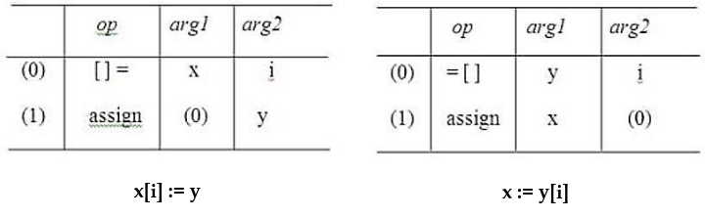
EXAMPLE
A ternary operation like x[i] : = y requires two entries in the triple structure while x : = y[i] is naturally represented as two operations.

Slide 38
INDIRECT TRIPLES
This representation is an enhancement over triple representation.
It uses an additional instruction array to led the pointer to the triples in the desired order.
Since, it uses pointers instead of position to stage reposition the expression to produce an optimized code.

Slide 39
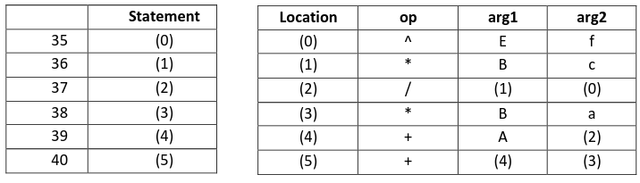
EXAMPLE

Slide 40
Comparison
When we ultimately produce the target code each temporary and programmer defined name will assign runtime memory location
This location will be entered into symbol table entry of that data.
Using the quadruple notation, a three address statement containing a temporary can immediately access the location for that temporary via symbol table.
But this is not possible with triples notation.
With quadruple notation, statements can often move around which makes optimization easier.
This is achieved because using quadruple notation the symbol table interposes high degree of indirection between computation of a value and its use.
With quadruple notation, if we move a statement computing x, the statement using x requires no change.
But with triples, moving a statement that defines a temporary value requires us to change all references to that statement in arg1 and arg2 arrays.
This makes triples difficult to use in optimizing compiler
With indirect triples also, there is no such problem.
A statement can be moved by reordering the statement list.

Slide 41
Space Utilization
Quadruples and indirect triples requires same amount of space for storage (normal case).
But if same temporary value is used more than once indirect triples can save some space.
This is bcz, 2 or more entries in statement array can point to the same line of op-arg1-arg2 structure.
Triples requires less space for storage compared to above 2.
Quadruples
direct access of the location for temporaries
easier for optimization
Triples
space efficiency
Indirect Triples
easier for optimization
space efficiency

Slide 42
PROBLEM
Translate the following expression to quadruple tuples & indirect tuples
a = b * - c + b * - c

Slide 43
Solution
Three address code for given expression is
t1 = uniminus c
t2 = b* t1
t3 = uniminus c
t4 = b* t3
t5 = t2 + t4
Q = t5

Slide 44
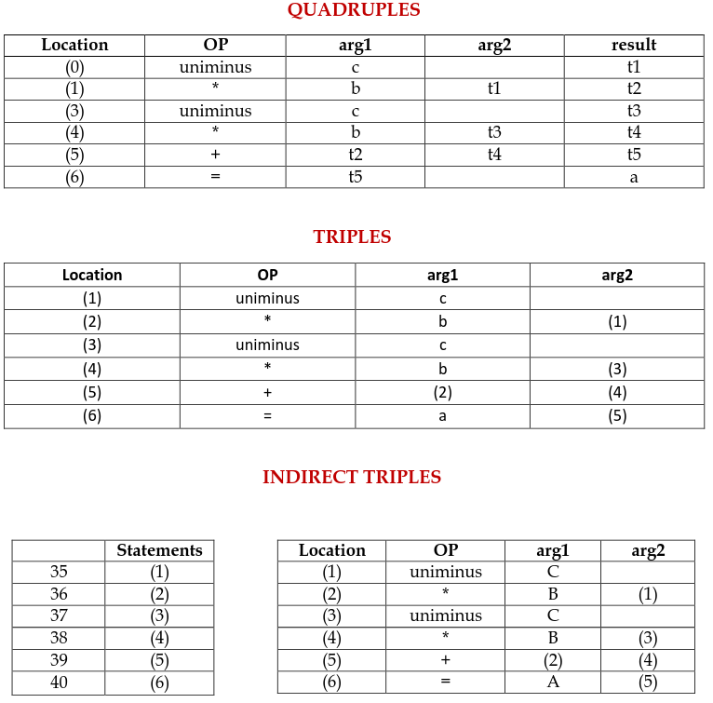
Contt.

Slide 45
BOOLEAN EXPRESSIONS
Boolean expressions have two primary purposes.
They are used to compute logical values.
But more often they are used as conditional expressions in statements that alter the flow of control, such as if-then-else, or while-do statements.
Boolean expressions are composed of the Boolean operators (and, or, and not) applied to elements that are Boolean variables or relational expressions.
Relational expressions are of the form E1 relop E2, where E1 and E2 are arithmetic expressions and relop can be <, <=, =!, =, > or >=
Here we consider Boolean expressions generated by the following grammar :
E->E or E | E and E | note | ( E ) |id relop id | true | false

Slide 46
Methods Of Translating Boolean Expressions
There are two principal methods of representing the value of a boolean expression.
They are :
Numerical Representation - To encode true and false numerically and to evaluate a Boolean expression analogously to an arithmetic expression.
Often, 1 is used to denote true and 0 to denote false.
Jumping Method (Short-circuit Method) - To implement Boolean expressions b flow of control, that is, representing the value of a Boolean expression by a position reached in a program.
This method is particularly convenient in implementing the
Boolean expressions in flow-of-control statements, such as the if-then and while-do statements.

Slide 47
Method 1: Numerical Representation
1 denotes true and 0 denotes false.
Expressions will be evaluated completely from left to right, in a manner similar to arithmetic expressions.
EXAMPLE
The translation for a or b and not c will result following three-address sequence
t1 : = not c
t2 : = b and t1
t3 : = a or t2

Slide 48
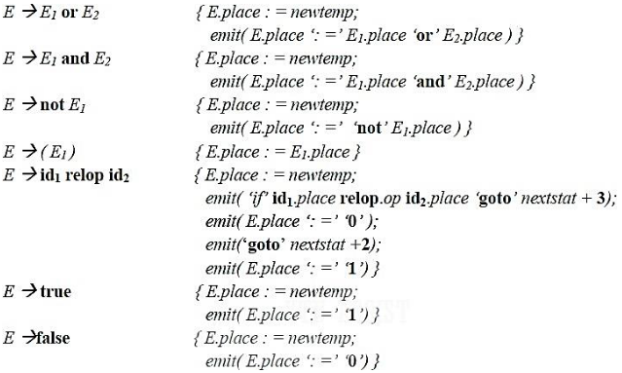
Problem
emit( ) output the three address statement into the output file
nextstat( ) gives the index of the next three address statement in the output sequence
emit increments nextstat after producing each three address statement.
A relational expression such as a < b is equivalent to the conditional statement
if a < b then 1 else 0 which can be translated into the three-address code sequence (let statement numbers start at 100)
100 if a < b goto 103
101 t : = 0
102 goto 104
103 t : = 1
104

Slide 49
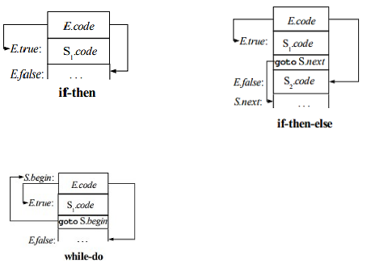
Method 2: Jumping or Short-Circuit Code
We can also translate a boolean expression into three-address code without generating code for any of the boolean operators and without having the code necessarily evaluate the entire expression.
This style of evaluation is sometimes called “short-circuit” or “jumping” code.
This is normally used for flow-of-control statements, such as the if-then, if-then-else and while-do statements those generated by the following grammar:
S → if E then S1| if E then S1 else S2| while E do S1

Slide 50
Contt...
Consider the grammar
S → if E then S1| if E then S1 else S2| while E do S1
In each of these productions, E is the Boolean expression to be translated.
In the translation, we assume that a three-address statement can be symbolically labeled, and that the function newlabel returns a new symbolic label each time it is called.
With each E we associate two labels E.true and E.false. E.true is the label to which control flows if E is true, and E.false is the label to which control flows if E is false.
The inherited attribute S.next is a label that is attached to the first three-address instruction to be executed after the code for S and another inherited attribute S.begin is the first instruction of S.

Slide 51
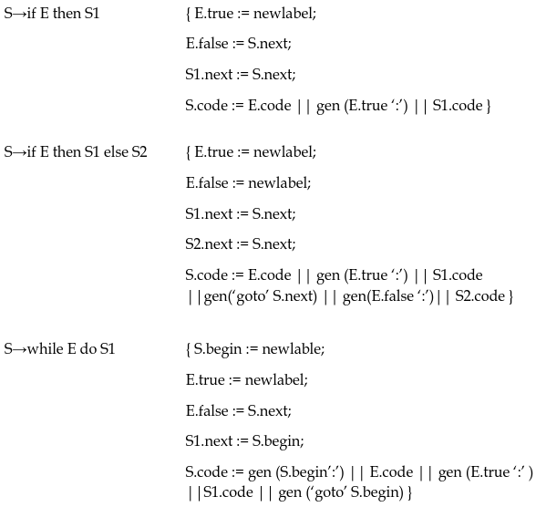
Syntax Directed Definition for flow –of –control statements

