Slide 1
CODE GENERATION

Slide 2
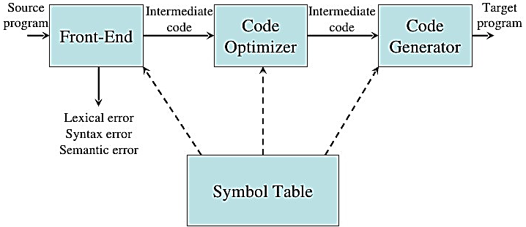
Introduction
The final phase in our compiler model is the code generator.
It takes as input an intermediate representation of the source program and produces as output an equivalent target program.

Slide 3
ISSUES IN THE DESIGN OF A CODE GENERATOR
The following issues arise during the code generation phase:
1. Input to code generator
2. Target program
3. Memory management
4. Instruction selection
5. Register allocation
6. Evaluation order
7. Approaches to code generation

Slide 4
Input To The Code Generator
The input to the code generator consists of the intermediate representation of the source program produced by the front end, together with information in the symbol table that is used to determine the run-time addresses of the data objects denoted by the names in the intermediate representation.
There are several choices for the intermediate language including postfix notation, three address representation such as quadruple, virtual machine representations such as stack machine code, and graphical representations such as syntax trees and dags.
We assume that prior to code generation the front end scanned, parsed and translated the source program into a reasonably detailed intermediate representation, so the values of names appearing in the intermediate language, type checking has taken place, so type conversion operators have been inserted wherever necessary.
The code generation phase can therefore proceed on the assumption that its input is free of errors.

Slide 5
Target programs
The output of the code generator is the target program.
This output may take on a variety of forms- absolute machine language, relocatable machine language or assembly language.
Producing an absolute machine language as output has the advantage that it can be placed in a fixed location in memory and intermediate Executed.
Producing a relocatable machine language program as output allows subprograms to be compiled separately.
A set of relocatable object modules can be linked together and loaded for execution by a linking loader.
Producing an assembly language program as output makes the process of code generation somewhat easier.
We can generate symbolic instructions and use the macro facilities of the assembler to help generate code.
The instruction set architecture of the target machine has a significant impact on the difficulty of constructing a good code generator that produces high quality machine code.

Slide 6
Memory Management
Mapping of variable names to address is done co-operatively by the front end and code generator.
Name and width are obtained from symbol table.
Width is the amount of storage needed for that variable.
Each three-address code is translated to addresses and instructions during code generation.
A relative addressing is done for each instruction.
All the labels should be addressed properly.

Slide 7
Instruction Selection
The code generator must map the IR program into a code sequence that can be executed by the target machine.
The complexity of performing this mapping is determined by a factor such as,
the level of the IR
the nature of the instruction-set architecture
the desired quality of the generated code.

Slide 8
Contt...
If we do not care about the efficiency of the target program, instruction selection is straightforward.
For each common three-address statement, a general code can be designed.
Eg: x = y + z
MOV y, R0
ADD z, R0
MOV R0, x

Slide 9
Register Allocation
A key problem in code generation is deciding what values to hold in what registers.
Registers are the fastest computational unit on the target machine, but we usually not have enough of then to hold all values.
The use of registers is often subdivided into two sub problems:
Register allocation, during which we select the set of variables that will reside in registers at each point in the program.
Register assignment, during which we pick the specific register that a variable will reside in.
Finding on optimal assignment of registers to variables is difficult, even with single- register machines and it is an NP-complete problem.
This problem becomes more complicated, if the target machine has certain conventions on register use.
Eg: in 8085, one of the operand of some operations should be placed in register A

Slide 10
Choice Of Evaluation Order
The order of evaluation can affect the efficiency of target code.
Some order requires fewer registers and instructions than others.
Picking the best order is an NP-complete problem.
This can be solved up to an extend by code optimization in which the order of instruction may change

Slide 11
Approaches To Code Generation
The target code generated should be correct.
Correctness depends on the number of special cases the code generator might face.
Other design goals of code generator are, it should be easily implemented, tested and maintained.

Slide 12
TARGET MACHINE
Familiarity with the target machine and its instruction set is a prerequisite for designing a good code generator.
Our target computer is a byte-addressable machine with four bytes to a word and n general purpose registers, R0, R1, R2.... Rn-1.
It has two address instructions of the form op source, destination in which op is an op-code and source and destination are data fields.
It has the following op-codes
MOV (move source to destination)
ADD (add source to destination)
SUB (subtract source from destination)

Slide 13
Contt….
The source and destination fields are not long enough to hold memory addresses, so certain bit patterns in these fields specify that words following an instruction contain operands and/or addresses.

Slide 14
Instruction Cost
Cost of an instruction is one plus the costs associated with the source and destination address modes, indicated by add cost in the above table.
This cost corresponds to the length of the instruction.
Address modes involving registers have cost zero, while those with a memory location or literal in them have cost one, because such operands have to be stored with the instruction.

Slide 15
Contt…..
We should clearly minimize the length of instructions.
Minimizing the instruction length will tend to minimize the time taken to perform the instruction as well.
1. The instruction MOV R0, R1 copies the contents of register R0 into register R1.
This instruction has cost one, since it occupies only one word of memory.
2. The (store) instruction MOV R5 , M copies the contents of register R5 into memory location M.
This instruction has cost two, since the address of memory location M is in the word following the instruction.
3. The instruction ADD # 1 , R3 adds the constant 1 to the contents of register R3, and has cost two, since the constant 1 must appear in the next word following the instruction.
4. The instruction SUB 4 (R0) , * 12 (R) stores the value contents (contents (12+ contents (R1))) - contents (contents (4 +R0)) into the destination *12 (R1) .

Slide 16
SIMPLE CODE GENERATOR
The code generation strategy is the generation of target code for a sequence of three- address statement.
We assume that computed result is in registers as long as possible, storing them only a) if their register is needed for another computation or b) just before a procedure call, jump or labelled statement.
For a three-address statement a = b + c, generate instruction ADD Rj, Ri with cost one, leaving the result a in register Ri.
This sequence is possible only if register Ri contains b, Rj contains c and b is not live after the statement; that is, b is not used after the statement.
If Ri contain b but c is in a memory location,
ADD c, Ri cost =2
Or
MOV c, Rj
ADD Rj, Ri cost =3

Slide 17
Register And Address Descriptors
The code generation algorithm uses descriptors to keep track of register contents and addresses for names.
1. A Register Descriptor keeps track of what is currently in each register.
It is consulted whenever a new register is needed.
2. An Address Descriptor keeps track of the location where the current value of the name can be found at run time.
The location might be a register, a stack location or a memory address.
This information can be stores in the symbol table and is used to determine the accessing method for a name.

Slide 18
A code-generation algorithm
Code generation algorithm takes input as a sequence of three-address statements constituting a basic block.
Statement of the form x = y op z performs the following actions.
1. Invoke a function getreg to determine the location L where the result of the computation y op z should be stored.
2. Consult the address descriptor for y to determine y’, the current location of y. Prefer the register for y’ if the value of y is currently both in memory and a register. If the value of y is not already in L, generate the instruction MOV y’ , L to place a copy of y in L.
3. Generate the instruction OP z’ , L where z’ is a current location of z. Prefer a register to a memory location if z is in both. Update the address descriptor of x to indicate that x is in location L. If x is in L, update its descriptor and remove x from all other descriptors.
4. If the current values of y or z have no next uses, are not live on exit from the block, and are in registers, alter the register descriptor to indicate that, after execution of x : = y op z , those registers will no longer contain y or z

Slide 19
The Function getreg M
The function getreg returns the location L to hold the value of x for the assignment x= y op z.
1. If the name Y is in a register that holds the value of no other names and Y is not live and has no next use after X := Y op Z then return register of Y for L. Update the address descriptor of y to indicate that y is no longer in L.
2. Failing (1) return an empty register for L if there is one.
3. Failing (2) if X has a next use in the block or op is an operator, such as indexing that requires a register, find an occupied register R. Store the value of R into a memory location (by MOV R, M ) If it is not already in proper memory location M, update the address descriptor for M, and return R. if R hold the value of several variables, a MOV instruction must be generated for each variable that need to be stored. A suitable occupied register might be one whose datum is referenced furthest in the future, or one whose value is also in memory. We leave the exact choice unspecified, since there is no one proven best way to make the selection.
4. If X is not used in the block. Or no suitable occupied register can be found, select the memory location of X as L.

Slide 20
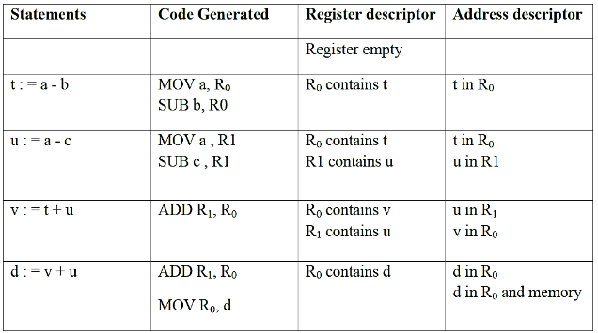
Generating Code For Assignment Statements
The assignment d : = (a-b) + (a-c) + (a-c) might be translated into the following three-address
code sequence:
t := a – b
u := a – c
v := t + u
d := v + u with d live at the end.

Slide 21
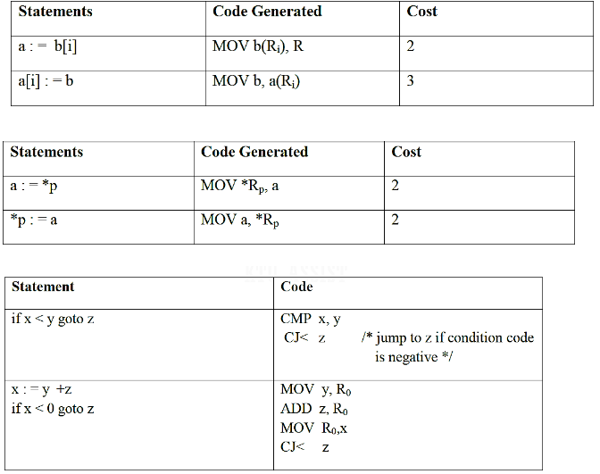
Generating Code for other type of statements

