Slide 1
CODE OPTIMIZATION

Slide 2
Introduction
The code generated by the compiler can be made faster or take less space or both.
Some transformations can be applied on this code called optimization or optimization transformations.
Compilers that can apply optimizing transformations are called optimizing compilers.
Code optimization is an optional phase and it must not change the meaning of the program.
2 points concerning the scope of optimization:
CO aims at improving a program, rather than improving the algorithm used in the program. Thus replacement of an algorithm by a more efficient algorithm is beyond the scope of CO.
Efficient code generation for a specific target machine (eg: by fully exploiting its instruction set) is also beyond the scope of CO.
Compiler was found to consume 40% extra compilation time due to optimization.
The optimized program occupied 25% less storage and executed 3 times faster than unoptimized program.

Slide 3
Need For Optimization Phase In Compiler
Code produced by a compiler may not be perfect in terms of execution speed and memory space.
Optimization by hand takes much more effort and time.
Machine level details like instructions and addresses are not known to the programmer.
Advanced architecture features like instruction pipeline requires optimized code.
Structure reusability and maintainability of the code are improved.

Slide 4
Criteria For Code Optimization
It should preserve the meaning of the program ie, it should not change the output or produce error for a given input. This approach is called safe approach.
Eventually it should improve the efficiency of the program by a reusable amount.
Sometimes it may increase the size of the code or may slow the program slightly but it should improve the efficiency.
It must be worth with the effort, ie, the effort put on optimization must be worthy when compared with the improvement.

Slide 5
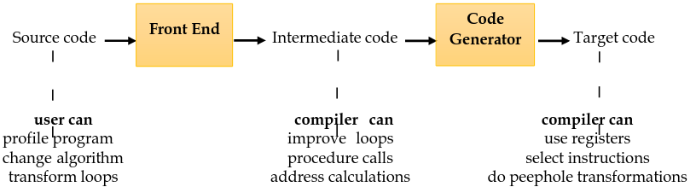
Optimization
Optimization can be applied in 3 places.
Source code
Intermediate code
Target code

Slide 6
Types of Optimization
There are two types of optimization
1. Machine dependent optimization – run only in particular machine.
2. Machine independent optimization – used for any machine.

Slide 7
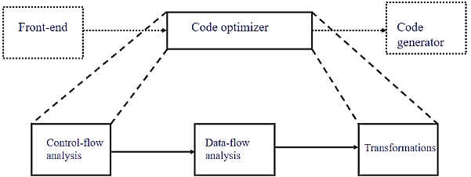
Organization Of Code Optimizer

Slide 8
Contt..
Optimization can be done in 2 phases:
1. Local optimization
Transformations are applied over a small segment of the program called basic block, in which statements are executed in sequential order.
Speed-up factor for local optimization is 1.4.
2. Global optimization
Transformations are applied over a large segment of the program like loop, procedures, functions etc. Local optimization must be done before applying global optimization.
Speed-up factor is 2.7

Slide 9
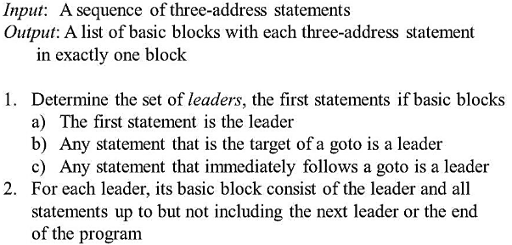
Basic Block
Basic block is a sequence of consecutive 3 address statements which may be entered only at the beginning and when entered statements are executed in sequence without halting or branching.
To identify basic block, we have to find leader statements.
Rules for leader statements are from a leader statement to all statements up to but, not including the next leader is a basic block.

Slide 10
Flow Graphs
Basic block is a sequence of consecutive 3 address statements which may be entered only at the beginning and when entered statements are executed in sequence without halting or branching.
To identify basic block, we have to find leader statements. Rules for leader statements are
It is the pictorial representation of control flow analysis in a program.
It shows the relationship among basic blocks.
Nodes are basic blocks and edges are control flow. It is a directed graph G = (N,E n0).
Where, N – set of basic blocks
E – set of control flows
n0 – starting node
If there is a directed edge from B1 to B2, the control transfers from the last statement of B1 to the first statement of B2.
B1 is called predecessor of B2 and B2 is successor of B1.

Slide 11
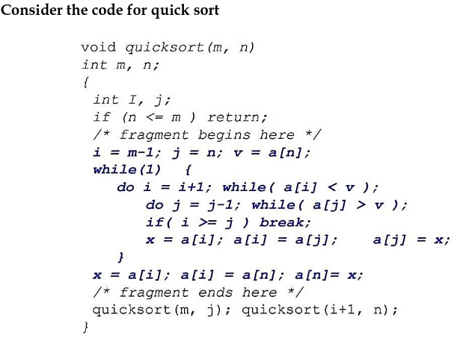
EXAMPLE

Slide 12
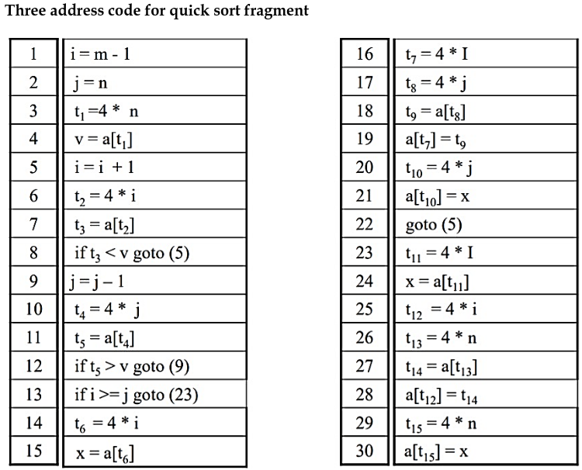
Contt.

Slide 13
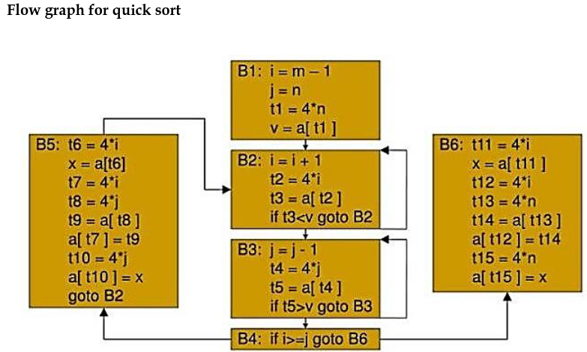

Slide 14
PRINCIPAL SOURCES OF OPTIMIZATION
A transformation of a program is called local if it can be performed by looking only at the statements in a basic block; otherwise, it is called global.
Many transformations can be performed at both the local and global levels. Local transformations are usually performed first.
1. Function preserving transformations
a. Common subexpression elimination
b. Copy propagation
c. Dead code elimination
d. Constant folding
2. Loop optimization
a. Code motion
b. Induction variable elimination
c. Reduction in strength

Slide 15
Function-Preserving Transformations
There are a number of ways in which a compiler can improve a program without changing the function it computes.

Slide 16
Common Sub Expression Elimination (CSE)
An occurrence of an expression E is called a common sub-expression if E was previously computed, and the values of variables in E have not changed since the previous computation.
We can avoid recomputing the expression if we can use the previously computed value.
Two types are: -
Local common sub expression elimination
Global common sub expression elimination

Slide 17
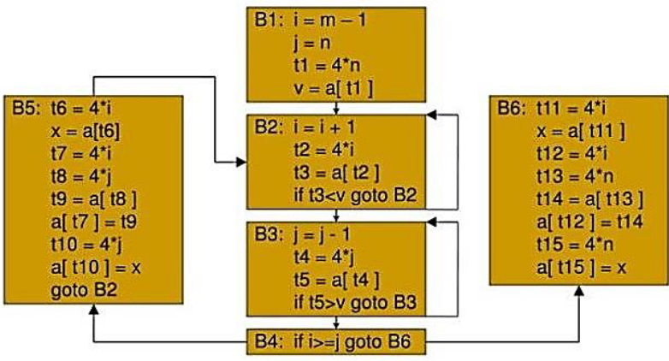
Consider the flow graph of quick sort fragment

Slide 18
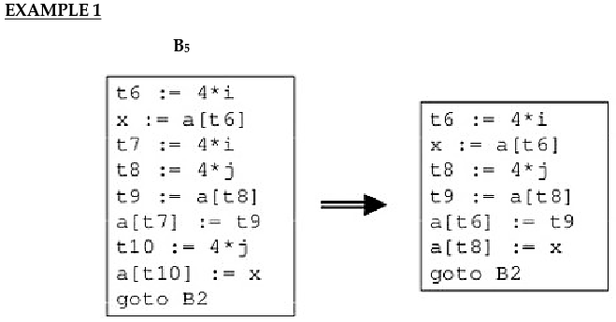
Local common sub expression elimination

Slide 19
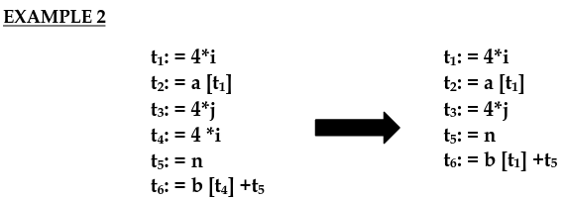
Contt.
The common sub expression t4: =4 * i is eliminated as its computation is already in t1 and the value of i is not been changed from definition to use.

Slide 20
Global common sub expression elimination
After local common subexpressions are eliminated, B5 stiil evaluates 4 * i and 4+ j, as shown in EXAMPLE of local common subexpression elimination.
t8 = 4 * j
t9 = a[t8]
a[t8] =x
in B5 can be replaced by
t9 = a[t4]
a[t4] = x using t4 computed in block B3
In Flow graph given above, observe that as control passes from the evaluation of 4 * j in B3 to B5, there is no change to j and no change to t4, so t4 can be used if 4 * j is needed.
Another common subexpression comes to light in B5 after t4 replaces t8.
The new expression a[t4] corresponds to the value of a[j] at the source level.
Not only does j retain its value as control leaves B3 and then enters B5, but a[j], a value computed into a temporary t5, does too, because there are no assignments to elements
of the array a in the interim.
The statements , t9 = a[t4] a[t6] = t9 in B5 therefore can be replace by a[t6] = t5 the same as the value assigned to t3 in block B2.
Block B5 is the result of eliminating common sub expressions corresponding to the values of the source level expressions a[i] and a[j] from.
A similar series of transformations has been done to B6 in Flow graph.
The expression a[tl] in blocks B1 and B6 is not considered a common sub expression, although tl can be used in both places.
After control leaves B1 and before it reaches B6, it can go through B5, where there are assignments to a.
Hence, a[t1] may not have the same value on reaching B6 as it did on leaving B1, and it is not safe to treat a[t1] as a common sub expression.

Slide 21
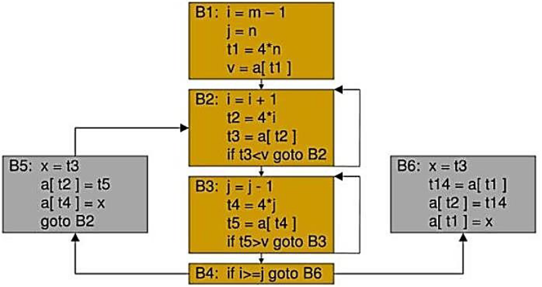
Contt.

Slide 22
Copy Propagation
Assignments of the form f : = g called copy statements, or copies for short.
The idea behind the copy-propagation transformation is to use g for f, whenever possible after the copy statement f: = g.
Copy propagation means use of one variable instead of another.
Copy statements introduced during common subexpression elimination.

Slide 23
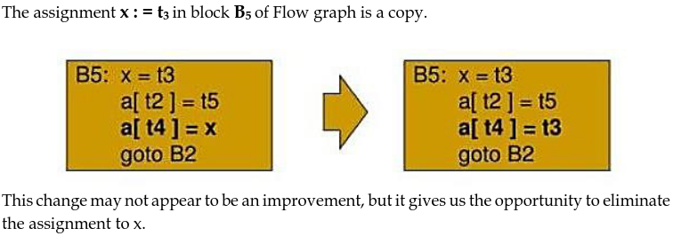
EXAMPLE 1

Slide 24
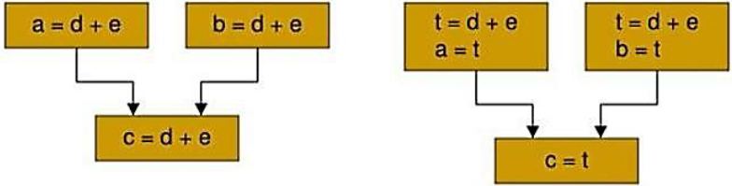
EXAMPLE 2
When the common subexpression in c := d+e is dominated in fig given below, the algorithm uses a new variable t to hold the value of d+e.
Since control may reach c := d+e either after the assignment to a or after the assignment to b, it would be incorrect to replace c := d+e by either c := a or by c := b.

Slide 25
ADVANTAGE
One advantage of copy propagation is that it often turns the copy statement into dead code.

Slide 26
Dead-Code Elimination
A variable is live at a point in a program if its value can be used subsequently; otherwise, it is dead at that point.
A related idea is dead or useless code, statements that compute values that never get used.
While the programmer is unlikely to introduce any dead code intentionally, it may appear as the result of previous transformations.

Slide 27
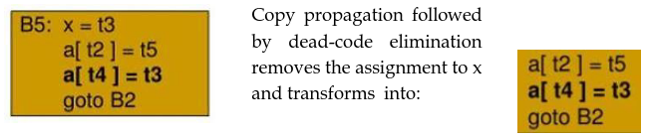
EXAMPLE 1

Slide 28
EXAMPLE 2
i=0;
if(i==1)
{
a=b+5;
}
Here, ‘if’ statement is dead code because this condition will never get satisfied.

Slide 29
Constant Folding
If all operands are constants in an expression, then it can be evaluated at compile time itself.
The result of the operation can replace the original evaluation in the program.
This will improve the run time performance and reducing code size by avoiding evaluation at compile- time.
EXAMPLE
a=3.14157/2 can be replaced by a=1.570 thereby eliminating a division operation.

Slide 30
Loop Optimization
The running time of a program may be improved if the number of instruction in an inner loop is decreased, even if we increase the amount of code outside the loop.
Mainly 3 techniques are there :-
Code Motion
Induction Variable
Reduction In Strength

Slide 31
Code Motion
An important modification that decreases the amount of code in a loop is code motion.
Execution time of a program can be reduced by moving code from a part of a program which is executed very frequently to another part of the program which is executed fewer times.
Ex: Loop optimization – loop invariant code motion
A fragment of code that resides in the loop and computes the same value of each iteration is called loop invariant code.

Slide 32
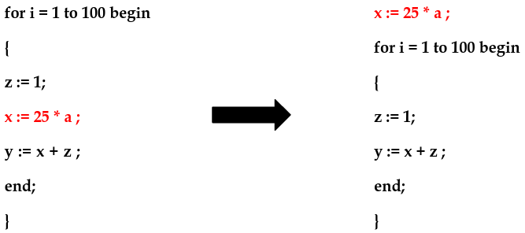
EXAMPLE 1
Here x := 25 * a ; is a loop variant. Hence in the optimised program it is computed only once before entering the for loop.
y := x + z ; is not loop invariant.
Hence it cannot be subjected to frequency reduction.

Slide 33
EXAMPLE 2
Evaluation of limit-2 is a loop-invariant computation in the following while-statement:
while (i <= limit - 2) /* statement does not change limit*/
Code motion will result in the equivalent of
t= limit - 2;
while (i<=t) /* statement does not change limit or t */

Slide 34
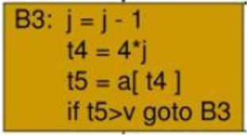
Induction Variables
Loops are usually processed inside out.
For example consider the loop around B3.
Note that the values of j and t4 remain in lock-step; every time the value of j decreases by 1, that of t4 decreases by 4 because 4*j is assigned to t4.
Such identifiers are called induction variables.

Slide 35
Reduction In Strength
When there are two or more induction variables in a loop, it may be possible to get rid of all but one, by the process of induction-variable elimination.
For the inner loop around B3 we cannot get rid of either j or t4 completely; t4 is used in B3 and j in B4.
However, we can illustrate reduction in strength and illustrate a part of the process of induction-variable elimination.
Eventually j will be eliminated when the outer loop of B2- B5 is considered.

Slide 36
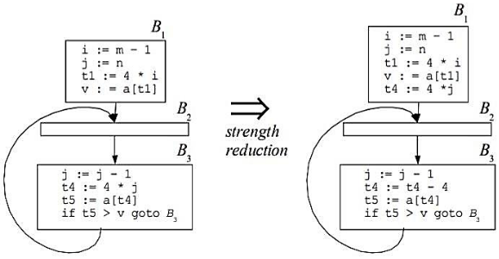
EXAMPLE

Slide 37
OPTIMIZATION OF BASIC BLOCKS
Many of the structure preserving transformations can be implemented by constructing a dag for a block.
There is a node n associated with each statement s within the block.
The children of n are those nodes corresponding to statement that are the last definitions prior to s of the operands used by s.

Slide 38
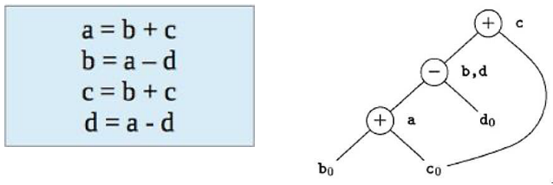
Directed Acyclic Graph
In compiler design, a DAG is an abstract syntax tree with a unique node for each value.
DAG is an useful data structure for implementing transformation on basic block.
DAG is constructed from three address code.
Common subexpression can be detected by noticing, as a new node m is about to added, whether there is an existing node n with the same children, in the same order, and with the same operator. If so, n computes the same value as m and may be used in its place.
When we construct the node for the third statement c = b + c, we know that the use of b in b + c refers to the node labeled -, because that is the most recent definition of b.

Slide 39
Application of DAG
Determine the common subexpression.
Determine which names are used in the block and compute outside the block.
Determine which statement of the block could have their computed value outside the block.
Simplify the list of quadruples by eliminating common subexpression and not performing the assignment of the form x = y and unless it is a must.

Slide 40
Rules For The Construction Of A DAG
In a DAG Leaf node represents identifiers, names, constants. Interior node represents operators.
While constructing DAG, there is a check made to find if there is an existing node with same children.
A new node is created only when such a node does not exist.
This action allows us to detect common subexpression and eliminate the same.
Assignment of the form x = y must not be performed until unless it is a must.

Slide 41
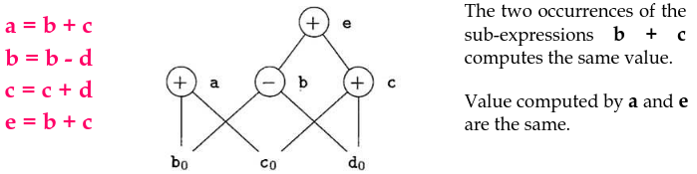
EXAMPLE 1

Slide 42
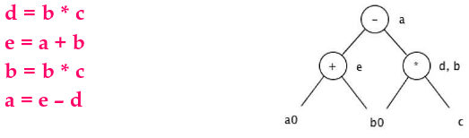
EXAMPLE 2

Slide 43
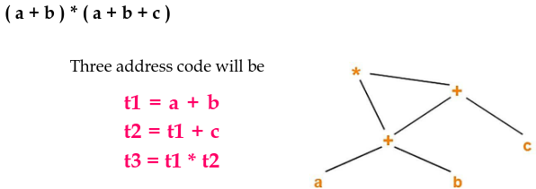
EXAMPLE 3

Slide 44
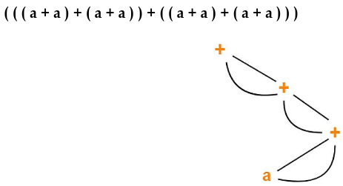
EXAMPLE 4

Slide 45
The Use of Algebraic Identities
It represents another important class of optimizations on basic blocks.
x + 0 = 0 + x = x
x – 0 = x
x * 1 = 1 * x = x
x / 1 = x
Another class of algebraic optimization includes reduction in strength.
x ** 2 = x * x
2 * x = x + x
x / 2 = x * 0.5
associative laws may also be applied to expose common subexpression.
a = b + c
e = c + d + b
With the intermediate code might be
a = b + c
t = c + d
e = t + b
If t is not needed outside this block, the sequence can be
a = b + c
e = a + d

