Slide 1
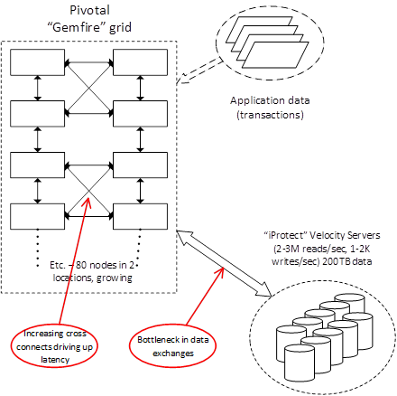
MasterCard Fraud Detection Solution
Grid system that does real time checking of all the transactions that transit the Mastercard networks
Grid system is a combination of home grown tools. It does search for anomalies in the flow of transactions
Handle 1 Billion Messages / Day for fraud detection and other purposes
Pivotal Gemfire Grid System
Performs real-time comparision of transactions from all input applications sources
Low latency interconnection
2 Locations , Each location configuration = 80 * Cisco UCS / 10GbE
iProtect Storage System
Generates 2-3 Million reads/sec
Only 1-2 K writes/sec
200 TB of Data
Challenges
Significant rack space to accommodate
Generates considerable latency because of FC SAN connection
Predict rapid growth storage volume
Open Queries from MasterCard team
Moving velocity servers in-memory instead of reaching out to disks for every referencing
What is HPE proposal for Grid systems and how to address growing no. of nodes
What is HPE suggestion on striking a balanced and scalable approach for Node / Memory / Storage
Storage array of Velocity servers require redundant data availability . Fast restart capability is must

Slide 2
Pivotal Gemfire
Based on Apache Geode – In-Memory Grid Processing Framework
Distributed Event Processing for Event Publisher Subscriber and continuous query
Memory Oriented – 10x too 100x faster than traditional relational database
Key elements of Gemfire/Apache Geode
(Optionally) HDFS Persistence
Off-heap storage – JVM Heap + Off Heap
Lucene Index
Spark Integration
Cloud Foundary services
Distributed transaction
Apache Derby
Heavily Java based application – Springboot
In-Memory Data Grid
Pool resources Memory , CPU , Network , Disks
Data Compression – snappy
JVM / Heap GC Tuning

Slide 3
HPE Open Questions/Thoughts
I would like to show MasterCard guys on how we differentiate with MDC for below workloads
Sparkle
Redis/Memcached Key/Value store
Off-Heap cache capability for JVM to take advantage of Off-Heap cache
Like Pivotal Gemfire ( based on Apache Geode ) , our proposition could be to have an alternate solution with Apache Ignite and Hadoop Ecosystem
I would like to also have data pipeline discussion with MasterCard architects
I still do not understand what is iProtect Velocity server comprised of . Is it hdfs ?

