Slide 1
Definition
A Servlet is a server side program written in Java that resides and executes in an JEE application server.
It extends the functionality of a web server by enabling the delivery of dynamic content by fetching the data from various data sources and working on them.
Servlets can respond to any type of request but they are commonly used to respond to HTTP/HTTPs request .
JEE application server that hosts the Servlets is called Servlet Container or Servlet Engine.
Servlet 3.0 specification is the one that will be discussed in the session. Underlying Java platform used will be Java SE 6.
Also we will be using Servlets to respond to HTTP requests.

Slide 2
Servlet Access Model
Web Server
Servlet Container
Client
HTTP request
Invokes Servlet
Other
Services
Servlet
Gives response
Client readable response
Servlet
Servlet

Slide 3
Servlet API
Java Servlet API 3.0 is an API of the Java Platform, Enterprise Edition (JEE)
Java Servlet Development Kit (JSDK) contains the class library that is required to create servlets and JSP.
The 2 packages that are required to create servlets are javax.servlet and javax.servlet.http.
The core of Servlet is javax.servlet.Servlet interface. A java class is a servlet if it directly or indirectly implements the javax.servlet.Servlet interface.
Servlet interface has life cycle methods.
Life cycle tells when the servlet be created and what happens during the life of the servlet and when does it get destroyed.

Slide 4
Servlet interface
Life cycle methods
public void init(ServletConfig config) throws ServletException
public void service(ServletRequest req, ServletResponse res) throws ServletException, java.io.IOException
public void destroy()
public ServletConfig getServletConfig()
public String getServletInfo()

Slide 5
What is a Servlet Container
It is a java application that controls the life cycle of a servlet,since servlet does not have a main method().
Eg: Tomcat,Jboss etc.

Slide 6
What does the container give you
Lifecycle management
Communications support
Mutilthreading support
Declarative Security
Jsp Support

Slide 7
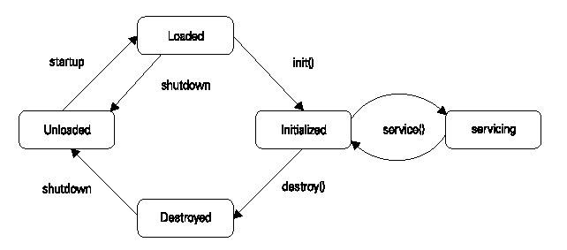

Slide 8
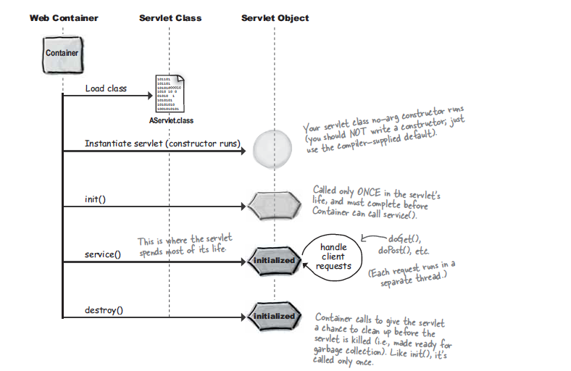
Life cycle of a servlet

Slide 9
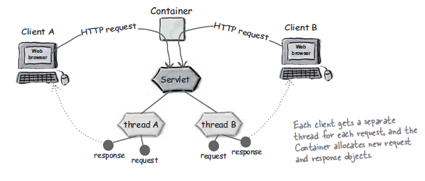
Each Request runs in it’s own thread

Slide 10
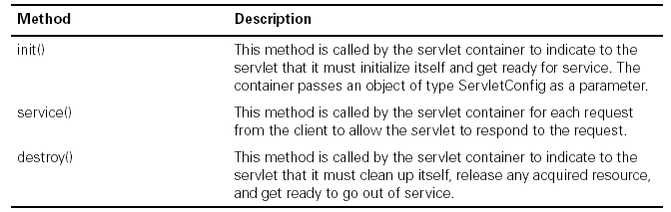

Slide 11
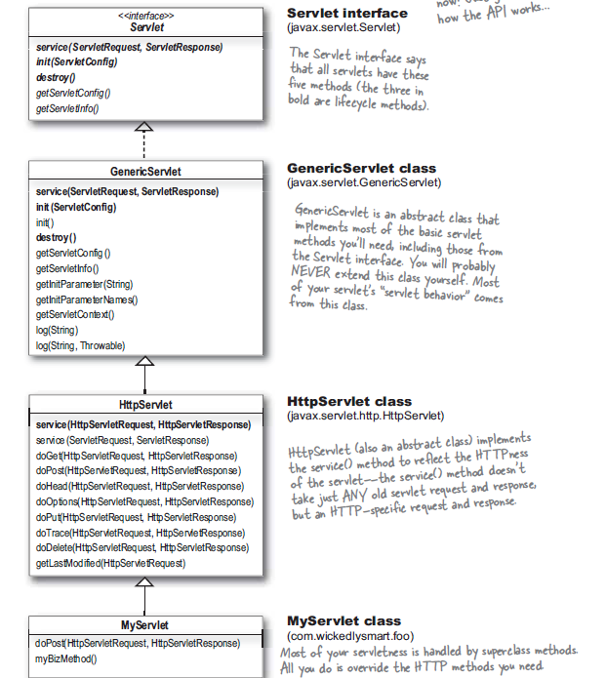

Slide 12
Servlet instance
In an undistributed environment, only one instance of a servlet class is created. The same instance is used for all the requests.
When the container shuts down, this instance is destroyed.
The container runs multiple threads on the service() method to process multiple requests.
Only a single instance of servlet of each type ensures minimum number of servlet objects created and destroyed on the server which in turn adds to scalability.
However, if the Servlet implements SingleThreadModel interface, the servlet container may instantiate multiple instances. This is usually done to handle a heavy request loads. It is recommended that this is very sparingly and not used for the sake of thread-safety.
In distributed environment, one servlet instance per JVM is created.

Slide 13
init(ServletConfig config)
public void init(ServletConfig config) throws ServletException
This method is called exactly once after instantiating the servlet.
The init method must complete successfully before the servlet can receive any requests.
If init() method throws a ServletException or UnavailableException, or if it does not return after certain time period defined by the application server, then the service() and destroy()is not called.
ServletConfig object has initialization and startup parameters for the servlet. → Will look into this a bit later

Slide 14
service()
public void service(ServletRequest req, ServletResponse res) throws ServletException, java.io.IOException
This method is called after the init() method returns successfully.
Since the service() method will be called by multiple threads, it is very important to synchronize access to any shared resources such as files, network connections, and also instance variables of the Servlet.
It is strongly recommended not to synchronize the service() (or methods dispatched to it like doGet(), doPost → coming up) as it may effect on performance.
This method may throw ServletException in case of some errors or UnavailableException in case servlet is unable to handle requests either temporarily or permanently.

Slide 15
destroy()
public void destroy()
This method is called once all threads within the servlet's service() method have exited or after a timeout period for the servlet is over.
After this method is called, service() method will not be called again on this servlet.
Usually clean up code like releasing resources etc is done put here.

Slide 16
getServletConfig(),getServletInfo()
public ServletConfig getServletConfig()
Returns ServletConfig object which is passed to init() method.
We will see how to use this object in the next session
public String getServletInfo()
Can be used to return about the servlet, such as author, version, and copyright.
Usually the response string from the servlet is in the form of HTML.
But here, the response should not be in form of HTML or XML. It must be plain text.

Slide 17
Tell me why
Why the service() method should throw IOException?
A servlet returns the response by using a Writer object which it creates using response object.
We are well aware that most of the methods of Writer object throw IOException.

Slide 18
Servlet Class hierarchy
javax.servlet.Servlet
javax.servlet.GenericServlet
javax.servlet.http.HttpServlet

Slide 19
GenericServlet
GenericServlet class provides basic implementation of the Servlet interface except service() method. This is an abstract class.
It also implements ServletConfig interface.
Other methods included are:
public void log(String message)
public void log(String message, Throwable t)
public void init() throws ServletException
Log methods are used to write specified message to a servlet log file.
The implementation of init(ServletConfig config)calls init()method.
For most purposes, we will need to extend HttpServlet.

Slide 20
HTTPServlet
This is also an abstract class which inherits from the GenericServlet and provides a HTTP specific implementation of the Servlet interface.
The service(ServletRequest req, ServletResponse res) method is implemented and handles standard HTTP requests by dispatching them to the handler methods for each HTTP request type .
This class adds another service method that takes HTTP requests and response.
Handler methods specific to each of the HTTP methods like GET, POST etc is also added in the form of doGet(), doPost() etc
This is the class that we subclass and override one or more of the doXXX().

Slide 21
Methods added in HTTPServlet
protected void service(HttpServletRequest req, HttpServletResponse res) throws ServletException, java.io.IOException
This
protected void doXXX(HttpServletRequest req, HttpServletResponse res)
XXX is GET, POST, TRACE, PUT, DELETE, HEAD, OPTIONS
protected long getLastModified(HttpServletRequest req)
It is recommended that service(), doOptions() and doTrace() methods are not overridden.

Slide 22
A Simple Servlet
/* This example overrides doGet() method. It dynamically generates an HTML page that says Hello and prints current date-time of the server.*/
import javax.servlet.http.*;
import javax.servlet.*;
import java.io.*;
public class GreetingServlet extends HttpServlet {
public void doGet(HttpServletRequest request, HttpServletResponse response) throws ServletException, IOException {
java.util.Date currDate=new java.util.Date();
java.io.PrintWriter out = response.getWriter();
response.setContentType("text/html");
out.println("<html><head><title>Greetings Servlet </title></head>");
out.println("<body>Hello "+currDate+"</body></html>");
}

Slide 23
Deploy a web application Eclipse Java EE IDE
Create web application.
Create servlets and override doGet()
Map Servlet through annotations or deployment descriptor (DD) web.xml.
Deploy and test the application

Slide 24
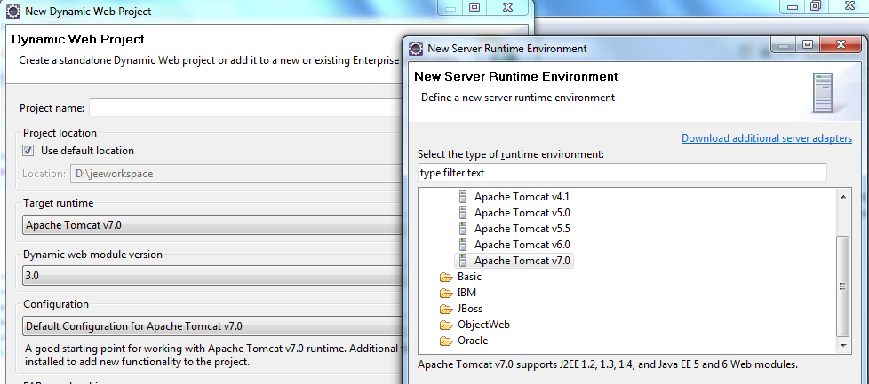
1. Create web application
Open Eclipse JEE IDE and enter a workspace location.
Select File→ New →Dynamic Web Project
Enter the name of the project say “Test”.
Select Target runtime as Apache Tomcat v.7.0. Select the Tomcat 7.0 installation directory.
Leave the rest of the default entries as it is. Close the Welcome screen.

Slide 25
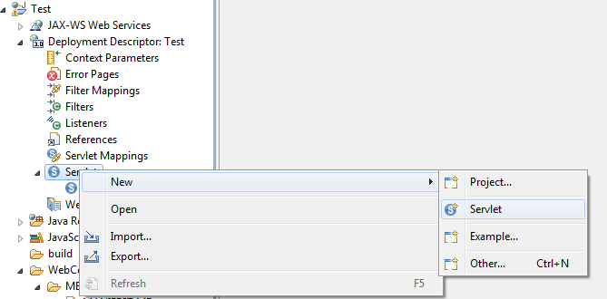
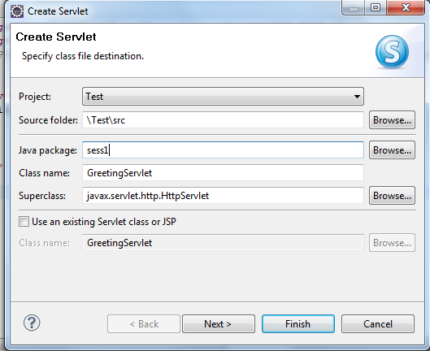
2. Create Servlet and override doGet()
Right click on the project or Deployment Descriptor, and Select Servlet.
Enter a package name say “sess1” and servlet name say “GreetingServlet”
Enter the code in the doGet() method and make it public.

Slide 26
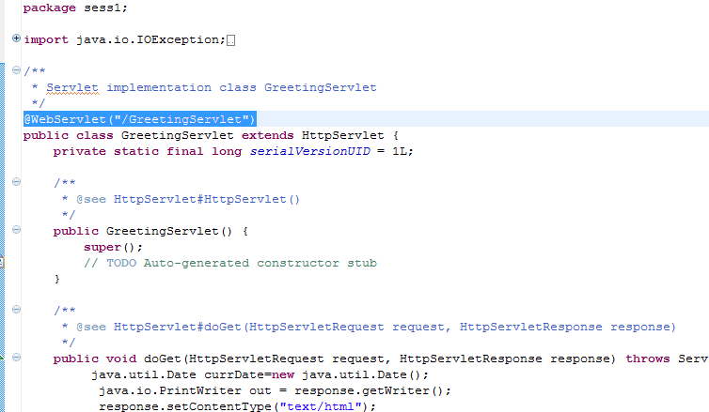
3. Map Servlet using annotation
By default the code creates an annotation for mapping the servlet class to the URL that is going to used to access this component.
The annotation used for this purpose is @WebServlet.

Slide 27
3. Map Servlet using web.xml
Older web application used web.xml file for configuration.
To use this, while creating project after entering the name for the project, click next and next again to get to the "web module" window. Click the checkbox "generate web.xml deployment descriptor" .
web.xml is deployment descriptor is an xml file that helps in managing the configuration of an application. This is the file using which an application can communicate with the container and vice versa.
<web-app>
<servlet>
<servlet-name>Greet</servlet-name>
<servlet-class>sess1.GreetingServlet</servlet-class>
</servlet>
<servlet-mapping>
<servlet-name>Greet</servlet-name>
<url-pattern>/GreetingServlet</url-pattern>
</servlet-mapping>
</web-app>

Slide 28
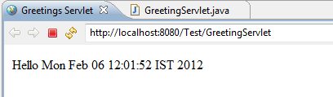
4. Deploy and test the application
Clicking on the run icon opens up a dialog for deploying the application on the selected server.
Since we have only one server configured, we select that server.
Click next and finish.
Tomcat 7.0 server starts.
The default browser window of the eclipse also opens.
The URL of the servlet is http://servername:8080/application_name/ servlet_url.
Note that we are able to access this servlet by specifying URL in the address because we have overridden doGet(). I

Slide 29
Activity: understanding GET and POST
Move the code in doGet() to doPost().
Remove the doGet() method.
Run the application and note the results.
Notes:
HTTP Status 405 - HTTP method GET is not supported by this URL

Slide 30
Packaging of web application
Packaging application means placing the files in the appropriate placeholders (directory).
Servlet specification lays out the rules of how enterprise applications should be packaged.
This is necessary so that the container (any j2ee container) knows where to find the files (the servlet class files, html class files etc.)
Since a web application is composed of many files, the specification also tells us how to archive the files and deploy it as single file application.

Slide 31
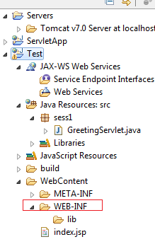
Hierarchy
The root of this hierarchy (document root, project name) is used as context path for web application by default.
The application hierarchy has a folder named “WEB-INF”. This directory contains all things related to the application.
This path is not directly accessible through browser. it is not part of the public document tree of the application.
The web application is deployed as a WAR file (Web Application ARchive File) with extension as .war.

Slide 32
Contents of WEB-INF
The /WEB-INF/web.xml deployment descriptor.
The /WEB-INF/classes/ directory for servlet and utility classes. The classes in this directory must be available to the application class loader.
The /WEB-INF/lib/*.jar area for Java ARchive files. These files contain servlets, beans, and other utility classes useful to the Web application. The Web application class loader must be able to load classes from any of these archive files.
Example of a typical web application:
/index.html
/register.jsp
/images/logo.gif
/WEB-INF/web.xml
/WEB-INF/lib/classes12.jar
/WEB-INF/classes/sess1/RegisterServlet.class
Here the Servlet class is sess1.RegisterServlet

Slide 33
Request and Response hierarchy
ServletRequest
ServletResponse
HttpServletRequest
HttpServletResponse
ServletRequest and ServletResponse are interfaces. These are passed to the service method of GenericServlet
HttpServletRequest and HttpServletResponse interface objects are passed to all the service() and doXXX() methods defined by HttpServlet

Slide 34
Some methods of ServletRequest
Enumeration getParameterNames(): Returns an Enumeration of String objects containing the names of the request parameters contained or an empty Enumeration.
String getParameter(String name)
String[] getParameterValues(String name)
Both the methods are used to get the form parameter values of HTTP or HTTPS request
We will see using an example how to work with these.

Slide 35
Some methods of HttpServletRequest
String getMethod(): Returns the name of the HTTP method with which this request was made, for example, GET, POST, or PUT
String getHeader(String name)
Enumeration getHeaderNames()
Returns all the values and names of the specified request header as an Enumeration of String objects. The header name is case insensitive.
String getQueryString(): Returns the query string that is contained in the request URL after the path
String getContextPath() , String getServletPath() and String getPathInfo()
http://localhost:8080/Test/GreetingServlet → getContextPath() returns /Test and getServletPath returns /GreetingServlet
getPathInfo() gets the rest of the path information after the servlet path in case there are any.

Slide 36
Some methods of ServletResponse
void setContentType(String type): Sets the content type (MIME type) of the response being sent to the client.
void setContentLength(int len):Sets the length of the content body in the response In HTTP servlets, this method sets the HTTP Content-Length header.
ServletOutputStream getOutputStream()
PrintWriter getWriter()
These method is used to write be called to write to the response body. Both of these methods cannot be used simultaneously. IllegalStateException will be thrown if used simultaneously.

Slide 37
Some methods of HttpServletResponse
Status code based on HTTP response is available as static constants in this class. Some of the common status code s are
SC_ACCEPTED (202), SC_BAD_REQUEST(400), SC_NOT_FOUND(404), SC_INTERNAL_SERVER_ERROR (500), SC_METHOD_NOT_ALLOWED(405), SC_REQUEST_TIMEOUT (408), SC_NOT_IMPLEMENTED (501), SC_SERVICE_UNAVAILABLE(503)
String addHeader(String name,String value)
void addIntHeader(java.lang.String name, int value)
void addDateHeader(java.lang.String name, long date)
The above methods add a response header with the given name and value
void setStatus(int sc) : Sets the status code for response

Slide 38
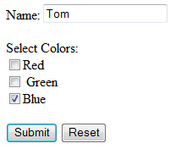
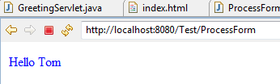
Example : to get form data in the servlet
In this example, we will create
A HTML form that has a text field and checkbox field
A servlet that fetches the data from the form and displays it.

Slide 39
index.html
Create a HTML page by right clicking on the project. Name the page as index.html and enter the form inside the <body> as
<form method="POST" action="ProcessForm">
Name: <input type="text" name="uname">
<p>Select Colors:<br>
<input type="checkbox" name="color" value=“Red">
Red <br>
<input type="checkbox" name="color" value="Green"> Green<br>
<input type="checkbox" name="color" value="Blue">
Blue</p>
<p><input type="submit" value="Submit" name="B1">
<input type="reset" value="Reset" name="B2"></p>
</form>
Note how the checkboxes are grouped as one set by using the same name. Radio buttons can also be grouped similarly.

Slide 40
Servlet that gets the form data
HttpServetRequest’s getParameter() method gets single value . This is used to get the uname textbox value of the HTML form.
HttpServetRequest’s getParameterValuess() method gets multiple values in the form of array of String . Since multiple checkboxes can be selected, multiple values are passed. This is can be obtained using getParameterValuess() method.

Slide 41
Servlet to get multiple param
// imports here
@WebServlet("/ProcessForm")
public class ProcessForm extends HttpServlet {
protected void doPost(HttpServletRequest request, HttpServletResponse response) throws ServletException, IOException {
java.io.PrintWriter out=response.getWriter();
out.println("<html>");
String name=request.getParameter("uname");
String colors[]=request.getParameterValues("color");
for(int i=0;i<colors.length;i++)
out.println("<font color='"+ colors[i]+"'>Hello "+name+"</font><br>" );
out.println("</body></html>");
}

Slide 42
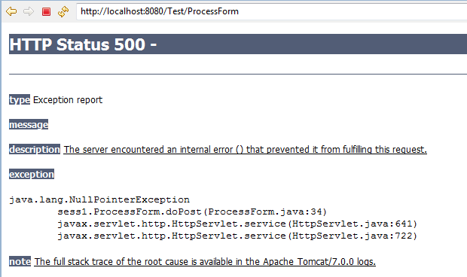
Tell me what
What happens if you don’t select any of the checkboxes?
If a request parameter does not exists null is returned.
If checkboxes are not selected, the response packet will not have request parameter “color”.
Therefore a NullPointerException is thrown.
When a servlet throws a runtime exception, we end up getting an error page with HTTP Status 500.

Slide 43
Test your understanding
What will happen if you type http://localhost:8080/Test/ProcessForm in the address bar?

Slide 44
SingleThreadModel Interface
In the servlet model that we have seen so far, a single servlet processes multiple requests simultaneously.
This means that the doGet and doPost methods must be careful to synchronize access to fields and other shared data, since multiple threads may be trying to access the data simultaneously.
On the other hand, you can have your servlet implement the SingleThreadModel interface, as below.
public class YourServlet extends HttpServlet implements SingleThreadModel {...}
This usage is highly discouraged because it makes the application less scalable.

Slide 45
Test your understanding
//assume imports
public class Getdate extends HttpServlet{
java.util.Date currDate=new java.util.Date();
public void doGet(HttpServletRequest request, HttpServletResponse response) throws ServletException, IOException {
java.util.Date now=new java.util.Date();
java.io.PrintWriter out = response.getWriter();
response.setContentType("text/html");
out.println("<html><head><title>Greetings Servlet </title></head>");
out.println("<body>"+ currDate.compareTo(now) +"</body></html>");
}
}}
Will the code always print 0?

Slide 46
Tell me what
We must be careful about the variable declaration in the servlet because they are not thread-safe. But we do have a init() method that is used for servlet initialization, which means there do have cases where these members are declared. What kind of variables are declared in servlet?
Servlet should not have member variables whose value will change or depend upon user requests.
Servlet member variables can be used to assign things which are fixed like application configuration, resource configuration information etc.

