Slide 1
Problems with hard-coding values of variable
The servlet member variables are usually fixed values. These do not change with respect to end user.
While this is true, should we hard code information like database URL, user name and password?
While developing the application we have one set of values for these, while in testing we have we will have another set of values, while in UAT we have yet another and finally we have actual values when we deploy.
So at the minimum we need go to the specific location and to compile the code at least 4 times.
Also things become complicated here because we are expecting all the people involved to be servlets savvy!.

Slide 2
Initialization
After the servlet object is instantiated it is initialized. Container calls the init(ServletConfig c) method to do this.
Initialization is provided so that a servlet can read persistent configuration data, initialize costly resources and perform other one-time activities.
This configuration object allows the servlet to access name-value initialization parameters from the Web application’s configuration information.
It also allows access to ServletContext object that is used to that describes the servlet’s runtime environment.

Slide 3
Scope of initial values in a web application
The Initialization values can be either
Servlet specific: values that is accessible only to the servlet
For this ServetConfig interface is used
Application specific: values that is accessible all the servlet
For this ServetContext interface is used

Slide 4
Servlet specific values
The values can be given either using Annotation or in web.xml.
Annotation @WebInitParam can be used in Servlet class to provide the name and values for parameters.
In web.xml:
<servlet>
<servlet-name>servlet-name</servlet-name>
<init-param>
<param-name>param-name</param-name>
<param-value>param-value</param-value>
</init-param>
…
</servlet>

Slide 5
init()
Servlet instance variables are initialized in init().
The ServetConfig object is a configuration object used by a servlet container to pass information to a servlet during initialization. Most of the time this information will be required to initialize variables.
There are two places where initialization can be done:
Override init(ServletConfig config)
Override init()and get config object using getServletConfig() method(of Servlet interface)

Slide 6
ServletConfig
This object is used to fetch the initialization parameters for individual servlets.
This object is passed on by the application server to the servlet during initialization when init(ServletConfig) method is called.
Getting ServletConfig object:
ServletConfig getServletConfig() method in Servlet interface
Methods to get init parameters in ServletConfig
String getInitParameter(String name)
Enumeration getInitParameterNames()
Since GenericServlet class implements also ServletConfig interface it provides the same method as the above.

Slide 7
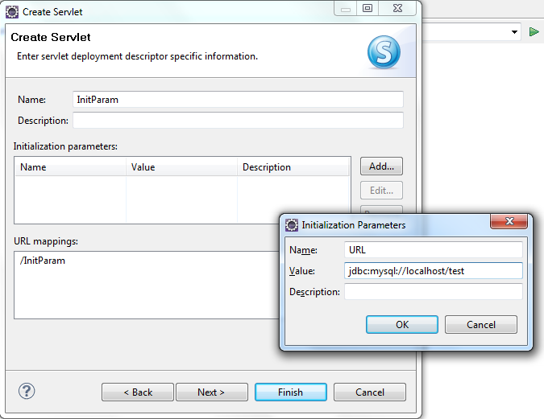
Example: Using annotation
While creating Servlet, after entering Servlet name, package name move to next tab.
Click on Add button in the Initialization parameter sections and add a name value pair.
Move to the next tab and select init() and doGet() method .

Slide 8
Servlet code generated
The servlet code generated has
@WebServlet(
urlPatterns = { "/InitParam" },
initParams = {
@WebInitParam(name = "url", value = "jdbc:mysql://localhost/test")
})
To get code added in init() method:
url=config.getInitParameter("url");

Slide 9
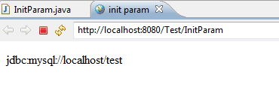
Code doGet() method to get the URL value:
protected void doGet(HttpServletRequest request, HttpServletResponse response) throws ServletException, IOException {
response.setContentType("text/html");
java.io.PrintWriter out = response.getWriter();
out.println("<html><head><title>init param </title></head>");
out.println("<body>"+ url+"</body></html>");
}

Slide 10
Application specific parameters
It is more likely that some of configuration values are more application specific than servlet specific.
For instance database related configuration information usually should be made available to all the components of the web application.
The ServletContext interface defines a servlet’s view of the Web application within which the servlet is running.
A ServletContext is rooted at a known path within a Web server.
These name-value pairs can be given only in web.xml.

Slide 11
ServletContext
This object is global to all servlets and jsps in an application context.
It is used to set and get variables that are global application variables.
It is also used by the servlet to get info about the servlet engine this servlet is running and info about other servlets.
Getting ServletContext
ServletContext getServletContext() method of HttpServlet
Methods of ServletContext
String getInitParameter(String name)
Enumeration getInitParameterNames()

Slide 12
Context parameters in web.xml
<web-app>
…
<context-param>
<param-name>param-name
</param-name>
<param-value>param-value </param-value>
</context-param>
</web-app>
In any servlet in of the current application:
ServletContext ctx=getServletContext();
String value=ctx.getInitParameter(“param-name”);

Slide 13
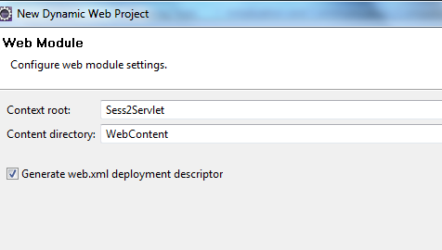
A web module with web.xml in eclipse
Create a new dynamic web project.
After specifying application name etc in the first tab, move on and click next.
Select the checkbox “Generate web.xml deployment descriptor” and then click finish.

Slide 14
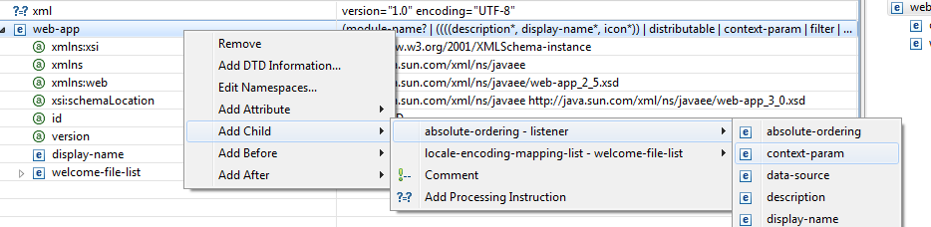
Adding context parameter in eclipse
Double click on Deployment Decsriptor.
It will open up a page similar to the above picture.
Right click on the web-app and select context-param as shown.
Change the param name and value to “url” and value to “jdbc:mysql://localhost/test” as shown in the next slide

Slide 15
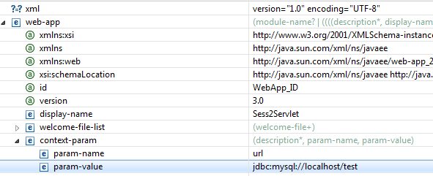

Slide 16
Code in Servlet to get context parameter
String url;
public void init(ServletConfig config) throws ServletException {
url=getServletContext().getInitParameter("url");
}
protected void doGet(HttpServletRequest request, HttpServletResponse response) throws ServletException, IOException {
response.setContentType("text/html");
java.io.PrintWriter out = response.getWriter();
out.println("<html><head><title>init param </title></head>");
out.println("<body>"+ url+"</body></html>");
}

Slide 17
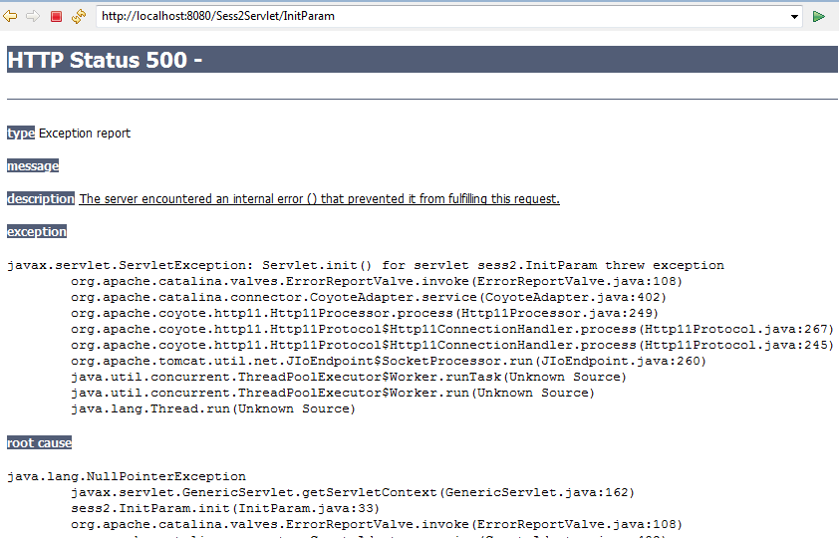
On Execution

Slide 18
Tell me why
Why does the previous code throw NullPointerException ?
Take a look at the init() method.
public void init(ServletConfig config) throws ServletException {
url=getServletContext().getInitParameter("url");
}
The super class init() method that takes ServletConfig object initializes ServletContext object.
Since we are not calling super class init(), getServletContext() returns null and hence an exception is thrown.
How will you correct this problem?

Slide 19
Ways to get Context parameters in init()
public void init(ServletConfig config) throws ServletException {
super.init(config);
url=getServletContext().getInitParameter("url");
}
public void init() throws ServletException {
url=getServletContext().getInitParameter("url");
}
Life cycle method which is called first is init(ServletConfig config). This method in turn calls init() method. Hence ServletContext object is available in init().

Slide 20
Welcome File List
Welcome file list XML tag of the web.xml file is used to specify the default page of a web application if none is specified .This tag can have any number of "<welcome-file>" tags.
<welcome-file-list>
<welcome-file>index.jsp</welcome-file>
</welcome-file-list>
User can execute the web project directly not the first page

Slide 21
<servlet>
<servlet-name>TestServlet</servlet-name>
<servlet-class>TestServlet</servlet-class>
<load-on-startup>1</load-on-startup>
</servlet>
The above example tells the container that the servlet will be loaded at first.The <load-on-startup> sub-element indicates the order in which each servlet should be loaded. Lower positive values are loaded first. If the value is negative or unspecified, then the container can load the servlet at anytime during startup.

