Slide 1
Listeners

Slide 2
Listeners
Servlet event listeners are java files that are invoked by the web container on occurrence of some event.
The listener methods are called in response to the relevant events.
Listeners are closely associated with lifecycle of the ServletContext and HttpSession and ServletRequest , in the event of state changes.
There may be multiple listener classes listening to each event type, and the order in which the container invokes the listener beans for each event type can also be specified.

Slide 3
Listeners in a web application
The listener classes are packaged into the WAR, either under the WEB-INF/classes archive entry, or inside a JAR in the WEB-INF/lib directory.
The listeners are registered through @WebListener annotation or in the web.xml file with the following entry
<listener>
<listener-class>ListnerClassName</listener-class>
</listener>

Slide 4
Types of Listeners
3 types of Listener
Request Listener
Context Listener
Session Listener

Slide 5
Request Listeners
Listener Interface | Function
ServletRequestListener | Responds to the life and death of each request
ServletRequestAttributeListener | Responds to any change to the set of attributes attached to a request object.
AsyncListener | A timeout, connection termination or completion of async processing
The first 2 listeners are the ones we are going to concentrate which are associated with synchronous processing. Servlet 3.0 introduces asynchronous processing as well. A note about this is given at the end of the slide.

Slide 6
ServletRequestListener
A class implementing ServletRequestListener interface has two methods to implement;
public void requestInitialized(ServletRequestEvent event)
-called at the beginning of any request’s scope.
public void requestDestroyed(ServletRequestEvent event)
-called for each request that comes to an end.

Slide 7
ServletRequestAttributeListener
A class implementing ServletRequestAttributeListener interface has three methods to implement.
public void attributeAdded(ServletRequestAttributeEvent event)
- called when ever a new attribute is added to any request.
public void attributeRemoved(ServletRequestAttributeEvent event)
- called whenever an attribute is removed from the request.
public void attributeReplaced(ServletRequestAttributeEvent event)
- called whenever a request attribute is replaced (calling setAttribute() for an attribute name already in use by the request).

Slide 8
ServletRequestEvent, ServletRequestAttributeEvent
EventObject
Object getSource()
java.util
ServletRequestEvent
ServletContext getServletContext()
ServletRequest getServletRequest()
javax.servlet
ServletRequestAttributeEvent
String getName()
Object getValue()

Slide 9
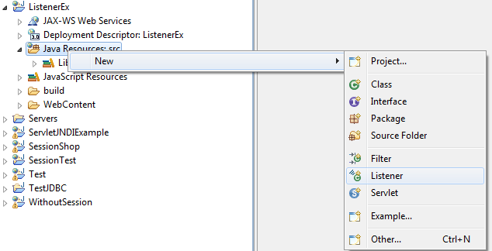
Creating Listener in Eclipse WTP
Steps needed to create a listener in eclipse WTP
Right click on the Java Resource src and select Listener.

Slide 10
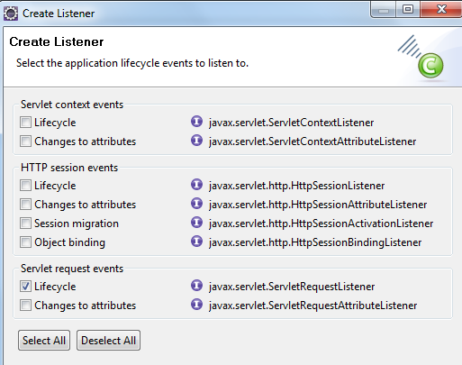
Enter the class name, package name and select Next
Select the :Listener class from the list

Slide 11
Example: Request Listeners
Calculating the time a user spent in a site.
Let us say we have 2 servlets in a web application where servlet one has link to servlet two. (Given below)
@WebServlet("/HomePage")
public class HomePage extends HttpServlet {
protected void doGet(HttpServletRequest request, HttpServletResponse response) throws ServletException, IOException {
java.io.PrintWriter out = response.getWriter();
out.println("<html><body>Hello Home <a href='Page1'>Page1</a></body></html>");}}
@WebServlet("/Page1")
public class Page1 extends HttpServlet {
protected void doGet(HttpServletRequest request, HttpServletResponse response) throws ServletException, IOException {
java.io.PrintWriter out = response.getWriter();
out.println("<html><body>Hello Page 1</body></html>");
}}

Slide 12
package lis;
import javax.servlet.ServletRequestEvent;
import javax.servlet.ServletRequestListener;
import javax.servlet.annotation.WebListener;
java.util.Calendar date,date1;
public PageTime() { }
public void requestDestroyed(ServletRequestEvent arg0) {
date1=java.util.Calendar.getInstance();
float diff= date1.getTimeInMillis() -
date.getTimeInMillis();
System.out.println("Time in millisecs "+diff);
}
public void requestInitialized(ServletRequestEvent arg0) {
if(date==null)
date= java.util.Calendar.getInstance();
}}
Set the time everytime a new request is completed
Each time the request cycle is over display the time in millisec. The last displayed time indicates the time that a user has spent in the web site
Set the time when the first request comes in

Slide 13


Console:
Time in millisecs 0.0
Console:
Time in millisecs 0.0
Time in millisecs 7585.0
After sometime request for HomePage again
Console:
Time in millisecs 0.0
Time in millisecs 7585.0
Time in millisecs 226869.0

Slide 14
Context Listeners
Listener Interface | Function
ServletContextListener | Responds to the life and death of the context for a web application
ServletContextAttributeListener | Responds to any change to the set of attributes attached to the context object.

Slide 15
ServletContextListener
A class implementing ServletContextListener interface has two methods to implement;
public void contextInitialized(ServletContextEvent event)
-called at the beginning of web application.
public void contextDestroyed(ServletContextEvent event)
-called when the web application is taken out of service.

Slide 16
ServletContextAttributeListener
A class implementing ServletContextAttributeListener interface has three methods to implement.
public void attributeAdded(ServletContextAttributeEvent event)
- called when ever a new attribute is added to the servlet context.
public void attributeRemoved(ServletContextAttributeEvent event)
-called whenever an attribute is removed from the servlet context.
public void attributeReplaced(ServletContextAttributeEvent event) -called whenever a context attribute is replaced (calling setAttribute() for an attribute name already in use by the servlet context).

Slide 17
ServletContextEvent and ServletContextAttributeEvent
EventObject
Object getSource()
java.util
ServletContextEvent
ServletContext getServletContext()
javax.servlet
ServletContextAttributeEvent
String getName()
Object getValue()

Slide 18
Example: ServletContextListener
One time application wide initialization can be done using contextInitialized() method.
Database configuration parameters can be are stored as separate strings in web.xml as context parameter.
Instead of every Servlet fetching these parameters adding to more lines of code, these can be commonly fetched moment the application is loaded in contextInitialized() method of ServletContextListener.
An object that carries these configuration parameters can then added to the ServletContext object.

Slide 19
In web.xml
<context-param>
<param-name>username</param-name>
<param-value>root</param-value>
</context-param>
<context-param>
<param-name>password</param-name>
<param-value>root</param-value>
</context-param>
<context-param>
<param-name>url</param-name>
<param-value>jdbc:mysql://localhost/test</param-value>
</context-param>

Slide 20
Class created to array configuration information
package lis;
public class ConnectionData {
String url;
String uname;
String pass;
public ConnectionData(String s1, String s2, String s3){
this.url=s1;
this.uname=s2;
this.pass=s3;
}
}

Slide 21
Context Listener class that initializes the ConnectionData object
package lis;
import javax.servlet.ServletContext;
import javax.servlet.ServletContextEvent;
import javax.servlet.ServletContextListener;
import javax.servlet.annotation.WebListener;
@WebListener
public class LoadContext implements ServletContextListener {
public LoadContext() {}
public void contextInitialized(ServletContextEvent arg0) {
ServletContext ctx=arg0.getServletContext();
ConnectionData conn= new ConnectionData(ctx.getInitParameter("username"),
ctx.getInitParameter("password"), ctx.getInitParameter("url") );
ctx.setAttribute("Con",conn );
System.out.print("Context Initialized");
}
public void contextDestroyed(ServletContextEvent arg0) {
System.out.print("Context destroyed");
}}

Slide 22
Any servlet code can now get the connection parameters from context attributes
ConnectionData con= (ConnectionData)getServletContext().getAttribute("Con");
Class.forName("com.mysql.jdbc.Driver");
Connection conn = DriverManager.getConnection(con.url,con.uname, con.pass);

Slide 23
Session Listeners
Listener Interface | Function
HttpSessionListener | Responds to the life and death of the session
HttpSessionAttributeListener | Responds to any change to the set of attributes attached to the session object
HttpSessionBindingListener | Responds when a value object is used as a session attribute
HttpSessionActivationListener | Responds when a value object is transported across JVM’s (distributed environment)

Slide 24
HttpSessionListener
A class implementing HttpSessionListener interface has two methods to implement.
public void sessionCreated(HttpSessionEvent event)
-called when a new session is created.
public void sessionDestroyed(HttpSessionEvent event)
-called at the moment a session is about to be invalidated (but before the session becomes invalid and unusable)

Slide 25
HttpSessionAttributeListener
A class implementing interface has three methods to implement.
public void attributeAdded(HttpSessionBindingEvent event)
-called when ever a new attribute is added to any session
public void attributeRemoved(HttpSessionBindingEvent event)
- called whenever an attribute is removed from any session.
public void attributeReplaced(HttpSessionBindingEvent event)
- called whenever an attribute is replaced (calling setAttribute() for an attribute name already in use on the called session).

Slide 26
Example: HttpSessionListener and HttpSessionAttributeListener
This time the example uses both the listeners . Note that same class can be used to implement both the listener.
We will add to the same application that we did in session handling.
The application sells books and cds online.
A discount of 10% on purchase of more than Rs.2000.
The discount part of the code is added as an independent component so that it can be plucked anytime.

Slide 27
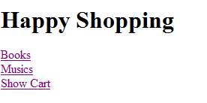
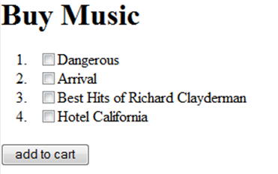
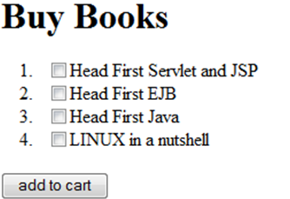

Slide 28
@WebServlet("/AddToCartServlet")
public class AddToCartServlet extends HttpServlet {
…
if(music!=null)
for(int i=0;i<music.length;i++)cart.add(music[i]);
if(book!=null)
for(int i=0;i<book.length;i++) cart.add(book[i]);
…
}
When ever an attribute (cart object) is changed to the session bill amount is calculated.
The calculation will be done when new cart object is added. So while initialization of session we add an empty cart object.
If bill amount exceeds 2000 a discount of 10% is given .

Slide 29
@WebListener
public class DiscListner implements HttpSessionListener, HttpSessionAttributeListener {
public DiscListner() {}
/*
Cart and bill attributes are initialized. attributeAdded will be called. But since nothing is done there is no effect
*/
public void sessionCreated(HttpSessionEvent arg0) {
HttpSession ses=arg0.getSession();
ses.setAttribute("bill",0.0);
ses.setAttribute("cart",new ArrayList<Object>());
System.out.println("new session created");
}
public void attributeAdded(HttpSessionBindingEvent arg0) {}
public void attributeRemoved(HttpSessionBindingEvent arg0) { }
public void sessionDestroyed(HttpSessionEvent arg0) {} arg0) {}

Slide 30
/*Get the cart items from the session and calculate the bill amount and bill attribute is added*/
public void attributeReplaced(HttpSessionBindingEvent arg0) {
HttpSession ses=arg0.getSession();
System.out.println("added listener");
ArrayList<Object> cart=(ArrayList<Object>)ses.getAttribute("cart");
double tot=cart.size()*500;
ses.removeAttribute("bill");
if(tot>2000){
tot=tot - (tot*0.1);
System.out.println(tot);
ses.setAttribute("bill",tot);
}
else ses.setAttribute("bill",tot);
}

Slide 31
Tell me why
Why are we removing bill attribute. Simply calling setAttribute("bill",tot) would overwrite the value anyway?
Now if we don’t call removeAttribute("bill") then when ever call setAttribute("bill",tot), attributeReplaced() method will be called and this turn would lead us to an infinite loop!
Calling removeAttribute("bill") and then setAttribute("bill",tot) ensures that attributeAdded() is called which does nothing.

Slide 32
HttpSessionBindingListener
A class implementing HttpSessionBindingListener interface has two methods to implement.
public void valueBound(HttpSessionBindingEvent event)
-called whenever the object implementing the interface is the value object set as attribute value to the session.
public void valueUnbound(HttpSessionBindingEvent event)
-called whenever the object implementing the interface is the value object removed from the session.
HttpSessionBindingListener is not declared in Deployment Descriptor!!

Slide 33
HttpSessionActivationListener
A class implementing HttpSessionActivationListener interface has two methods to implement.
public void sessionWillPassivate(HttpSessionEventevent)
-called just before a session is serialized to be cloned to another JVM.
public void sessionDidActivate(HttpSessionEvent event)
-called just after a cloned session is deserialized in a target JVM.
HttpSessionActivationListener is not declared in Deployment Descriptor!!

Slide 34
HttpSessionEvent, HttpSessionBindingEvent
EventObject
Object getSource()
java.util
HttpSessionEvent
HttpSession getSession()
javax.servlet.http
HttpSessionBindingEvent
String getName()
Object getValue()

Slide 35
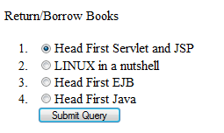
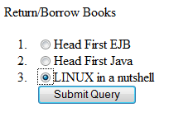


Example: HttpSessionBindingListener
Users can borrow one book at a time to read from an online library.
1
2
4
3

Slide 36
package bon;
import java.util.ArrayList;
import javax.servlet.http.*;
public class Book implements HttpSessionBindingListener{
String book;
static ArrayList<String> books = new ArrayList<String>();
static{
books.add("Head First Servlet and JSP");
books.add("Head First EJB");
books.add("Head First Java");
books.add("LINUX in a nutshell");
System.out.println("init");}
/*When the Book object is added to the session, it should be removed from the books ArrayList.*/
public Book(String s){ book=s;}
public void valueBound(HttpSessionBindingEvent event) {
books.remove(book);}
/*When the Book object is removed from the session, it should be added to the books ArrayList.*/
public void valueUnbound(HttpSessionBindingEvent event){
books.add(book);
}}
Book value bound object
Represents all the books in the library

Slide 37
BorrowBook servlet
/*
The doGet() method displays the books available in library
*/
@WebServlet("/BorrowBooks")
public class BorrowBooks extends HttpServlet {
private static final long serialVersionUID = 1L;
protected void doGet(HttpServletRequest request, HttpServletResponse response) throws ServletException, IOException {
PrintWriter out = response.getWriter();
out.println("<html><body>Return/Borrow Book <br><form method='post' action='BorrowBooks'><ol>");
for(String s : Book.books){
out.println("<li><input type='radio' name='book' value='"+s+"'>"+ s);
}
out.println("<br><input type='submit'></ol></form></body></html>");
}

Slide 38
/*
The doPost() method removes the old book from the session and adds the new book in session
*/
protected void doPost(HttpServletRequest request, HttpServletResponse response) throws ServletException, IOException {
PrintWriter out = response.getWriter();
String book= request.getParameter("book");
HttpSession session= request.getSession();
if(!session.isNew()) session.removeAttribute("book");
session.setAttribute("book", new Book(book));
out.println("<html><body>To return and borrow another book ");
out.println("<a href='BorrowBooks'> click here</a><br>");
out.println("<a href='Done'> click here to stop</a><br></body></html>");
}
}

Slide 39
Done servlet
/*
When user is done with the reading he clicks on link which takes him to this sevrvlet. This servlet removes the book from the session and invalidates the session.
*/
@WebServlet("/Done")
public class Done extends HttpServlet {
private static final long serialVersionUID = 1L;
protected void doGet(HttpServletRequest request, HttpServletResponse response) throws ServletException, IOException {
HttpSession session= request.getSession();
if(!session.isNew()) session.removeAttribute("book");
session.invalidate();
PrintWriter out = response.getWriter();
out.println("<html><body><h1>Thank you </h1></body></html>");
}
}

Slide 40
Welcome files
When a request for a URL (which is a valid partial request like application context path URL ) that is not mapped to a web component, the servlet container looks for one of the files specified in the <welcome-file-list> of web.xml
The first file present in the web application is automatically picked in case of partial valid request.
<web-app>
<display-name>ServletExample</display-name>
<welcome-file-list>
<welcome-file>index.html</welcome-file>
<welcome-file>index.htm</welcome-file>
<welcome-file>index.jsp</welcome-file>
<welcome-file>default.html</welcome-file>
<welcome-file>default.htm</welcome-file>
<welcome-file>default.jsp</welcome-file>
</welcome-file-list>

Slide 41
Overview: Asynchronous processing
One of the new features that Servlet 3.0 added apart from annotations is asynchronous processing of servlet.
Some times a servlet is waiting for a resource or event like database connection or response from a web service or chat like events and so is unable to proceed with something else which is not dependent on these or even is unable send response in case the get event is delayed.
In such cases, asynchronous processing enables servlet to continue with other tasks without having to wait for the response from a slow process.
We will not be covering this in detail .

