Slide 1
JSP
•JavaServerPages (JSP) technology allows web developers to
rapidly develop dynamic web pages and easily maintain them.
•JSP technology helps in embedding dynamic content within a
HTML page. This avoids generating the complete HTML page
using a Servlet.
•Hence, page design can be done by designer and wherever
the dynamic content has to come, programmer can put the
Java code.

Slide 2
What a JSP page contains ?
Text-based document that contains two types of text :
– Static components, expressed in any text-based format,
such as HTML, WML, XML
– JSP elements, which construct dynamic content

Slide 3
Main Purpose of JSP
Separation of static from dynamic content
– Logic to generate the dynamic content is separated from
the static presentation templates by using it within
external JavaBeans components.
– The JavaBeans are then created and used by the JSP
page using special tags and scriptlets.
–When a page designer makes any changes to the
presentation template, the JSP page is automatically
recompiled and reloaded into the web server by the JSP
engine.

Slide 4
JSP -Advantages
•Write Once Run Anywhere
JSP pages can be moved easily across platforms, and
across web servers, without any changes
•Dynamic content can be served in a variety of formats
There is nothing that mandates the static template data
within a JSP page to be of a certain format.
JSP can service a diverse clientele ranging from
conventional browsers using HTML/DHTML, to handheld
wireless devices like mobile phones and PDAs using
WML, to B2B applications using XML.

Slide 5
JSP – Advantages(Contd..)
•Recommended Web access layer for n-tier architecture: Sun's
J2EETM Blueprints, which categorically recommends JSP over
servlets for serving dynamic content.
•Completely leverages the Servlet API:
You can do almost anything that can be done with servlets
using JSP--but more easily!

Slide 6
JSP Architecture
JSP pages are subject to two phases.
– Translation phase
– Request processing phase
Translation phase : The JSP page is translated
only once into Servlet, until the JSP page changes again.
Request processing phase : After the page
has been translated, the request processing
phase is handled by the servlet.

Slide 7
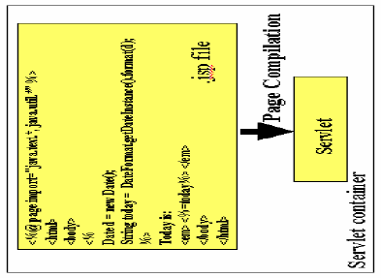

Slide 8
JSP Translation (Contd..)
•The translation phase is carried out by the JSP engine itself,
when it receives an incoming request for the JSP page for the
first time.
•The JSP 1.1 specification allows for JSP pages to be
precompiled into class files. Precompilation may be useful in
removing the start-up lag that occurs when a JSP page
receives the first request from a client.
Note : Many details of the translation phase, like the location
where the source and class files are stored are implementation
dependent

Slide 9
JSP Translated Servlet
•The JSP page implementation class file extends
HttpJspBase, which implements the Servlet interface. The
service method of this class, _jspService(), essentially inline
the contents of the JSP page.
Note : Although _jspService() cannot be overridden, the
developer can describe initialization and destroy events by
providing implementations for the jspInit() and jspDestroy()
methods within their JSP pages

Slide 10
Once this class file is loaded within the servlet container, the
_jspService() method is responsible for replying to a client's
request.
•By default, the _jspService() method is dispatched on a
separate thread by the servlet container in processing
concurrent client requests

Slide 11
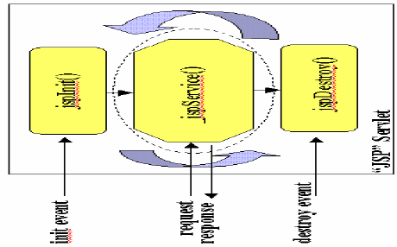

Slide 12
JSP Syntax Basics
Directives :
JSP directives are messages for the JSP engine
•Tell the engine what to do with the rest of the JSP page
•JSP directives are always enclosed within the <%@ ... %> tag

Slide 13
Page Directive
Typically, the page directive is found at the top of almost all of your JSP pages
Any number of page directives could be added within a JSP
page, although the attribute/value pair must be unique
•Simple page directive importing a java package:
<%@ page import="java.util.*" %>

Slide 14
Include Directive
Helps in separating content into manageable elements. For example : a common header or footer in all the pages of a web application could be included with this directive.
The page included can be a static HTML page or more JSP
content. The page could be included at any location.
<%@ include file="copyright.html" %>

Slide 15
Declarations
A typical declaration directive would be:
<%! int i=0; %>
We can also declare methods. For example, you can
override the initialization event in the JSP life cycle by
declaring:
<%! public void jspInit()
{ //some initialization code }
%>

Slide 16
Expressions
Typically expressions are used to display simple values of
variables or return values by invoking a bean's getter
methods.
•The results of evaluating the expression are converted to a string and directly included within the output page.
JSP expressions begin within <%= ... %> tags and do not
include semicolons:
<%= fooVariable %> <%= fooBean.getName() %>

Slide 17
Scriptlets
•JSP code fragments or scriptlets are embedded within <%
... %> tags.
•The java code is run when the request is serviced by the
JSP page. You can have just about any valid Java code
within a scriptlet, and is not limited to one line of source
code. For example, the following displays the string
"Hello" within H1, H2, H3, and H4 tags, combining the use
of expressions and scriptlets:
•<% for (int i=1; i<=4; i++) { %>
<H<%=i%>>Hello</H<%=i%>> <% } %>

Slide 18
Comments tag
•Although you can always include HTML comments in JSP
pages, users can view these if they view the page's source.
If you don't want users to be able to see your comments,
embed them within the <%-- ... --%> tag:
•<%-- comment for server side only --%> A most useful
feature of JSP comments is that they can be used to
selectively block out scriptlets or tags from compilation.
Thus, they can play a significant role during the debugging
and testing process

Slide 19
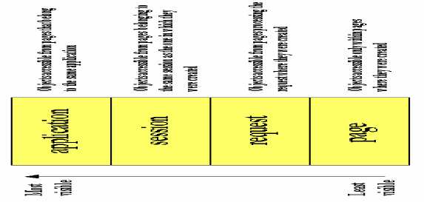
Object Scopes

Slide 20
JSP Implicit Objects
The JSP container makes available implicit objects that can be used within scriptlets and expressions, without the page author first having to create them.
The nine implicit objects are :
1) request: Represents the HttpServletRequest triggering the service invocation. Request scope

Slide 21
2) response: Represents HttpServletResponse to the request.
3) pageContext: Encapsulates implementation-dependent features in PageContext.
4) application: Represents the ServletContext obtained from servlet configuration object. Application scope.
5) out: A JspWriter object that writes into the output stream

Slide 22
config: Represents the ServletConfig for the JSP. synonym for the "this" operator, as an HttpJspPage. Not used often by page authors.
session: An HttpSession. Session scope.
exception: the uncaught Throwable object that resulted in the error page being invoked. Page scope.

Slide 23
These implicit objects are only visible within the system generated _jspService() method. They are not visible within methods you define yourself in declarations.

Slide 24
Synchronization Issues
By default, the service method of the JSP page implementation class that services the client request is multithreaded. Thus, it is the responsibility of the JSP page author to ensure that access to shared state is effectively synchronized.
There are a couple of different ways to ensure that the service methods are thread-safe. The easy approach is to include the JSP page directive.

Slide 25
<%@ page isThreadSafe="false" %>
This causes the JSP page implementation class to implement the SingleThreadModel interface, resulting in the synchronization of the service method, and having multiple instances of the servlet to be loaded in memory.
The concurrent client requests are then distributed evenly amongst these instances for processing in a round-robin fashion.

Slide 26
Synchronization
A better approach is to explicitly synchronize access to shared
objects (like those instances with application scope, for example) within the JSP page, using scriptlets:
<% synchronized (application) {
SharedObject foo =
(SharedObject)application.getAttribute("sharedObject");
foo.update(someValue);
application.setAttribute("sharedObject",foo);
}
%>

Slide 27
Exception handling
JSP provides a rather elegant mechanism for handling
runtime exceptions. Although you can provide your own
exception handling within JSP pages, it may not be possible to anticipate all situations.
By making use of the page directive's errorPage attribute, it is possible to forward an uncaught exception to an error handling
JSP page for processing.

Slide 28
Exception handling(Contd..)
For example :
<%@ page isErrorPage="false“errorPage="errorHandler.jsp"
%>
- informs the JSP engine to forward any uncaught
exception to the JSP page errorHandler.jsp. It is then
necessary for errorHandler.jsp to flag itself as a error processing page using the directive:

Slide 29
<%@ page isErrorPage="true" %>
- This allows the Throwable object describing the exception
to be accessed within a scriptlet through the implicit exception object.

Slide 30
Session Management
Sessions are a good place for storing beans and objects that
need to be shared across other JSP pages and servlets that
may be accessed by the user.
By default, all JSP pages participate in an Httpsession.
The HttpSession object can be accessed within scriptlets
through the session implicit JSP object.
The session objects is identified by a session ID and stored in the browser as a cookie.

Slide 31
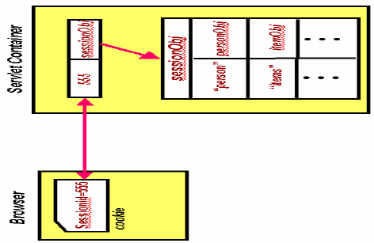
Session Management(Contd..)

Slide 32
Using JavaBean Components
Before you can access a bean within a JSP page, it is
necessary to identify the bean and obtain a reference to
it. The <jsp:useBean> tag tries to obtain a reference to an
existing instance using the specified id and scope, as the
bean may have been previously created and placed into
the session or application scope from within a different
JSP page.
The bean is newly instantiated using the Java class name
specified through the class attribute only if a reference
was not obtained from the specified scope.

Slide 33
<jsp:useBean id="user" class="com.jguru.Person"
scope="session" />
In this example, the Person instance is created just once and placed into the session. If this useBean tag is later
encountered within a different JSP page, a reference to the original instance that was created before is retrieved from the
session

Slide 34
Access Java Bean properties(Contd..)
•Once you have declared a JavaBean component, you have
access to its properties to customize it.
•The value of a bean's property is accessed using the
<jsp:getProperty> tag. With the <jsp:getProperty> tag, you
specify the name of the bean to use (from the id field of
useBean), as well as the name of the property whose value
you are interested in. The actual value is then directly printed
to the output:
<jsp:getProperty name="user" property="name" />

Slide 35
Access Java Bean properties(Contd..)
Changing the property of a JavaBean component requires you
to use the <jsp:setProperty> tag. For this tag, you identify the
bean and property to modify and provide the new value:
•<jsp:setProperty name="user" property="name" value="jec" />
or
•<jsp:setProperty name="user" property="name"
value="<%=expression %>" />

Slide 36
Better Approach
•When developing beans for processing form data, you can
follow a common design pattern by matching the names of
the bean properties with the names of the form input
elements.
You also need to define the corresponding getter/setter
methods for each property within the bean. The advantage in
this is that you can now direct the JSP engine to parse all the
incoming values from the HTML form elements that are part of
the request object, then assign them to their corresponding
bean properties with a single statement, like this:
•<jsp:setProperty name="user" property="*"/>

Slide 37
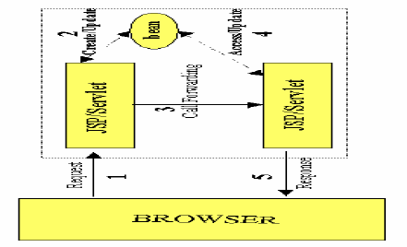
Forwarding requests

Slide 38
A <jsp:forward> tag may also have jsp:param subelements
that can provide values for some elements in the request used
in the forwarding:
•For example :
<jsp:forward page="<%= somePage %>" > <jsp:param
name="name1" value="value1" /> <jsp:param name="name2"
value="value2" /> </jsp:forward>

Slide 39
•With the <jsp:forward> tag, you can redirect the request to any
JSP, servlet, or static HTML page within the same context as
the invoking page. This effectively halts processing of the
current page at the point where the redirection occurs,
although all processing up to that point still takes place:
•<jsp:forward page="somePage.jsp" />

Slide 40
Including Requests
For example:
•<jsp:include page="shoppingcart.jsp”/>
not only allows shoppingcart.jsp to access any beans placed
within the request using a <jsp:useBean> tag, but the dynamic
content produced by it is inserted into the calling page at the
point where the <jsp:include> tag occurs. The included
resource, however, cannot set any HTTP headers, which
precludes it from doing things like setting cookies, or else an
exception is thrown

Slide 41
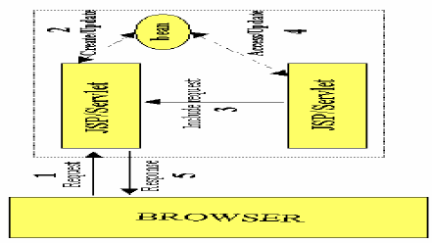
Including Request

