Slide 2
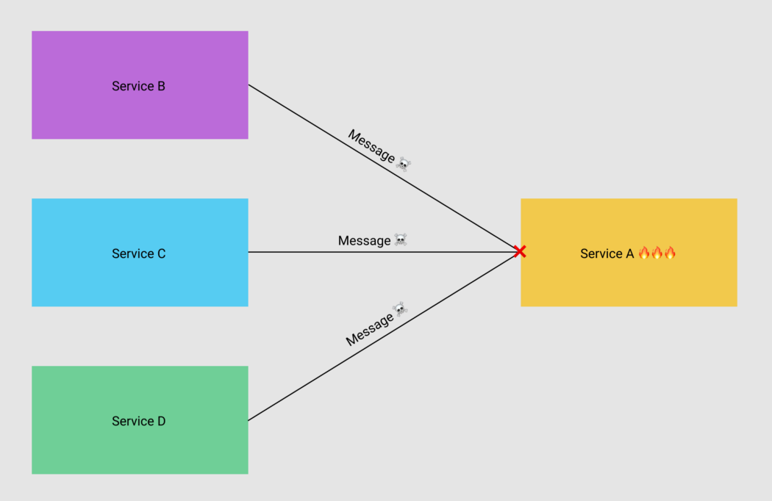

Slide 3
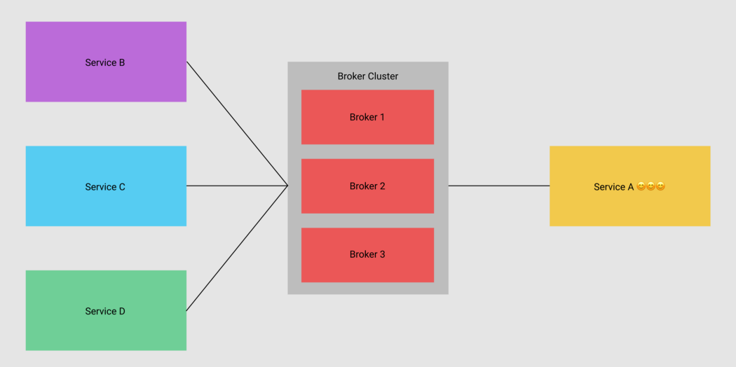

Slide 4
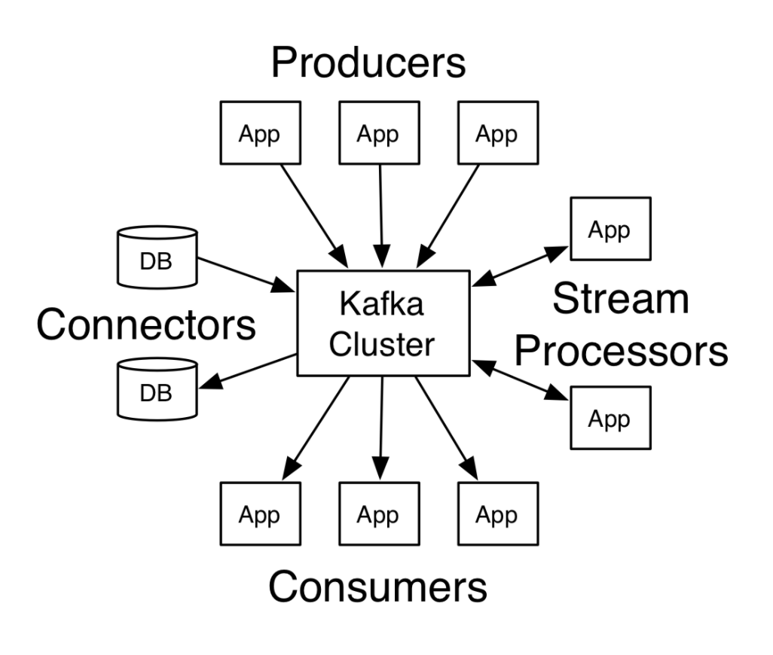

Slide 5
Kafka excels at the following areas:
Excellent horizontal scalability: Kafka can easily scale to 100 message brokers and millions of messages per second.
High performance: latency could be less than 10ms, which can be considered as real-time.
Highly trusted: the technology is trusted by many top tech companies such as LinkedIn, Airbnb, and Netflix.

Slide 6
