Slide 1



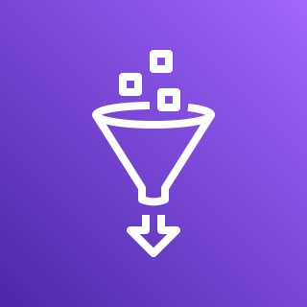
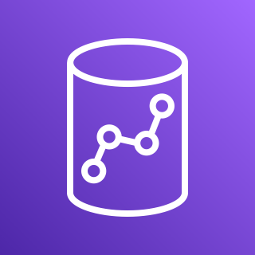



AWS Database Migration Service (AWS DMS)
Crawler
Amazon Simple Storage Service (Amazon S3)
AWS Glue
AWS
Amazon Redshift
On Premise
Oracle
instance
Oracle
instance
Amazon QuickSight

