Slide 1
Intro to markdown
Github: https://github.com/ashish-mw/workshop-markdown

Slide 2

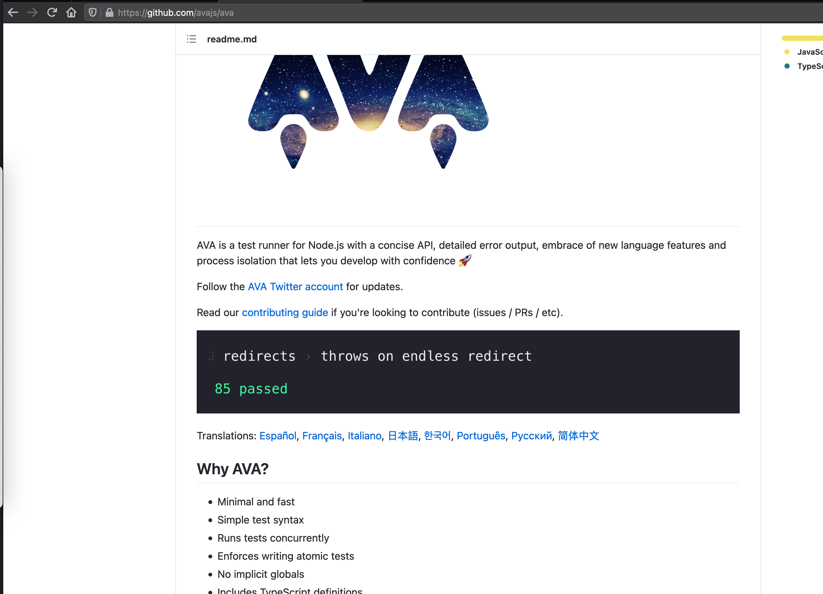
What is markdown?
- A light-weight markup language.
- Focus on content rather than syntax.
- Popular among software projects for writing READMEs and other documentation.

Slide 3
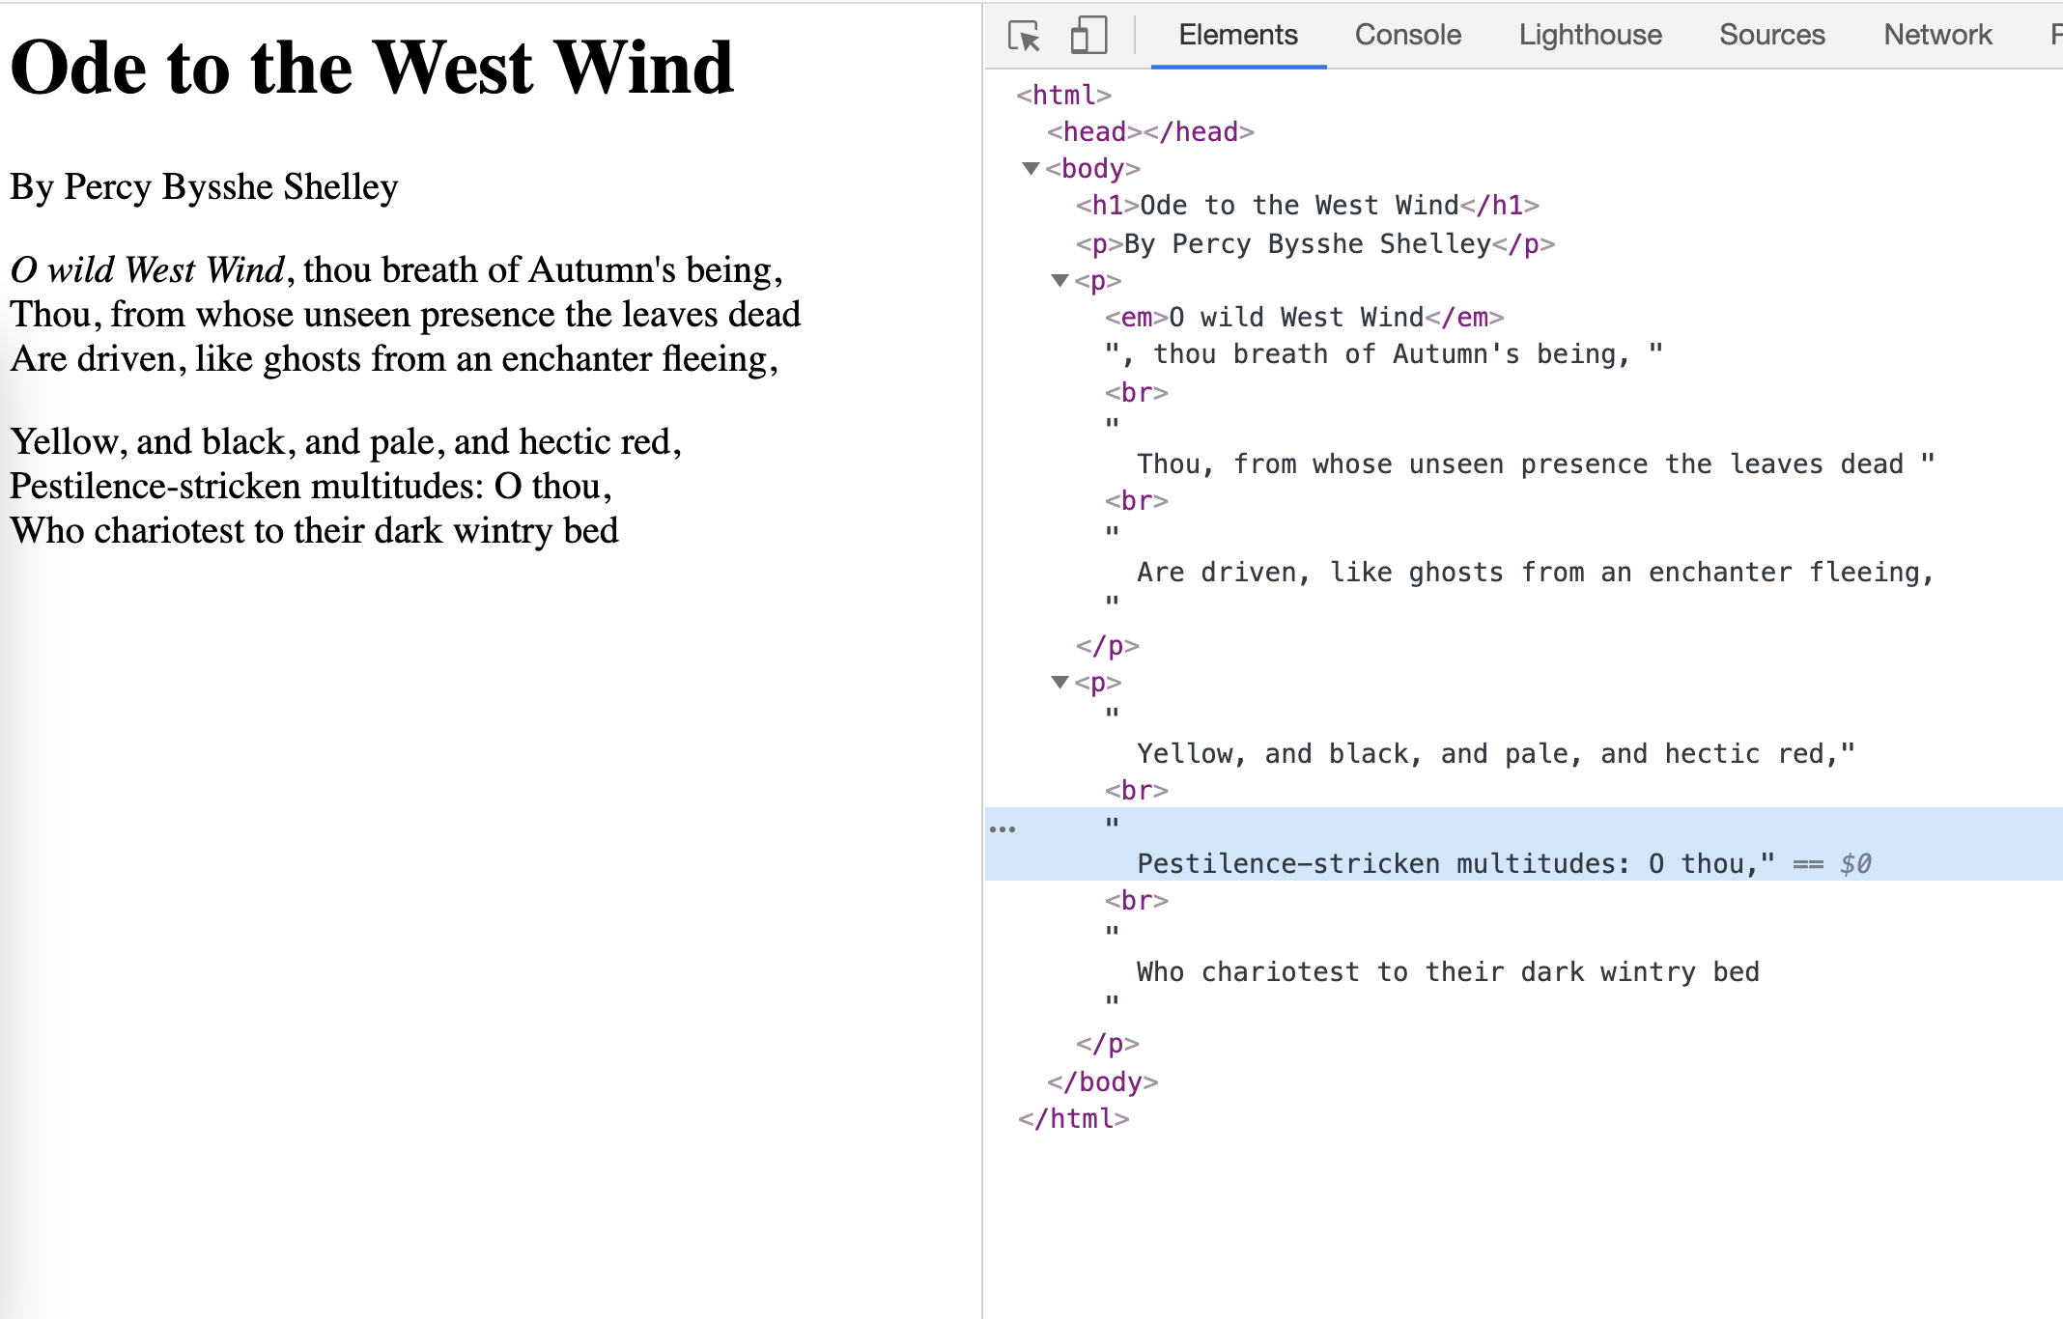
Markup?
A web-browser renders HTML into rich text.

Slide 4
Benefits of writing in markdown
Conversion to other document formats.
Focus more on content.
Plain-text.
Code repo hosts (GitHub and GitLab) usually render files with extension .md.

Slide 5
Demo
https://www.dillinger.io/

Slide 6
Questions?
https://www.fossmint.com/best-markdown-editors-for-macos
https://www.oberlo.in/blog/markdown-editors
Slack: @ashish
Email: ashish@mindwaveventures.com

