Slide 1
CoupleLens
The World's First Relationship Operating System
AI-Powered Platform for Couples • Therapist Marketplace • Relationship Analytics
Product Presentation • March 2026

Slide 2
The Problem
💔 50% of marriages end in divorce
Most couples lack accessible tools to address relationship issues early.
🔇 Communication breakdown is #1 cause
Couples struggle to express needs without triggering conflict.
💰 Therapy costs $150-300/session
Professional help is expensive, hard to access, and stigmatized.
📊 No data-driven relationship insights
Couples have no way to objectively track relationship health over time.

Slide 3
Our Solution: CoupleLens
An end-to-end intelligent platform combining AI assistance with professional therapist services to help couples at every stage.
🤖 AI Relationship Assistant — Context-aware companion with multiple expert personas
⚖️ AI Conflict Mediator — Unbiased analysis of both perspectives with actionable compromises
✍️ AI Conversation Rewrite — Transform harsh messages into respectful communication
📊 Relationship Health Dashboard — Track 5 key metrics with visual trends
🧩 Compatibility Assessment — Financial, lifestyle & parenting evaluation
💰 Couple Financial Tools — Shared budgeting & expense tracking
📸 Memory Timeline — Private couple feed with milestone reminders
👨‍⚕️ Therapist Marketplace — Vetted professionals with integrated booking

Slide 4
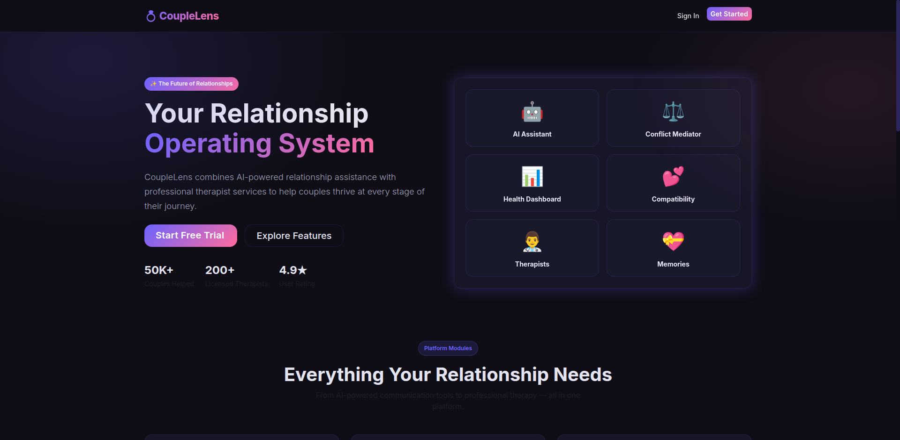
Landing Page
First impression — clean, professional design with clear value proposition

Slide 5
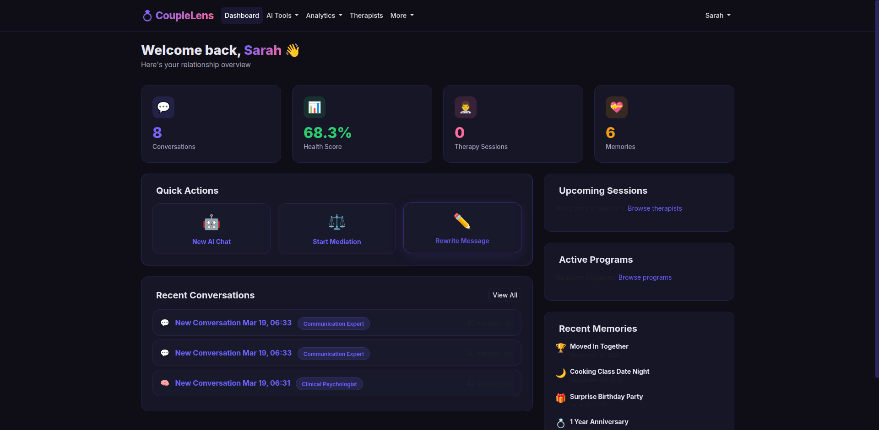
User Dashboard
Central hub with relationship score, quick stats, recent activity & navigation

Slide 6
Relationship Health Parameters
CoupleLens tracks 5 core metrics, each scored 0-100%, to give couples a clear picture of their relationship health.
💬 Communication
How effectively the couple communicates needs, feelings, and expectations.
🤝 Trust
Level of reliability, honesty, and emotional safety between partners.
⚖️ Conflict Resolution
Ability to navigate disagreements constructively without escalation.
❤️ Intimacy
Depth of emotional and physical closeness and connection.
🎯 Shared Goals
Alignment on future plans, values, and life direction.
Score Thresholds: 🟢 ≥70% Healthy | 🟡 40-69% Needs Attention | 🔴 <40% At Risk

Slide 7
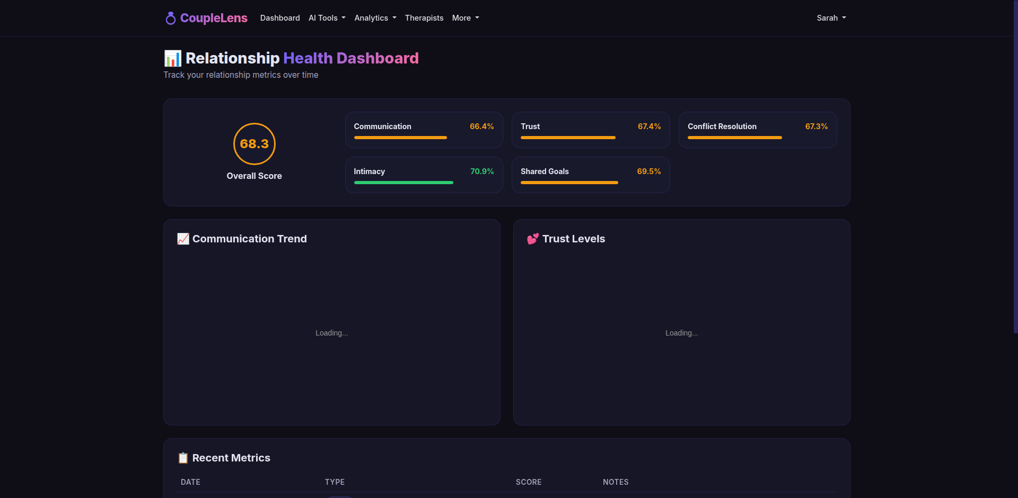
Relationship Health Dashboard
Interactive charts tracking Communication, Trust, Conflict Resolution, Intimacy & Shared Goals

Slide 8
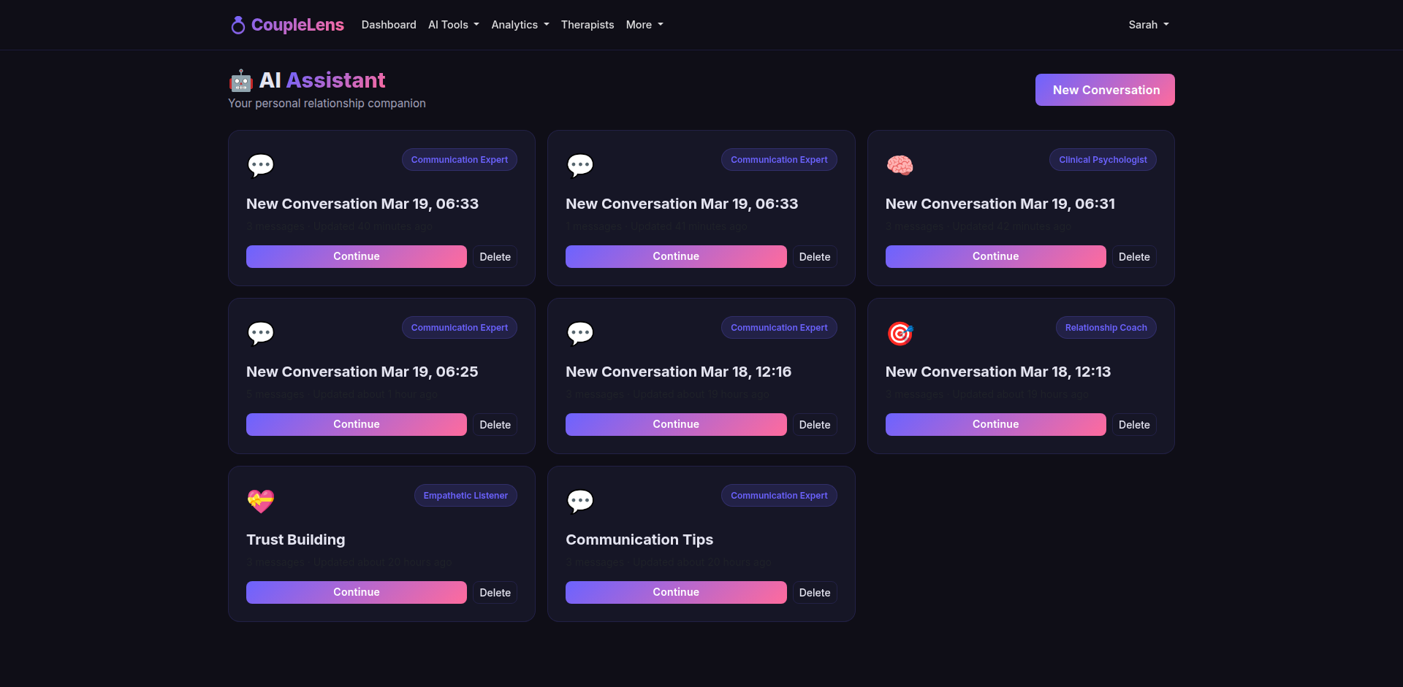
AI Relationship Assistant
Context-aware AI companion with multiple expert personas for ongoing support

Slide 9
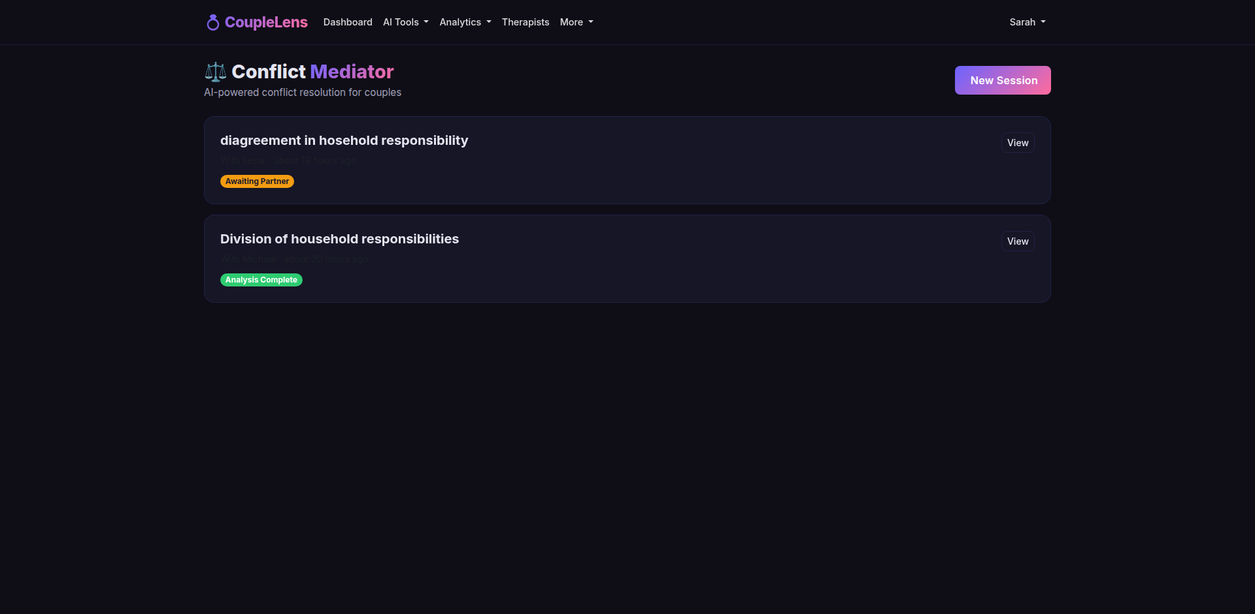
AI Conflict Mediator
Structured mediation — both perspectives analyzed with neutral AI-generated compromises

Slide 10
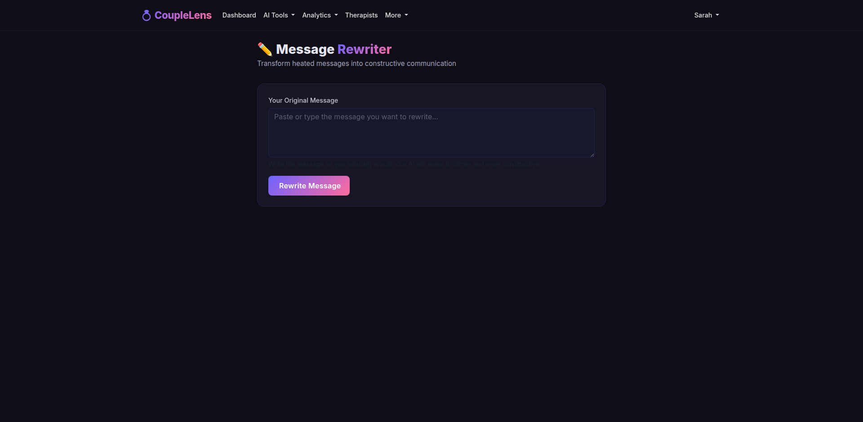
AI Conversation Rewrite Tool
Transform harsh messages into calm, respectful communication while preserving intent

Slide 11
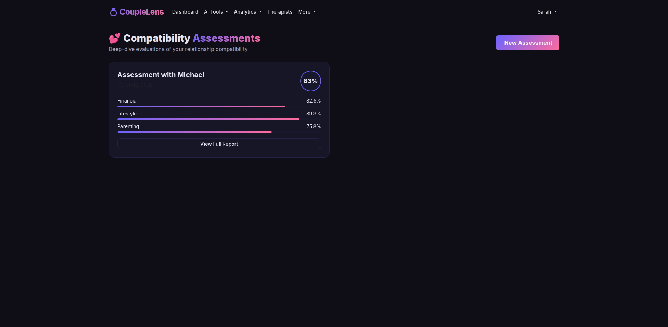
Compatibility Assessment Engine
Deep-dive evaluation of Financial, Lifestyle & Parenting compatibility

Slide 12
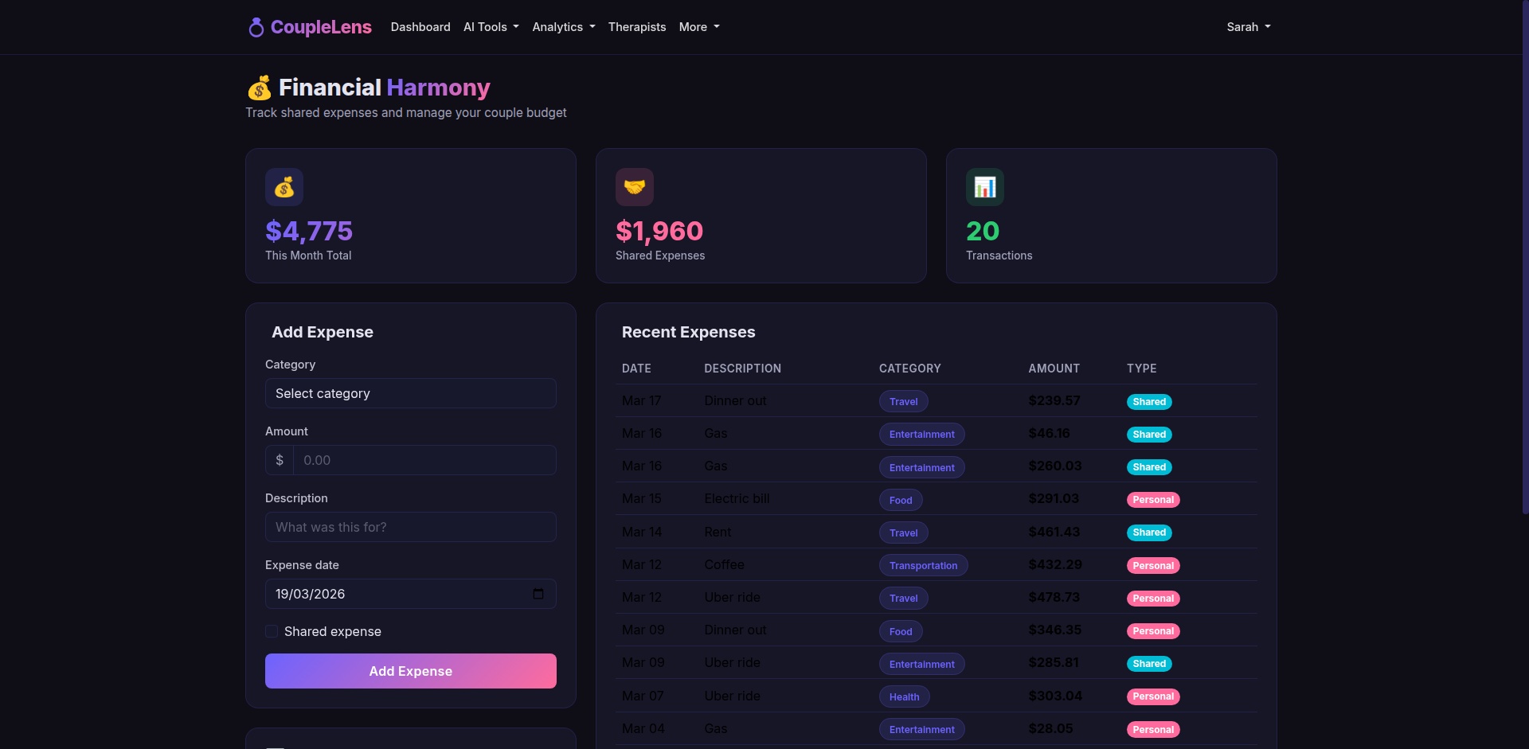
Couple Financial Harmony Tool
Shared budgeting, joint expense tracking & financial personality insights

Slide 13
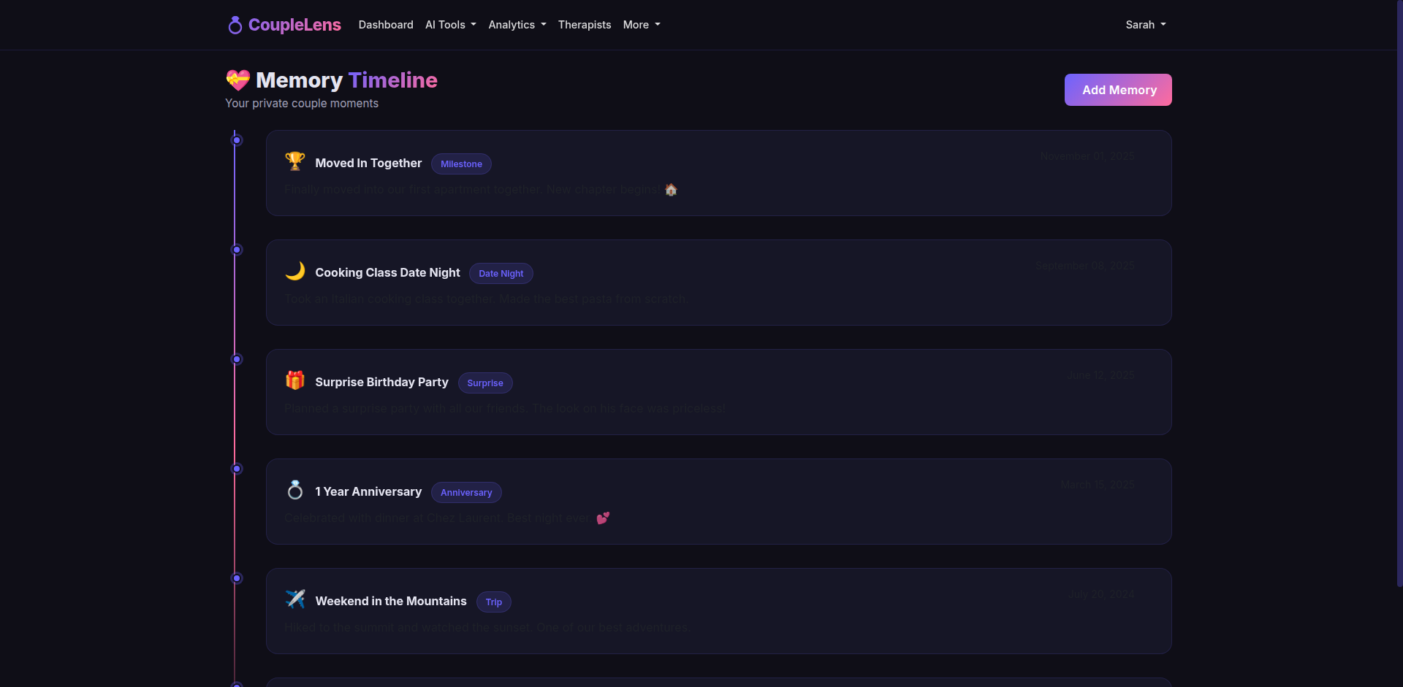
Couple Memory Timeline
Private couple feed with photos, milestones & automated reminders

Slide 14
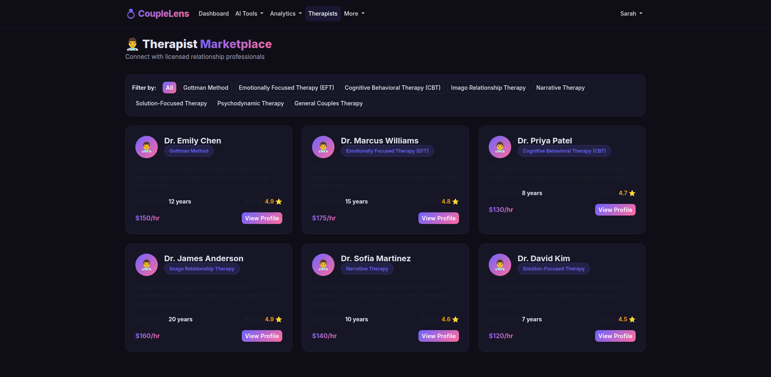
Therapist Marketplace
Vetted directory of licensed professionals — filter by specialization, language & price

Slide 15
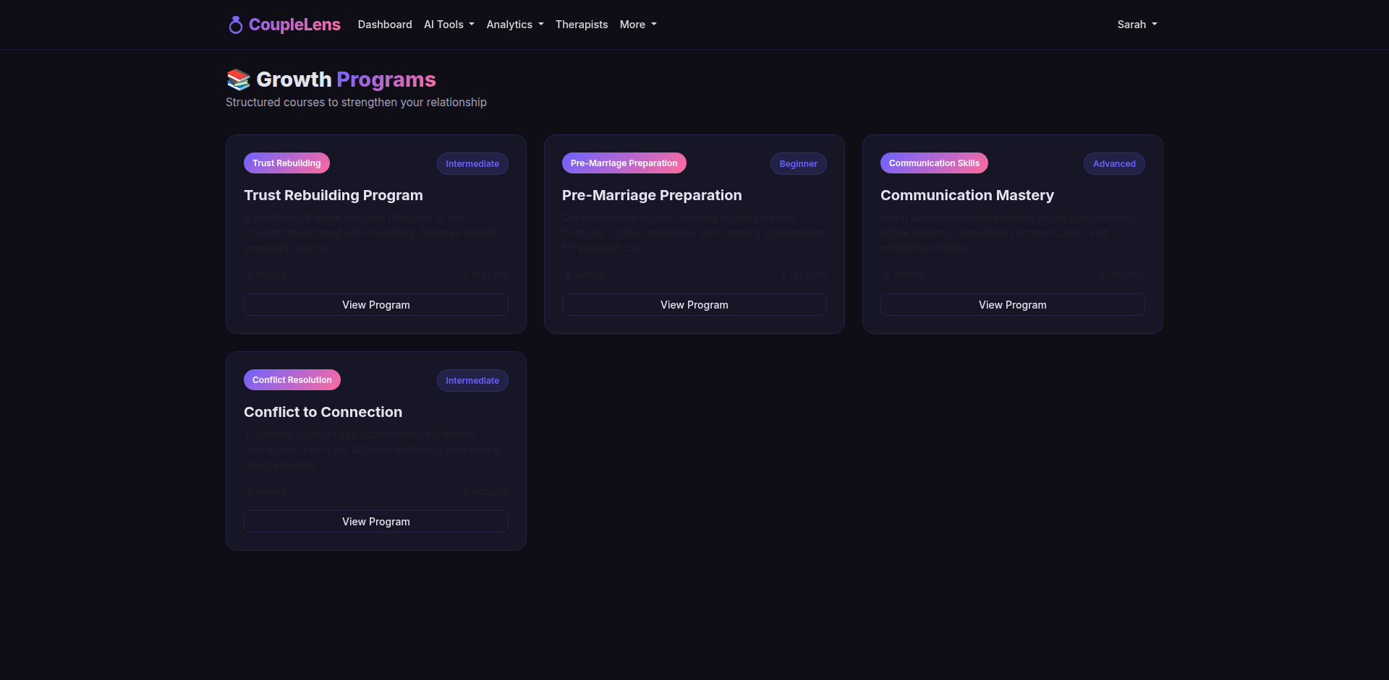
Relationship Growth Programs
Structured courses: Trust Rebuilding, Pre-Marriage Prep, Communication Mastery & more

Slide 16
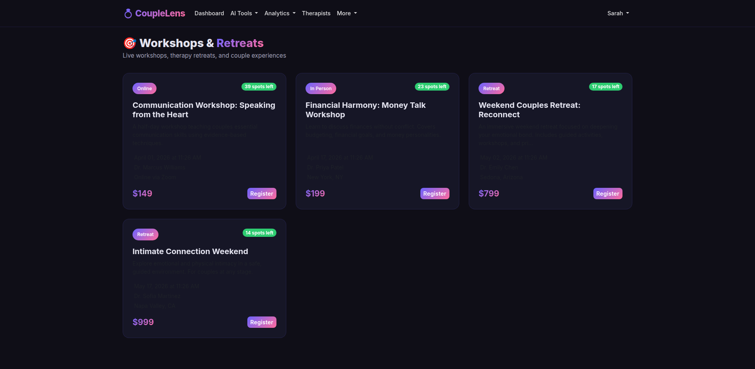
Workshops & Retreats Marketplace
Live events — online workshops, in-person sessions & immersive retreats

Slide 17
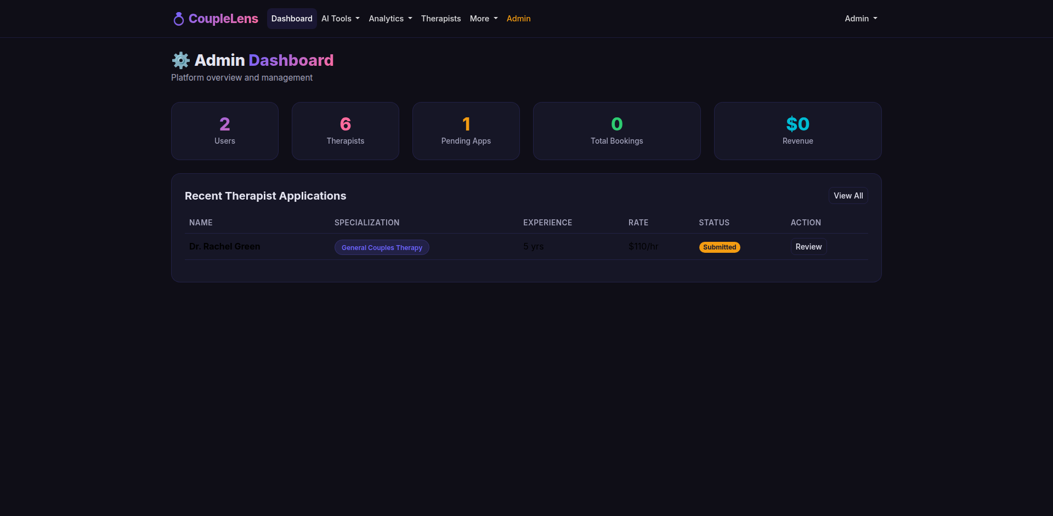
Admin Dashboard
Operational backend for therapist vetting, platform analytics & user management

Slide 18
User Roles & Capabilities
👫 Couple Member
• Access AI assistant, conflict mediator, rewrite tool
• View relationship health dashboard & compatibility reports
• Track shared expenses & memory timeline
• Book therapist sessions, enroll in programs & workshops
👨‍⚕️ Therapist
• Manage professional profile & availability
• Conduct video, voice, or chat sessions
• Receive bookings through the marketplace
🔧 Admin
• Review & approve therapist applications
• Manage marketplace visibility & platform analytics
• User support & content management

Slide 19
Technology Stack
Backend
Ruby on Rails (Full-Stack MVC)
Frontend
Hotwire (Turbo + Stimulus) + Bootstrap
Database
PostgreSQL
AI Engine
OpenAI API (GPT-4)
Payments
Stripe & Stripe Connect
Background
Sidekiq + Redis
Storage
Active Storage + AWS S3
Security
Devise Auth, MFA, E2E Encryption, HIPAA Ready
Architecture
Modular Rails Monolith with aggressive Redis caching

Slide 20
Revenue Model
💎 Premium Subscription
Monthly/annual fee for advanced AI features, unlimited conversations, and deep analytics.
🏥 Marketplace Commission
Percentage fee from each therapy session booked through the platform.
📋 One-off Purchases
Compatibility reports, specialized growth programs, and detailed assessments.
🎟️ Event Commission
Transaction fees from workshop and retreat ticket sales.

Slide 21
CoupleLens vs Competitors
Feature Paired Lasting CoupleLens
Relationship Health Tracking ✓ ✓ ✓ 5 metrics with trends
Guided Programs & Courses ✓ ✓ ✓ Interactive lessons
Communication Tools ✓ ✓ ✓ AI Rewrite Tool
Compatibility Assessments ✓ ✓ ✓ 3 dimensions
AI Chat Assistant ✗ ✗ ✓ Multi-persona AI
Live Therapist Marketplace ✗ ✗ ✓ Full booking system
AI Conflict Mediator ✗ ✗ ✓ Structured mediation
Financial Tools ✗ ✗ ✓ Joint budgeting
Workshops & Retreats ✗ ✗ ✓ Event marketplace

Slide 22
Success Metrics (KPIs)
📈 MAU / DAU
Monthly & daily active users measuring engagement.
📅 Therapist Booking Rate
Conversion from marketplace browsing to booked sessions.
💳 Subscription Conversion
Free-to-premium conversion rate.
❤️ Health Score Improvement
Aggregate improvement in relationship health scores over time.
⭐ User Satisfaction (NPS)
Net Promoter Score from in-app surveys.

Slide 23
Thank You
CoupleLens — Empowering Couples, One Connection at a Time
Questions & Discussion

