Slide 1

Big Data Technology Final PROJECT
Tweeter keywords Search

Slide 2
Final Course Project (Knowing & Showing Your Hidden Potential to Integrate Parts to Create a Whole)
Submitted To: Prof. Mrudula Mukadam
Submitted By:
Ashish Pokhrel
Saugat Pageni
Brian Onyango

Slide 3
Technologies Used
Hadoop Version 2.7.0
Java JDK & JRE Version 8
Intellij
Kafka Version 2.11-1.1.0
HBase Version 2.2.5
Spark Version 3.2.4

Slide 4
Project Overview
Getting Started Part 1: Spark Streaming Application Choose a Twitter API and set up developer credentials.
Configure Apache Flume to collect Twitter data in real-time.
Run the Spark Streaming application to process and visualize Twitter data.
Part 2: HBase Integration Install and configure HBase on your cluster.
Modify the Spark Streaming application to save processed data to HBase.
Develop a data retrieval mechanism for accessing data stored in HBase.
Part 3: Kafka Integration Install and configure Apache Kafka on your cluster.
Modify the Spark Streaming application to stream processed data to a Kafka topic.
Create a Kafka consumer to further process or distribute the data as needed.

Slide 5


Project Big Picture
KAFKA PRODUCER/ KAFKA CONSUMER
FLUME
TWITTER
SPARK STREAMING
HBASE
Notes:
1.First we will get the data from twitter and store it in the Kafka Logs
2.Now from Kafka logs, we will use Spark Streaming to store the data in the HBase tables(Perform some aggregation)
3.Now we will read the data stored in Hbase table and using Spark SQL we will store the it HDFS.
4.Now we will create External Hive table using location where the csv file stored in HDFS
5.Now connect Hive to Tableau and visualize.

Slide 6
Details
Twitter Kafka Producer:
Obtaining Twitter data through the API
We utilized a developer credentials provided by Twitter to access tweets via the API.
For streaming tweets, we employed the “Stream GET API" at "https://api.twitter.com/2/tweets/sample/stream."
We established a connection to a Kafka topic and tested for the messaged received to this Kafka topic.

Slide 7
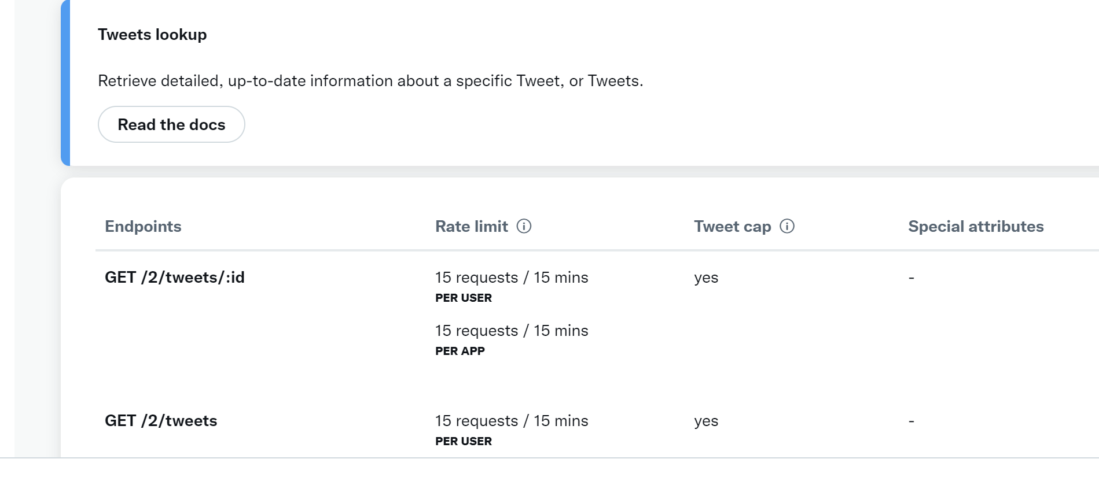
API Used from Twitter

Slide 8
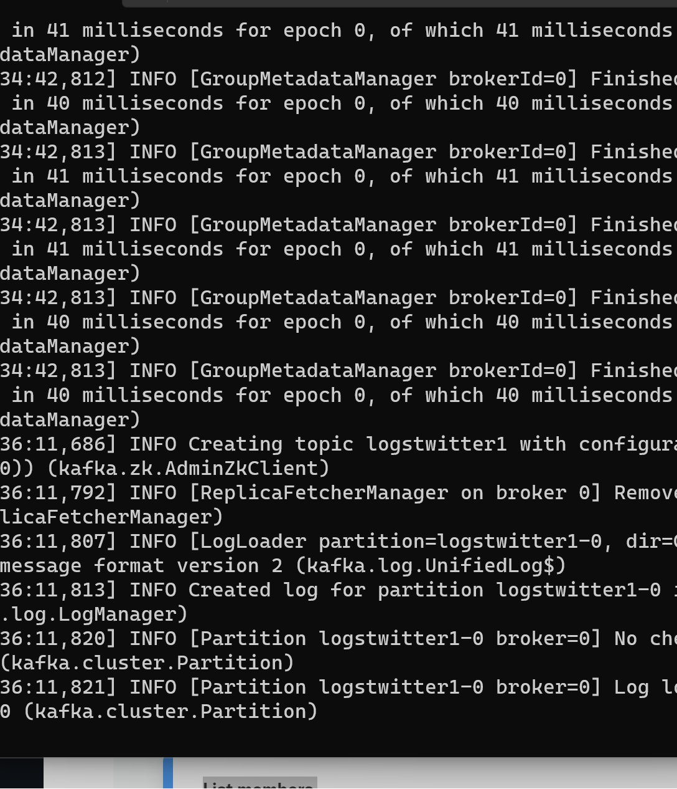
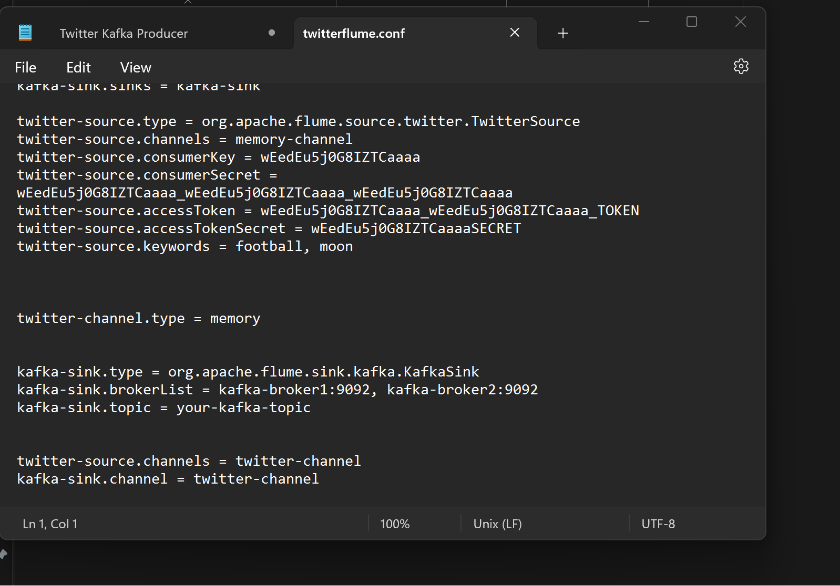
FLUME SOURCE CHANNEL AND SINK Twitter And Kafka

Slide 9
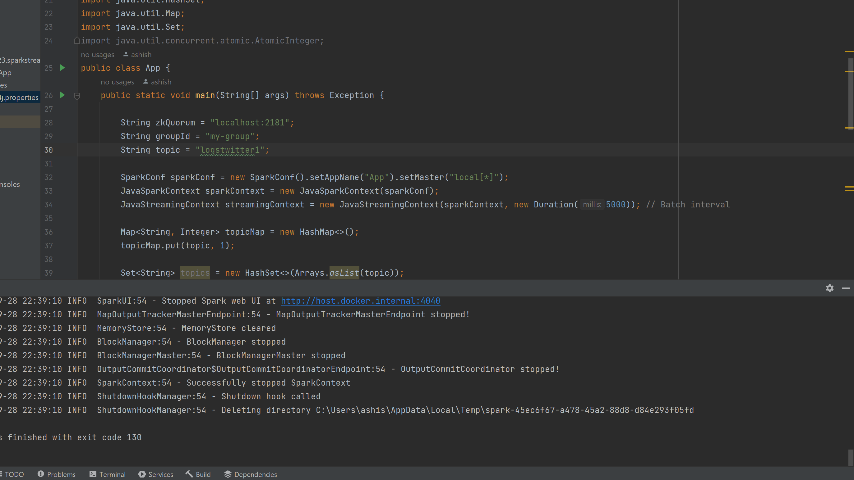
Cont’d…

Slide 10
SPARK-KAFKA-HBASE
Spark Streaming Kafka Consumer Flow:
Flume Ingestion: Receives tweets from a Kafka topic.
Keyword Filtering: Filters tweets by keywords from an HBase table.
Spark Processing: Aggregates and processes selected tweets.
HBase Storage: Stores filtered tweets in HBase.

Slide 11
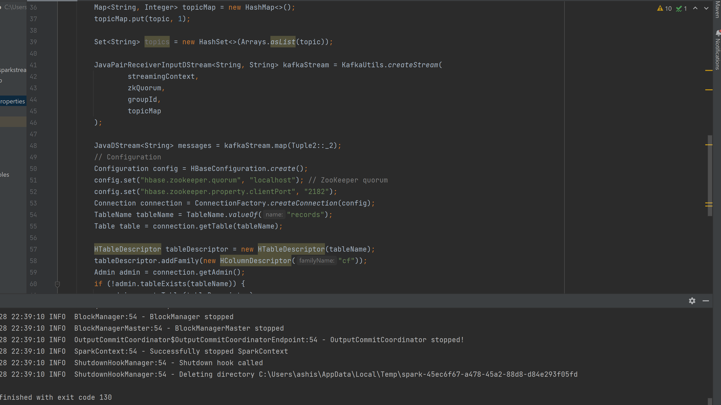
Spark Streaming Kafka topics to HBase

Slide 12
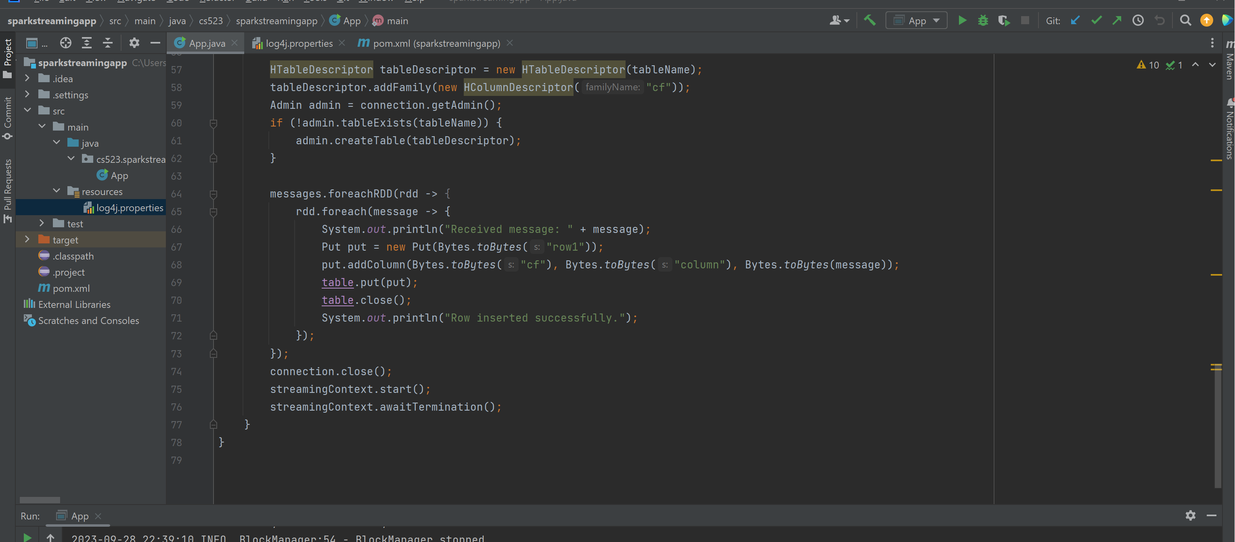
Spark Streaming Kafka topics to HBase Cont’d…

Slide 13
Cont’d

Slide 14
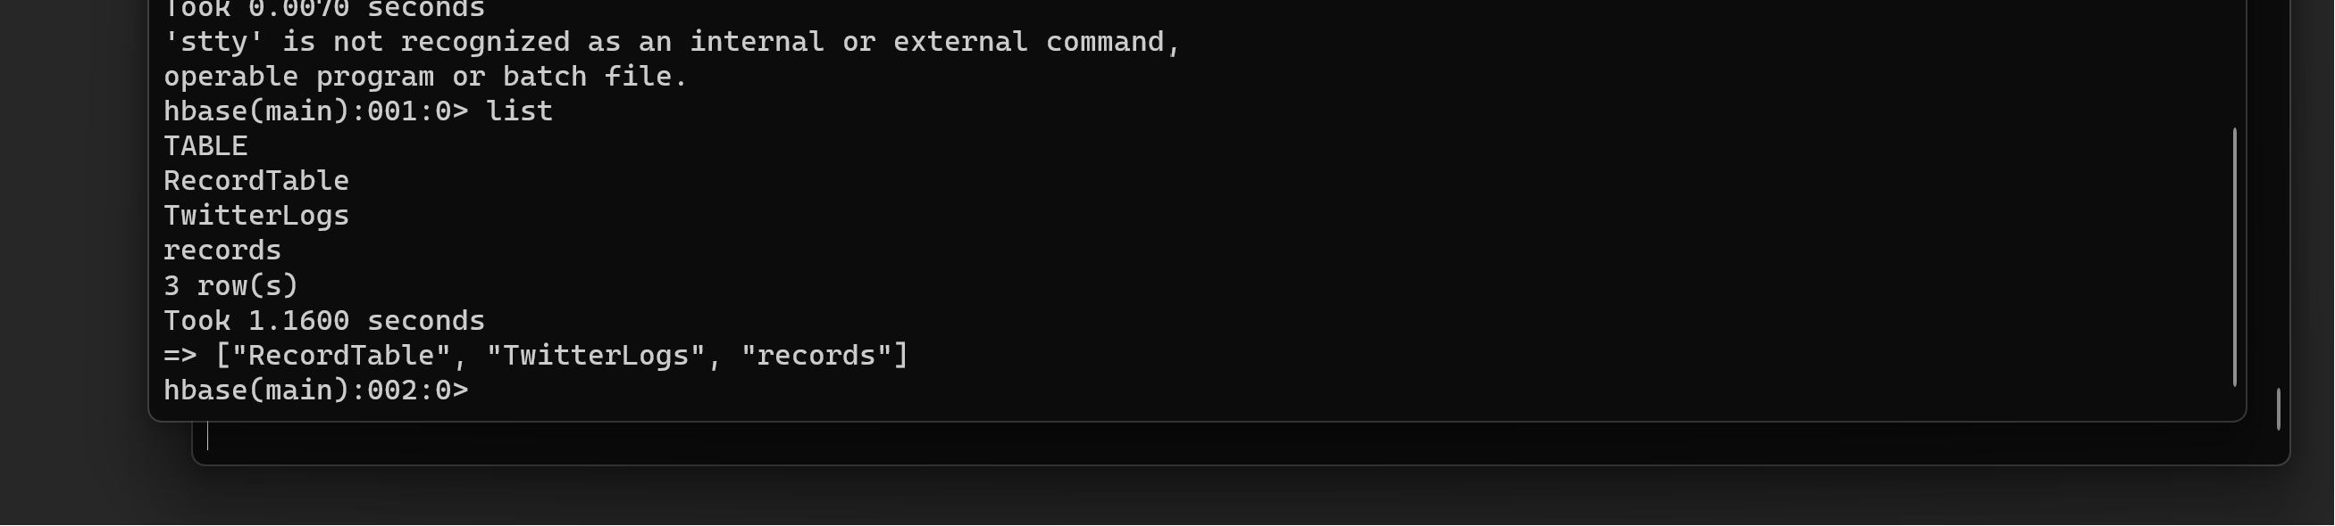
Cont’d

Slide 15
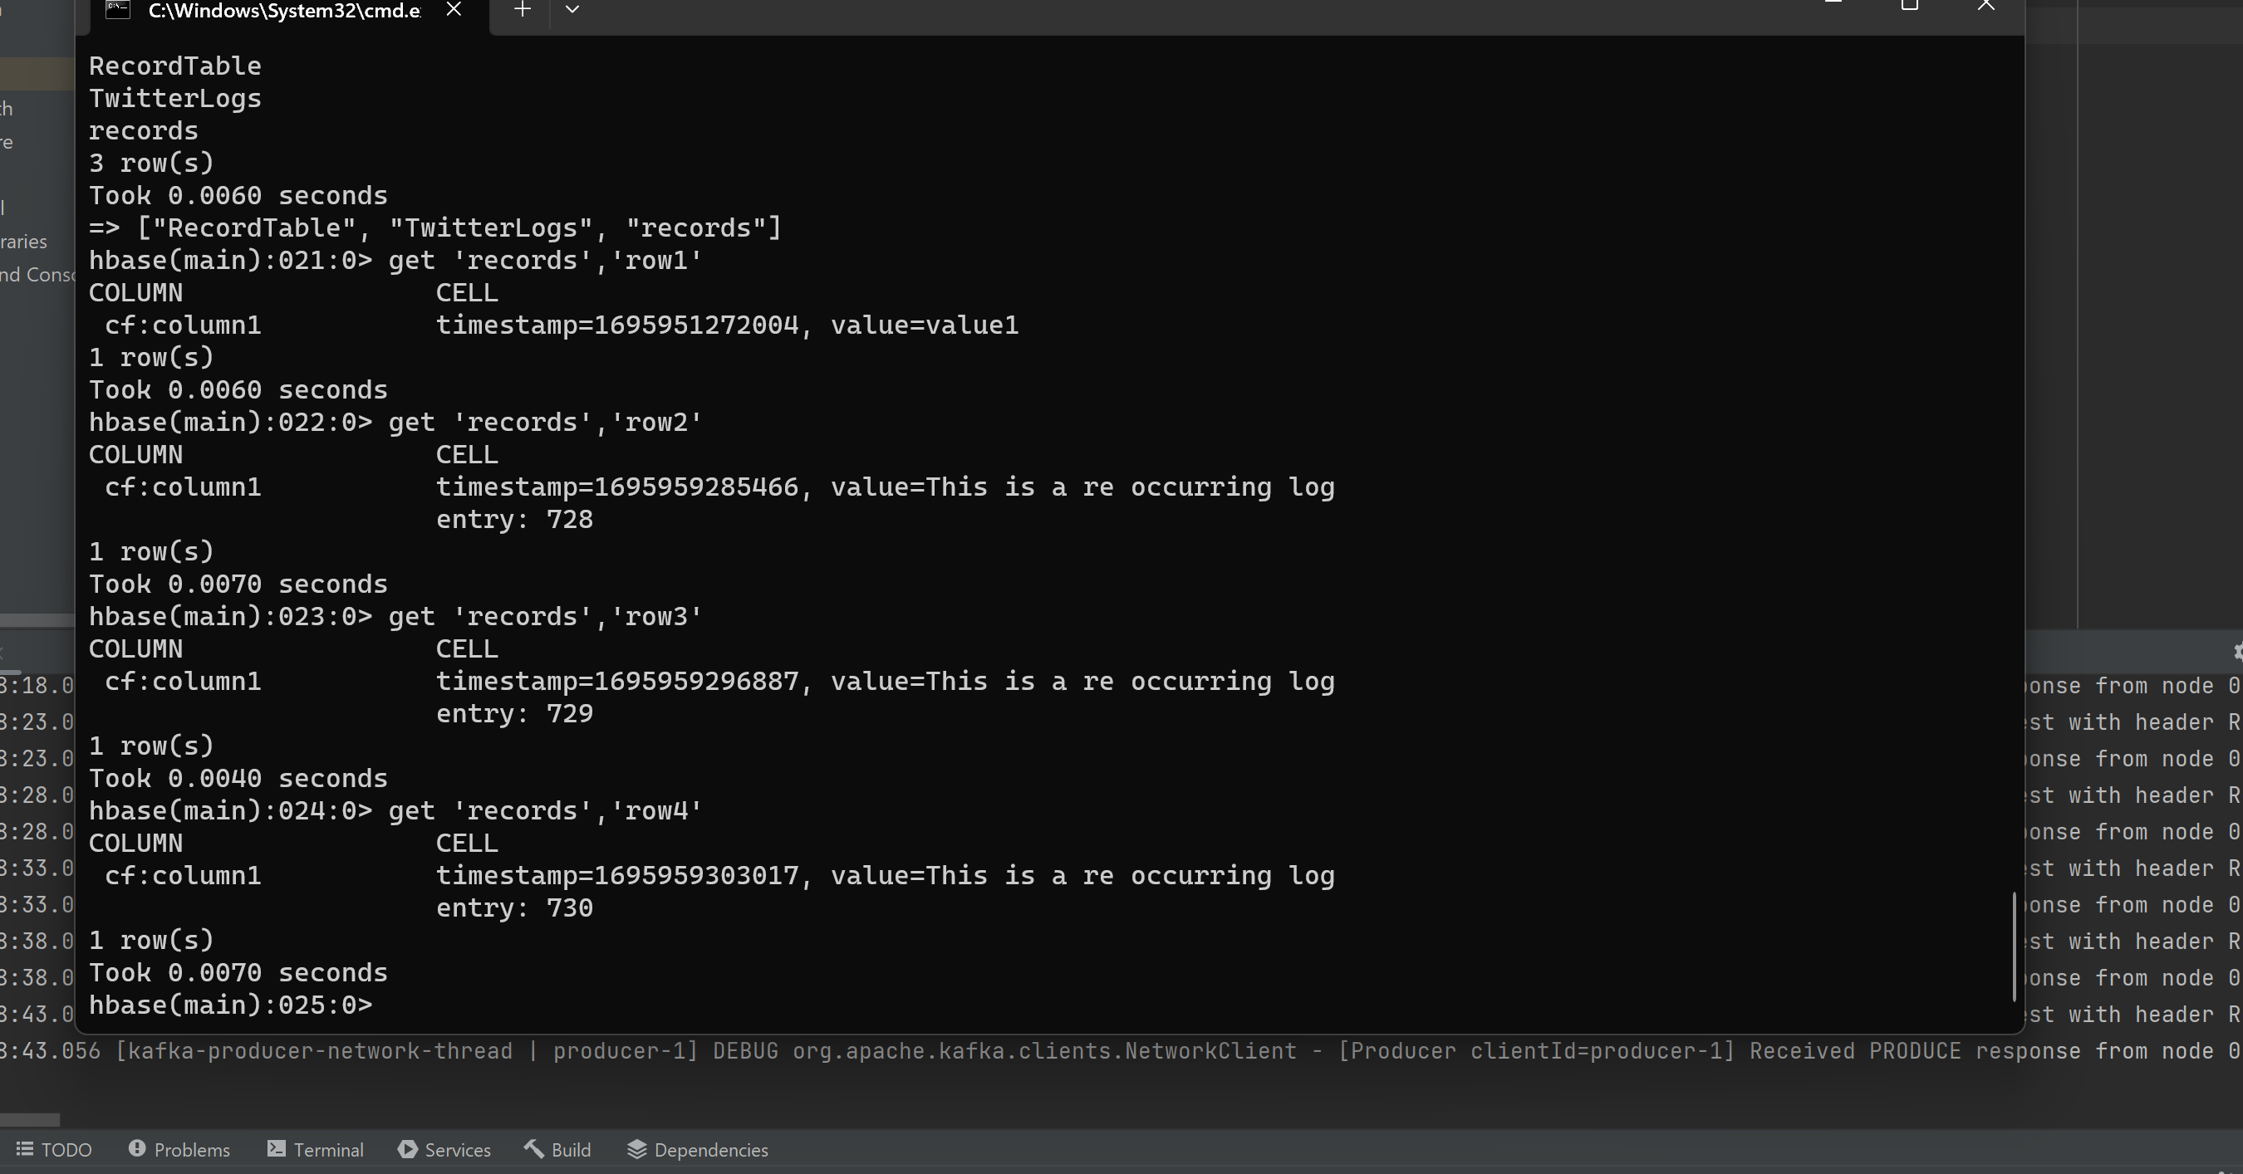
Cont’d

Slide 16
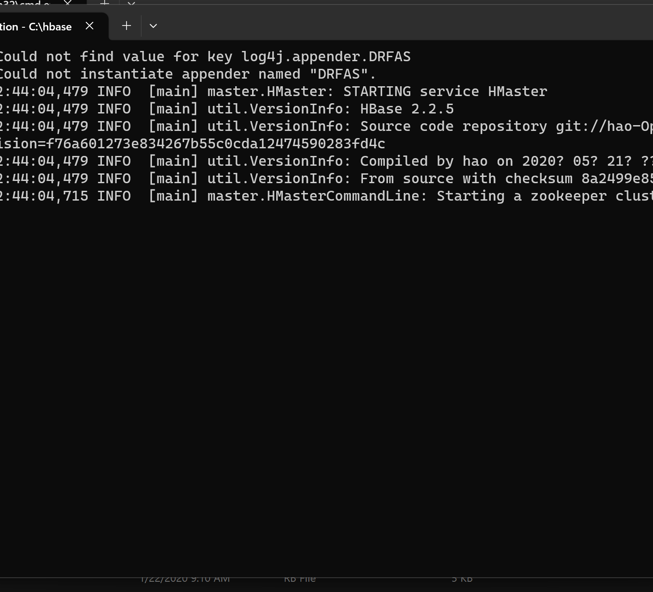
Cont’d

Slide 17
Wholeness of Project
In this project, we've harnessed a range of technologies including Kafka, Spark, HBase, FLUME, among others, to gather tweets from Twitter and conduct insightful analyses.
Additionally, we explore the realm of Consciousness Science and Technology. Our journey involves delving into the layers of creation and uncovering the unified field of consciousness. To achieve this understanding, we engage in a daily practice of Transcendental Meditation. Through this practice, we witness positive transformations in our daily lives, sometimes even finding that nature itself offers its support along the way.
Notes:
Notes:

Slide 18
ANY
Notes:
Notes:

Slide 19
THANK YOU

