Slide 1
Fraud Detection Using Machine Learning
Presented by: Ashish

Slide 2

Financial fraud is a major threat, causing significant losses and eroding trust. This project leverages machine learning to develop a fraud detection model, enabling financial institutions to identify and prevent fraud in real-time.
By accurately distinguishing between legitimate and fraudulent transactions, this model safeguards businesses and customers from financial losses and protects institutional reputation.

Slide 3
Value:
• Reduce financial loss
• Improve fraud monitoring
• Strengthen transaction safety
Objectives:
• Perform EDA
• Engineer features
• Handle imbalance with SMOTE
• Train ML models
• Evaluate performance

Slide 4
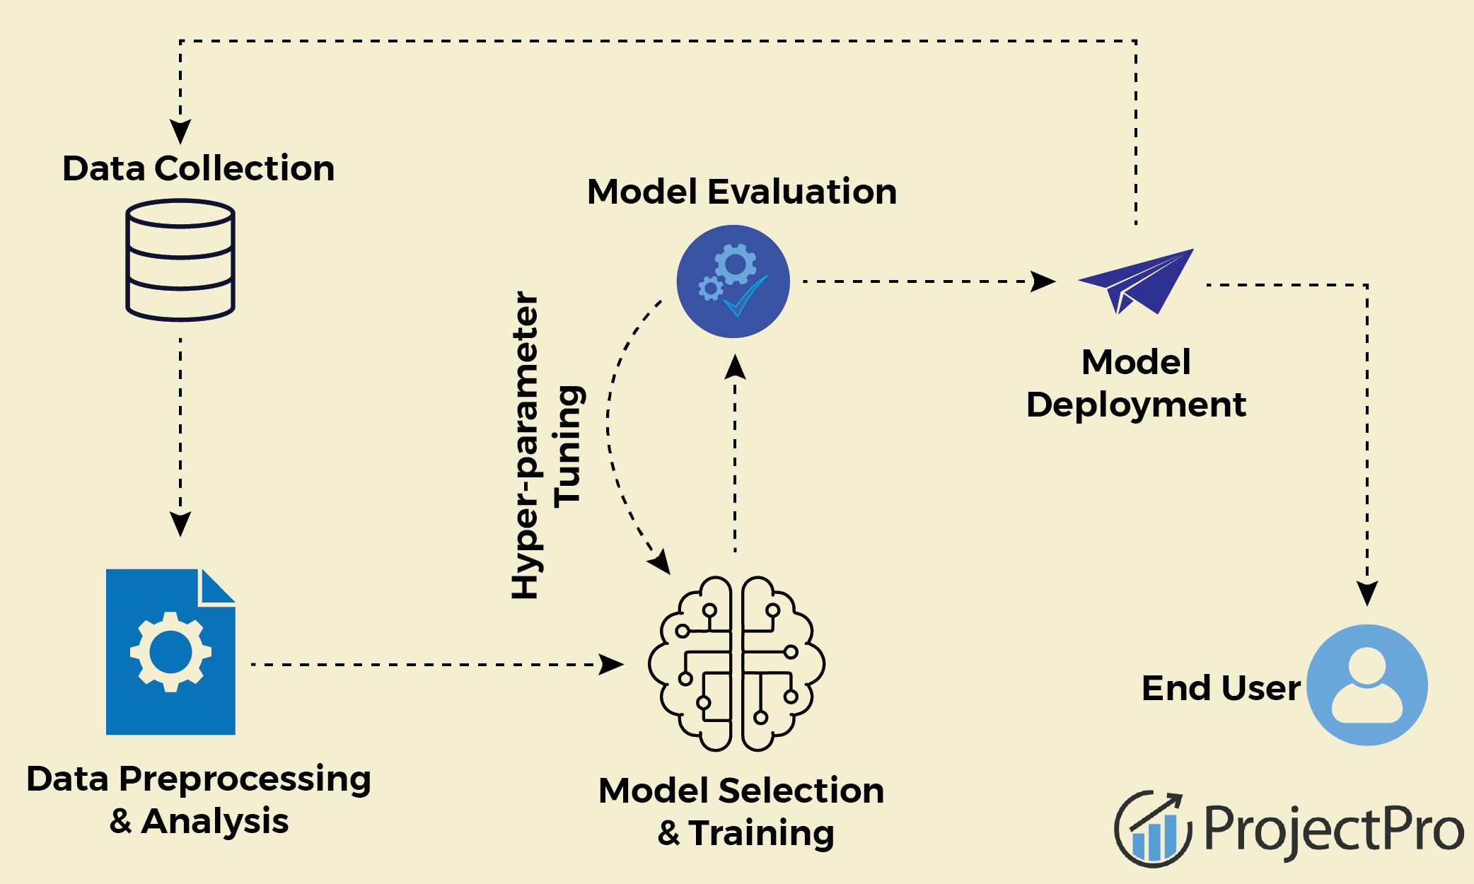
Workflow
1. Data Collection
2. Exploratory Data Analysis
3. Feature Engineering
4. Scaling & Encoding
5. Train–Test Split
6. SMOTE Oversampling
7. Model Training
8. Evaluation
9. Model Deployment

Slide 5
Dataset Overview
step - maps a unit of time in the real world. In this case 1 step is 1 hour of time.
type - CASH-IN, CASH-OUT, DEBIT, PAYMENT and TRANSFER.
amount - amount of the transaction in local currency.
nameOrig - customer who started the transaction
oldbalanceOrg - initial balance before the transaction
newbalanceOrig - new balance after the transaction.
nameDest - customer who is the recipient of the transaction
oldbalanceDest - initial balance recipient before the transaction.
newbalanceDest - new balance recipient after the transaction.
isFraud - This is the transactions made by the fraudulent agents inside the simulation. In this specific dataset the fraudulent behavior of the agents aims to profit by taking control or customers accounts and try to empty the funds by transferring to another account and then cashing out of the system.
Dataset: Fraud_Analysis_Dataset.csv
Features:1) step
2) type
3) amount,
4) nameOrig
5) oldbalanceOrig
6) newbalanceOrig
7) nameDest
8) oldbalanceDest
9) newbalanceDest
Target: isFraud (0=genuine, 1=fraud)

Slide 6
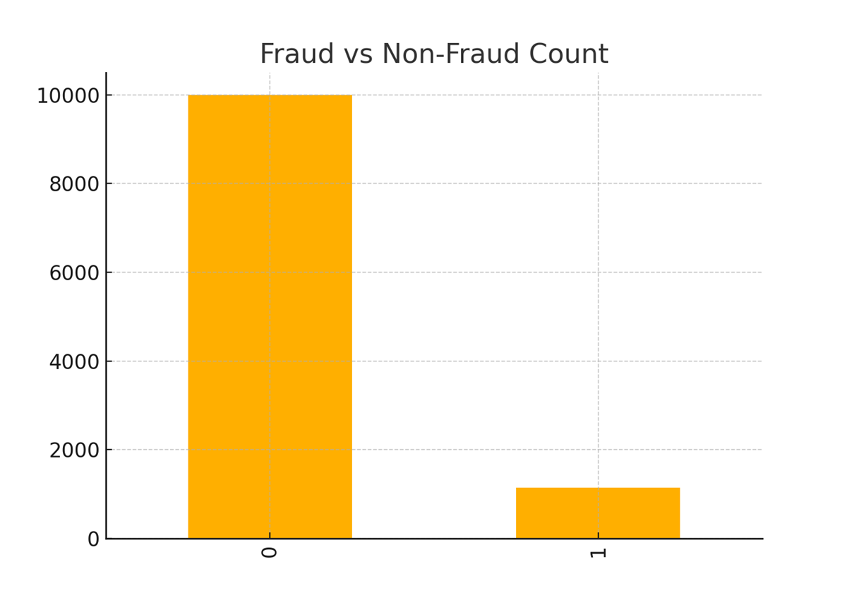
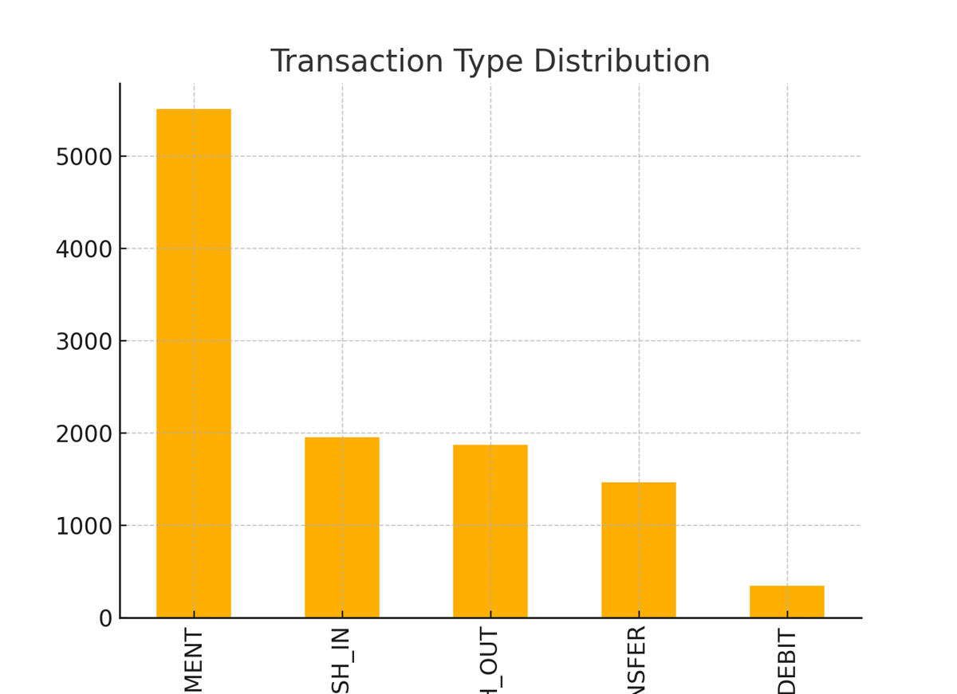
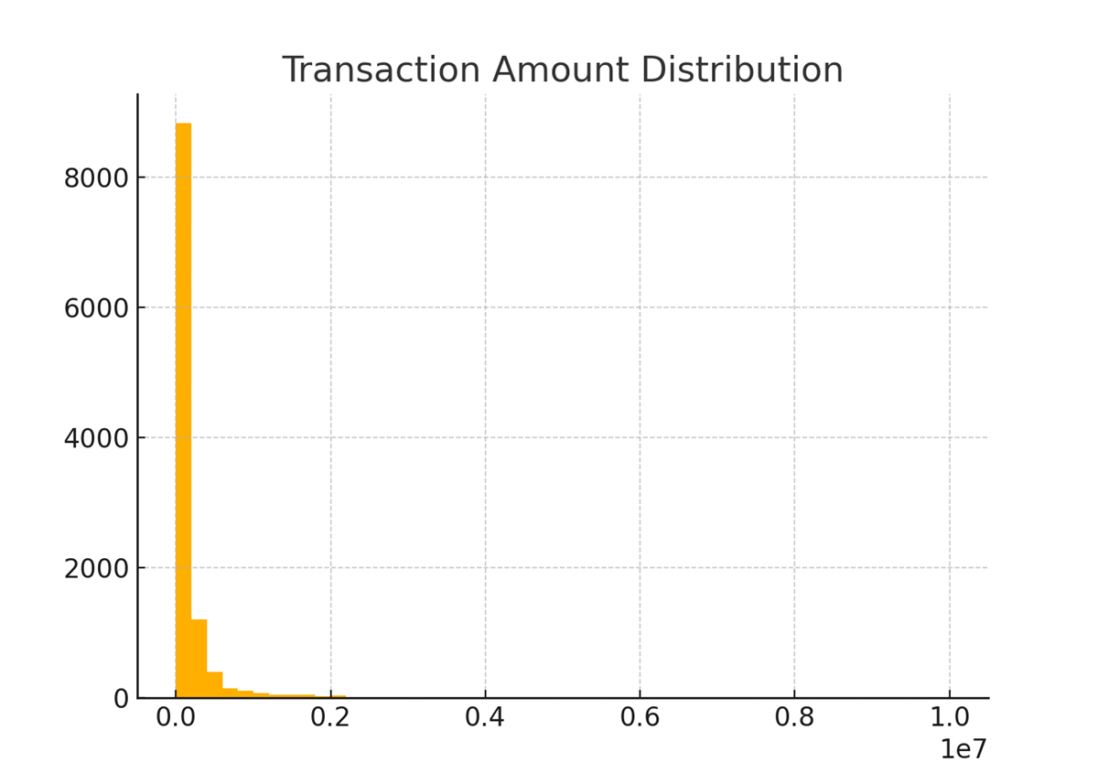
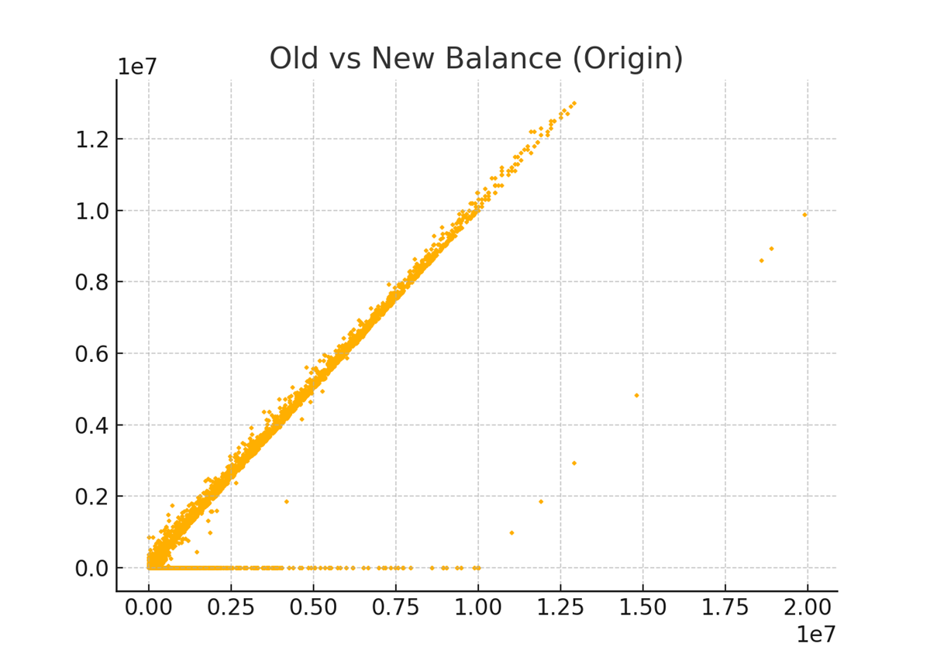
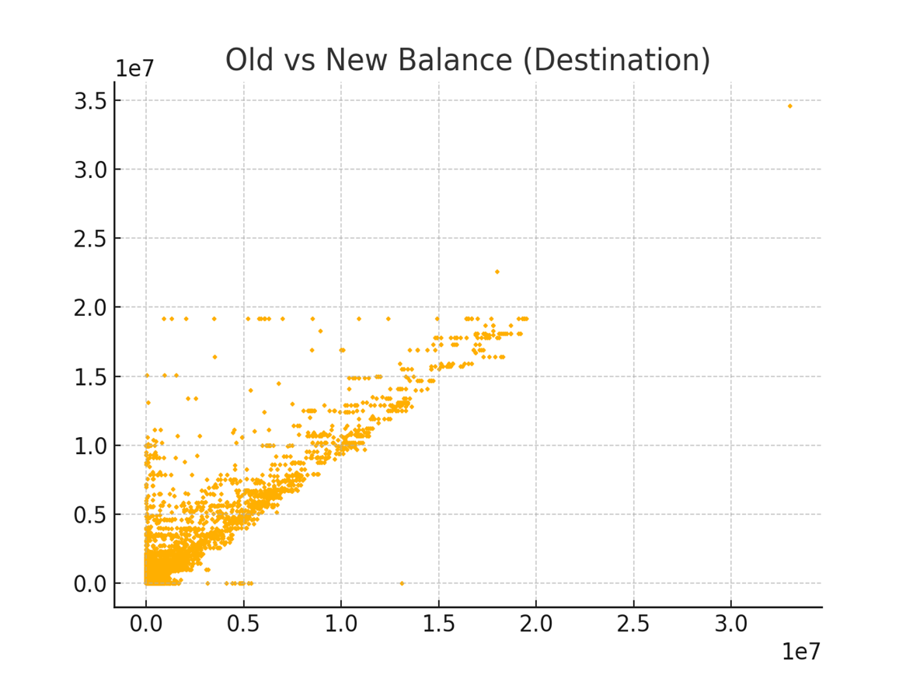
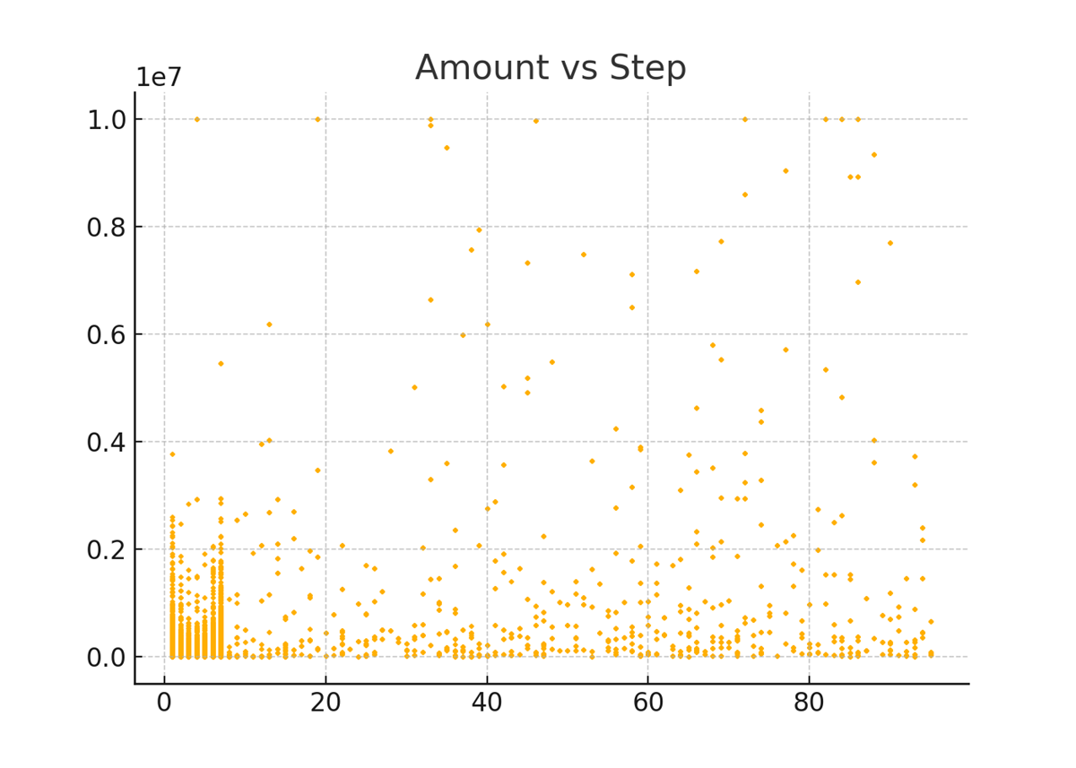
Exploratory Data Analysis
EDA reveals:
• Heavy class imbalance
• Presence of outliers
• Skewed amount distribution
• Strong relationships in balance diffs

Slide 7


Fraud cases are much fewer compared to non-fraud.
This dataset is imbalanced, meaning you must use SMOTE, class weights, or balanced sampling while training ML models.
PAYMENT transactions are the most common.
TRANSFER and CASH_OUT are known to be highly associated with fraud in many real-world datasets.
You may want to isolate specific transaction types for fraud modeling.

Slide 8


Most transactions are very small.
A few transactions are extremely large (millions), creating a heavy right skew.
Fraudsters often attempt abnormally large amounts.
Many transactions follow a straight-line pattern → amount deducted correctly.
Many points drop to zero new balance, meaning account was emptied.
Suspicious transactions often show large drop to zero or inconsistent patterns.

Slide 9

Receivers often go from 0 to large values suddenly.
Fraud transactions frequently show sudden big balance increases.
High-value transactions happen throughout time.
No clear trend — fraud can occur at any time step.
Some time steps have dense activity (clusters), useful for temporal modeling.

Slide 10
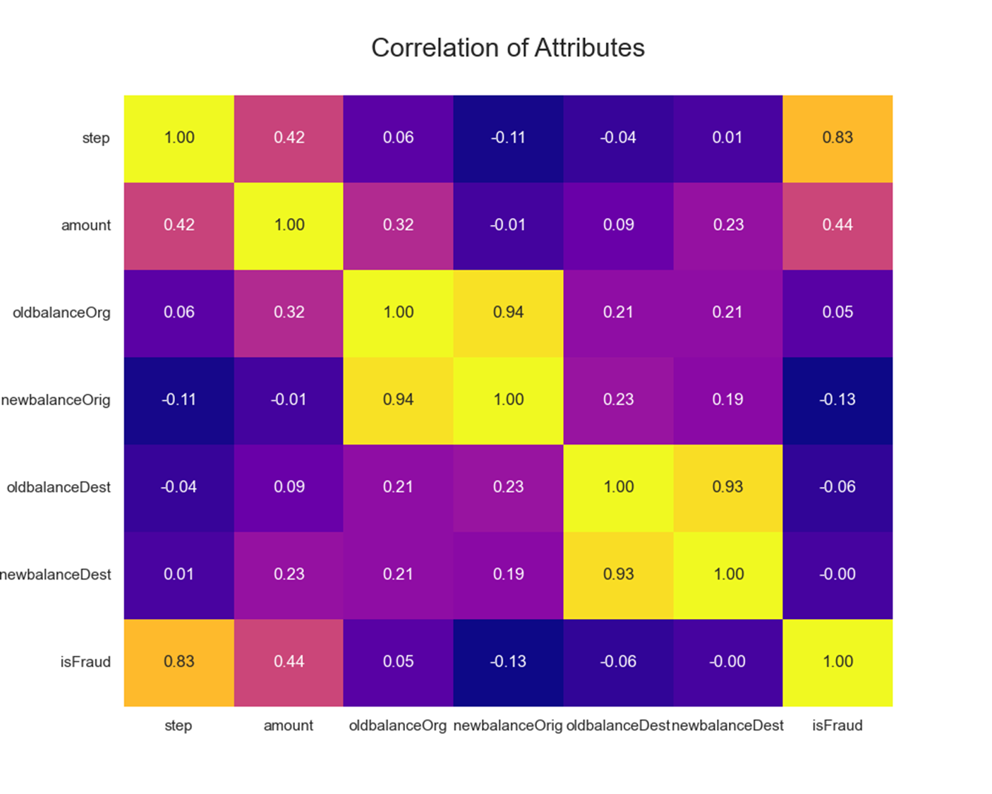
step → isFraud = 0.83This is a very high positive correlation. It means frauds happen more often at specific time steps (blocks of hours).This makes step an important feature for your model.
oldbalanceDest and newbalanceDest
are highly correlated.so we can remove one of them.
newbalanceDest has no correlation
with Target .So we can drop this
Feature.

Slide 11
Feature Engineering
Feature engineering was applied to create new features and transform existing ones to improve the model's ability to detect fraud.
New feature: 1) origDiff
2) destDiff
df['origDiff'] = df['oldbalanceOrg'] - df['newbalanceOrig’]
df['destDiff'] = df['oldbalanceDest'] - df['newbalanceDest']

Slide 12
Preprocessing
• Dropped irrelevant columns
df.drop(["nameOrig","nameDest","newbalanceDest","oldbalanceDest"],axis=1,inplace=True)
• Encoded categorical variables
new_cat_col=df.select_dtypes(include="object").columns
for col in new_cat_col:
df[col]=LabelEncoder().fit_transform(df[col])
• Handle outliers using RobustScaler()
df[new_num_col]=RobustScaler().fit_transform(df[new_num_col])

Slide 13
Model Selection and Training
>> A range of machine learning algorithms were tested to identify the
best fit for detecting fraudulent activities.
Logistic
Regression
Decision Tree
Classifier
Test Data
30%
Training Data
70%
Random Forest
Classifier
Support Vector
Machine
Classifier

Slide 14
Model Performance Evaluation
Models were trained on 70% of the dataset (x_train and y_train) and tested on the remaining 30% (x_test and y_test).
Performance was assessed using metrics like accuracy, precision, recall, F1-score.
A table or chart can be used to display these metrics for each model.
Classifier | Precision | Recall | F-1 Score | Accuracy
Logistic Regression | 0.98 | 0.90 | 0.94 | 0.98
Decision Tree | 0.97 | 0.97 | 0.97 | 0.99
Random Forest | 1 | 0.97 | 0.98 | 0.99
SVC | 0.97 | 0.63 | 0.77 | 0.96

Slide 15
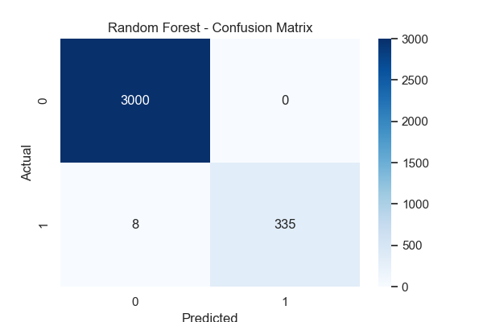
Results & Interpretation
Performance Metrics:
• Accuracy= 0.99
• Precision=1
• Recall =0.97
• F1-score =0.98
Random Forest shows strongest recall for fraud detection

Slide 16
Conclusion
This project successfully developed a highly reliable fraud detection system using the Random Forest Classifier. Through data exploration, feature engineering, and model evaluation, we determined that the Random Forest is the most effective model, achieving perfect precision, recall, and accuracy on the training data. This indicates its strong potential to reduce financial losses and improve security by accurately detecting fraudulent transactions while minimizing false positives. Although further testing on unseen data is advised to confirm real-world effectiveness, this project lays a solid foundation for deploying a robust fraud detection solution.
Key Takeaways
EDA: Provided valuable insights into transaction patterns and fraud indicators.
Feature Engineering: Improved the model's ability to identify complex patterns.
Model Selection: Chose the Random Forest Classifier as the best-performing model.
Performance: Achieved perfect precision, recall, and accuracy on training data.
Financial Impact: Potential to significantly reduce losses from fraud.

Slide 17
Questions ?

Slide 18
Thank You!

