Slide 1
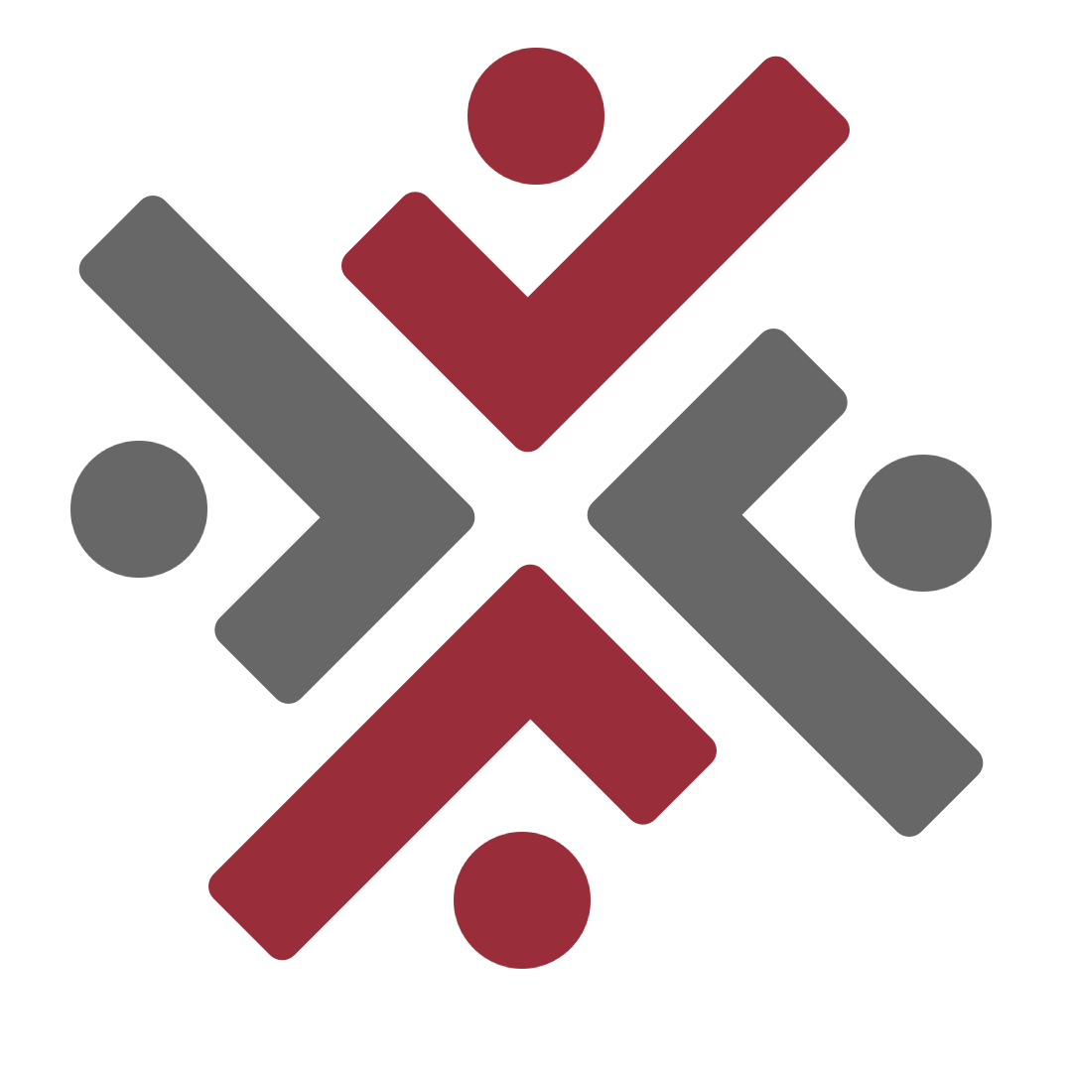
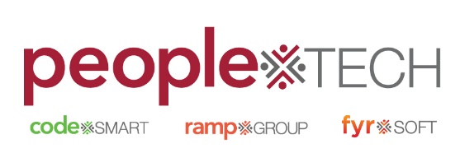
Agile , Waterfall Methodology
By: S.Ashish
A Quest Global Company

Slide 2
Agile Method:
Iterative development approach focused on collaboration, flexibility, and customer feedback.

Slide 3
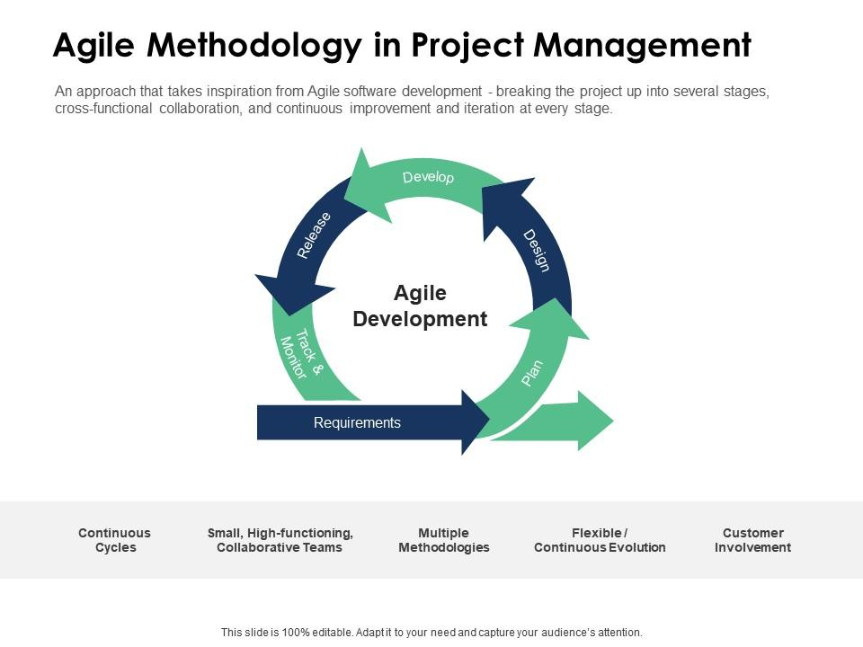

Slide 4
What is Agile?
Agile is an iterative approach where work is divided into small, manageable chunks.
Emphasizes collaboration among cross-functional teams and continuous delivery.
Common Agile frameworks: Scrum, Kanban, XP (Extreme Programming).

Slide 5
Principles of Agile
Customer collaboration over contract negotiation.
Responding to change over following a plan.
Working software over comprehensive documentation.
Individuals and interactions over processes and tools.

Slide 6
Benefits of Agile
Faster time-to-market.
Flexibility to accommodate changes during the project.
Continuous improvement through feedback loops.
High customer satisfaction.

Slide 7
Waterfall Method:
Traditional linear approach, where each phase must be completed before moving to the next.

Slide 8
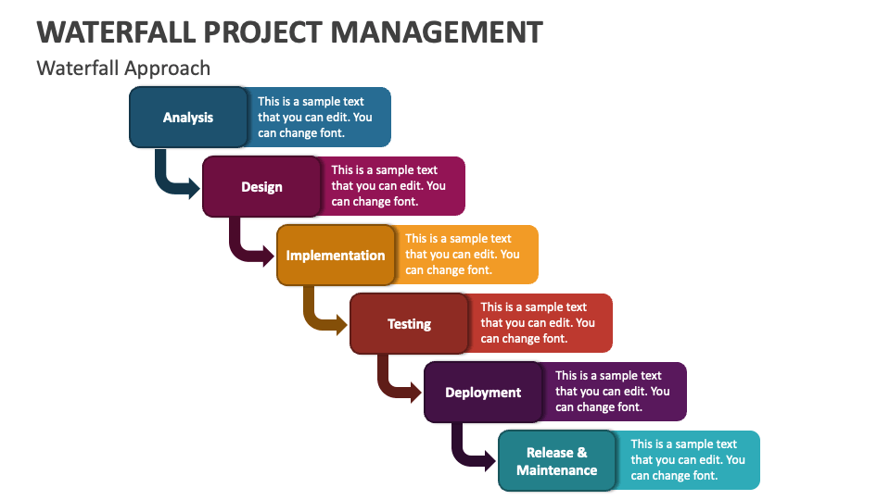

Slide 9
What is Waterfall?
Waterfall is a sequential design process where progress flows in one direction, like a waterfall.
Each phase (e.g., Requirements, Design, Implementation, Testing) is completed before moving to the next.
Often used in highly regulated industries or for projects with well-defined requirements.

Slide 10
Phases of Waterfall
Requirements gathering: Collecting all project requirements.
System design: Architectural design and specifications.
Implementation: Writing code based on design specifications.
Testing: Systematic testing of the implemented system.
Deployment: Releasing the system into the production environment.

Slide 11
Benefits of Waterfall
Easy to understand and manage.
Well-documented process, making it ideal for regulated industries.
Clear project milestones and timelines.

Slide 12
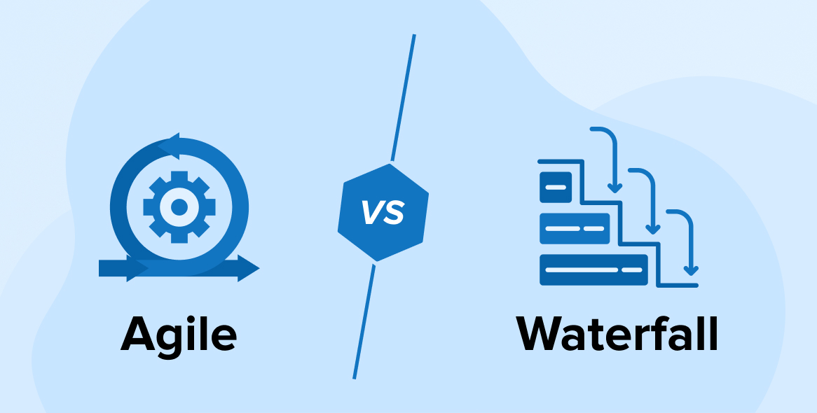

Slide 13
Agile vs. Waterfall (Comparison)
Feature | Agile | Waterfall
Approach | Iterative & Incremental | Sequential & Linear
Flexibility | High, welcomes change | Low, changes are difficult to manage
Timeline | Continuous delivery | Fixed deadlines and stages
Risk | Low risk with frequent releases | Higher risk due to long phases
Customer Feedback | Continuous feedback & collaboration | Minimal feedback, mostly at the end
Documentation | Light documentation | Heavy documentation

Slide 14
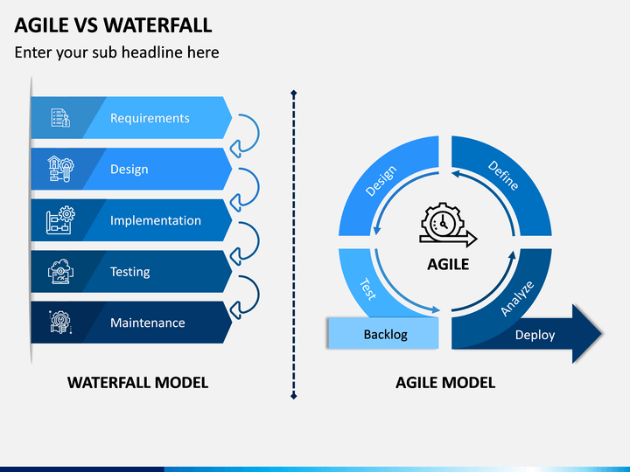

Slide 15
When to Use Agile
Projects with unclear or evolving requirements.
Projects needing frequent changes or updates.
High customer interaction and collaboration is essential.

Slide 16
When to Use Waterfall
Projects with clearly defined requirements and low chances for change.
Industries with regulatory constraints (e.g., healthcare, aerospace).
Large projects with extensive documentation requirements.

Slide 17
Conclusion
Both Agile and Waterfall have their strengths and weaknesses.
Agile is best for dynamic, flexible projects that require quick adaptation.
Waterfall is best for projects that are well-defined, have a fixed scope, and are unlikely to change.

Slide 18

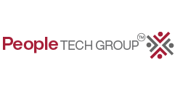
Thank You...

