Slide 1
Catalogue:
Content Guidelines

Slide 2
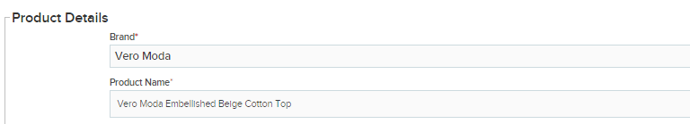
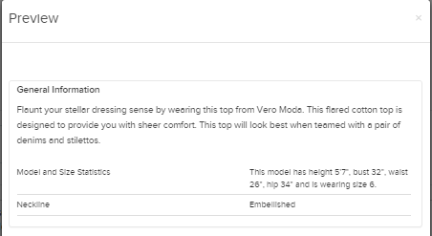
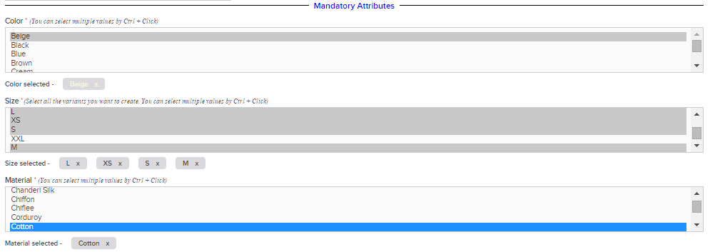
Introduction
A catalogue should include all necessary information about a product so customers can make an informed purchase decision. A catalogue page, also called the Product Details page, typically includes:
Product name
Product description
Product attributes – mandatory and optional fields
Product Name
Product Description
Product Attributes

Slide 3
Topics
Product Name
Product Description
Product Attributes

Slide 4

Importance and Components of Product Name
Product name is the most critical elements of your catalogue as it directly determines how many views your product will receive. After images, an informative product name plays a vital role in grabbing the interest of your potential customers. Typically, a product name should include the following components:
Components of Product Name |  | Example
Brand | Always mention the name of the brand or the designer in the beginning. | Nike, Levi’s, HP, Samsung
Model Number/Name | You must mention the accurate model number or name in the product name, especially for electronics. | Nike Air Zoom Structure 19, Levi's 2 Horse Tee, Dell Inspiron 15 3542 Notebook, Samsung Galaxy S6 Edge
Colour | Include the colour of the product when. | --
Product Type | Always Include the type or leaf category of the product. | Running shoes, casual t-shirt, gaming laptop, smart phone

Slide 5
Guidelines
While adding a product name, you should follow the below guidelines.
Do not add misleading keywords that does not accurately describe your product.
Do not use special characters, punctuations or asterisks. This reduces the searchability quotient of your product.
Absolutely avoid typos or spelling errors in product names as it reflects poorly on your listing.
Avoid using any acronyms or abbreviations. Customers may not know what they stand for.
Absolutely avoid using all upper case as it reduces readability.
Never use words like 100% genuine or original
Always use searchable keywords that accurately describe your product.
Use correct spellings as typos are not search engine optimised.
Always use title case; i.e. the first letter of every word should be in upper case. For example, Red Cotton Levi’s T-shirt
Add all important product specifics in the product name.

Slide 6
Incorrect vs. Correct Product Names
Here are some and good examples of product names:
Levi’s Denimx , Slim Fit (Boys)
Why is this incorrect?
Important information like brand and colour are missing.
Contains special characters, such as comma (,).
There are typos.
Levi's Men 511 Navy Blue Slim Fit Jeans
Why is this correct?
‘Jeans’ has replaced ‘Denimx’ to make it search engine optimised.
Special characters have been removed.
Dell 17 inch laptop
Why is this incorrect?
Model number is missing.
Key features have not been included.
Casing standard has not been followed; inch is in lower case.
Dell 17 Alienware (AW17781 TB2A1) (4th Gen Core i7/8 GB DDR3 /1TB /43.18 cm (17)/Windows 8/2 GB ) (Grey)
Why is this correct?
Model name and number have been added.
Key informative features have been added to increase searchability.

Slide 7
Topics
Product Name
Product Description
Product Attributes

Slide 8
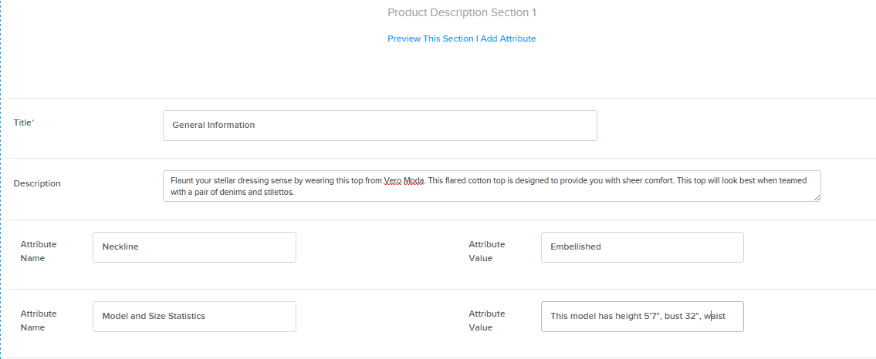
Importance and Components of Product Descrition
Product description is your opportunity to provide more information about your product. A powerful product description should summarise:
Why your customer should buy the product
The key features of the product in case of electronics
Different uses and benefits
Suggested occasions and size guide in case of apparels and footwears
Warranty details of the products in case of electronics and home appliances
Additional attributes that are not listed under mandatory or optional fields.
Tip: After adding the content and attributes in the product description section (in Seller Panel), always preview it to check how this section will look on the website.
Product Description Section
Product Description Preview

Slide 9
Guidelines
While adding a product description, you should follow the below guidelines.
Do not use misleading information that does not describe your product.
Avoid creating long, lengthy descriptions as most customers will not read them.
Avoid using negative sentences to grab a customer’s attention.
Do not use product descriptions copied word-to-word from other listings in Paytm or other e-commerce websites.
Use searchable and relevant keywords to make it search engine optimised.
Always keep the language simple and crisp, and follow basic rules of grammar.
Use correct spellings as typos are not search engine optimised.
Always use sentence case; i.e. only the first letter of every sentence should be in upper case. For example, Make a distinct style statement wearing this black dress from Zara.
Use multiple Product Description sections to describe each attribute of your product.
Use bullet points as they are easy to read.

Slide 10
Poor vs. Good Product Descriptions
Here are some and good examples of product names:
Stylish and cool Levi's Blue Cotton Jeans For Men
More than 140 years after inventing the blue jeans, one thing is clear: Levi’s clothes are loved by the people who wear them—from presidents to movie stars, farmers to fashion icons, entrepreneurs to the everyman. 'Live in Levi’s’ asserts with confidence and pride that Levi’s clothes are indeed for everybody who is not just anybody.
Silver Men chronograph watch by Gyanemdra shop phone no. 74629e493 please contact in case of issue.
Legend watches are here for stylish men. Grab this sophisticated piece of accessory telling time and statement of fashion. This decorative wristwatch is a top choice for gentlemen and professionals. Moreover, it adds that extra oomph factor to your dressing.

Slide 11
Topics
Product Name
Product Description
Product Attributes

Slide 12
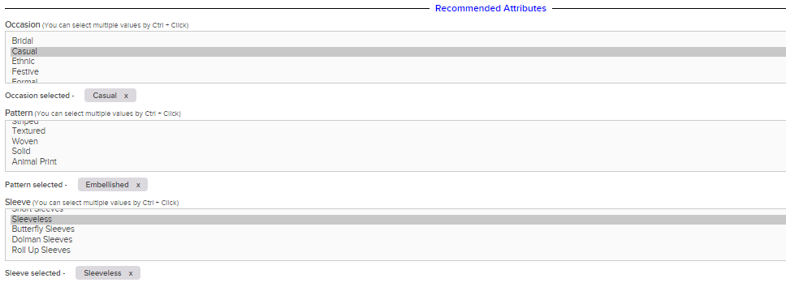
Importance of Product Attributes
Product attributes is the section where detailed features of your products need to be mentioned. This is the section that helps customers find your product and informs them about your product . Therefore, you should add as many attributes as possible.
Our Product Detail page and catalogue templates have been divided into two parts for attributes:
Mandatory attribute fields
Optional attribute fields
Mandatory Attributes
Optional Attributes

Slide 13
Guidelines
Here are some things to keep in mind while listing the attributes of your products:
Always mention as many attributes as possible. This helps your customers make purchase decisions and ensures increase in sales.
Do not ignore optional attributes fields. Fill as many optional fields as possible.
Ensure that you select the value of the attributes from the options that are already provided in the template. This helps customers add filters and find your product easily.
In case of electronics, you should mention all mandatory and optional technical attributes accurately.

Slide 14

Thank you!

