Slide 1
Work Flow

Slide 2
Catalog Is Dumped By The Category/BD Team

Slide 3
Review Team Checks It For Errors

Slide 4
Review Team Checks It For Errors
Errors are reverted back to the CAT team in case of no errors passed to the Content Creation Team Lead

Slide 5
CAT connects with the merchant to fill in all the details required

Slide 6
CAT connects with the merchant to fill in all the details required

Slide 7
Review Team Checks It For Errors
If Everything Is There it is shared with the content creation team lead.

Slide 8
The lead assigns the catalog to the Creation SPOC

Slide 9
The SPOC creates the catalog

Slide 10
The Image and Crawling Team Helps them Image Team Crawling Team

Slide 13
After The completion of content creation
The catalog is passed to the QC team

Slide 14
Errors are reverted back to the Content SPOC

Slide 17
Once the catalog is checked it is passed to the Web QC/Uploading Team

Slide 18

Once the catalog is checked it is passed to the Web QC/Uploading Team

Slide 20
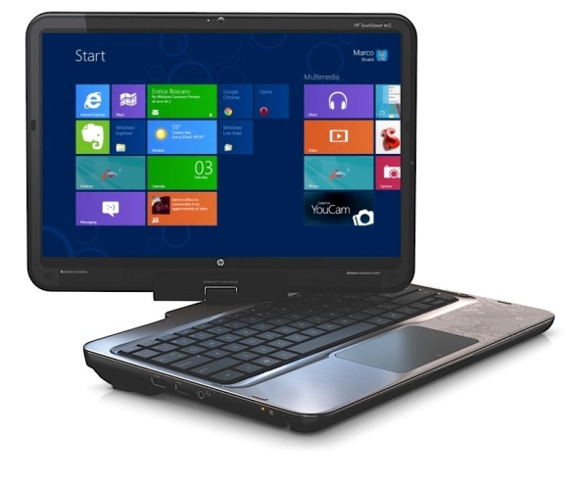
The Products Are Live now

