Slide 1


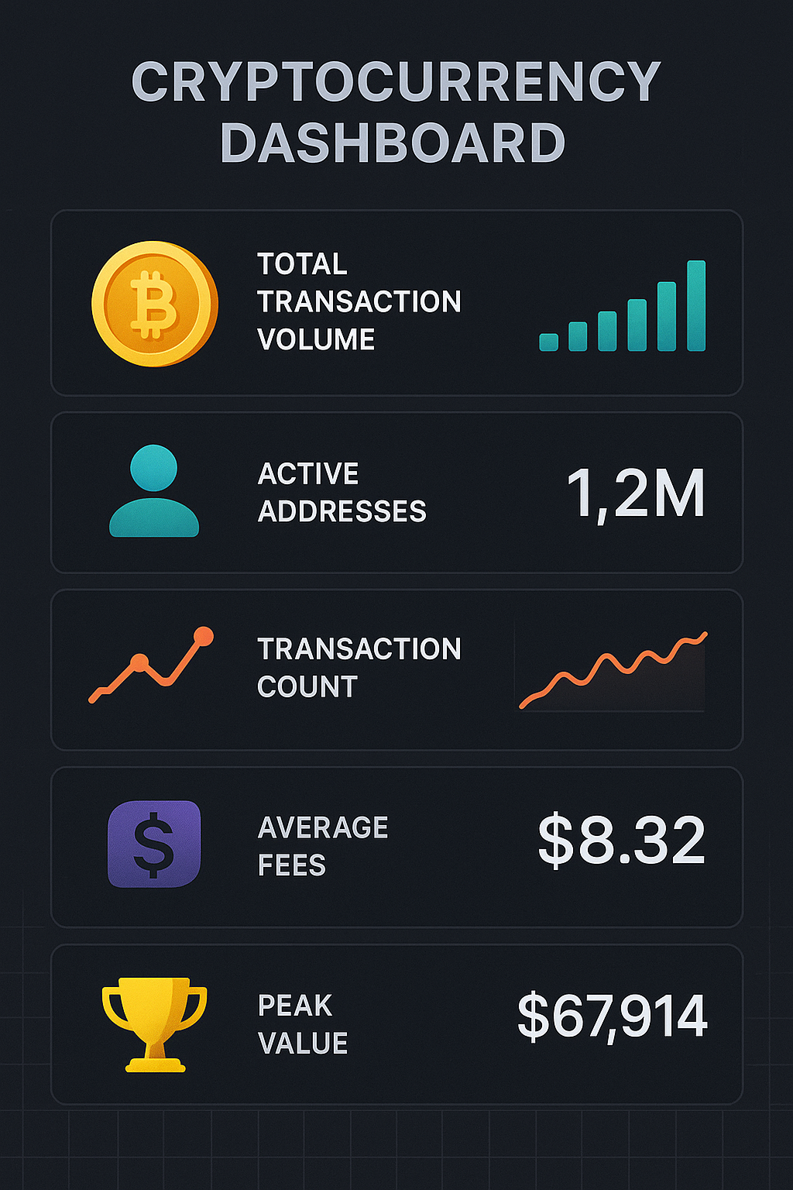
Cryptocurrency Transaction Analysis
Summer Training Project, August 2025
Team
Aru Shubham Singh (2400100100114)
Ashish Giri (2400100100122)
Avjeet Kumar (2400100100137)
Supervisor: Dr. Snehlata, Dept. of Computer Science, UCER

Slide 2


Abstract
Explores how blockchain transaction data is analyzed to find patterns, detect anomalies, and ensure security.
Uses advanced analytics, machine learning, and graph theory to trace transactions and identify illicit activities.
Focuses on how decentralized systems present unique challenges for analysis.
Highlights the importance of transparency, scalability, privacy, and regulatory compliance in cryptocurrency.

Slide 3

What is Cryptocurrency
Digital/assets (not physical) secured by cryptography.
Decentralized: No single authority controls supply or transactions.
Runs on blockchain technology—a distributed, public ledger.
Resistant to counterfeiting and double-spending due to its design.

Slide 4
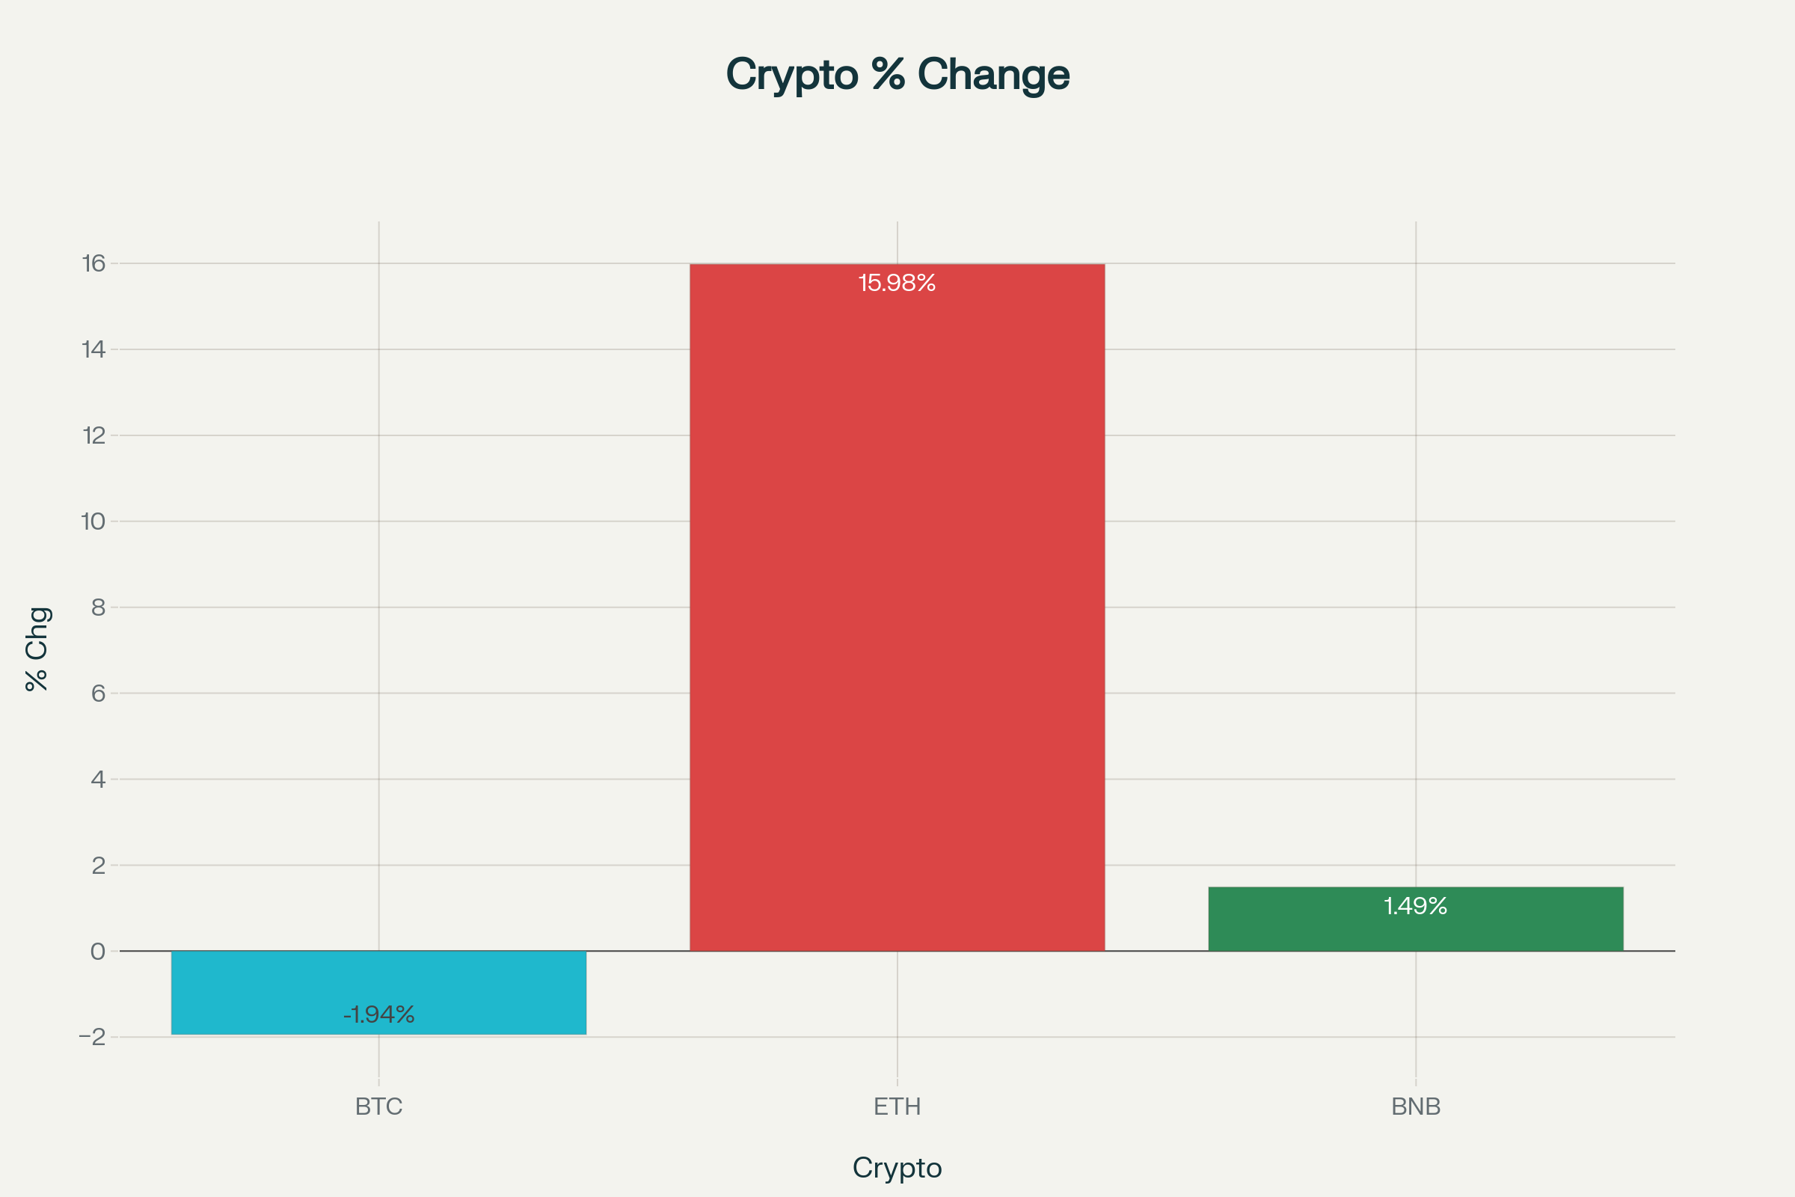

Top Cryptocurrencies
Bitcoin (BTC): The first and highest valued crypto, a reference standard.
Ethereum (ETH): Second largest, known for smart contracts (programmable money).
Binance Coin (BNB): Utility token for Binance exchange, 3rd by market cap.
Ripple (XRP): Used for fast, low-fee cross-border payments.
Many “altcoins” (other cryptos) exist with unique features.

Slide 5
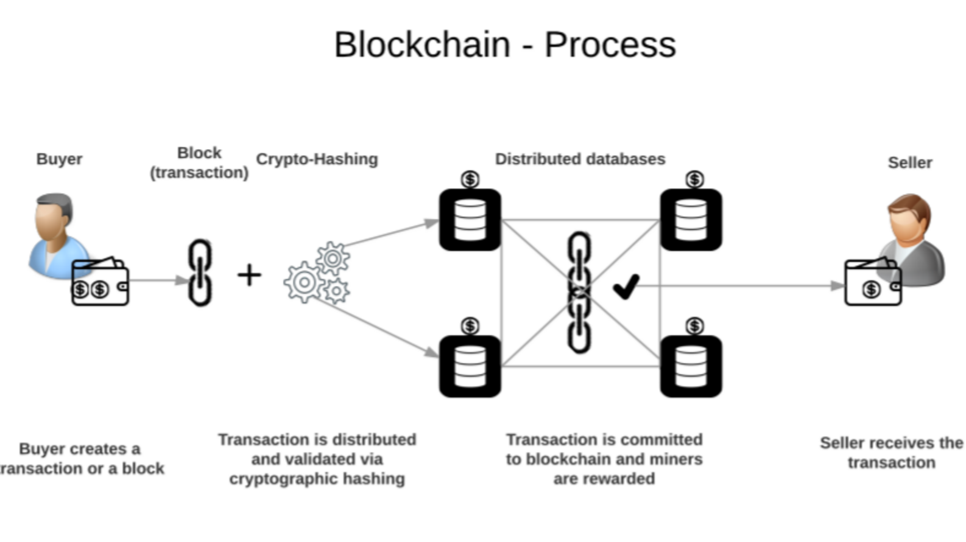
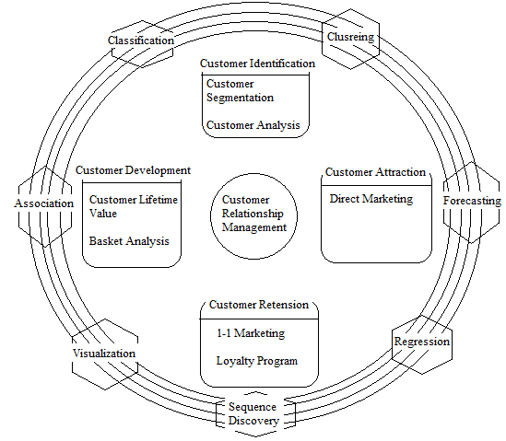
How Does Cryptocurrency Work?
Blockchain: Public ledger records all transactions.
Mining: New coins created by solving complex math (Proof of Work) or by holding tokens (Proof of Stake).
Wallets: Secure software/hardware stores, sends, or receives coins.
Transactions are broadcast and confirmed by network participants, not banks.

Slide 6
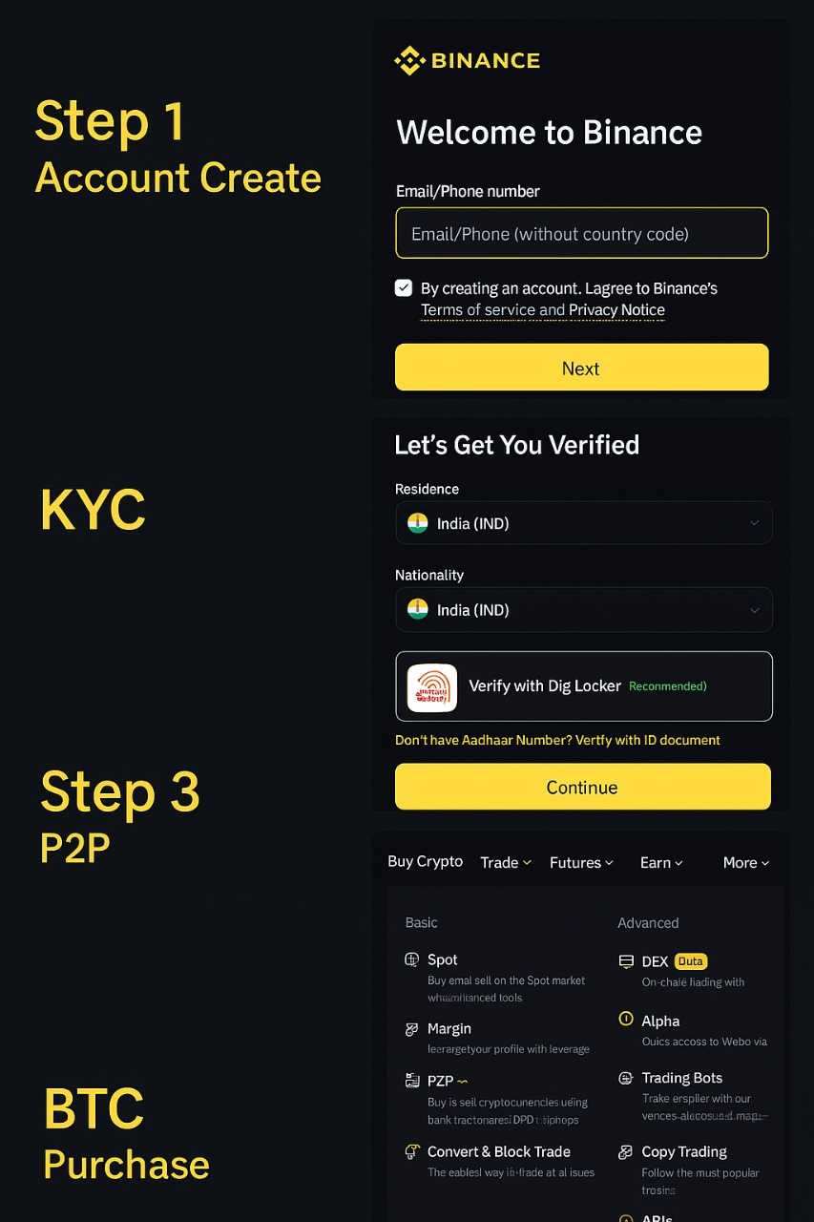
How to Purchase Cryptocurrency
Choose a reputed cryptocurrency exchange (Binance, Kucoin, CoinDCX, etc.).
Register using email/phone; complete identity verification (KYC).
Deposit money (often by buying USDT via P2P).
Select a coin, set amount, buy at market price, and track holdings in wallet.

Slide 7
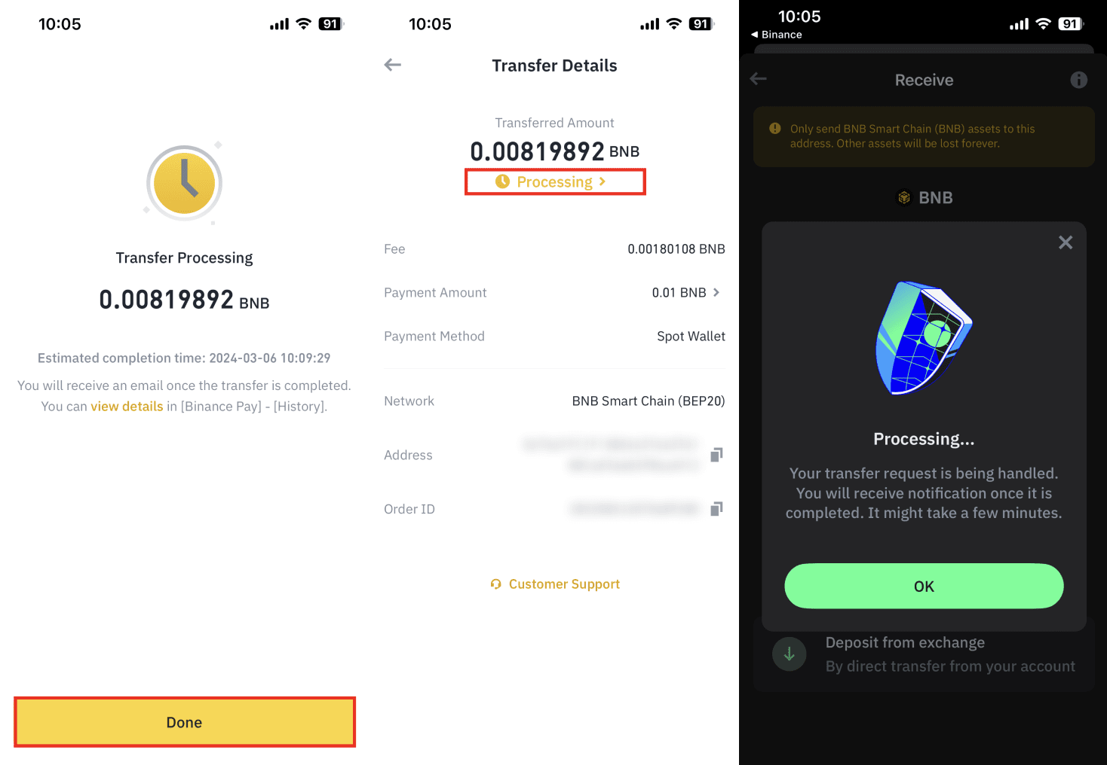
Key Cryptocurrency Transaction Terms
Transaction (Tx): Transfer of crypto from one wallet to another.
TxID (Hash): Unique code tracking each transaction.
Input/Output: Source & target addresses for funds.
Fees: Paid to miners/validators; speeds up confirmation.
Confirmation: Number of times a transaction is verified and added to blockchain.
UTXO: Unspent outputs ready to be used in future transactions.
Signature, Nonce, Memo: Security & tracking details within the transaction.

Slide 8
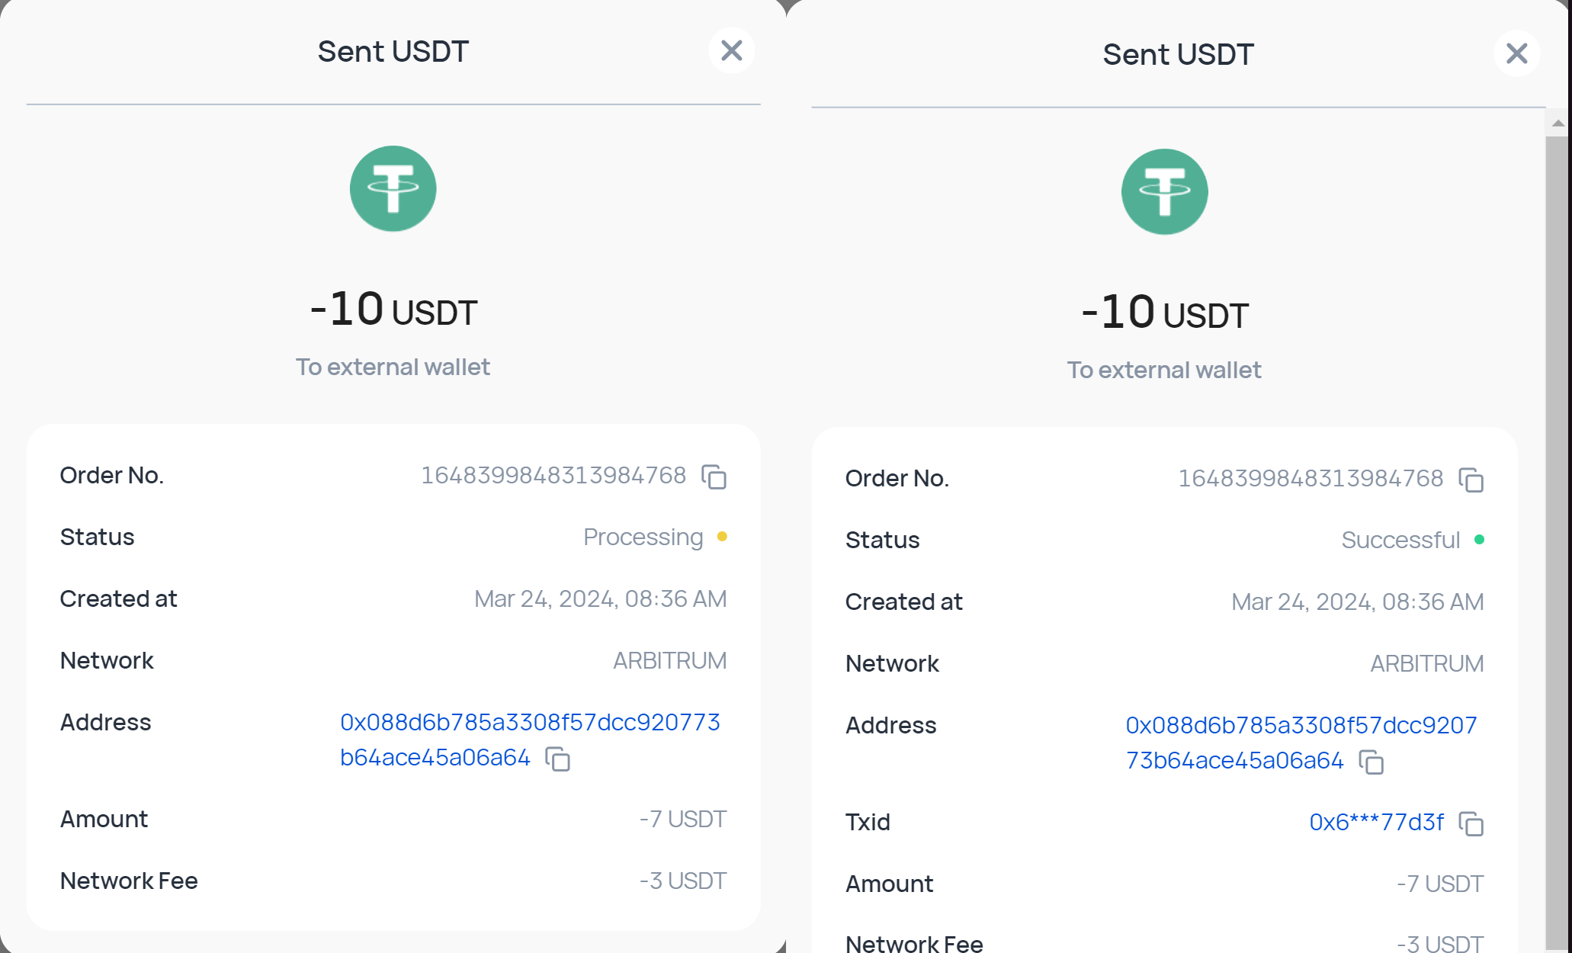
How Transactions Work ?
Initiation: Sender enters amount, address, sets (optional) fee.
Signing: Transaction is cryptographically signed.
Broadcast: Sent to network; seen by all nodes.
Verification: Nodes check validity, balances, signature.
Mempool: Awaiting confirmation, miners select for next block.
Block Inclusion: Miners add to a block, seek consensus.
Confirmed: Added to blockchain, visible to all, irreversible.
Recipient: Gets credited in their wallet.

Slide 9
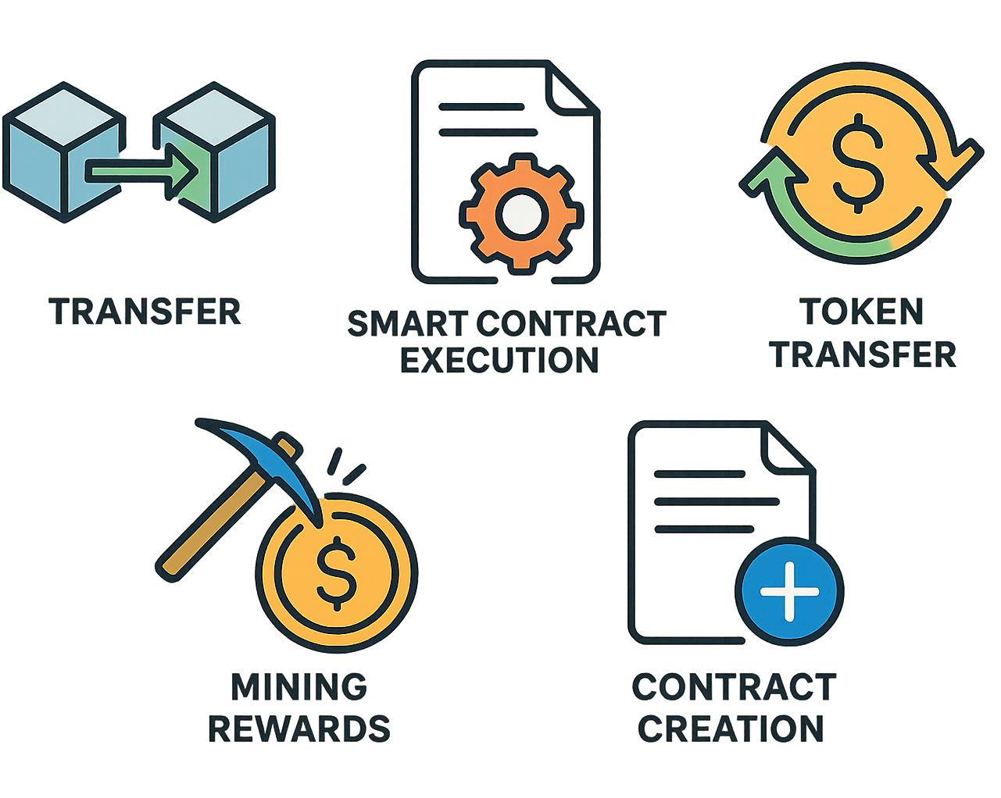
Types of Crypto Transactions
Transfer: Basic send/receive between wallets.
Smart Contract: Programmed actions (DeFi, NFT trades, etc.).
Token Transfer: Moving tokens built on top of blockchains (e.g., ERC20 on ETH).
Mining Rewards: Newly minted crypto to miners/validators.
Contract Creation: Deploying new code/smart contracts to the blockchain

Slide 10
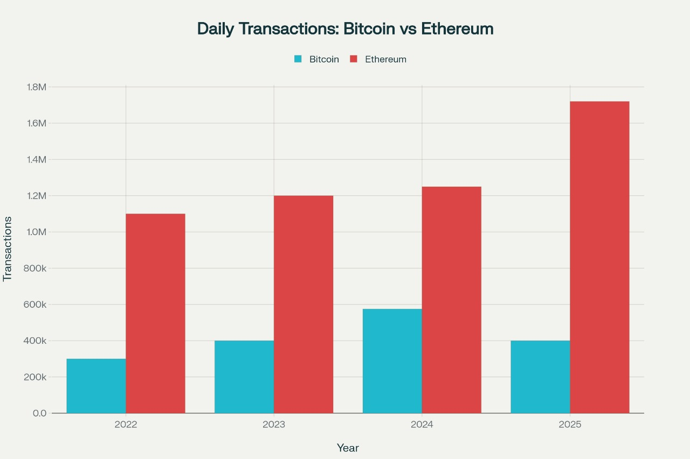
BTC & ETH Transaction Analysis
Number of transactions can be measured by year, month, day.
BTC: High-value, slower, higher fees.
ETH: More frequent transactions due to DeFi & NFTs.
Growth shows increasing adoption and expands variety of use-cases.

Slide 11
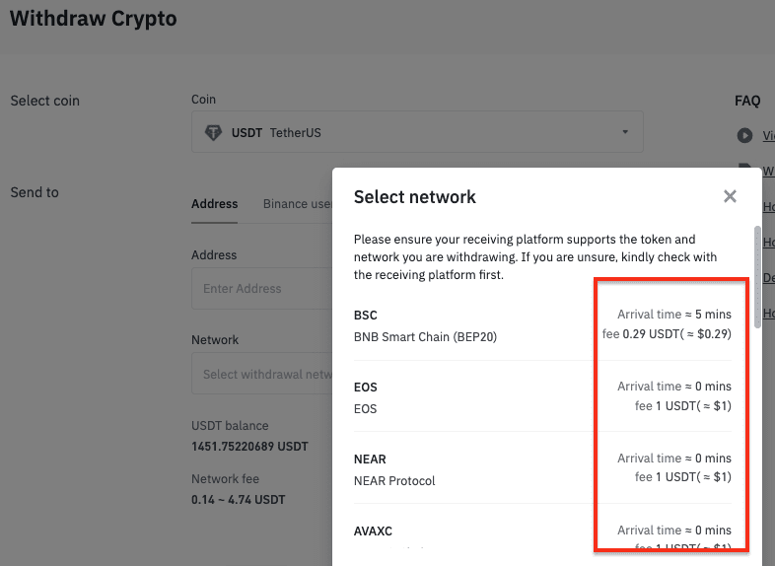
Transaction Fees
Paid to miners/validators for processing.
Fluctuate with demand and network congestion.
BTC: Calculated per byte of transaction.
ETH: Depends on “gas” used for operations.
Can be reduced by timing, batching, and using fee optimization tools.

Slide 12

Cryptocurrency Vulnerabilities
Exchange & Wallet Hacks: Large targets for theft.
Endpoint Vulnerability: Attacks on wallets/interfaces.
Phishing/Social Engineering: Stealing private keys.
“51%” Attacks: Majority, double-spending, halting.
Smart Contract Bugs: Software flaws (like the DAO hack).
Bridge Attacks, Sybil/Network Routing: Multiple attack vectors

Slide 13
Vulnerability Management in Crypto
Asset Discovery: Knowing what needs protection.
Vulnerability Assessment: Scanning for security flaws.
Risk Prioritization: Focused, high-severity fixes first.
Remediation: Patch/update/correct flaws.
Best Practices: Penetration Testing, Secure Coding, 2FA, Secure APIs.

Slide 14
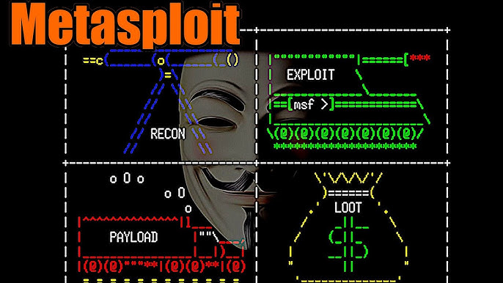
Crypto Security Tools in Kali Linux
OpenVAS: For vulnerability scans.
Metasploit: Testing/live exploitation in a secure environment.
Nmap: Finds live crypto servers, nodes, APIs.
Burp Suite, Nikto, SQLMap: For web/API penetration testing.
Also consider specialized tools (Mythril, Slither) for smart contracts.

Slide 15

Case Study: Crypto Attack & Response
2021: Hackers exploit wallet API & steal millions.
Attack vector: Phishing & weak endpoint security.
Response: Exchange halts transactions, updates security, reimburses users, launches awareness campaign

Slide 16

Conclusion & Future Perspective
Transaction analysis is crucial for security, transparency, and regulatory compliance.
Ongoing threat monitoring and best security practices are essential.
Future focus: Privacy improvements, better user protection, and evolving with regulations

Slide 17


Slide 18

Q & A
Use this portion of your presentation to answer audience questions.

