Slide 1





Dedupe: Eliminating duplication in Cloud Storage with Machine Learning
Co-founders
Ashish Veeramachaneni
Poojitha Jakkampudi
Chandan Chowdary Ghanta
Jagathi Sai Guthikonda
Harika Potluri

Slide 2


PROBLEM
Problems associated with duplication in cloud storage

Slide 3
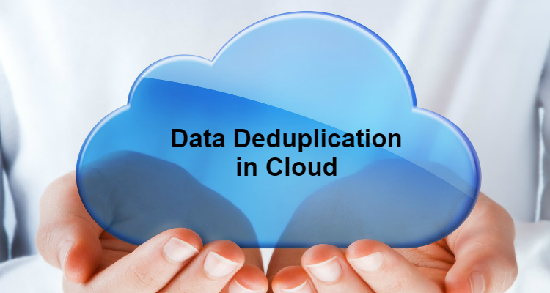
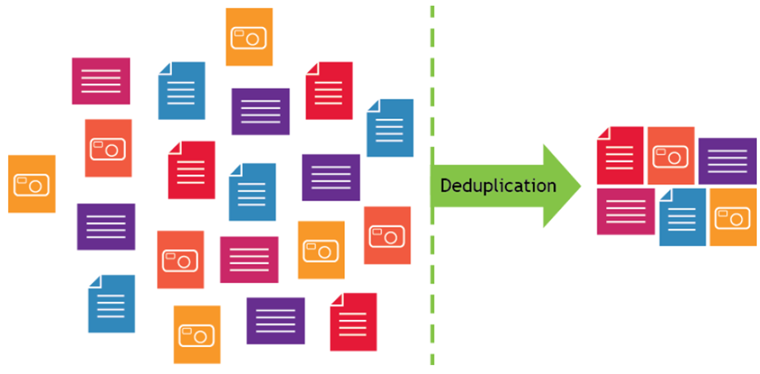
Service Representation

Slide 4
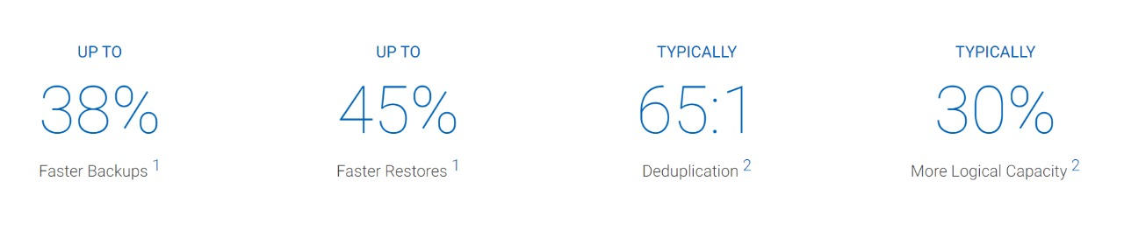
JUSTIFICATION
Enterprises
Enterprises of all sizes rely on backup and recovery with deduplication for fast, reliable, and cost-effective backup and recovery.
Any user can store personal data in to cloud without storing the same dataset multiple times

Slide 5
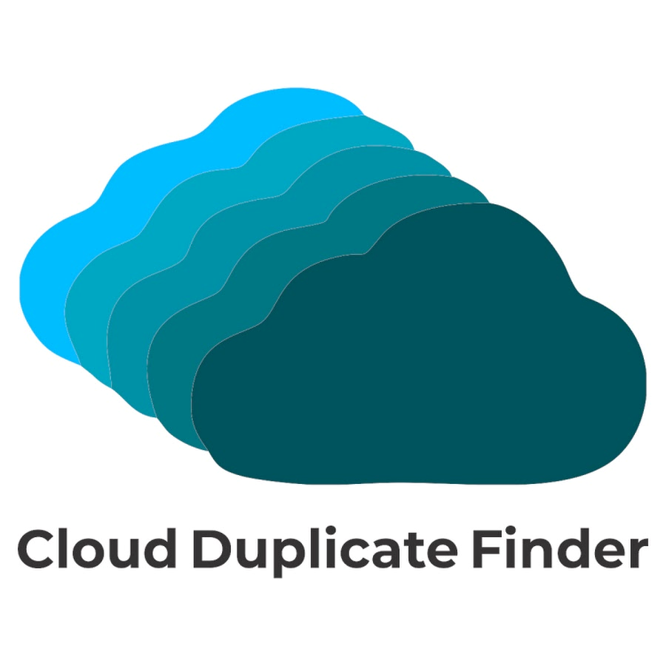
MARKET RESEARCH
Choose the target area and launch the scan.
Scans duplicate files in cloud storage.
Select the duplicate files you want to remove.
Finally, kill the duplicates completely or move them to a separate folder.
Limitations:
Cloud efficiency
Cost optimization

Slide 6


WHY OUR PRODUCT ?
It simplifies data back up across end points, data centers and cloud workloads by eliminating redundancies at the start of the process.
It ensures only unique data is transmitted through the network and stored on cloud

Slide 7
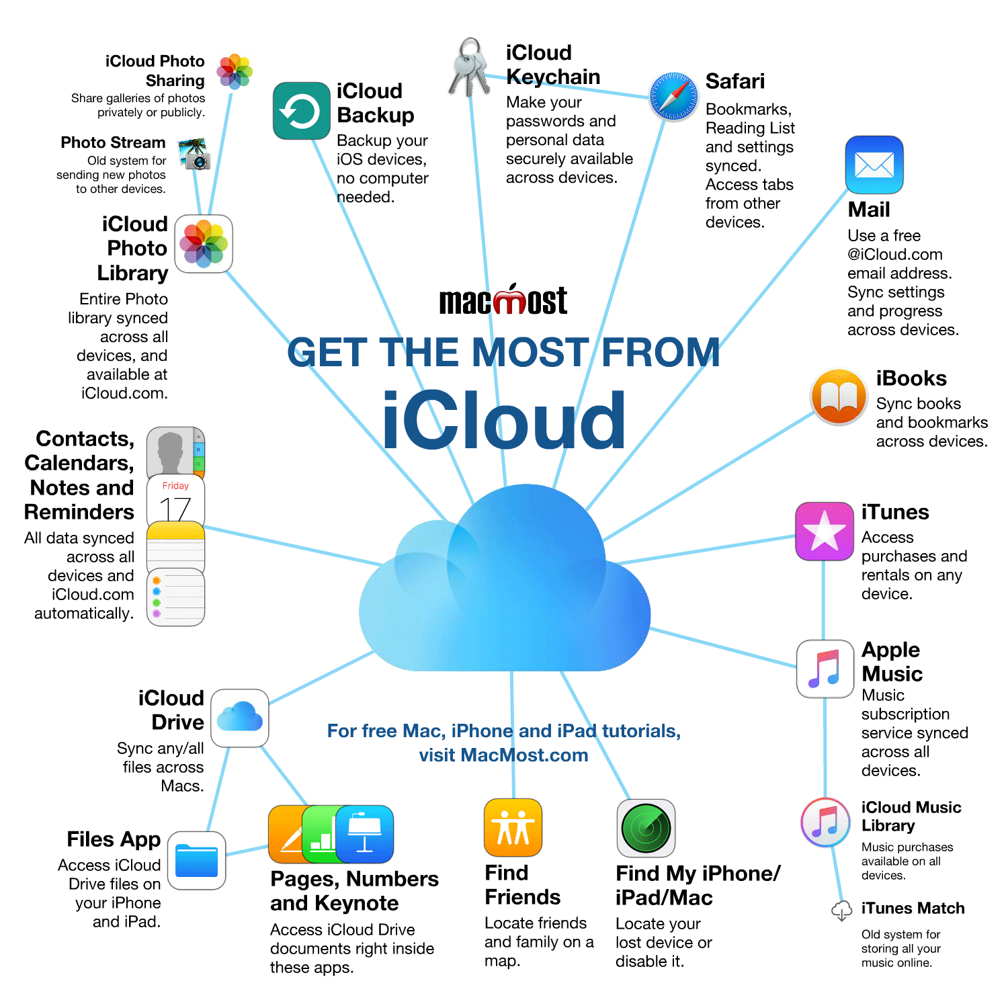

Slide 8


BUSINESS MODEL AND REVENUE GENERATION

Slide 9
MEET OUR TEAM
Team Manager
Python Developer
Ashish Veeramachaneni
Poojitha Jakkampudi
UX/Web Designer
Jagathi Sai Guthikonda
Chandan Chowdary Ghanta
Tester
Database Developer
Harika Potluri

Slide 10

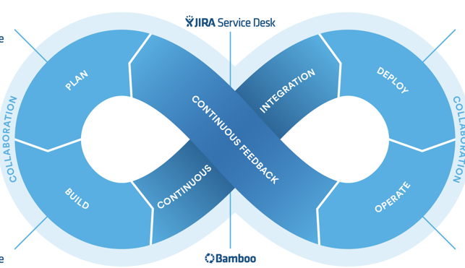


TOOLS TO ACCOMMODATE DEVELOPMENT

Slide 11


