Slide 1


LET'S PLAY
SPACE SHOOTER 2D

Slide 2

BRIEF ABOUT THE GAME
1. Gameplay Mechanics: - Movement: Players can move their ships in multiple directions using keyboard or controller. - Shooting: Players fire projectiles to defeat enemies, often with upgrades available. 2. Enemies: - Various types of enemy ships, each with unique behaviors and attack patterns. - Boss battles typically occur at the end of levels, requiring strategy to defeat. 3. Power-Ups: - Collectible items that enhance player abilities, such as health, weapon upgrades, and shields. 4. Levels and Progression: - Multiple levels with increasing difficulty and diverse backgrounds, often set in different space environments. - Scoring systems that reward players for performance and accomplishments.

Slide 3

CONCEPT OF THE GAME
1. Player Character: - Players choose from several unique spaceship designs, each with distinct abilities, speed, and firepower. - Customization options allow players to upgrade weapons, shields, and special abilities. 2. Controls: - Simple and intuitive controls for movement (WASD/Arrow keys) and shooting (spacebar or mouse). - Ability to use special attacks or power-ups via keyboard shortcuts.
- Each level introduces new enemy types and challenges, increasing in difficulty. 3. Enemies: - A variety of enemy ships with unique behaviors: - Fighters: Basic ships that attack in swarms. - Bombers: Slow-moving ships that drop bombs. - Stealth Ships: Temporary cloaking to ambush players. - Boss battles at the end of each level, featuring multi-phase fights. 4. Score and Progression: - A scoring system based on enemies defeated, levels completed, and collectibles gathered. - Unlockable achievements and upgrades based on performance.

Slide 4

SOFTWARE
Game Development Engines
1.Unity
2.Godot
3. Construct
4.Game Maker Studio
Graphics and Animation Tools
1.Aseprite
2.Photoshop / GIMP
3.Inkscape
Sound and Music
1.Audacity
2.FL Studio / Ableton Live
3.Bfxr
Level Design Tools
1.Tiled
2. **Unity Tilemap
Version Control
1. Git
Documentation and Project Management
1. Trello / Notion
2. Google Docs

Slide 5

HARDWARE
Development Hardware
1.Computer Specifications: - Processor (CPU): A modern multi-core processor (e.g., Intel i5 or AMD Ryzen 5 or better) to handle game engine performance and resource management. - RAM: At least 8GB of RAM; 16GB is recommended for smoother multitasking, especially if using multiple software tools simultaneously. - Graphics Card (GPU) 2.Input Devices: -Mouse: Essential for navigating the development environment and for testing controls.
-Keyboard: Required for coding and general navigation.
-Game Controller: Optional but useful for testing gameplay if you plan to support gamepad input.
3.Display: - A monitor with a resolution of at least 1920x1080 for clear visuals while developing and testing your game.

Slide 6

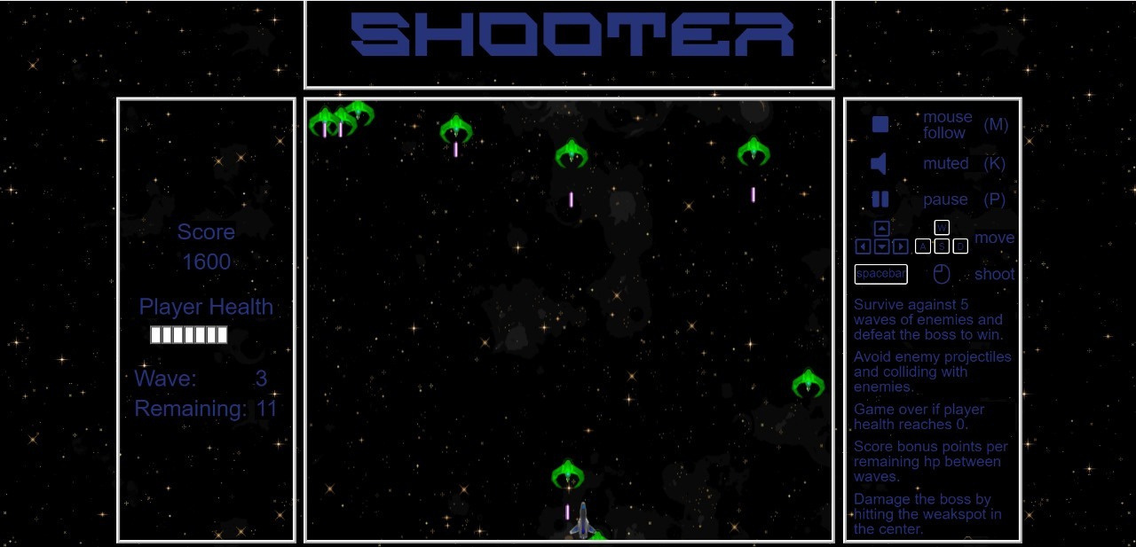
GAME PIC

Slide 7

CONCLUSION
As the dust settles after the climactic confrontation with Supreme Commander Vrax, the galaxy holds its breath for the outcome of Captain Zara's pivotal decision. The choice she made—whether to engage in further conflict or pursue a path of diplomacy—shapes not only her fate but also that of humanity and the Krythians.

Slide 8

the end
by
TEAM NO.1

