Slide 1


Travel Reviews Dataset
by TripAdvisor
Presented By:
Rajat Kumar Sahu
Aman ANAND
ashish Dsouza
S. Santosh

Slide 2


Trip advisor
Tripadvisor, the world's largest travel guidance platform, helps hundreds of millions of people each month become better travelers, from planning to booking to taking a trip.
With more than 884 million reviews and opinions of 7.9 million businesses, travelers turn to Tripadvisor to find deals on accommodations, book experiences, reserve tables at delicious restaurants and discover great places nearby.

Slide 3
Content
About TripAdvisor
Clustering
Recommendation
Problem Statement
Data Description
Technique used for Clustering and Recommendation
1)K-means and PCA
2)Recommendation
3)Random forest and LDA
Results and Discussion

Slide 4
Clustering
Clustering is the process of dividing the entire data into groups (also known as clusters) based on the patterns in the data.
Properties of Clusters
All the data points in a cluster should be similar to each other.
The data points from different clusters should be as different as possible.

Slide 5
Recommendation
A Recommender System refers to a system that is capable of predicting the future preference of a set of items for a user, and recommend the top items.
Methods for building Recommender Systems :
Content-based recommendation
Popularity-based recommendation
Random- based recommendation and more.

Slide 6
Problem Statement
This data set is populated by crawling TripAdvisor.com.
Reviews on destinations in 10 categories mentioned across East Asia are considered.
Each traveler rating is mapped as Excellent (4), Very Good (3), Average (2), Poor (1), and Terrible (0) and average rating is used against each category per user.
Task 1: Analysis we aim at comparing key clustering algorithms with the aim of finding an optimal value that can be adopted in tourism domain .
Task 2 : Recommendation of most highly rated place.

Slide 7
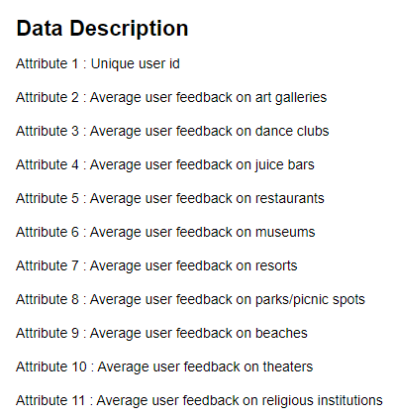
Data Description

Slide 8
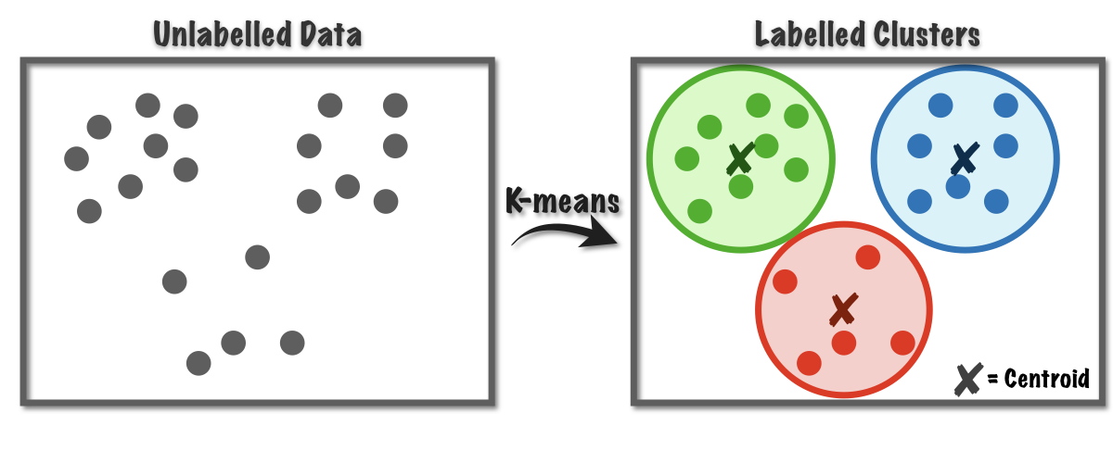
Techniques Used For Clustering and Recommendation
K-Means
K-means clustering is a type of unsupervised learning, which is used when you have unlabeled data (i.e., data without defined categories or groups).
The goal of this algorithm is to find groups in the data, with the number of groups represented by the variable K.
The algorithm works iteratively to assign each data point to one of K groups based on the features that are provided. Data points are clustered based on feature similarity.
The results of the K-means clustering algorithm are:
The centroids of the K clusters, which can be used to label new data
Labels for the training data (each data point is assigned to a single cluster)

Slide 9
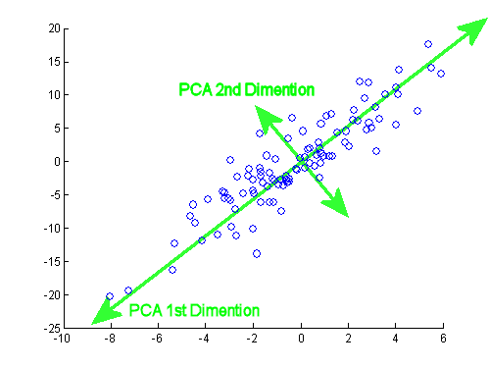
Principal Component Analysis (PCA)
Principal component analysis (PCA) is a technique used for identification of a smaller number of uncorrelated variables known as principal components from a larger set of data. The technique is widely used to emphasize variation and capture strong patterns in a data set.

Slide 10
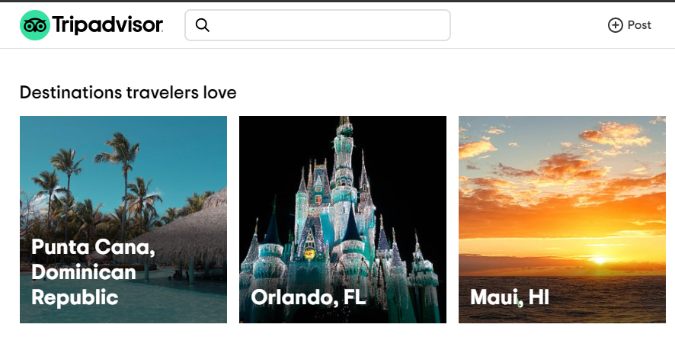
Popularity-based Recommendation
It is a type of recommendation system which works on the principle of popularity and or anything which is in trend. These systems check about the product or movie which are in trend or are most popular among the users and directly recommend those.

Slide 11
Result and Discussion
We are comparing both the cluster and we can say that the parks/picnic sports, religious institutions and beaches are mostly visited by user.
Users of cluster 0 visited museums more than the cluster 1.
We observe the avg rating in both the cluster for every category is different.
While comparing the LDA and random forest classifier, the random forest classifier is overfitting so we will consider LDA with 0.94 accuracy is the good model.

Slide 12
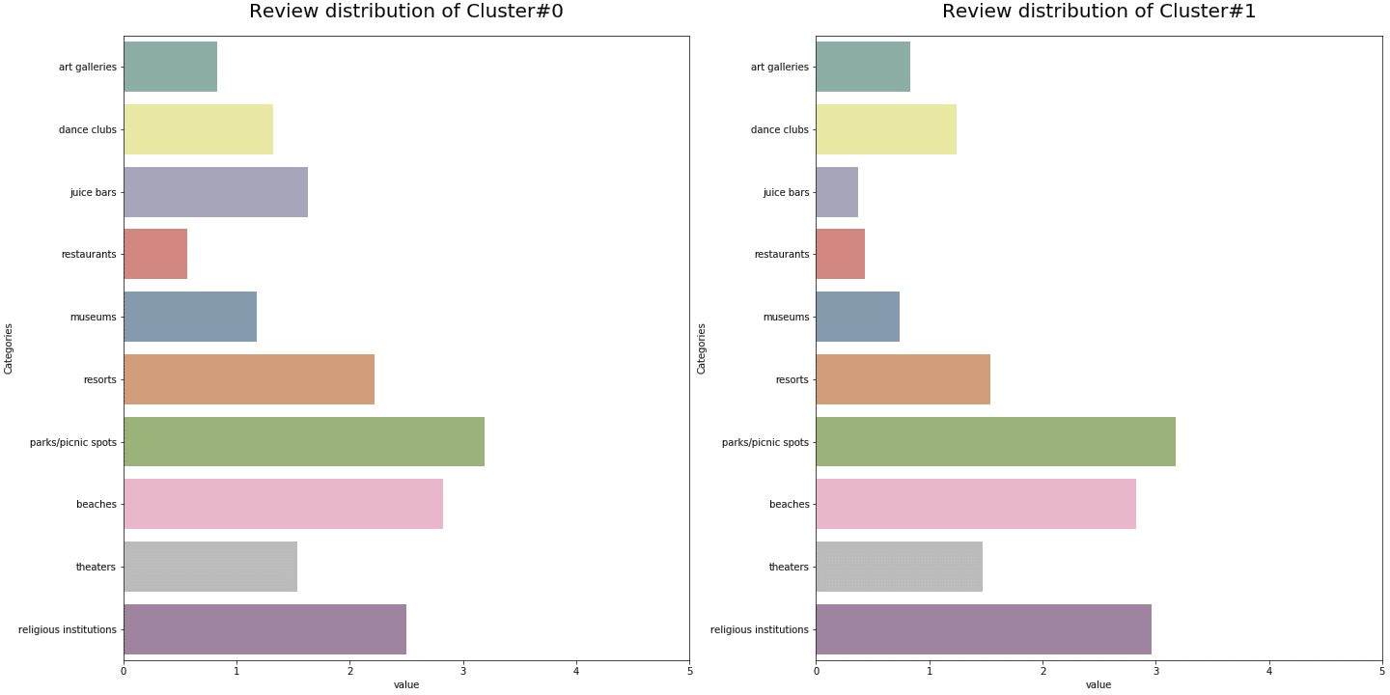
Comparison of Cluster 0 and Cluster 1

Slide 13


