Slide 1


ZIGBEE TECHNOLOGY
Team-
Vikhyat Mishra
Himanshu Soni
Ashish Kr. Gupta
Suryansh Pandey
Yashwant Yadav

Slide 2
INTRODUCTION
Zigbee is a wireless communication protocol based on IEEE 802.15.4 standard.
Designed for short-range, low-power, low-data-rate applications.
Commonly used in IoT, smart homes, and industrial automation.

Slide 3
HISTORY
Zigbee Alliance formed in 2002.
First Zigbee specification released in 2004.
Zigbee 2006 improved interoperability.
Zigbee PRO (2007) enhanced scalability & security.
Zigbee 3.0 (2016) unified standards for IoT.

Slide 4
VERSIONS
Zigbee 2004 – Initial version.
Zigbee 2006 – Enhanced interoperability.
Zigbee PRO 2007 – Improved routing & security.
Zigbee 3.0 (2016) – Unified version for IoT applications.

Slide 5
FEATURES
Low power consumption.
Supports large number of nodes (up to 65,000).
Operates at 2.4 GHz globally.
Secure and scalable communication.
Short to medium range (10–100 meters).

Slide 6
COMPONENTS
Zigbee Coordinator (ZC) – manages the network.
Zigbee Router (ZR) – extends coverage.
Zigbee End Device (ZED) – simple, low-power nodes.

Slide 7
REAL LIFE APPLICATIONS
Smart lighting systems (Philips Hue).
Smart thermostats and HVAC control.
Industrial IoT monitoring systems.
Healthcare and patient monitoring.
Agricultural sensor networks.

Slide 8
WORKING PRINCIPLE
Zigbee operates in the 2.4 GHz ISM band using radio waves.
Devices communicate using star, tree, or mesh topology.
Data transmission is reliable with AES-128 encryption.
Coordinator forms the network, routers extend it, and end devices connect.

Slide 9
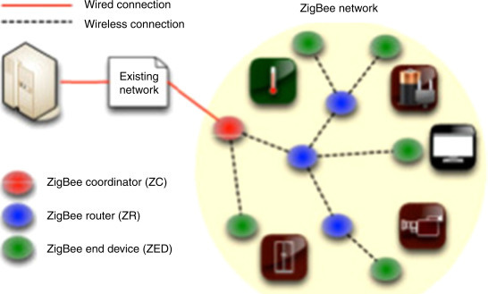
WORKING PRINCIPLE

Slide 10
MODES OF OPERATION
Sleep Mode – saves energy when device is idle.
Active Mode – device is fully operational.
Idle Mode – device is on but not transmitting.

Slide 11
CONCLUSION
Zigbee is a secure, energy-efficient, and scalable wireless technology.
Ideal for smart homes, IoT, industrial, and healthcare applications.
Future-ready with Zigbee 3.0 for unified IoT communication.

