Slide 1

BANK ANALYSIS
GROUP - 1
MEMBERS --
ASHISH RANJAN
IPSHA RANI SETHY
PIYUSH AJAY MODA
RAJNIKANT RAM AMRADEV JAISAWAL
SONAL M. KHOBRAGADE
SUPRIYA JALINDAR JADHAV
TANISHKA MAHESHWARI
TEJASWI SOLANKI

Slide 2
CONTENTS
Introduction
KPIs
Analysis report in different modules
Challenges and overcomes
Summary

Slide 3
INTRODUCTION
The Bank Loan Analysis project aims to examine loan transactions and customer data to enhance financial services. By leveraging a comprehensive dataset of loan applications and approvals, we seek to uncover valuable insights.
PURPOSE OF ANALYSIS :
IMPORTANCE :
SCOPE :
To evaluate loan offerings and terms.
To assess the risk and benefits involved in securing a bank loan.
To provide insights for informed borrowing decisions.
Facilitates better financial planning and management.
Helps in comparing different loan products effectively.
Aids in understanding repayment structures and interest rates
Overview of different types of bank loans home ownerships.
Key factors influencing loan approval and terms.
Analysis of loan structures.
Evaluation of credit scores and their impact.
Recommendations for borrowers.

Slide 4
Year wise Loan Status
Analysis
Trends Over Time: Analyze how each KPI has changed year over year.
Risk Assessment: Pay attention to default and delinquency rates to assess the overall health of the loan portfolio.
Operational Efficiency: Examine approval rates and cost of risk to evaluate operational effectiveness.
Market Position: Use net loan growth and loan-to-deposit ratio to assess market competitiveness.
As we have the data for the year 2007 to 2011, here we can see the loan amount was less compared to in 2011 i.e. 260.51m and in 2007 it was 2.22m.
As the trends changes the amount was also increased.

Slide 5
Grade and sub grade wise revolving balance
Key Components for Analysis
Loan Grades: Define the grading system used (e.g., A, B, C, D, F) based on creditworthiness.
Sub-Grades: Further classify each grade into sub-grades (e.g., A1, A2, B1, B2).
Revolving Balances: Track the outstanding balances of loans within each grade and sub-grade.

Slide 6
Total payment for verified status v/s total payment for Non verified status
Verified status :-
Non verified status :-
Verified Status: Payments that have been confirmed or validated.
Higher Payments from Verified Accounts: If verified accounts consistently show higher payments, this may indicate stronger creditworthiness.
Non-Verified Status: Payments that have not been confirmed or validated.
Concerns with Non-Verified Accounts: A significant amount of total payments coming from non-verified accounts could point to potential risks and the need for better verification processes.

Slide 7
MONTH WISE LOAN STATUS
Overview:-
The analysis covers loan performance metrics from January 2008 to December 2015, focusing on total loan originations, outstanding balances, delinquency rates, default rates, and payments received. This period includes significant economic events that influenced lending practices and borrower behavior.
Conclusion:-
The analysis from 2008 to 2015 indicates a robust recovery in the lending market, with growing loan originations and payments, alongside decreasing delinquency and default rates. Strategic adjustments based on these insights can further enhance loan portfolio performance and risk management practices.

Slide 8
Homeownership and last payment date status
The graph shows the number of homeownerships over the years from 2008 to 2016, based on the last payment date. Here’s a summary of the key points:
Steady Growth Until 2013:
There is a significant rise in homeownership counts from 2008 to 2013.
The count starts at 70 in 2008, growing to 4,501 in 2013, peaking in 2014.
Peak in 2014:
The peak occurs between 2013 and 2014, with a count of 4,501 in 2013 and a slight drop to 4,424 in 2014.
Sharp Decline After 2014:
After 2014, the homeownership numbers drastically decrease.
The count drops to 1,063 by 2015 and further to 780 by 2016.

Slide 9
Kpi cards
Total loan
Total Customers
Total Fund
Total Revol Balance
Average Interest
445.60 M
39,717
434.81 M
531.51 M
12.02 %

Slide 10
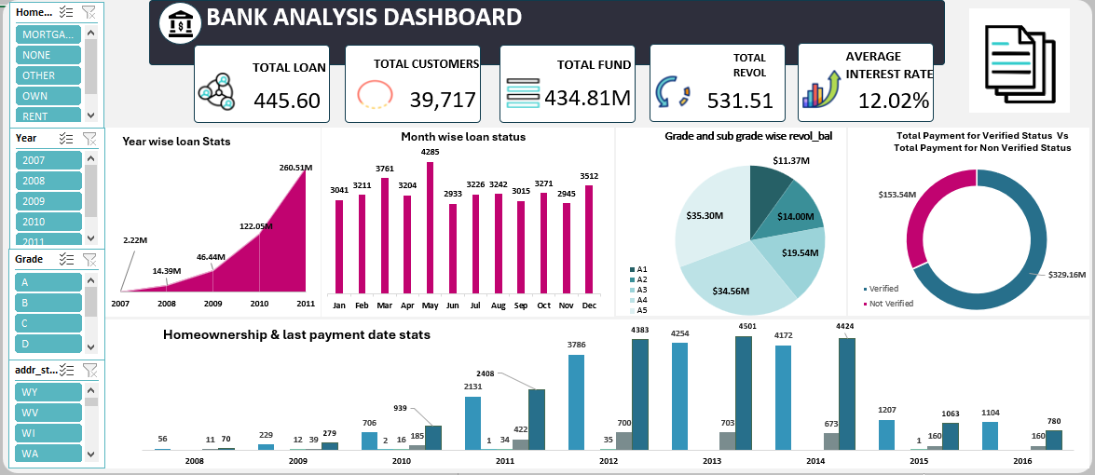
EXCEL DASHBOARD

Slide 11
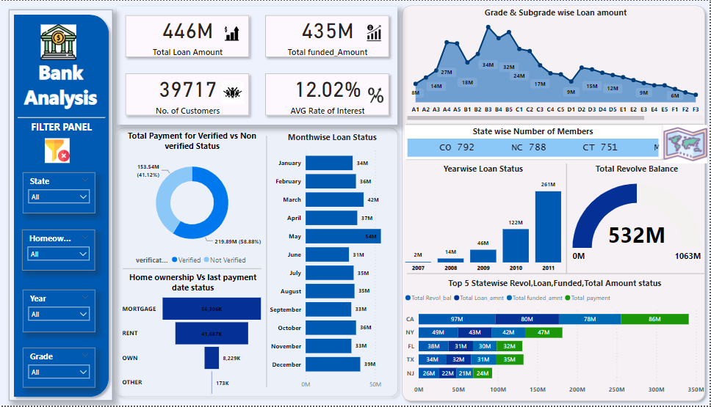
POWER BI DASHBOARD

Slide 12
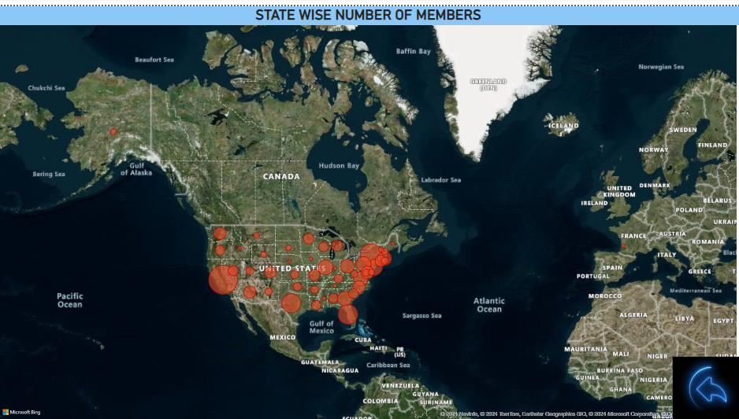
POWER BI DASHBOARD
2

Slide 13
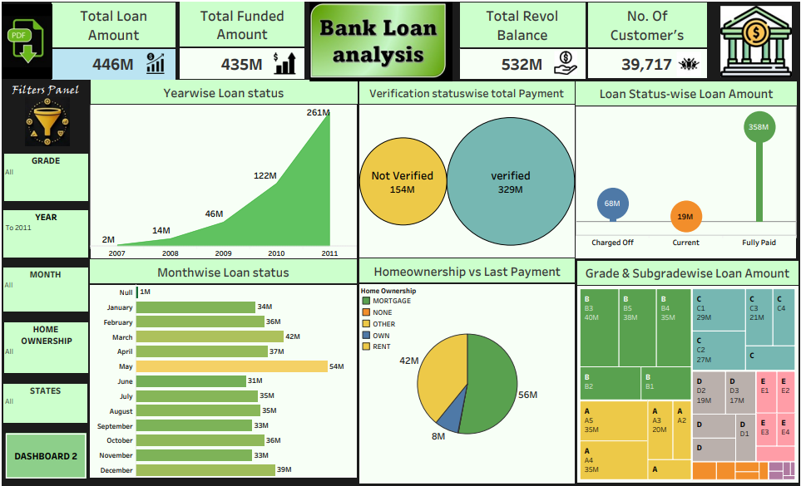
TABLEAU DASHBOARD

Slide 14
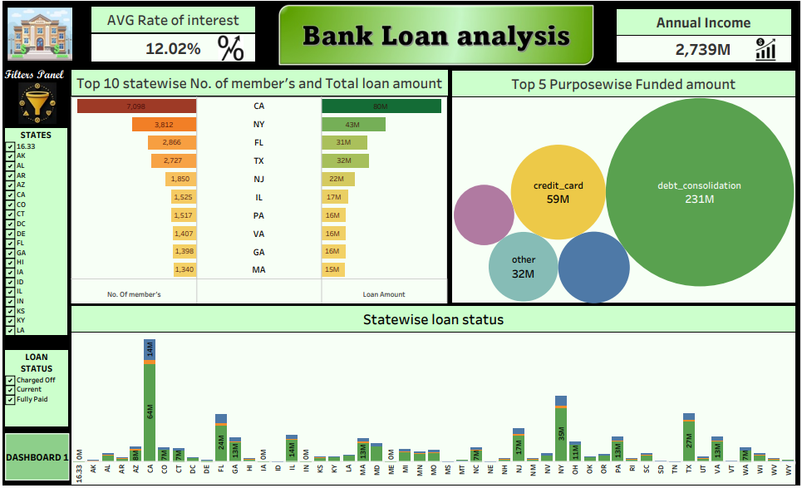
TABLEAU DASHBOARD
2

Slide 15


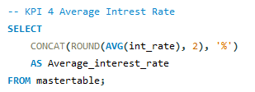

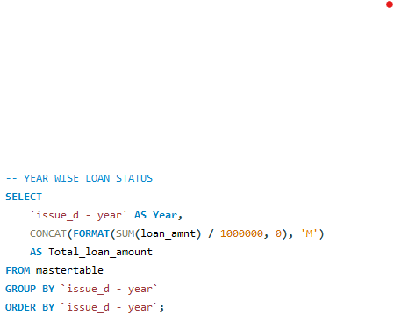
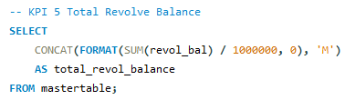
SQL QUERIES
KPI 1 – TOTAL LOAN AMOUNT
KPI 2 – TOTAL FUNDED AMOUNT
KPI 4 – AVERAGE INTEREST RATE
KPI 3 – TOTAL CUSTOMERS
CHART 1 - YEAR WISE LOAN STATUS
KPI 5 – TOTAL REVOLVING BALANCE

Slide 16
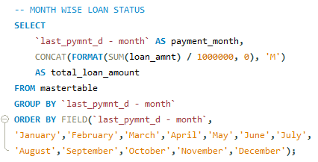
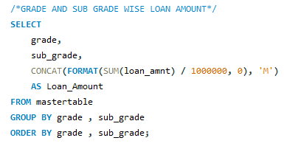
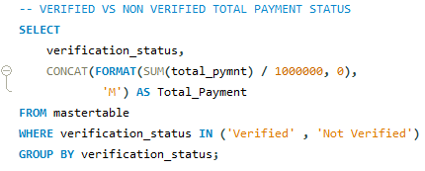
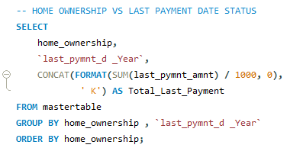
SQL QUERIES
CHART 2 – MONTH WISE LOAN STATUS
CHART 4 – GRADE & SUBGRADE WISE LOAN AMOUNT
CHART 3 – VERIFIED / NON-VERIFIED TOTAL PAYMENT STATUS
CHART 5 – HOME OWNERSHIP VS LAST PAY. DATE STATUS

Slide 17
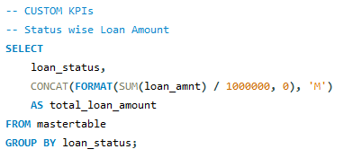
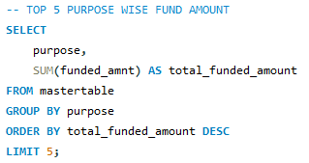
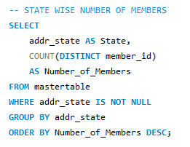
SQL QUERIES
CUSTOM KPIs
2- TOP 5 PURPOSE WISE FUND AMOUNT
1- STATUS WISE LOAN AMOUNT
3- STATE WISE NUMBER OF MEMBERS

Slide 18
CHALLENGES & OVERCOMES
Data Standardise
Barriers- Two file formats while importing in excel. One in excel and one in csv. Need a master file to import.
Strategies- Imported files individually,merged two Excel files into a master file.
Data Type Inconsistencies
Strategies- Convert text fields to appropriate numeric types for proper calculations.
Data Handling
Strategies- Remove incomplete rows if not Removing Unnecessary data columns to make data less complicated and making it more efficient while loading in different modules.
Duplicate Entries
Strategies- Identify and remove duplicates by checking the uniqueness of id values
Data Misalignment:
Barriers:-Mismatched records across files (e.g., missing rows in one file) could lead to loss of important data when merging.
Strategies-Choose an appropriate merge method (e.g., inner join for only matching records, outer join for all records).
Inconsistent Date Formats
Strategies-Normalize date formats (e.g., converting all dates to a common format like YYYY-MM-DD).

Slide 19
CONCLUSION
This Bank Loan Analysis project has effectively demonstrated the significance of data-driven decision-making in the banking sector. By analyzing loan offerings, risk factors, and customer data through various KPIs and visual dashboards, the project offers a clear understanding of the loan landscape.
The project’s findings will help inform lending strategies and borrowing decisions, contributing to more efficient financial planning for both banks and customers.

Slide 20
THANK YOU
GROUP 1

