Slide 1

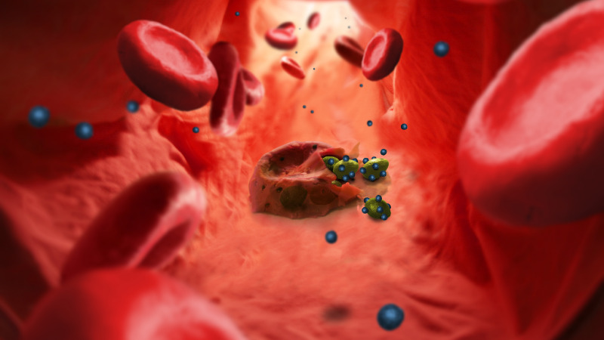

Deep Learning for Malaria Detection
Ashish Kumar

Slide 2
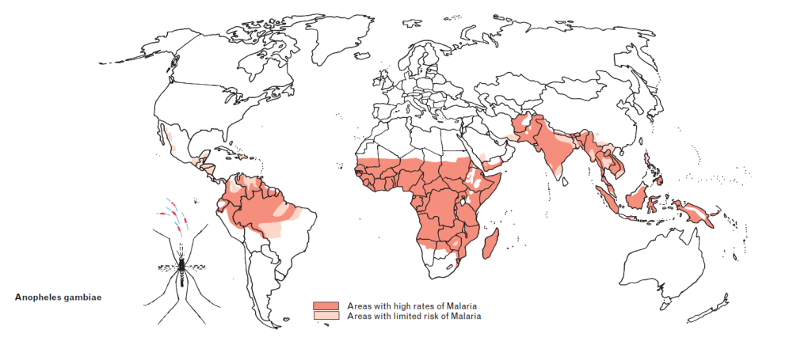
Objective
Problem Statement
Malaria remains a global health concern
Microscopic diagnosis, though highly accurate, is tedious, time consuming, and highly dependant on technician's expertise
Early and accurate detection can dramatically improve morbidity and mortality rates
Solution
Develop a CNN (Convolution Neural Network) model to analyze blood smear images; and improve efficiency, accuracy, and scalability of malaria diagnosis
Source - https://www.iamat.org/risks/malaria

Slide 3
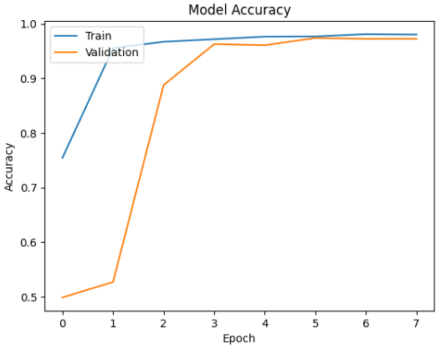
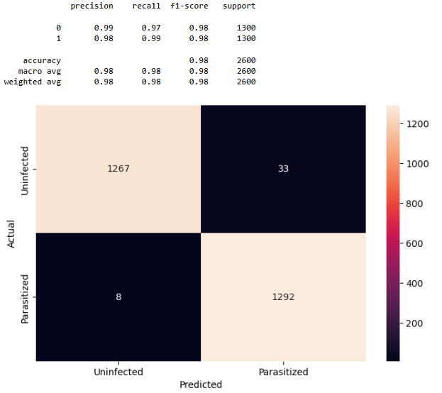
Observations & Next Steps
Observations:
High Accuracy – Compared to the other models, this model achieved high accuracy of 98%, and classified only 8 false positives (predicted = uninfected, actual = parasitized) driving the recall to 0.99
Generalization – The convergence between training and validation accuracy (98%) indicates the model has generalized well to the variations in the dataset
Training time – The model took only 8 epochs to train, even with 4 convolution layers and ~0.6M parameters
Next Steps
Data Quality/Bias – Training the models with high-quality labeled datasets that have diversity in geographic regions, patient demographics, and malaria species would be essential to limit bias and improve generalization of the model
Explainability – In order to make the model more interpretable explore what features are being learnt and how they influence the classification. This can be done through SHAP and/or plotting the features being learned by each layer
Confusion Matrix

Slide 4
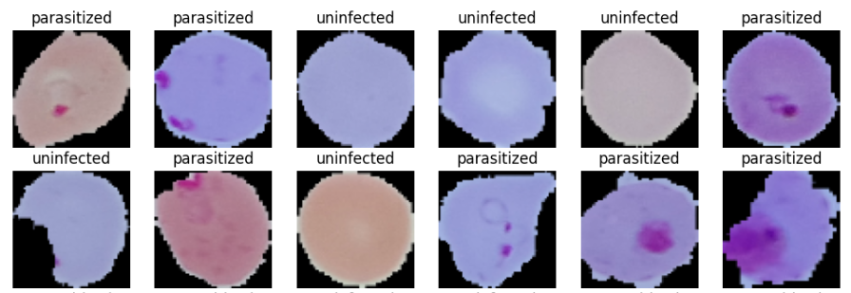
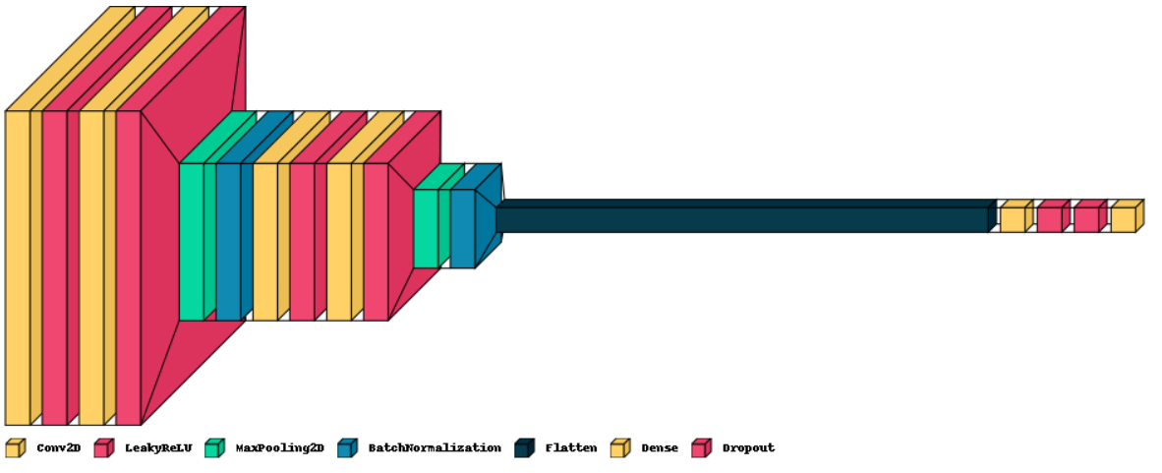
Solution Architecture
Dataset:
Train – 25K labeled RGB images (12.6K parasitized, 12.4K uninfected)
Test – 2.6K labeled RGB images (1.3K parasitized, 1.3K uninfected)
Model:
4 convolution 2D layers of 16, 32, 32, 64 filters respectively to learn features such as what species of parasite is present, what is the stage of infection, what are the changes in RBC morphology, etc.
LeakyReLU activation function with a negative slope of 0.1 to capture complex relationships within the data by avoiding dead neurons
Max pooling with filter size 2x2 to extract dominant features
Regularization –
Batch Normalization to fasten training and reduce sensitivity to initialization
Dropout rate of 0.5 to reduce overfitting
Output layer – sigmoid activation for binary classification
Input Dataset
Malaria Detection CNN Model Architecture

Slide 5
Things to Consider
Deployment –
Model conversion – Convert the model to a format compatible with the desired deployment environment. This may involve converting to TensorFlow Lite for mobile deployment or ONNX for cloud deployment
API development – Develop an API that allows users to submit blood smear images and receive predictions from the model
Integration – Integrate the API into the desired platform (web app, mobile app, etc.)
Other factors:
Computation resources – Training deep CNN is computationally expensive and can be a challenge if hardware resources are limited
Model drift – Keeping up with new parasites strains and lab practices would be key to the long term efficacy of the CNN model, which could be cost prohibitive
Accessibility – CNN model when deployed in areas with constrained healthcare personnel resources, can increase accessibility and provide significant public health benefits

Slide 6
Appendix

Slide 7
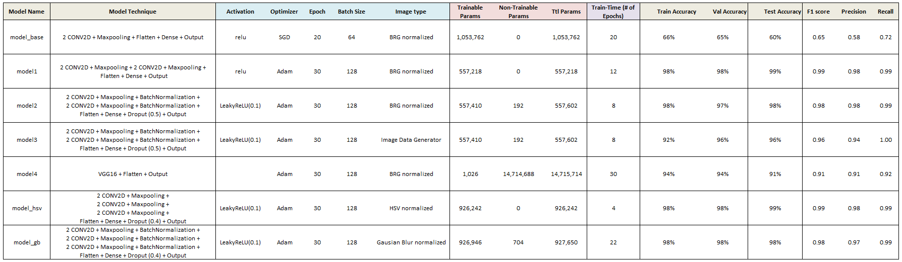
Model Comparison
Final Model

Slide 8
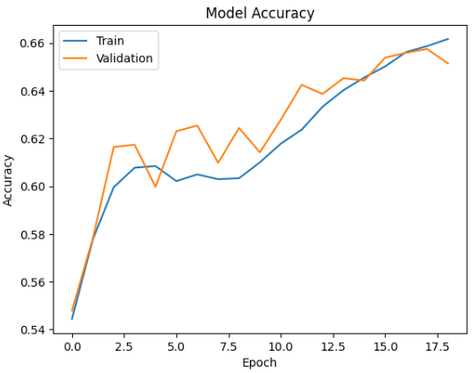
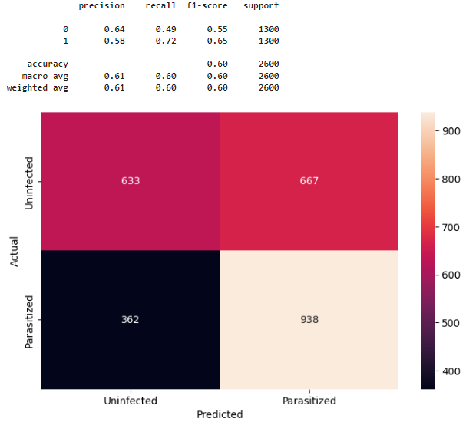
Base Model - Training Accuracy & Confusion Matrix
Confusion Matrix
Train accuracy – 66.16%
Validation accuracy – 65.14%
Test accuracy – 60.42%

Slide 9
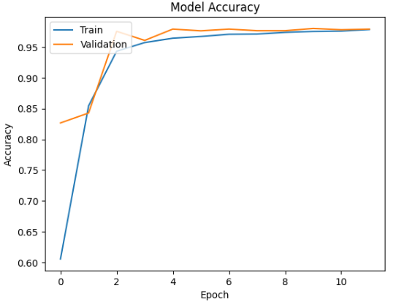
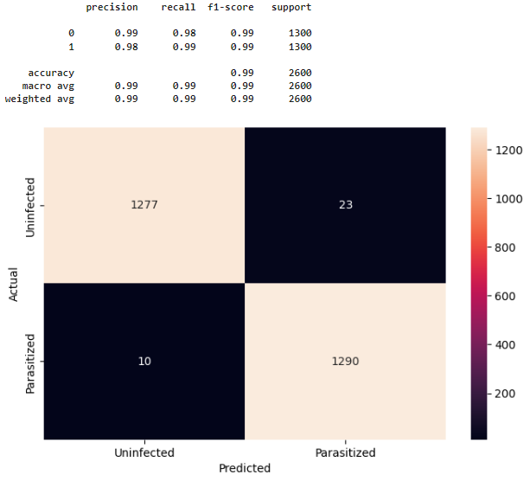
Model1 - Training Accuracy & Confusion Matrix
Confusion Matrix
Train accuracy – 97.85%
Validation accuracy – 97.92%
Test accuracy – 98.73%

Slide 10
Model2 - Training Accuracy & Confusion Matrix
Confusion Matrix
Train accuracy – 98.01%
Validation accuracy – 97.24%
Test accuracy – 98.42%

Slide 11
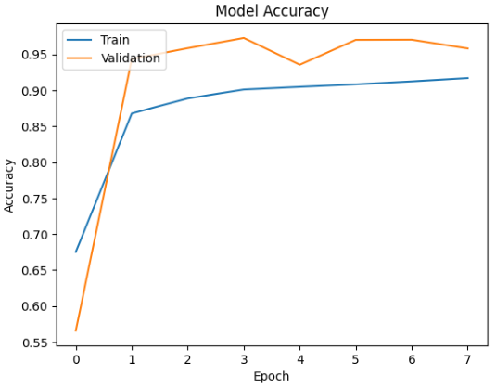
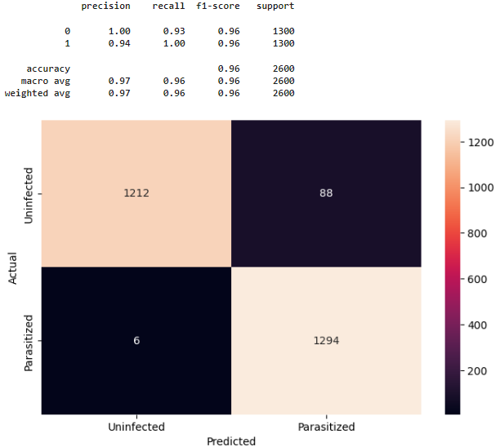
Model3 - Training Accuracy & Confusion Matrix
Confusion Matrix
Train accuracy – 91.7%
Validation accuracy – 95.81%
Test accuracy – 96.38%

Slide 12
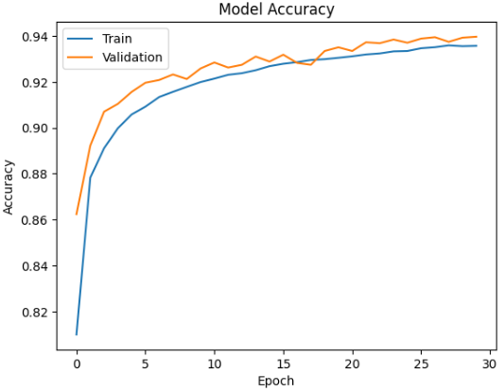
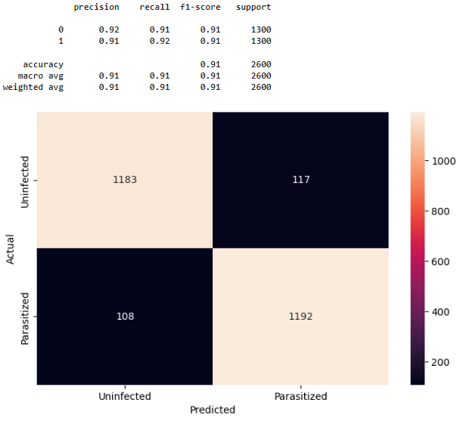
Model4 - Training Accuracy & Confusion Matrix
Confusion Matrix
Train accuracy – 93.57%
Validation accuracy – 93.97%
Test accuracy – 91.35%

Slide 13
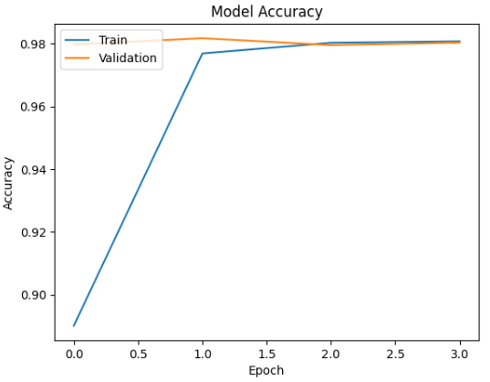
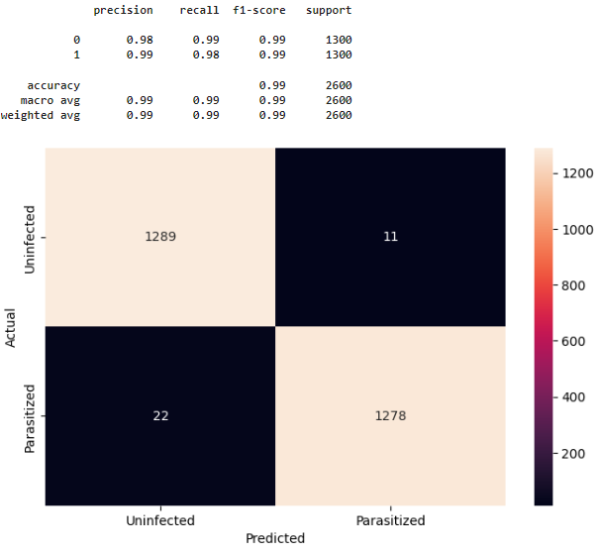
Model_HSV - Training Accuracy & Confusion Matrix
Confusion Matrix
Train accuracy – 98.08%
Validation accuracy – 98.04%
Test accuracy – 98.73%

Slide 14
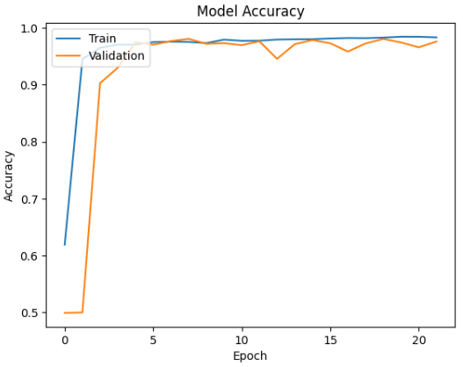

Model_GB - Training Accuracy & Confusion Matrix
Confusion Matrix
Train accuracy – 98.33%
Validation accuracy – 97.6%
Test accuracy – 98.19%

