Slide 1
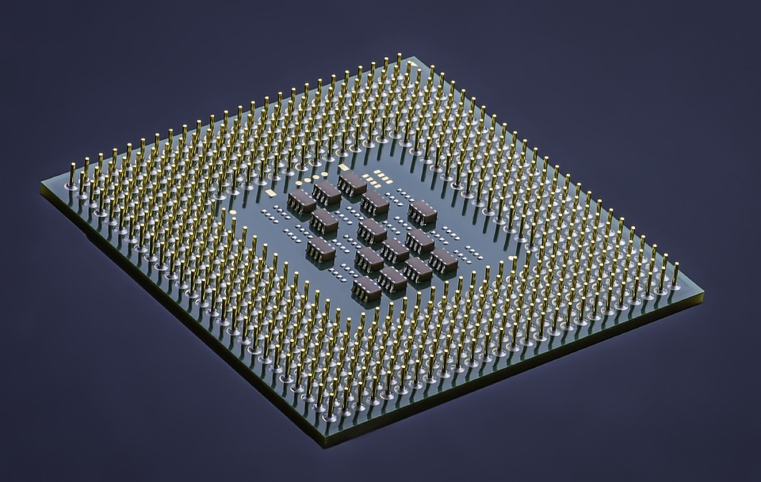
Semiconductor Industry in India
INDIAN CASE CHALLENGE 2023-Precase
Team: Bombay Analysts
Ashish Prasad
Alaukik Kumar Varma
Dhruv Pandey
Harsheet Singh

Slide 2
Introduction
A ubiquitous component of 21-st century existence, semiconductors have emerged as the world's most critical resource, known as the 'new-oil' on which modern world depends. With the global semiconductor industry projected to double to a trillion-dollar industry in the next ten years, driven by the growth of AI, cloud computing and electric vehicles, governments across the world are eyeing to set up a semiconductor ecosystem in-house.
Covid 19 pandemic driven push to take sizable parts of daily economic and essential activity online, or at least digitally enable them has highlighted the centrality of the chip-powered computers and smartphones in people’s lives. Once the preserve of the trade press, the semiconductor industry has taken over mainstream media for several months.
On the news, and on the front page of press sites, chip shortages are constantly mentioned. And for good reason, the repercussions are numerous and have put companies - in many sectors - in difficulty. Its shortage causes cascading effects, given that the first creates pent-up demand that becomes the cause of the follow-up famine.
The ongoing chip shortage has only accentuated the concerns over over-dependence on a few markets for critical technologies which provides India the perfect opportunity to capitalize on these insecurities.

Slide 3
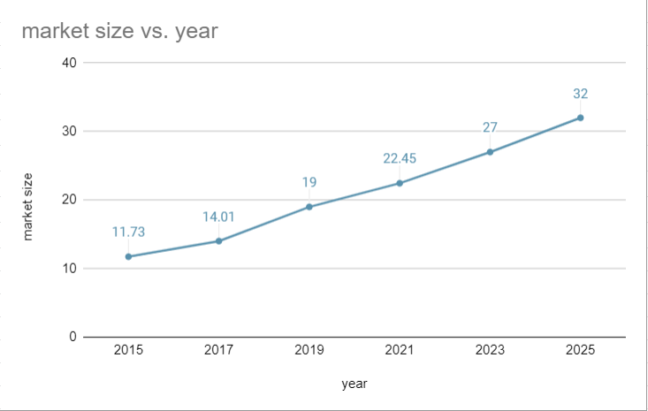
Chips produced in India= 63 Million units
Total chips= 140 Million
The fraction of chips domestically produced= 9%
Total market size= 700 Million units
Share of EVs= 20%
Number of EVs in India= 46,000
Chips required per EV= 3,000
Number of EVs produced by TATA = 40,000
Market share of TATA= 87%
What is the market and production capability of the Indian semiconductor industry?
India is expecting $22 billion in the semiconductor market and a CAGR growth of 11%.
There is a great opportunity for Indian Companies to come forward and work on building solutions to fulfill this demand gap
Presently India only satisfies 9% of its Demand
​

Slide 4
Key Semiconductor Demand Drivers
Data Processing
Mobile computing platforms and data centres are increasing the demand for ICs
Increasing industry costs
Companies are now adopting Fab-Lite strategy
Automobile Industry
Semiconductor are essential in electric vehicles
Currently growing at a high rate of 94.4%.
They are outsourcing parts of value chain to lower cost
Diversification of global supply chain
Telecommunication
Demand for secured wired and wireless communication has
China, South Korea, and Taiwan followed by the US and Japan influence supply to a large extent
increased the need for semiconductor devices
Reduce dependence on some specific countries.

Slide 5
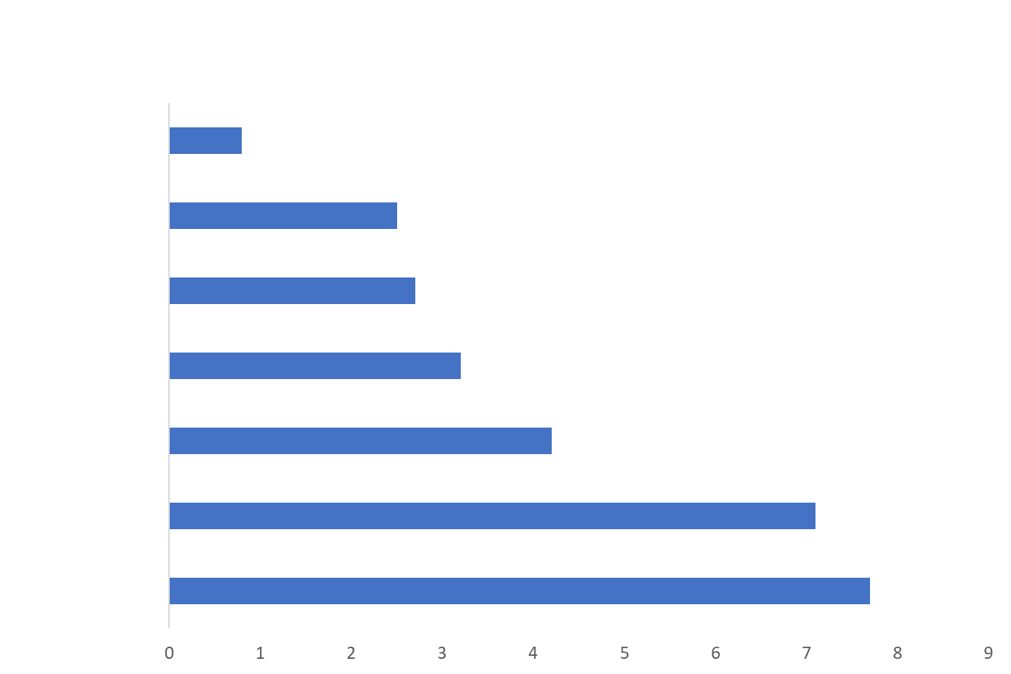
Automobile industry is fueling the demand for semiconductors
Increase in semiconductor demand due to the incorporation of advanced safety systems
The recent adoption of safety-related electronics systems induces the use of various semiconductor devices
Advanced driver-assistance systems (ADAS) will have the highest growth further inducing an increase in the demand for semiconductor devices
Semiconductor products required per vehicle are 5 times higher for a full automation system than a hybrid one
EVs are new drivers for semiconductor demand
Future autonomous driving systems will need an enormous number of cutting-edge processors (7nm), which are much more efficient computationally and in power management.
Electric vehicle sales grew consistently throughout 2020 with 40% Y-o-Y growth even though overall auto sales were down by 15%.
The average amount of semiconductor components within an EV is growing rapidly.
Features like blind-spot sensors and backup cameras become standard on all cars, require semiconductors.
Source: Chen & al.,Pwc, 2019

Slide 6
TATA needs a very large number of chips just to fulfil its own requirements
TATA Communications provides services like cloud, IoT, security, network, carrier, and VPN services. It requires larger chips (> 28nm) for its carrier and voice services spread across India.
Reduce dependence in global supply chain to prevent losses due to disruption. During Global chip shortage TATA had to bear heavy losses, waiting time for EV shifted from 2 to 15 months
TATA Elxsi works primarily in research in AI, robotics, healthcare, and automotive sectors and also provides solutions for autonomous driving, broadcast, and other technical solutions.
Voltas requires chips for size greater than 28 nm for production of its consumer electronics
TATA motors alone would require 120 million chips for achieving its EV target.
Given such high in-house demand TATA, at present, should satisfy the supply requirements of its subsidiaries giving them an edge over other offerings, both in terms of quality and cost.
Source: Chen & al. 2019,Pwc, 2019

Slide 7
SWOT Analysis of TATA
Strengths
Sublime Performance in New Market
Tata has constructed an ability at going to new business sectors and making them.
Robust Distribution Network
Strong Dealer Community
Reliable Suppliers
Strong Brand Portfolio
Opportunity
Tata has purchased a majority stake in Saankhya Labs, which currently produces chips of size greater than 28nm. Saankhya Labs is among the leading and upcoming fabless firms in India
Access to UPW: TATA has acquired Bisleri and also has brands like TATA Pure and Himalayan which produce drinking water. Production of drinking water requires sizeable amounts of distilled water. It has access to raw materials, a supply chain, and slight modifications to technology that could result in the production of UPW.
Access to Silicon: TATA Subsidiary TATA Power Solar procures silicon for its solar plants. Tata has a strong supplier and distribution network in place.
Weaknesses
Organization Structure
Financial Planning: The current asset ratio and liquid asset ratios propose that the organization still has to utilize the money more efficiently than what it is doing as of now.
Does not have the required expertise to enter the semiconductor manufacturing market
Threats
Increasing Competition : Upcoming startups and major companies like Reliance are also planning to enter this market
Geopolitical Considerations: China and America are leading players in semiconductor manufacturing and their rivalry is causing disruption in various parts of supply chain.

Slide 8
Major hurdles to market entry
Silicon is the one major component to make semiconductors
It requires a highly technical refining process which transforms it into a silicon wafer
Manufacturing needs uninterrupted power supply
High Capital Requirement
Initial manufacturing setup cost is very high
Rapid technology changes, increasing complexity of process requires consistent capital investment
Technology transfer costs also contribute a lot to capital requirement and are lower for legacy node architecture (higher chip sizes)
Availability of Ultra-Pure Water (UPW)
It requires a large amount of UPW
Very few suppliers in the Indian market and they cater to the needs of Pharmaceutical industry
Access to Raw Material
External Factors
Shortage of any component in the supply chain can cause huge losses to the companies.
Previous initiatives to establish fabs in India have failed to materialize due to bureaucratic delays
Location:
Large distance from suppliers and technology hubs can cause delays
Delays can result in huge losses
Insufficient access to raw-material hinders manufacturing capabilities
A Fab requires more than 5 million gallons of UPW/day. To generate this much of pure water, one requires at least 8 million gallons of city water per day.
75% of the Fabs globally are established in arid or semi-arid regions of Asia
Companies require constant RnD investment to remain competitive in the market
Source: News 18

Slide 9
Different strategies for TATA's foray into the semiconductor industry
Brave it out on their own
The chip manufacturing process is extremely complicated, and it would be very difficult for a firm to enter the fabrication industry without any prior experience in the field.
To quote TATA's chairman Mr. N Chandrashekharan, "We will have discussions with multiple players" which raises the possibility of partnerships with existing chip manufacturers as launching a chipmaking business on its own is a challenge for an inexperienced company.
Mergers and Acquisitions
To establish a chip manufacturing plant, TATA needs to acquire companies which have prior experience in chip fabrication and plant management. However, firms (foundries like TSMC and IDMs like Intel and Samsung) that have the required experience, operate at the global level and supply global demand. Thus, acquisition of such large firms is not a feasible option.
Valuation of TATA Group is $311 billion whereas TSMC is valued at $404 Billion and Samsung at $311 Billion. Financially, TATA cannot acquire these companies.
Partnering with existing firms
Benefits of partnering with existing firms -
More capital If there are multiple partners in a business, it will be easier to acquire capital for business operations. Moreover, a prospective partner can have a wide range of network channels what can help a company attract investors.
Wide range of expertise Partnering with firms with expertise in a particular segment of the supply chain is better than venturing into it alone especially when the process is extremely complicated.
Source: Nikkei Asia

Slide 10


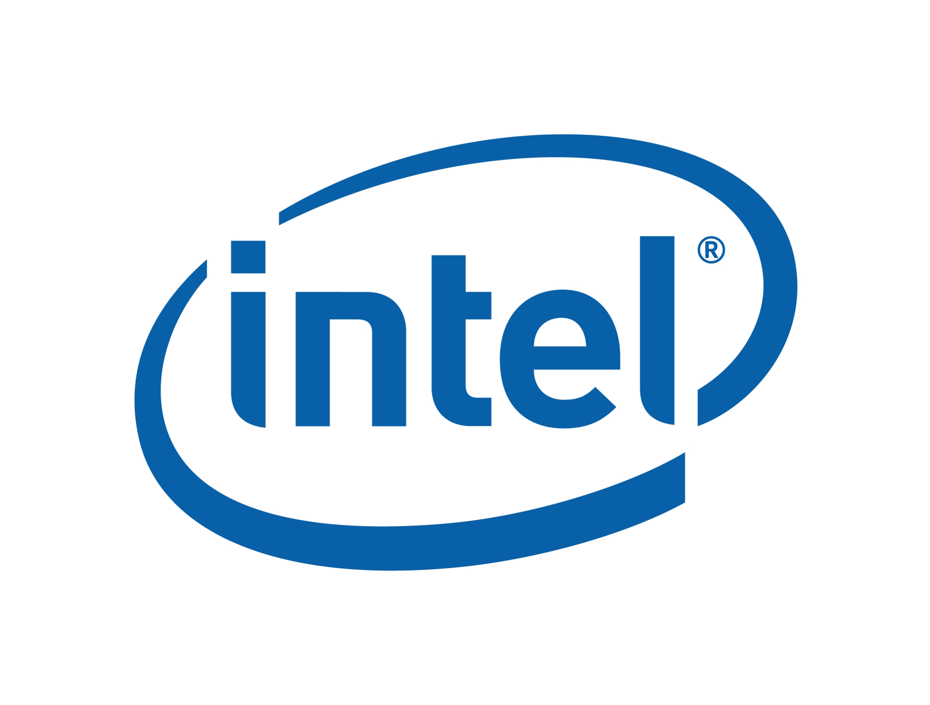
Candidates for Potential Partnerships
Fabless semiconductor company that specializes in power management applications for moblie devices like smartphones and tablets.
The firm has no prior experience in chip fabrication
Foxconn and Vedanta have decided to build a chip-manufacturing plant In Gujarat.
Vedanta is facing many challenges in this venture, especially capital procurement.
Foxconn was brought on board by Vedanta as a technical partner, but it is not known to have any prior experience in running a 28nm chip fabrication plant.
Foxconn is notorious for announcing projects that are still in the making or essentially 'kept under wraps'. It has not been able to deliver on its recent promises and is still considered to be soft on China.
Intel is not willing to set-up a chip manufacturing plant in India and believes that India should instead focus on chip designing.
"India should not focus on manufacturing microprocessors in the country as there’s already overcapacity in the space globally. Instead, chip design is an area that’s closer to India’s skill base and that’s where we can lead the world. Even China aspires to be there,” Intel India President Kumud Srinivasan had said in February.
With Cirel systems and Foxconn having no prior experience in chip fabrication and Intel's lukewarm response towards setting up a chip manufacturing plant in India, the aforementioned companies are not suitable candidates for partnership
Source: analyticsindiamag

Slide 11


AMD is an American fabless company specializing in chip design for computers, workstations etc.
It is raising an India-focused technology fund with a target corpus of $200 million USD. It has partnered with Hindustan Semiconductor Manufacturing Corporation (HSMC) to kickstart chip fabrication in India.
AMD president and CEO, Lisa Su, believes that local chip manufacturing could be beneficial for India and wants to support the semiconductor ecosystem in its entirety. The company prefers to do end-to-end design in India and the CEO also believes that this policy will hopefully stimulate more indigenous use of the technology.
India and Taiwan have signed a Bilateral Investment Agreement in 2018. Due to increasing geopolitical concerns, Taiwan wants to withdraw assets from the Chinese soil and reduce its reliance on China.
India is rapidly developing its technological capabilities and fostering international cooperation. Thus, it is in both nations' best interests to foster a more cooperative framework.
Talks between India and Taiwan for signing a Free Trade Agreement are underway and are firmly pivoted around setting up a chip manufacturing plant in India.
According to a Bloomberg report, officials in New Delhi and Taipei have met in recent weeks to discuss a deal that would bring a chip plant worth an estimated $7.5 billion to India to supply everything from 5G devices to electric cars. Taiwanese Semiconductor giants like TSMC and UMC have come up as possible candidates for the implementation of the project.
Thus, of the above, Intel and TSMC are the only semiconductor companies with prior manufacturing experience. However, Intel's focus is on chip design rather than chip fabrication which does not align with TATA's interest. With Taiwan pushing for a cooperative framework and TSMC's indubitable expertise in the industry, TSMC would be the best candidate for partnership with TATA.
Source: The Hindu

Slide 12
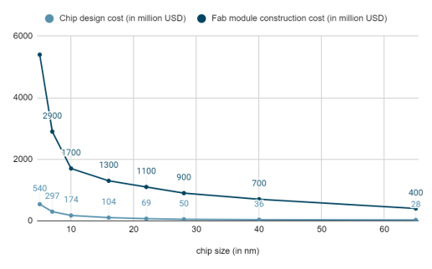
Targeting right size impacts costs and revenue
chip size (in nm)​ | chip design cost (in million USD)​ | fab module construction cost (in million USD)​ | wafer utilization ratio​ | cost of unit lithography machine (in million USD)​ | wafer cost (in USD)​ | cost of semiconductor per wafer (in USD)​
65​ | 28​ | 400​ | 0.9​ | 40​ | 1585​ | 1.073​
40​ | 36​ | 700​ | 0.86​ | 40​ | 1808​ | 0.940​
28​ | 50​ | 900​ | 0.798​ | 100​ | 2362​ | 0.720​
22​ | 69​ | 1100​ | 0.756​ | 100​ | 2981​ | 0.570​
16​ | 104​ | 1300​ | 0.684​ | 100​ | 4205​ | 0.404​
10​ | 174​ | 1700​ | 0.6​ | 180​ | 6783​ | 0.251​
7​ | 297​ | 2900​ | 0.55​ | 180​ | 9690​ | 0.175​
5​ | 540​ | 5400​ | 0.5​ | 200​ | 13566​ | 0.125​
The costs involved in end-to-end manufacturing of semiconductor chips are of two major types
Chip design costs
Fabrication Module : It consists of all fixed costs like land, machinery
Water manufacturing plant
These costs vary a lot as per size. This can be illustrated from the following graph
Chip design and fab module construction cost increase significantly at size lesser than 22nm semiconductors.
Another major cost is that of lithography machines. Suppose a manufacturer wants to build a wafer capacity of 40,000 per month. They would require 15 to 20 lithography machines which would typically range from 600million ( 40nm chips) to 3.6 billion (7 nm chips)
Wafer utilization also decreases with size from 0.9 to .55 causing wastage of wafer which also leads to increasing costs.

Slide 13
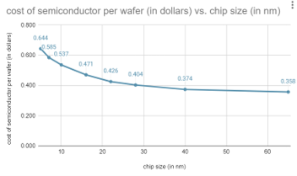
Cost Analysis
chip size (in nm)​​​ | cost of semiconductor per wafer (in USD)​​​
65​​​ | 0.358​​​
40​​​ | 0.374​​​
28​​​ | 0.404​​​
22​​​ | 0.426​​​
16​​​ | 0.471​​​
10​​​ | 0.537​​​
7​​​ | 0.585​​​
5​​​ | 0.644​​​
The cost of wafer decreases as chip size increases as technology gets less complex at larger size.
This trend can also be observed in chip design and fab module costs.
1
4
Chip design cost, technology transfer fee and is significantly lower at 28nm range than at 7nm.
The slope at size around 10nm is much steeper than the slope at 28nm size.
2
5
This implies that if a firm is planning to scale its production in the range of 60nm to let's say 30 nm, the change in cost would be much smaller than the case when the company operating at a range of 10nm plans to target 7nm or 5nm range.
3
Considering costs, a new company should first target higher chip size market
6

Slide 14
How to solve the problem of UPW?
UPW systems consist of three subsystems:
I) Pretreatment II) Primary treatment III) Polishing
I) Pretreatment:
Pretreatment produces purified water.
It is used by all major water purifying companies like Bisleri and Himalayan subsidiaries (or acquired) of TATA
Bisleri and Himalayan are subsidiaries (or acquired) of TATA
A water treatment plant can be converted to an UPW plant on modifying the process
Bisleri employs a 10-step process to produce bottled mineral water. We must stop at the 4th step to proceed with the primary treatment.
We can recycle the drain UPW from the fab to increase efficiency and decrease the cost.
STEP 4: Reverse Osmosis
STEP 1: Collection of Water
STEP 2: Ozonation
STEP 3: Sand and Carbon
Primary Treatment
UV Treatment
Demineralization
Degasification
Polishing
Heat exchange
Ion exchange
Heater
Source: Wikipedia

Slide 15
Silicon is an essential raw material and ways for its procurement are limited
Availability of purified crystal silicon is an important component of chip making​
Silicon is then used for making wafers which is the base of a chip​
Silicon also has other industrial applications such as steel refining and aluminum-casting.​
The availability of single crystal silicon wafers will also help India in manufacturing the solar cells required for our energy security.
India has huge reserves of silica minerals
Strategies to source silicon
Self-Production
Cost of production is very high
Prices of other components such as coal, quartz, oil, natural gas, and electrodes impact the silicon prices
Importing
India imports most of its Silicon from China, USA and UK.
China produces 6000 Mt silicon followed by Russia 580 Mt and Brazil
Quartz mining is concentrated among few players which means India is not likely to be a member of the silicon producing and exporting countries.
Australian government has signed several trade agreements with India to ensure silicon supply
Self production does not seem a viable option for India at this point
India's import from Brazil is growing at a high rate and India can also increase its imports from Russia and Australia so as to reduce its dependence on few countries to ensure a steady supply
Source: EQ International

Slide 16
Where to set-up the Fabrication Unit ?
TATA Chemicals have facilities producing Silica which are located in
Mithapur(Gujarat)with an Installed capacity of 875,000 Tonnes per annum (about 34 % of the country's capacity)
In Cuddalore (Tamil Nadu) to produce customized grades of highly dispersed silica and High-Performance Conventional Silica and is the only silica plant in south India
Possible sites for setting up semiconductor manufacturing plants include:
Gujarat,
Tamil Nadu
Karnataka
Uttar Pradesh
Haryana
Vedanta and Foxconn are planning to setup its semiconductor manufacturing Fab in Dholera in Gujarat
ISMC and Singapore-based IGSS will be setting up semiconductor plants in Karnataka and Tamil Nadu, respectively.
Indian Government in collaboration with Indian Institute of Science, Bangalore and the Indian Institute of Technology, Bombay is planning to setup 2 wafer units in Greater Noida in Uttar Pradesh and in Prantij in Gujarat.
Panasonic Corporation, has plans to set up a new plant at Jhajjar in Haryana
Gujarat is favored by various companies planning to enter the semiconductor industryy
Source: Economic Times

Slide 17
Gujarat provides Fiscal as well as Operational support for establishing manufacturing unit
It has launched a dedicated policy for semiconductors and display manufacturing.
Fiscal Benefits
Gujarat government will facilitate eligible projects during the land allotment stage, expedite approvals processes, improve access to utilities like power, water, and gas besides industrial infrastructure, and offer a support package of fiscal incentives.
They shall provide 50-75% subsidy on the land required for FAB project
Capital assistance form the state government at the rate of 40 percent of the capital expenditure from the central government
Operational Benefits
The government will also provide a The government 50% subsidy for the building of a desalination plant (for UPW sing)
Companies are entitled to a power tariff subsidy of INR 2 per unit for a period of 10 years starting from COD.
They can claim exemption from paying electricity duty as under the Gujarat Electricity Duty Act, 1958.
The state government will direct any of its agencies to construct or facilitate the construction of clean rooms, common facilities centre, and / or other buildings as required by the project to commence its operations at short notice.
Source: Dezan Shira & Assc.

Slide 18

What lies ahead for the Indian Semiconductor Industry
EV sales will grow at a CAGR of 49% between 2022 and 2030
IOC plans to create 22,000 EV charging stations over 3-5 years
The Indian government has been implementing several programs to encourage the growth of electric mobility
In 2021, investment into EV startups reached a record high, rising by about 255 per cent to reach $ 444 Mn
Automobiles
IoT and Communication
Consumer Electronics
Defense and Space Sector
IoT connectivity market size is expected to grow at a CAGR of 20.3% during 2023-2028
India has over 100 smart city initiatives planned, which focuses on seamless communication and higher efficiency
With 5G connectivity, IoT solutions will be crucial for home automation, security, and several other industrial issues
Global cellular IoT module shipments grew 20% (year-over-year) in Q2 2022
Consumer Electronics sales will grow at a CAGR of 6.5% between 2022 and 2030
Rising disposable income, rapid urbanization, and the introduction of novel products in the market are expected to further contribute to the market growth
FDI in the industry has almost doubled to USD 481 million till June in 2022 from 2021
Many government efforts, such as ‘Make in India,’ ‘Digital India,’ and ‘Start-up India,’ have made electronics manufacturing a critical pillar
Growth rate of the Indian Aerospace and Defense Market is 6.4% between 2020 and 2025
India is the third largest military spender in the world, behind the US and China. Rivalry with Pakistan and increasing tensions with China have spurred spending in recent years
Semiconductors are used in fighter jets, copters, tanks, naval warships, submarines, missiles, night-vision devices, radars, displays for pilots, space applications and communication networks
About 50,000 such chips are expected to be deployed in systems and equipment for the armed forces

Slide 19
Conclusion
Although it took recent chip shortages to cement their 'critical status', semiconductors have now established their place as a truly essential industry. The global chip shortage started in 2020 and aggravated over time, pointing out the shortcomings in the global supply chain like high geographic concentration, influence of geopolitical friction etc.
Through our analysis, we have chalked out the possible difficulties for TATA in this venture and listed their possible solutions. Here are some of the insights that we gained during our analysis -
We analyzed different strategies for TATA's entry into the industry and found partnership with an existing firm with experience in chip fabrication as the most viable option.
Of the possible candidates, TSMC emerged as the best partner owing to their indubitable experience in the industry and Taiwan's push towards reducing dependence on China and development of a more cooperative framework with India.
Our cost analysis shortlisted node sizes greater than 28nm to be the best for chip manufacturing (in the nascent stage) keeping in mind various factors like current and future demand, setup cost, technology transfer fee, legacy node relevance etc.
Gujarat has launched a relatively large number of fiscal incentives and subsidies on water and electricity for firms looking to setup a chip manufacturing plant in the state making it the best option for TATA to invest its money in building a fab there.
We also analyzed the problem of UPW and raw material acquisition and found innovative ways to solve the problem in the most efficient manner possible.
The global semiconductor industry is committing to increase its overall output capacity at an unprecedented level and it is high time now, for India and TATA for that matter, to play an active role in the semiconductor supply chain realignment and position itself as a major semiconductor hub. India needs to create strategies and put robust policy mechanisms in place to meet the global supply requirements of semiconductors.

Slide 20
Thank You

