Slide 1

KNN
P2 (5,4)
P1 (1,1)
What’s the Distance?

Slide 2
Euclidean Distance
P2 (5,4)
P1 (1,1)

Slide 3
Manhattan Distance
P2 (5,4)
P1 (1,1)

Slide 4
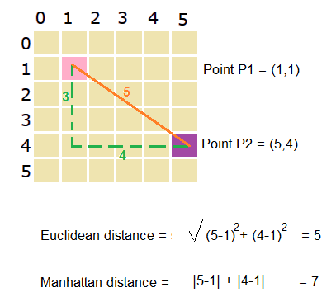
Difference
Manhattan Distance
P2 (5,4)
Euclidean Distance
P1 (1,1)

