Slide 1

INTERNSHIP
PRESENTATION
SkillCraft Technology
Internship Overview & Learning Journey
Data Science Internship
Student
Ashish Kushwaha
Roll Number
25SCS1003004994
Batch
Role
2026–27
Data Science Intern

Slide 2
Internship at a Glance
Key details from the supplied SkillCraft Technology internship report
Organization
Designation
Internship ID
SkillCraft Technology
Data Science Intern
SCT/JUL26/4527
Duration
Domain
Certificate Date
16 July 2026 – 16 August 2026
Data Science
22 August 2026
The report presents the internship objectives, scope, methodology, expected outcomes, and supporting internship documents.
Data Science Internship | SkillCraft Technology
2

Slide 3
Organization & Role
Professional context of the Data Science internship
SkillCraft Technology
Role
The internship was completed under SkillCraft Technology in the Data Science domain.
Data Science Intern — focused on practical data-oriented workflows and professional documentation.
Internship Period
Supporting Evidence
16 July 2026 – 16 August 2026
Offer letter and completion certificate are included in the internship report.
Data Science Internship | SkillCraft Technology
3

Slide 4
Internship Objectives
Core learning goals for the Data Science internship
• Understand the end-to-end data science lifecycle.
• Strengthen data cleaning, preprocessing, and exploratory analysis skills.
• Learn how data visualization supports data-driven decision making.
• Understand the basics of machine-learning model development and evaluation.
• Improve technical documentation and communication.
• Develop professional habits such as planning, review, accountability, and continuous learning.
Data Science Internship | SkillCraft Technology
4

Slide 5
Scope of the Internship
Areas covered by the report's Data Science framework
Data Handling
Exploratory Analysis
Visualization
Cleaning, preprocessing, transformation, and quality checks.
Descriptive analysis, pattern identification, and interpretation.
Using charts and visual summaries to communicate patterns.
Machine Learning
Documentation
Professional Practice
Understanding model development, validation, and evaluation.
Methodology, assumptions, findings, limitations, and conclusions.
Communication, time management, review feedback, and structured problem solving.
Data Science Internship | SkillCraft Technology
5

Slide 6
Data Science Methodology
A practical workflow connecting problem definition to communication
1
2
3
4
5
6
7
8
Problem
Collect Data
Clean
Explore
Features
Model
Evaluate
Communicate
The workflow begins by defining the problem and ends with communicating results, limitations, and recommendations. Data quality and validation remain important throughout.
Data Science Internship | SkillCraft Technology
6

Slide 7
Tools & Technologies
Technologies relevant to data-oriented project work
Python
Pandas
NumPy
Matplotlib / Seaborn
Programming, automation, analysis
Data cleaning and transformation
Numerical computation
Visualization
Scikit-learn
Jupyter
SQL
Git / GitHub
Machine learning
Interactive analysis
Structured data querying
Version control & collaboration
Data Science Internship | SkillCraft Technology
7

Slide 8
Week-wise Learning Framework
Aligned with the one-month internship duration
WEEK 1
Orientation & Data
Orientation & Data
Role expectations, Python/data fundamentals, dataset quality checks
WEEK 2
EDA & Visualization
EDA & Visualization
Cleaning, descriptive analysis, charts, patterns and anomalies
WEEK 3
Machine Learning
Machine Learning
Features, baseline models, training/testing, evaluation
WEEK 4
Finalization
Finalization
Interpretation, documentation, presentation, feedback and improvements
Data Science Internship | SkillCraft Technology
8

Slide 9
Skills & Learning Outcomes
Technical and professional capabilities from the internship framework
• Data handling: cleaning, preprocessing, transformation, and quality checks.
• Analysis: descriptive statistics, EDA, visualization, and pattern identification.
• Machine learning: understanding model selection, training, validation, and evaluation.
• Documentation: clear methodology, assumptions, findings, limitations, and conclusions.
• Professional skills: communication, time management, review feedback, and structured problem solving.
• Responsible practice: awareness of data privacy, bias, model limitations, and honest reporting.
Data Science Internship | SkillCraft Technology
9

Slide 10
Conclusion
Key takeaways from the internship report
• The internship provided professional exposure in the role of Data Science Intern.
• The supplied documents confirm the internship period, role, domain, and completion.
• A disciplined data science workflow connects problem definition, data preparation, analysis, modelling, evaluation, and communication.
• The experience builds a foundation for further work in Data Science, Machine Learning, and Data Analytics.
• Continuous learning, documentation, responsible data practice, and feedback are important for long-term growth.
Thank You
Data Science Internship | SkillCraft Technology
10

Slide 11
Appendix — Internship Offer Letter
Supporting document supplied with the internship report
INTERNSHIP OFFER LETTER
SkillCraft Technology Data Science Internship Student: Ashish Kushwaha Internship ID: SCT/JUL26/4527 Duration: 16 July 2026 – 16 August 2026
Data Science Internship | SkillCraft Technology
11

Slide 12
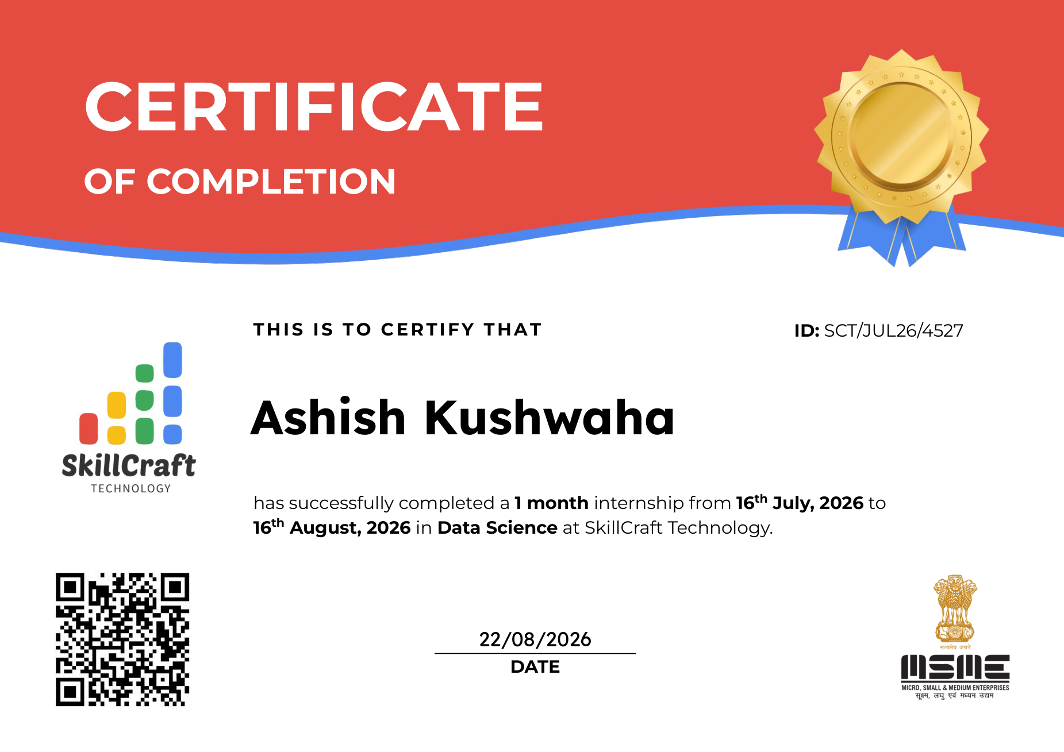
Appendix — Internship Certificate
Official completion certificate supplied with the internship report
Data Science Internship | SkillCraft Technology

Slide 13
THANK YOU
Data Science Internship | SkillCraft Technology
Ashish Kushwaha • B.Tech CSE • Batch 2026–27

