Slide 1



Exploratory Data Analysis on : Repaying the credit
Gold Atlantis
Mentors :
Rupali maam.
Sharayoo maam
Image downloaded from :deccanherald.com

Slide 2
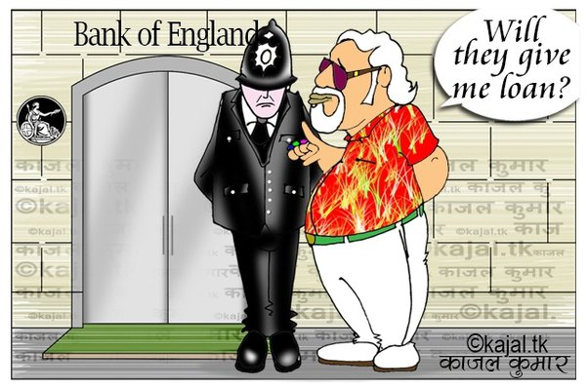
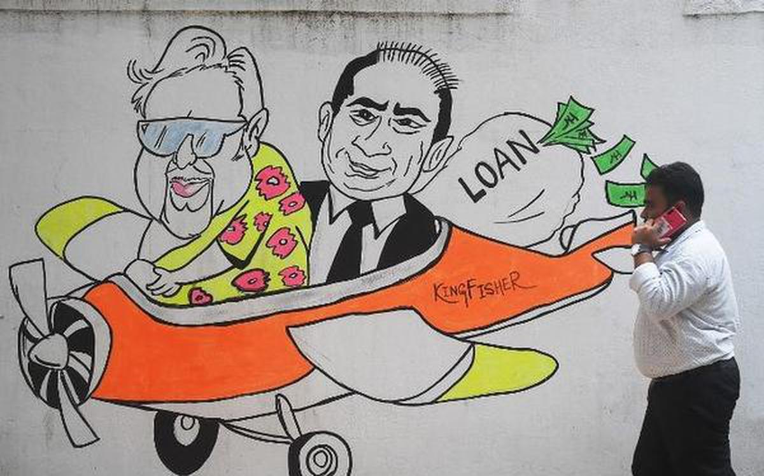
Objective Find insight who have lower % of becoming defaulter.
Image downloaded from :deccanherald.com

Slide 3







OPTION 04
No. Days Employed
OPTION 03
OPTION 05
House Available or Not
Amount of loan
OPTION 06
OPTION 02
Repayment Record
Occupation
OPTION 07
OPTION 01
Income Type
Income
Key Parameter to be taken

Slide 4
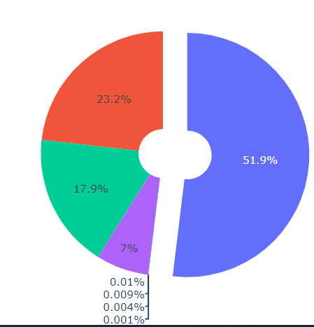
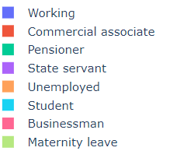
Income Category
Conclusion:
Here more than 50% account holder belong to working category
And 7% belong to state servant it means this two category people
having regular source of income.

Slide 5
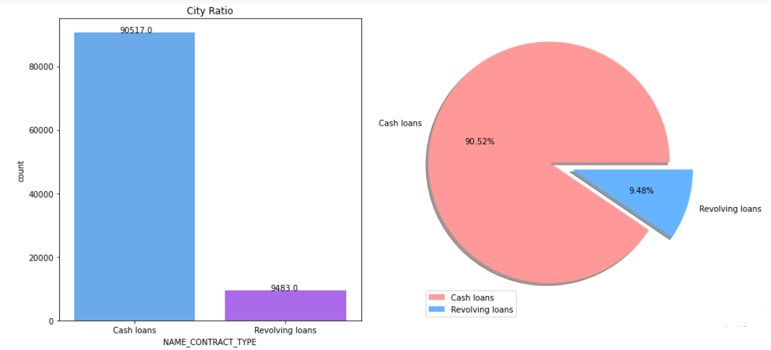
Contract Type
Conclusion : Here 90.5% of account holder do cash loan and 9.48% (9483) account
holder prefer to revolving Loans.

Slide 6
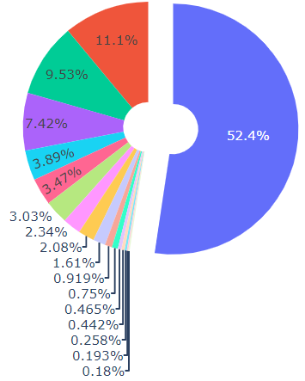
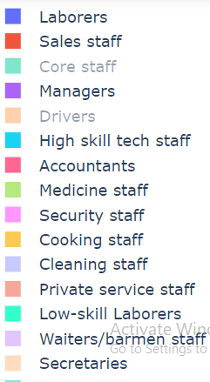
Occupation Type
Conclusion : Here 52.4% of account holder belong to Laboure as occupation.

Slide 7
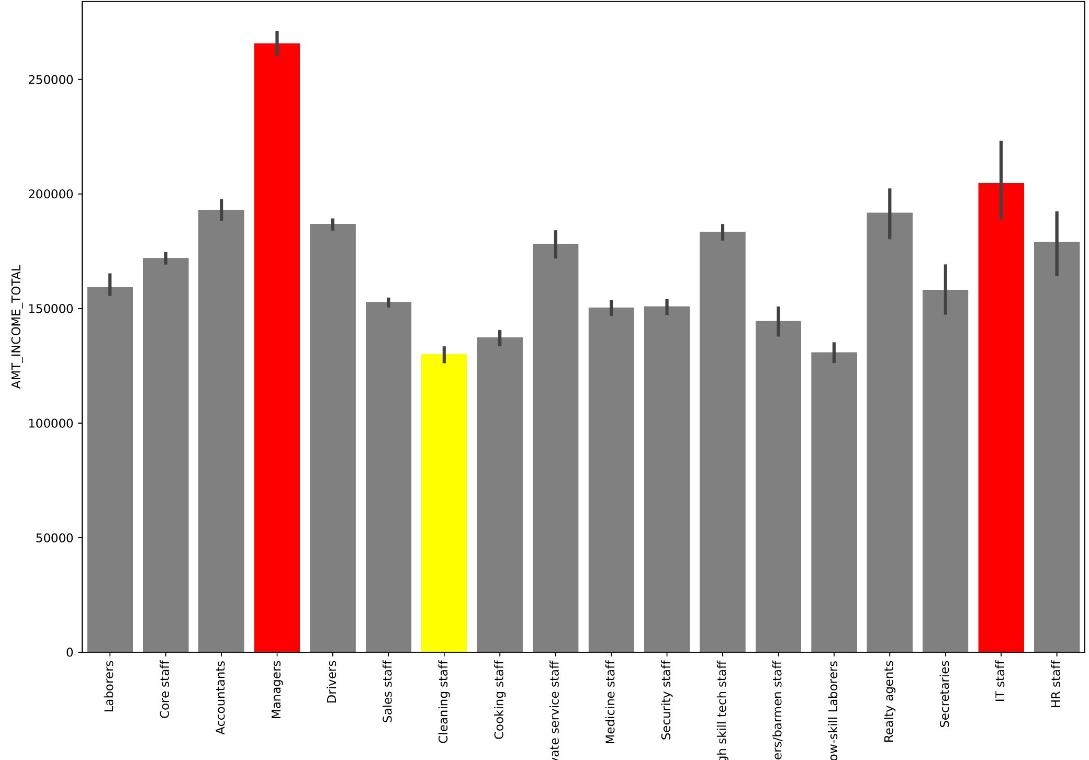
Occupation Type Vs Yearly income
Note: Red bars represent people
who are getting yearly income Greater than
2 lakh and people who are getting very less average income highlighted as in yellow.

Slide 8
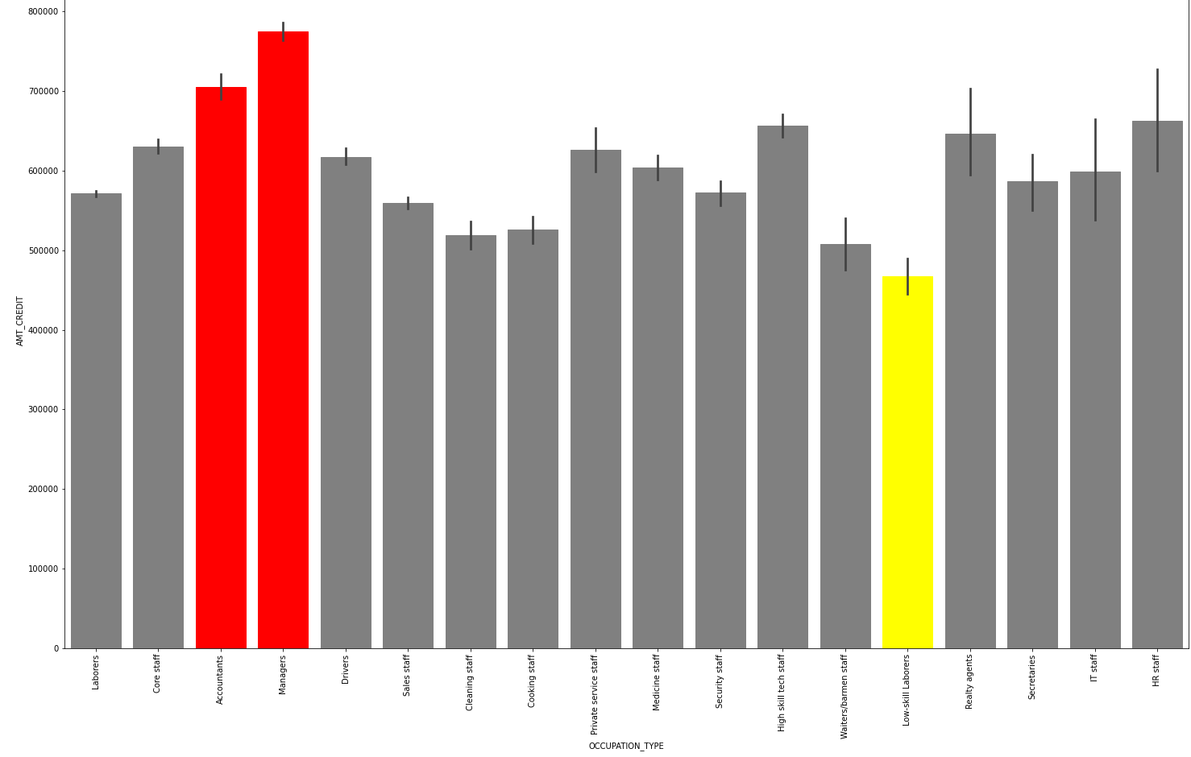
Occupation vs Credit loan
Note: Red bars represent people who are loan greater than 700000 and people getting very less amount of loan are in yellow color.

Slide 9
Property owned by consumer
Note: Payment difficulties and regular with payment
House | Car | Count Of such consumer | In percentage
Yes | Yes | 23613 | 23.61%
Yes | No | 45715 | 45.71%
No | Yes | 10369 | 10.36%
No | No | 20303 | 20.30%
Note: Data with Payment difficulties
House | Car | Count Of such consumer | In percentage
Yes | Yes | 1753 | 21.66%
Yes | No | 3808 | 47.05%
No | Yes | 739 | 9.13%
No | No | 1793 | 22.15%
Conclusion :
Here 22% of account holder does not owned any of the property with them which may lead them as defaulter
After that 9.13% account holder only owe car who are having payment difficulties.

Slide 10
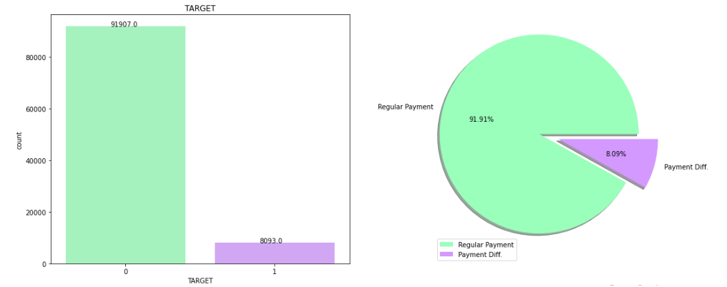
Percentage of people defaulter
Conclusion : Here 8.09% of account holder are not regular in their payment towards loan.

Slide 11
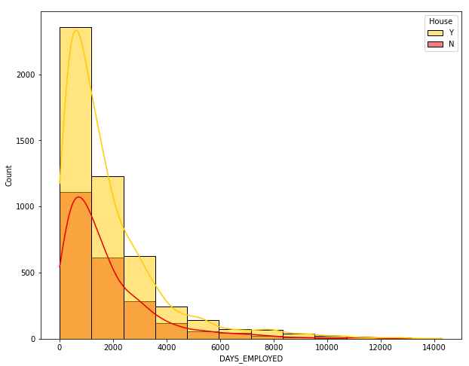
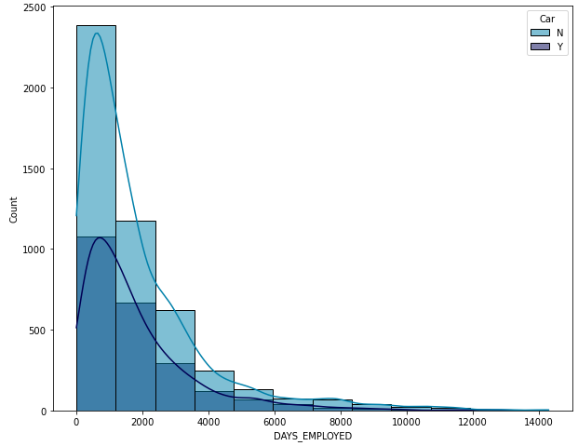
No of days worked and having house/car.
Conclusion : Here we can say that account holder who are having working days more than 2000 and
having house or car can be removed from defaulter list.

Slide 12

To whom company should not choose as defaulter ?

Slide 13
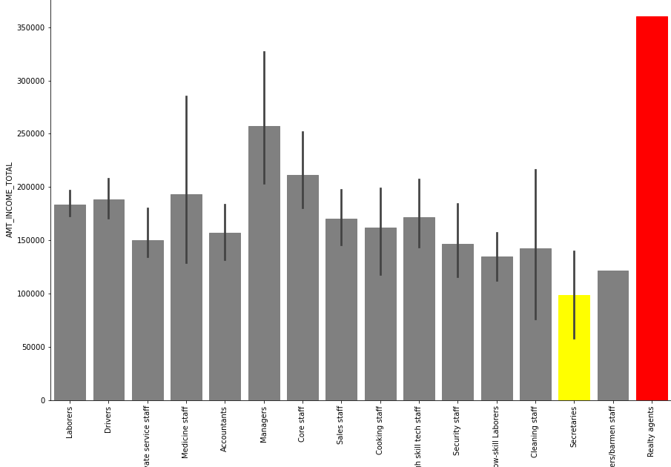

Case 1 :
No. of working days Greater than 2000 (5+ years) and having
both house and car.
There are 512 such account holder which is 0.5% of whole data of account holders and this should not be considered as defaulter.
They can become valuable account holder in future. So there loan should be approved.
By Occupation wise Realty agents should be given more priority as that of secretaries while approving load

Slide 14
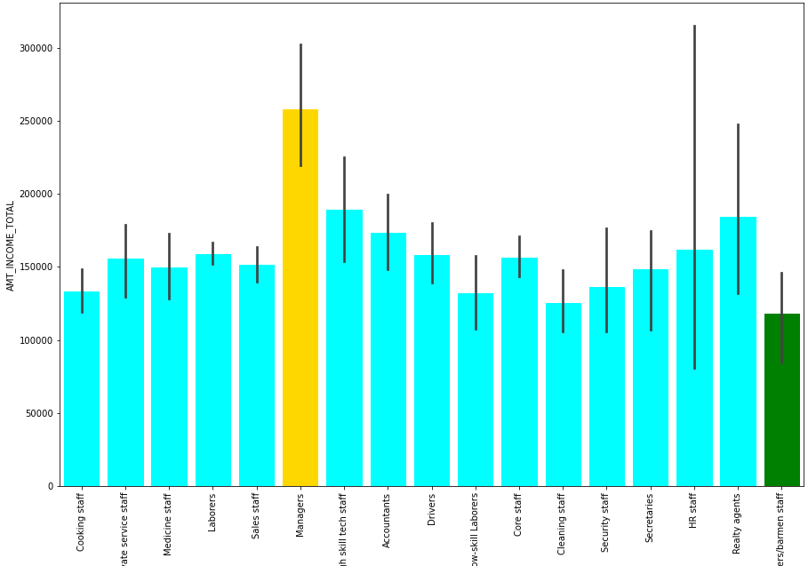
Case 2 :
No. of working days Greater than 2000 (5+ years) and having
house only.
There are 995 such account holder which is 1 % of whole data of account holders and this account holder should not be considered as defaulter.
They can become valuable account holder in future. So there loan should be approved.
By Occupation and income wise Managers should be given more priority as that of waiters while approving load

Slide 15
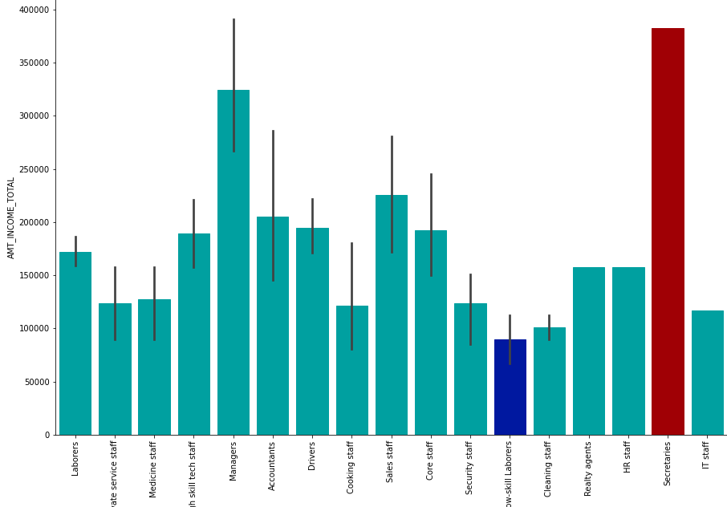
Case 3 :
No. of working days Greater than 2000 (5+ years) and having
car only.
There are 209 such account holder which is 0.2 % of whole data of account holders and this account holder should not be considered as defaulter.
They can become valuable account holder in future. So there loan should be approved.
By Occupation and income wise Secretaries should be given more priority as that of low skilled labour while approving load

Slide 16

Case 4 :
Not having house and cars .
There are 1587 such account holder which is 1.58 % of whole data of account holders and this account holder should be considered as defaulter.
So there loan should not be approved.

Slide 17
Conclusion:
Earlier the Percentage of defaulter account holder was 8.09% which is 8093 accounts but after doing
Exploratory data analysis the percentage of defaulter is decreased which is 6 %
(because not taken data of less than 5 years work experience in case1,case2 and case3,
and not having house and car both )
So after considering all the factors currently 93.62% of account holder having
lower percentage of becoming defaulter

Slide 18


