Slide 1


Exploratory Data Analysis on : Sales Data
Using Time Series
Furniture Sales

Slide 2







OPTION 04
Category
OPTION 05
Period
OPTION 03
Region
OPTION 06
Model
OPTION 02
Profit
OPTION 07
OPTION 01
Conclusion
Sales
Key Parameter to be taken on the basic of sales data

Slide 3

Data Available
1. Order date.
2.Category-Sub Category
3. Region
4. Sales
5. Profit

Slide 4

Data preparation & EDA
Imported Data using pandas
Find : a. Shape
b. Dimension
c. Summary
3. Null value
4. Filling Null values
5. EDA
6.Tableau Presentation
7. Model Building

Slide 5
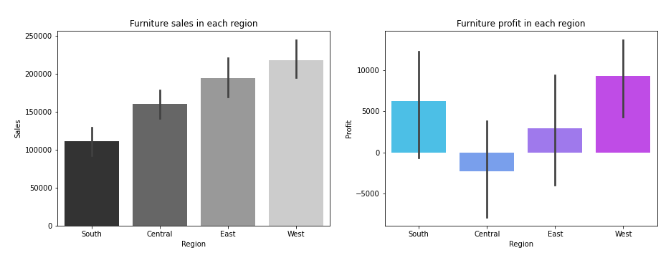
Furniture (Sales / Profit )
Conclusion:
In west region we can observe both sales and profit are at maximum point ,but central region is showing huge loss in furniture.

Slide 6
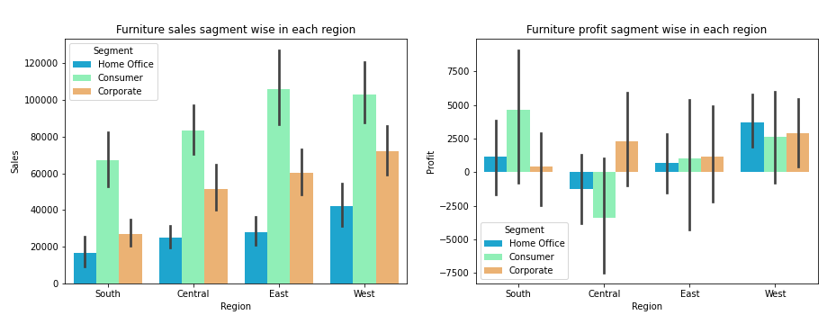
Segment wise ( Sales/ Profit )
Conclusion:
In all region consumer segment having maximum sales and home office having minimum sales , but in other hand central region is showing maximum loss in consumer segment.

Slide 7

Tableau Dashboard

Slide 8

Future Forecast For Furniture sales

Slide 9
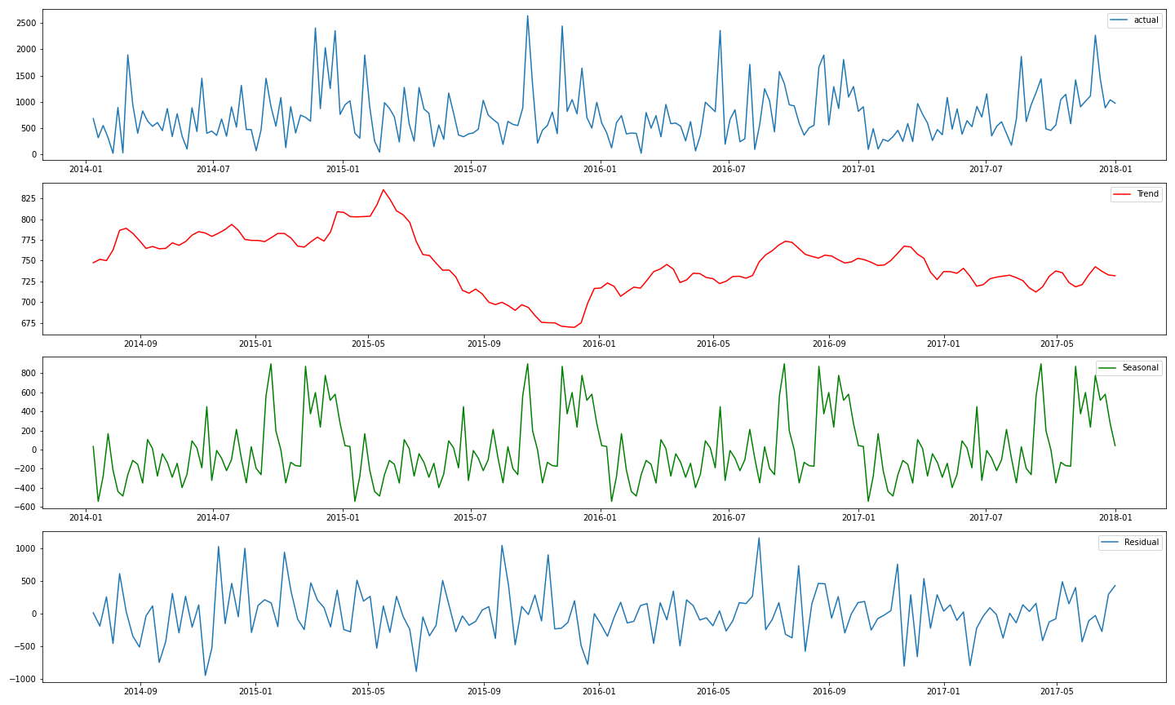

Trend/Seasonality
Actual Sales
Trend
Seasonality
Trend
As our data has both trend and seasonality in our data, so we will proceed with SARIMA and SARIMAX model

Slide 10
Model used(Time Series)
SARIMA
SARIMAX

Slide 11
Best Time series Model
SR No. | Model Name | AIC value | BIC value
1. | SARIMA | 2690 | 2717
2. | SARIMAX | 2520 | 2556
By comparing all Time series model we can go with SARIMAX model because in giving low AIC and BIC .

Slide 12
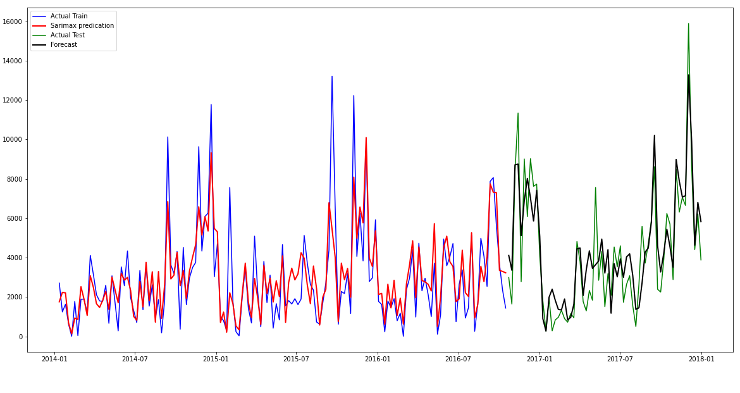
Forecast Value(for SARIMAX model)
Fitted values for train data
Black line is a
forecast data
Conclusion:
Here in SARIMAX model forecast value is similar to our actual test value

Slide 13

Conclusion:
As per the forecast data produced by SARIMAX model, it shows that in future the sales for furniture will increase over the period as per given past data.

Slide 14


