Slide 1


Exploratory Data Analysis on : Mall Customer
Using cluster model
Mall Customer

Slide 2







OPTION 04
Age
OPTION 05
Model Building
OPTION 03
Gender
OPTION 06
OPTION 02
Focused Area
Spending Score
OPTION 07
OPTION 01
Conclusion
Annual income
Key Parameter to be taken on the basic of Mall Data

Slide 3

Data Available
1. Customer Id.
2.Gender
3. Age
4. Annual Income
5. Spending score

Slide 4
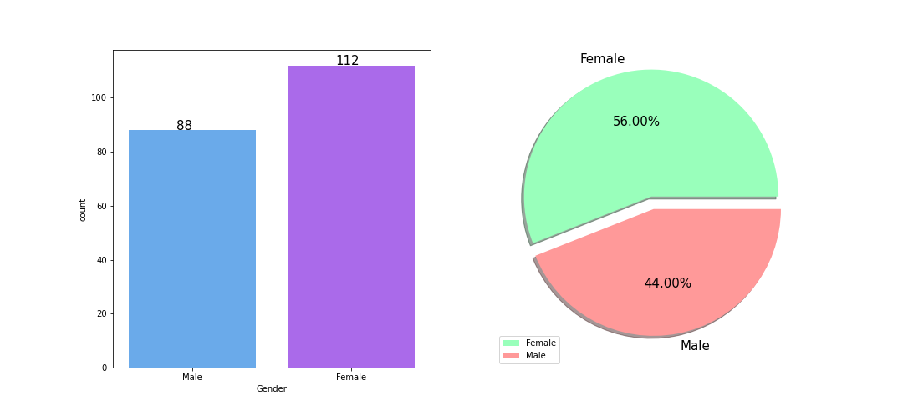
Gender Distribution
Conclusion:
Here 56 % of gender belong to Female category and 44 % belong to Male category it means female customer visits more as that of male.

Slide 5
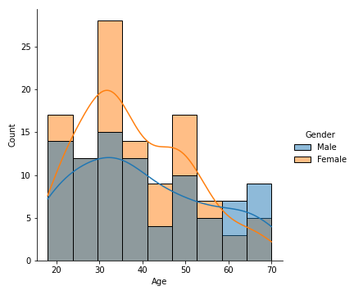
Age Distribution
Conclusion:
Here maximum no. of customer are below age 40 for both category of Gender.

Slide 6
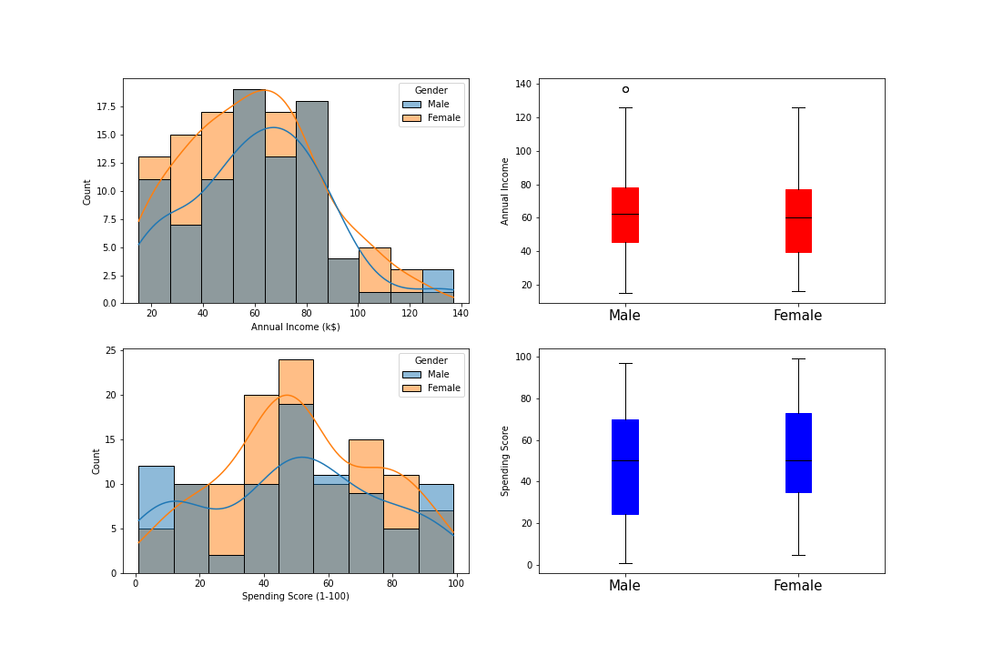
Income and Spending
Conclusion:
On the basic of gender both male and female ,maximum customer having income less than $ 80k.
But if go on spending wise customer whose income greater than $ 40 k their spending is high.

Slide 7
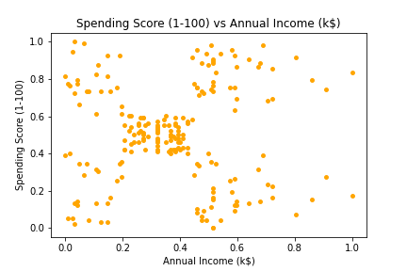
Income and Spending
Conclusion : 5 no of cluster can be formed

Slide 8

Which Category of customer we need to focus more

Slide 9
Best Cluster Model
Sr. No. | Model Name | Score
1 | K – Mean | 55.36 %
2 | Hierarchical Cluster | 55.31 %
3 | DBSCAN | 17.82 %
By comparing all clustering model we can go with k mean clustering model because in giving best score as that of other model .

Slide 10
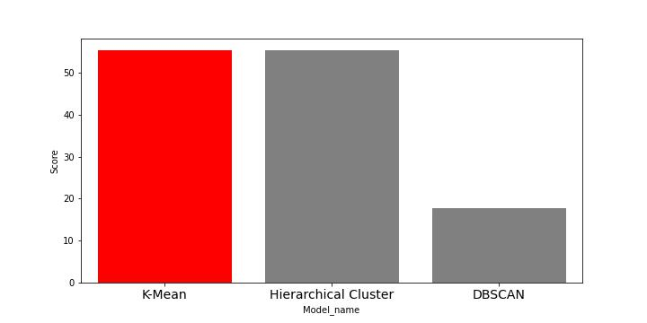
Best Model
Conclusion:
K- mean model shows the score of 55.36% which is highest among all other Cluster model

Slide 11
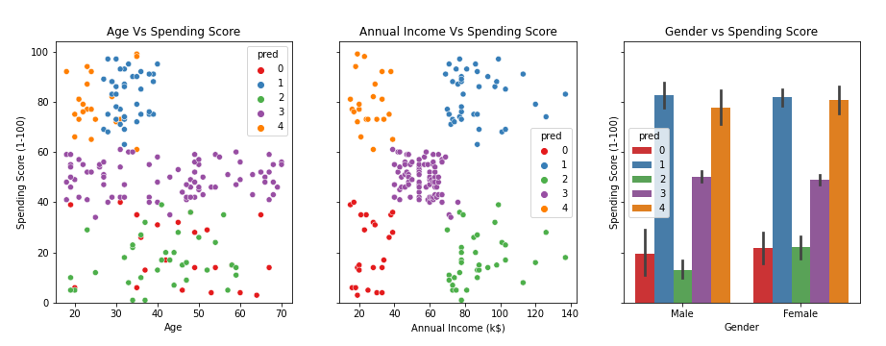
Best Model ( K mean)
Conclusion:
Age is the most important factor in determining Spending Score. Irrespective of their Annual income, younger people tend to spend more.

Slide 12

Conclusion:
As per the given data of mall customer Here I will suggest
Customer who are having age below 40 years their spending score is high. So we have to provide special offer to this age group to increase profit .

Slide 13


