Slide 1


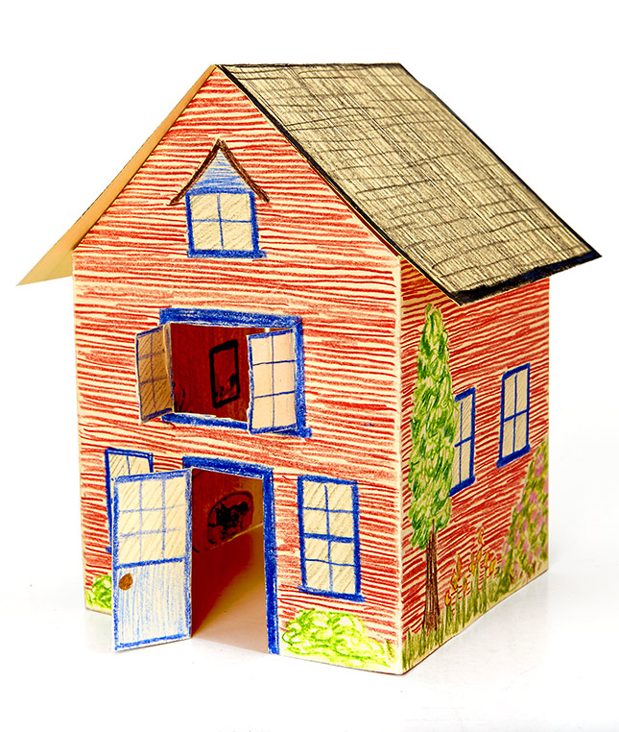
Exploratory Data Analysis on : House grade
Housing Grade
Image downloaded from :deccanherald.com

Slide 2







OPTION 04
No. Rooms
OPTION 05
No. of
washroom
OPTION 03
Roof (Yes/No)
OPTION 06
OPTION 02
Model Building
Price
OPTION 07
OPTION 01
Conclusion
House Grade
Key Parameter to be taken on the basic of Grade

Slide 3

Data Available
1. Grade.
2.Price
3.Roof(yes/No)
4.Each Grade (No. bedrooms )
5. Bedroom with no. wash room

Slide 4
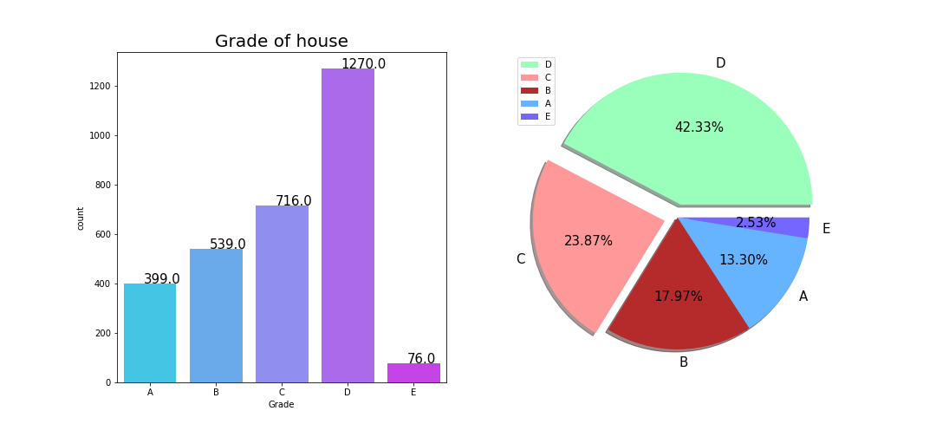
House Grade distribution
Conclusion:
Here 42.33% house belong to Grade D category and 28.87% belong to Grade C category it means this two category are main part of where people can buy house.

Slide 5
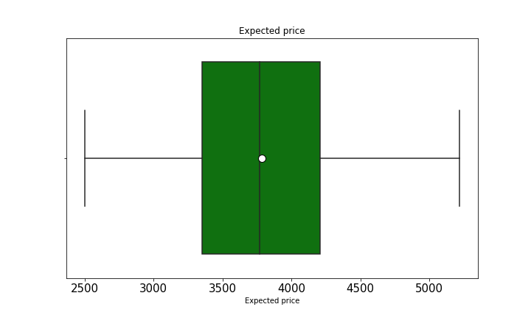
Property Pricing
Conclusion:
Here price of maximum property lies in range of 3300 to 4300,
Lowest starting is from 2500 and max price till 5600.

Slide 6

If customers ask:
Condition 1 : He wants a property in range of 4500 to 5600.
Condition 2 : With Open Roof.
Condition 3 : With 7 bed room and 6 washroom

Slide 7
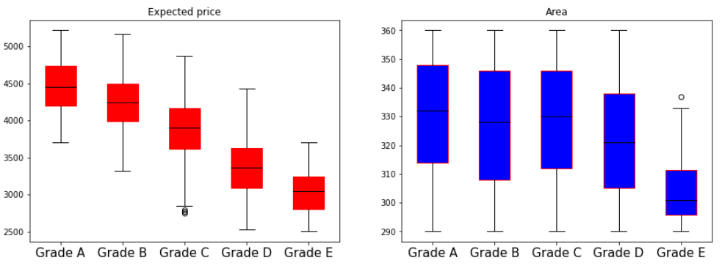
Grade wise Property Pricing and Area
Conclusion:
Here we can observe that Grade A property having high price and property are also having in large range as the grade decreases price and area also decreases

Slide 8
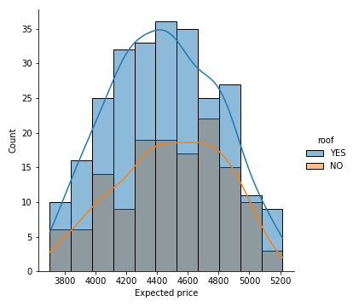

Range of flat with/without roof
With roof
Conclusion:
Here we can observe that in Grade A ,we are having large variety of range for with roof property as that of without roof .

Slide 9
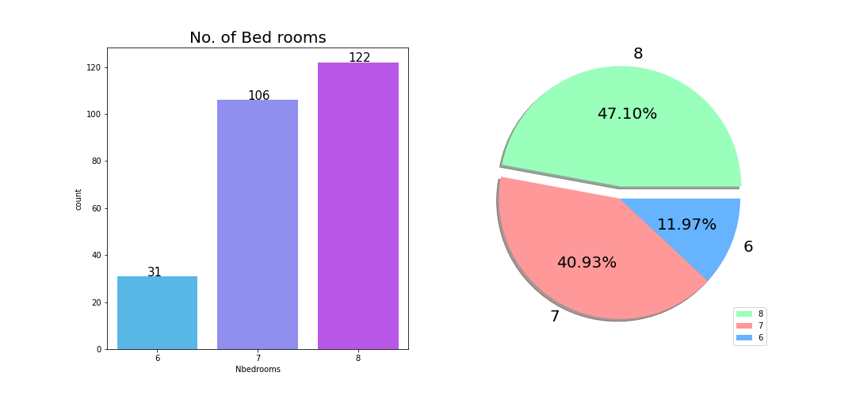
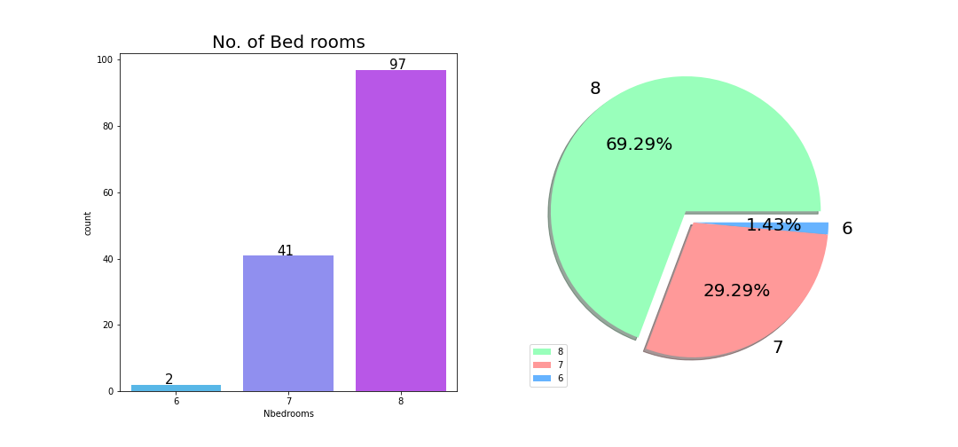
No. of bed room available roof(yes/No)
No. of bed room with roof
No. of bed room without roof
Conclusion:
With roof 8 no. of bed room are mostly available in grade A which is 47.10%
Without roof 8 no. of bed room are mostly available in grade A which is 69.29%
Note : BI for Grade A

Slide 10
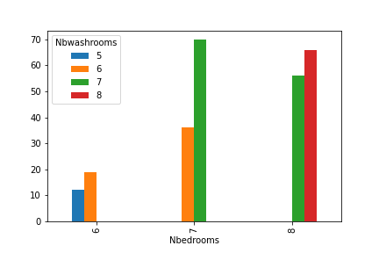
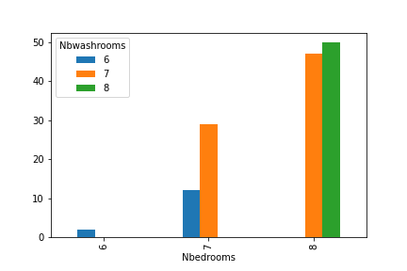
No. of wash room ,Each type of bed rooms
No. of washroom ,bedroom with roof
No. of washroom ,bedroom without roof
Conclusion:
Here for both roof category were no. of room are 8 having maximum no. of washroom

Slide 11

Conclusion:
As per the given range Here I will suggest in Grade A with roof 3 types of bed rooms are available and for each type of bed room different variety of washrooms are available.

Slide 12
Best Model
SR No. | Model Name | F1 Score
1 | Logistic Reg | 92.52 %
2 | Stacking | 92.27 %
3 | Decision Tree | 89.75 %
4 | Random Forest | 89.75 %
5 | AdaBoost | 82.06 %
By comparing all classification model we can go we Logistic Reg or by Stacking model because in both model we are getting best score as that of other model.

Slide 13
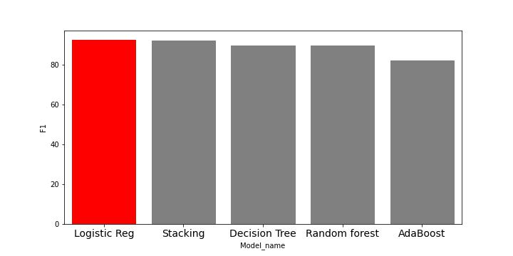
Best Model
Conclusion:
Logistic Reg model shows the score of 92.52% which is highest among all other Classificatio model

Slide 14
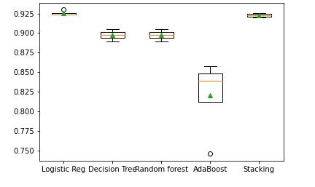
Range of each model Using Boxplot(Cross validation)
Conclusion:
Here we can observe the various range of each model

Slide 15


