Slide 1

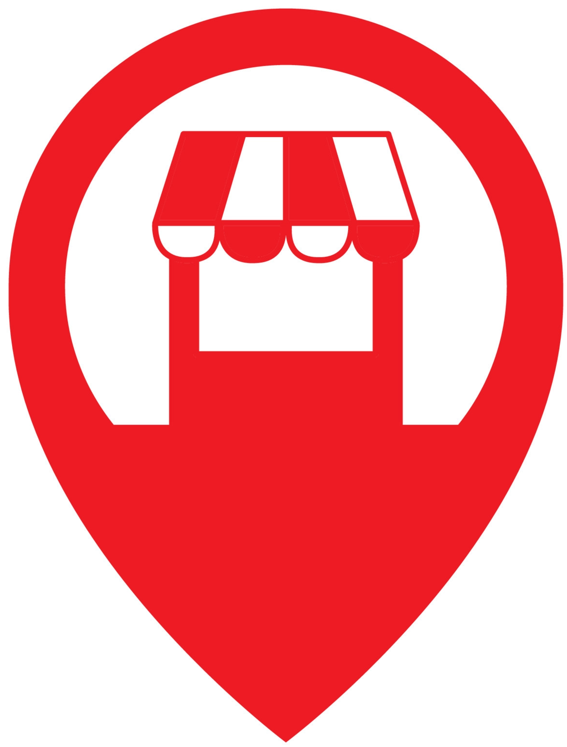
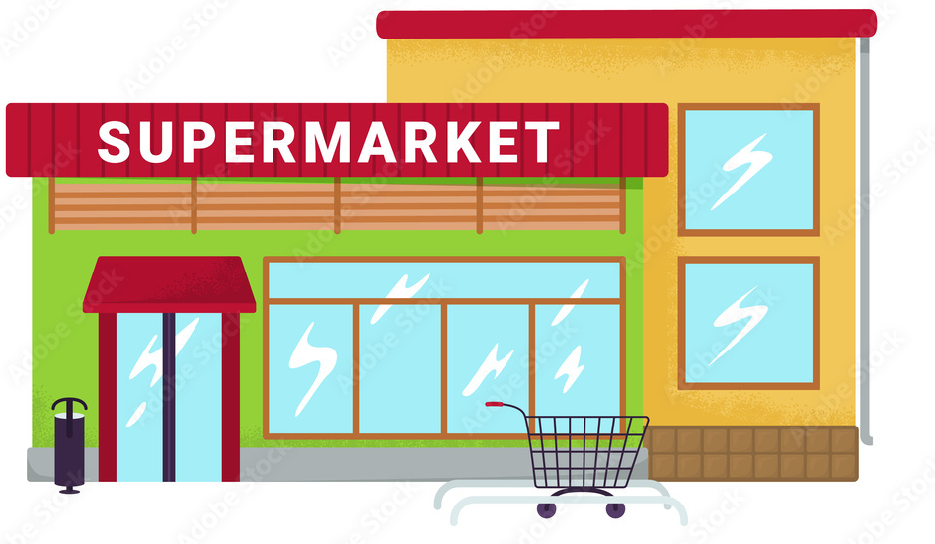
Exploratory Data Analysis on : Sales
Where to
Open New store?
Image downloaded from :deccanherald.com

Slide 2







OPTION 04
Focused Item
OPTION 05
OPTION 03
Key Insights
Outlet type
OPTION 06
OPTION 02
Model Building
Outlet Location
OPTION 07
OPTION 01
Conclusion
Outlet size
Key Parameter to be taken on the basic of sales

Slide 3
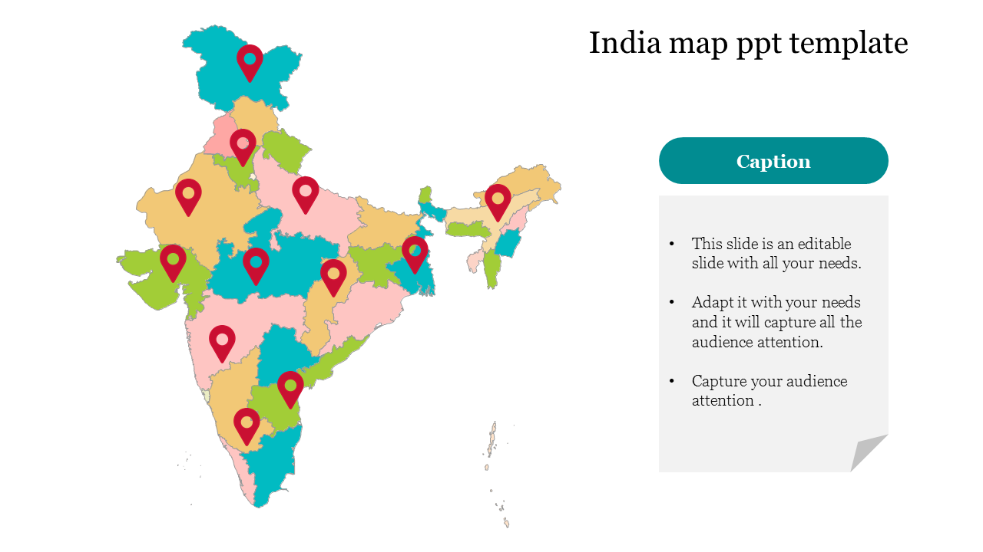
Data Available
1.Outlet location.
2.Outlet Size
3.Outlet type
4.Most popular product
5.Product Pricing(Sales)

Slide 4
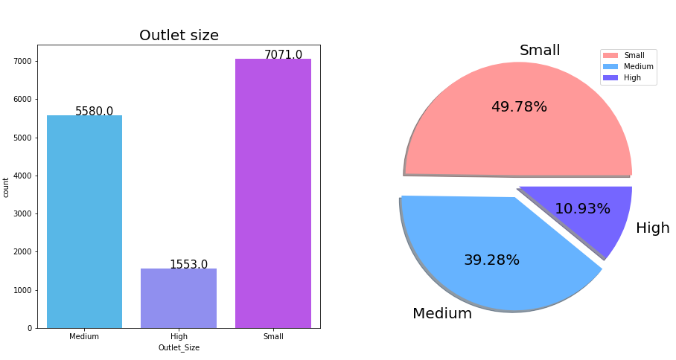
Store distribution on outlet size
Conclusion:
Here 50% outlet size belong to small category and 40% belong to medium category it means this two category are main part of business to run.

Slide 5
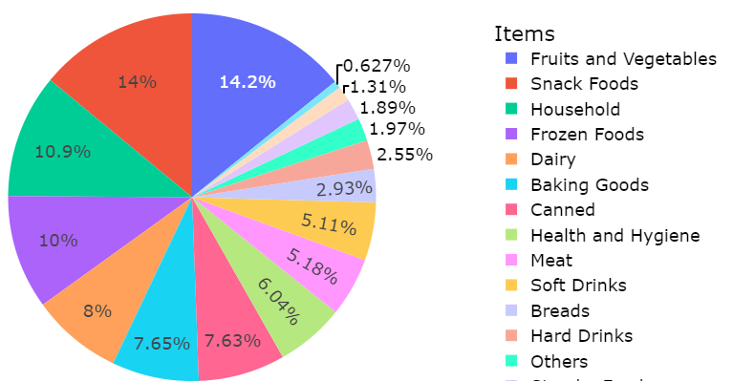
Product having high demand
Conclusion:
The item having high demand through every store are Fruit and vegetables with 14.2% ,snack Foods with 14% and Household with 10.9%.
This gives the clear picture of our data In which segment to focus more.

Slide 6

Where to open new store ?
What will be the size of store?
Which type of store ?
Which Item should we focused ?

Slide 7
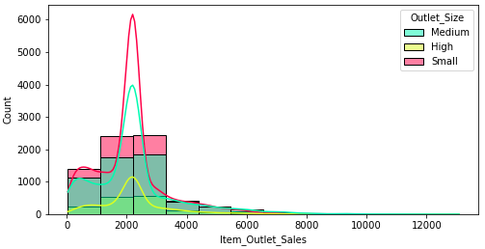

Size of store On basic of sales
Small Size outlet having highest sales
Conclusion:
On the basic of sales small outlet are having highest sales as compare to other outlet size .

Slide 8
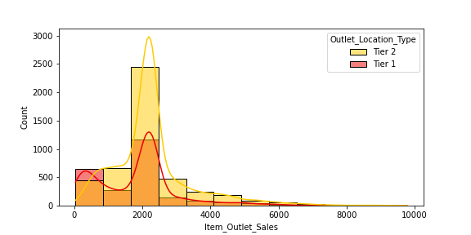
Location of store On basic of sales
Tier 2 city having highest sales
Conclusion:
On the basic of sales tier 2 city are having highest sales as compare to other city location type with small outlet size .
Note : After filtering the data for small outlet

Slide 9
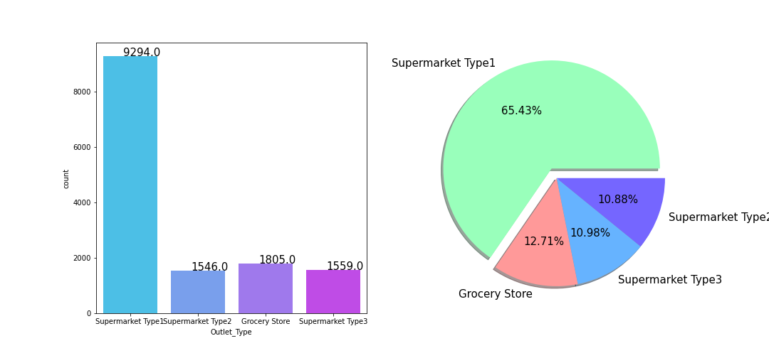
Which type of store.
Conclusion:
Here 65.43% outlet type belong to Supermarket Type 1 category and 12.71% belong to Grocery Store category it means supermarket type 1 are most liked by people to buy products.

Slide 10
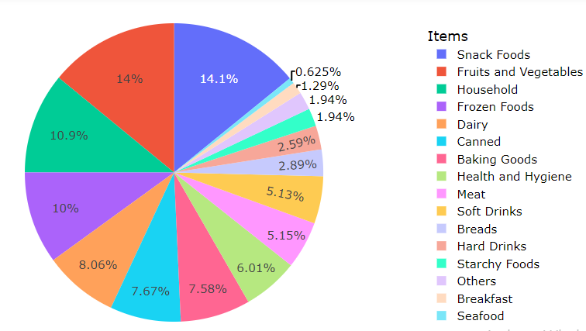
Product having high demand
(tier2-small outlet-Supermarket type 1)
Conclusion:
The item having high demand through every store are with 14.1% snack Foods , Fruit and vegetables with 14% and Household with 10.9%.
This gives the clear picture of our data In which segment to focus more.

Slide 11
Conclusion:
So, if I want to open a new store I will see weather it belong to Tier 2 or not ,
After that I will prefer to small size outlet with super market type 1 with larger quantity of Snacks food ,fruit ,vegetable and household items to run my store with high sale

Slide 12
Best Model
Model | R2(CoD) | MSE | RMSE | MAE
Linear Regression | 29.70% | 1201854.72 | 1096.29 | 821.16
Random Forest | 24.46% | 1240752.14 | 1113.89 | 841.34
Decision Tree | 37.12% | 1129039.03 | 1062.56 | 804.30
KNN | 62.71% | 2112530.30 | 1453.45 | 1052.55
By comparing all regression model we can go we KNN model because
in KNN model only we get best score as that of other model.

Slide 13
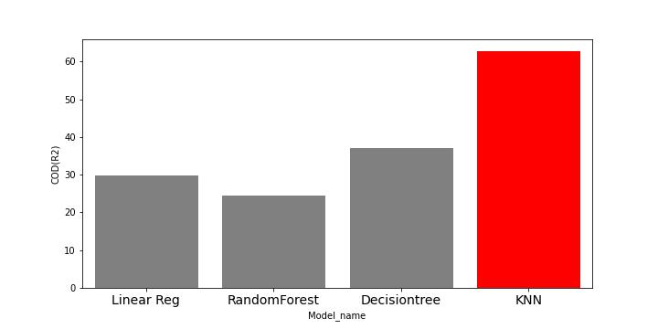
Best Model
Conclusion:
Knn model shows the score of 62.71% which is highest among all other regression model

Slide 14
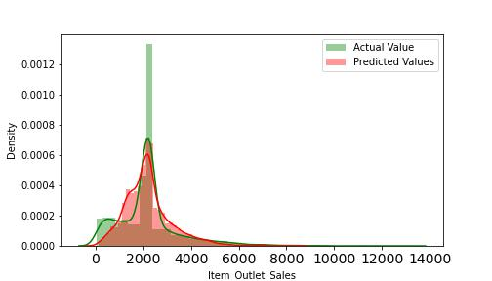
Actual and predicted value for best model
Conclusion:
Here actual and predicted value are nearly same to each other.

Slide 15


