Slide 1
Automatic Deployment of virtual Labs on Cloud Infrastructure
Presented By :
Archita Jindal, Ashish Agarwal, P.Amulya Sri, Yogesh Agrawal

Slide 2
Project Description
“Physical distances, lack of resources must not be a problem for students to develop the skills.”
But, the fear of Availability, Scalability, Robustness still holds us back. These concerns are lessened if we move these labs to a cloud infrastructure.

Slide 3
Virtualization v/s Cloud Computing
Is Virtualization right for Virtual Labs ?
How about Cloud Computing !!!!

Slide 4
A better thinking…
If you want scalability, self-service capability, elasticity, automated management, pay-as you go service and relief from the burdens of maintaining hardware and software yourself, then cloud is better option.

Slide 5
Why Cloud is preferred
Hardware costs hugely decreases: You don't need to purchase the computer with the most specifications or with the most powerful processor.
Remote Access: Storing files remotely.
Save enormous costs: Licensed software's can be installed on servers.
Less IT work: means more concentration on other problems or issues.
No more physical servers, No maintenance.

Slide 6
Infrastructure Used
Eucalyptus
OpenStack

Slide 7
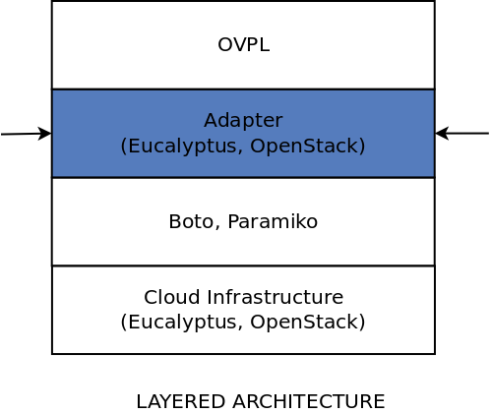
Stack Architecture

Slide 8
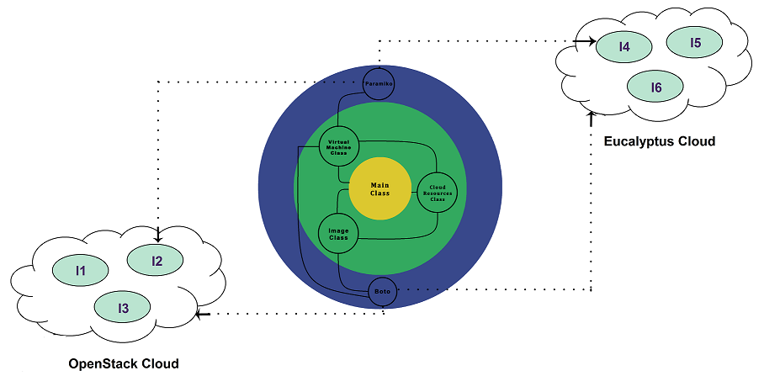
Motivation : Cloud

Slide 9
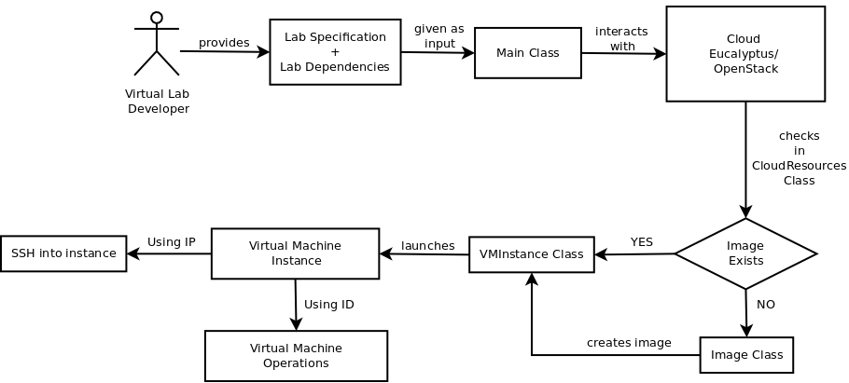
API Workflow

Slide 10
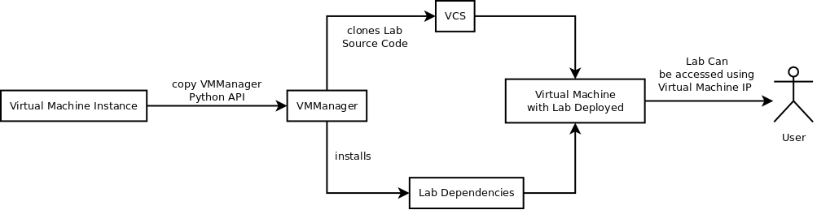
API Workflow

Slide 11
Logging
To provide a complete record of the lab deployment, all major
events in API get logged to the console using Python’s standard
logging framework.

Slide 12
Testing Environment
As part of testing this API we use Python standard unit testing
framework called nose.

Slide 13
Questions ?

Slide 14
Thank You.

