Slide 1
Parkinson’s disease novel diagnosis using complex-valued artificial neural network and k-means clustering feature weighting method
Aditya Sriram (13IT104)
Ashish Kumar Singh (13IT107)
Rohan Ramesh Nair (13IT135)
Ohileshwar Itagi (13IT251)

Slide 2
Introduction
Parkinson’s disease is a neurodegenerative disease of the central nervous system that causes partial or complete loss of the motor reflex, speech, behavioral, and mental processes, and other vital functions.
Currently, no specific method has been developed for PD diagnosis. Specialists currently use measurement techniques based on the history of the disease. They detect the existence and severity of symptoms. They are time and effort consuming.
Studies have proved the relationship between degradation of speech and the disease. Speech samples can be used in computer based solutions research to aid in medical decision making. In our case, diagnosis.

Slide 3
Problem Statement
To build a novel diagnosis system to determine if a patient has Parkinson’s disease or not.

Slide 4
Objectives
To apply the K-Means Clustering Feature Weighting Method to the given dataset
The output of the KMCFW method is fed into a Complex Valued Artificial Neural Network.
To classify by comparing the actual labels against the predicted labels

Slide 5
Methodology
The working of the KMC algorithm can be summarized as follows:
1. k units are selected randomly as initial cluster centers.
2. Units without cluster centers are assigned in accordance with the defined distance measure to the clusters that the initial cluster centers belong to.
3. New cluster centers are created by averaging the variables in k initial sets that were created.
4. Units are assigned to the closest clusters which are the newly created cluster centers. Distances are calculated.
5. The distances to the previous cluster centers are compared with the distances to the newly created cluster centers.
6. If the distances reduce reasonably, return to step 4.
7. If a fundamental change is not in question, the iteration is finalized and the algorithm is ended.

Slide 6
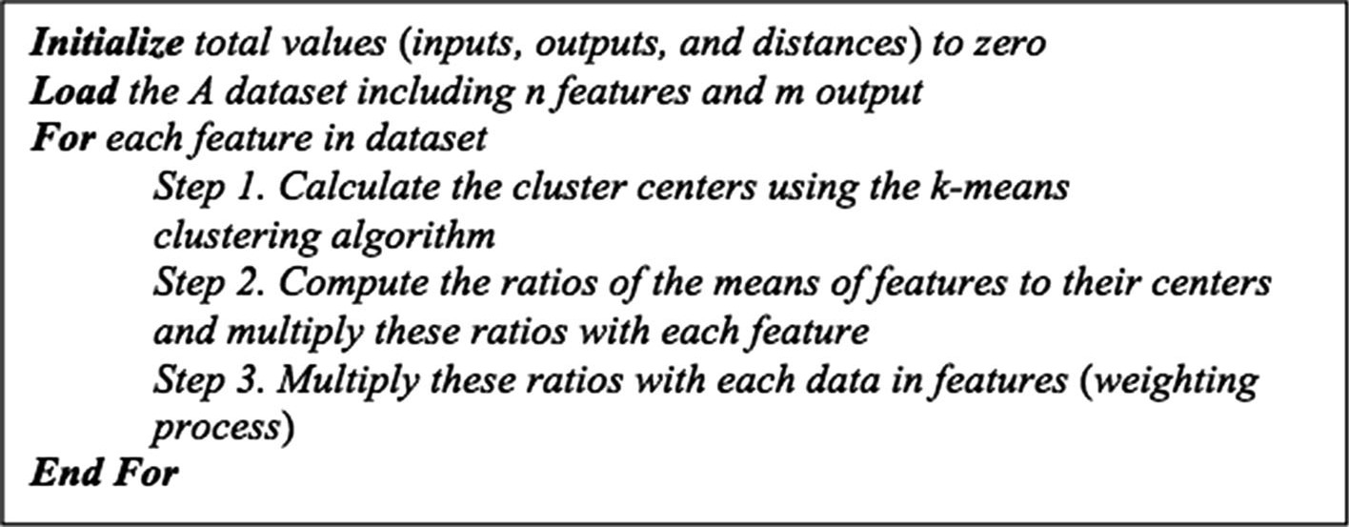
Feature Weighting Pseudocode

Slide 7
CVANN Algorithm
• Initialization: Assign all weight and threshold values as complex numbers.
• Submission of inputs and outputs (the target): Providing complex-valued input vectors I1, I2, I3, …, IN and corresponding complex-valued output (target) vectors T1, T2, T3, …, TN to the network. N is the number of patterns to be used in training.
• Calculation of actual output: Calculate the actual output (Yn). Actual output is calculated using Eq. 10.
• Determining the error value: Calculating the error value depends on the obtained output and the target output value according to Eq. 11.
• Changing the weight and threshold values: Update the weight and threshold values using the formulas in Eqs. 17–20. Continue this process until the error is minimized.

Slide 8
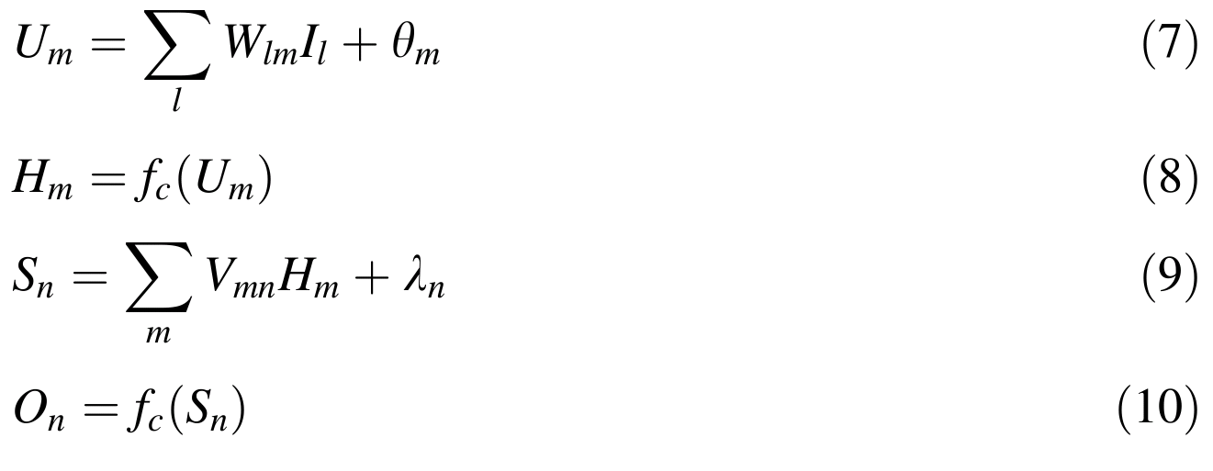
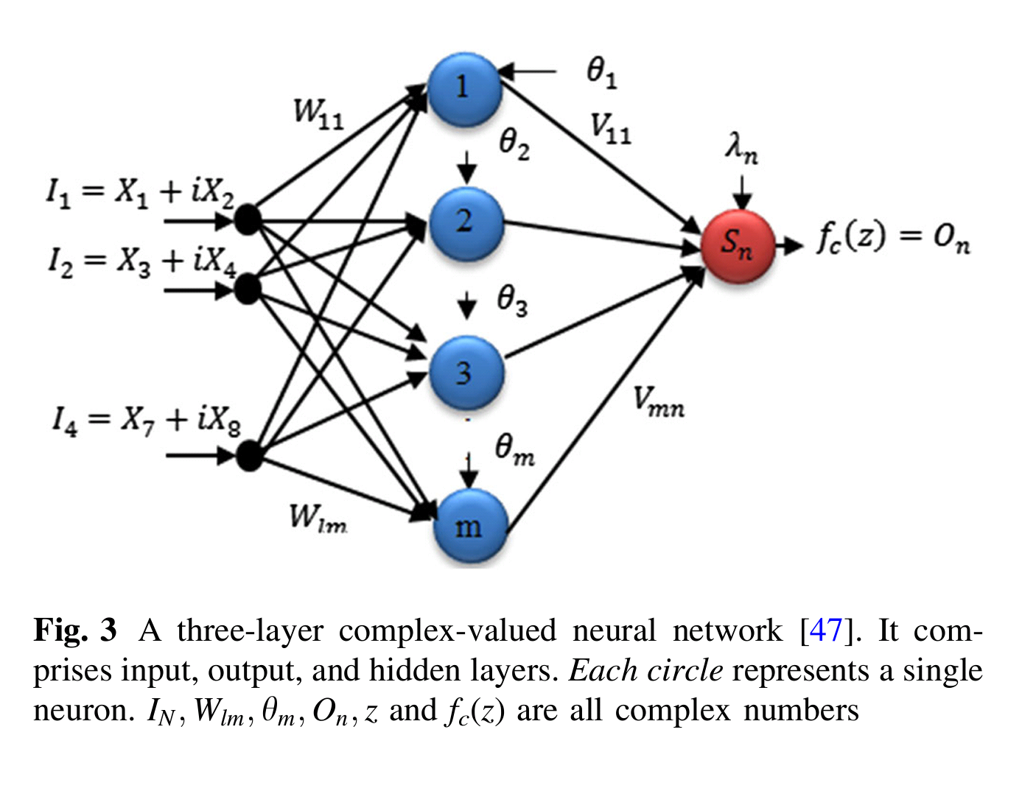
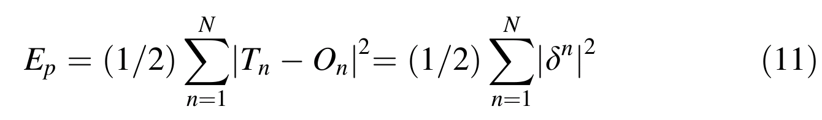
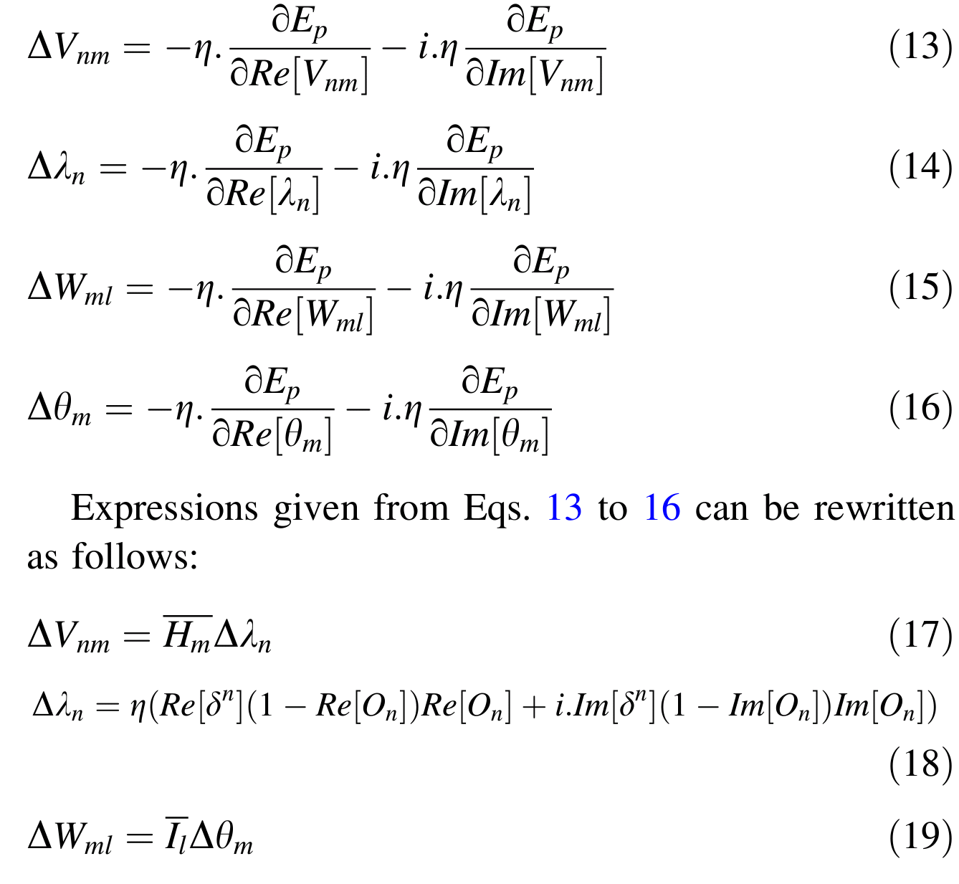

Slide 9
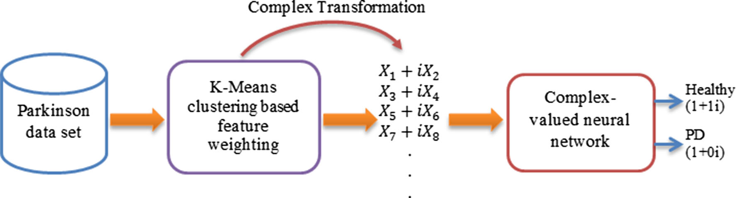
Block Diagram of the Proposed System

Slide 10
Results
Test | Total Number of Samples | Number of Correctly Predicted Samples | Accuracy(%)
1 | 195 | 193 | 99.0
2 | 195 | 190 | 97.5
3 | 195 | 193 | 99.0
4 | 195 | 195 | 100.0
5 | 195 | 166 | 85.0

Slide 11
Conclusion
So we conclude that the system built was able to achieve a good classification accuracy in diagnosing Parkinson’s Disease for a given sample.

Slide 12
References
Link to main paper. http://link.springer.com/article/10.1007%2Fs00521-015-2142-2
Parkinsons Dataset. https://archive.ics.uci.edu/ml/datasets/Parkinsons.
Other papers referred:
Gunes S, Polat K, Yosunkaya S (2010) Efficient sleep stage recognition system based on EEG signal using k-means clustering based feature weighting. Expert Syst Appl 37(12):7729–7736
Sivachitraa M, Savithab R, Sureshb S, Vijayachitrac S (2015) A fully complex-valued fast learning classifier (FC-FLC) for real-valued classification problems. Neurocomputing 149:198–206

Slide 13
THANK YOU

