Slide 1
TRank: Ranking Twitter Users According to Specific Topics
By:
Ashish Kumar Singh (13IT107)
Anjan Ragh KS (13IT204)
Pranav Konanur V (13IT228)

Slide 2
Problem Statement
TRank – A method designed to address the problem of identifying the most influential Twitter users on specific topics identified with hashtags.
Combines different Twitter signals (that represent both the user and the user’s tweets) to provide three different indicators that are intended to capture different aspects of being influent.
Where can TRank be used?
Business scenario
Politics
Marketing
Notes:
<number>

Slide 3
Existing Methods and their Limitations
Based on number of followers of a user.
Based on user profile.
Based on analysing the characteristics of the user relationship network and the tweeting activity of users.

Slide 4
What is TRank?
Algorithm to find most influential twitter users based on specific topics.
Not based on the simple magnitude of data like the absolute number of followers or of retweets.
Different Twitter signals used to compute three different indicators that are intended to capture different aspects of being influent:
the follower influence
the retweet influence
the favourite influence

Slide 5
TRank Algorithm
TRank works in three main steps:
1) Given a hashtag h and time interval I, select all tweets sent in interval I that contain hashtag h.
2) For every such tweet, determine the user that wrote it and score the user with three indicators FI, RI and FVI.
3) Select and output the best scoring users.

Slide 6
Followers Influence (FI)
FI_{u} = User U followers influence indicator.
aFw_{i} = Number of active users u_{i} is following.
u₁ , u₂ …… u_{n} = Other users(followers of user U).
Notes:
<number>

Slide 7
Retweet Influence (RI)
RI_{T} = Tweet T retweet influence indicator.
Rt_{T} = Number of retweets T got.
aF_{U} = Number of followers of U that have been active in the time interval I.
Notes:
<number>

Slide 8
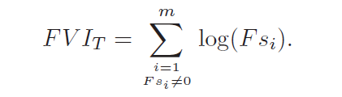
Favourite Influence (FI)
FVI_{T} = Tweet T Favorite influence indicator.
m = Number of users who marked tweet T as their favourite.
Fs_{i} = Number of followers of user u_{i}.
Notes:
<number>

Slide 9
Implementation
The list of steps followed to get the results and perform calculations are as follows :
Use Application Authentication to get authentication into the twitter database
Using the TwitterAPI we retrieve status objects for a particular hashtag in a JSON
format.
Process the JSON object to get required data i.e the tweetId,userId,userName,retweet
count, favourite count, followers count, friend count or the followings and the times-
tamp of the tweet and store it into a database
Perform calculations to get the values of FI , RI and FVI .
Sort the users according to each of these values namely FI , RI and FVI and pick
the top 3 users in each.
Find the number of repetitions of each name in all the 3 tables by performing union
all on the tables.
If the count is 3, then that user is Highly Influential. If count is 2, then he is
Influential and if the count is just 1, he is Potential influencial.

Slide 10
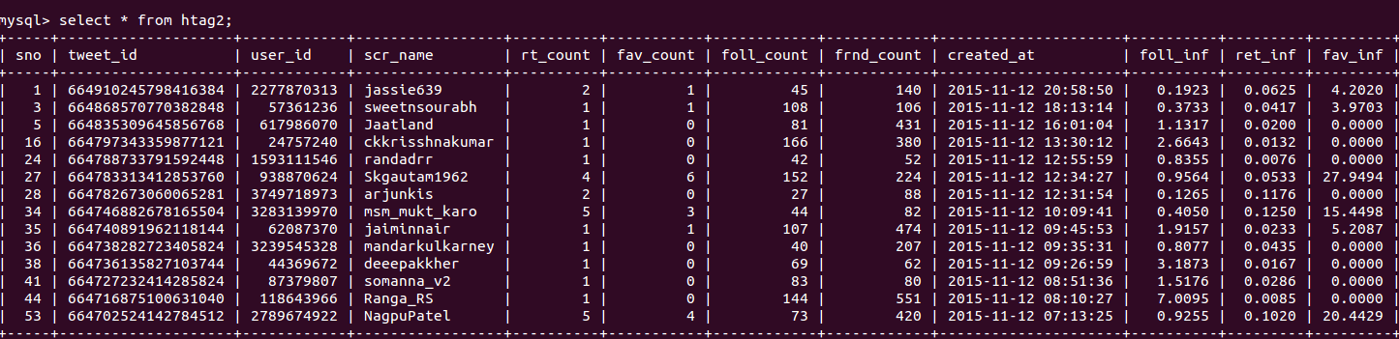
Populating Database with Tweets and Calculation of the 3 Influence Parameters

Slide 11
Results For #TipuJayanti
LIMIT : TOP 3 No highly influential users. Influential Users are: msm_mukt_karo NagpuPatel Potential Influential Users are: arjunkis ckkrisshnakumar deeepakkher Ranga_RS Skgautam1962 | LIMIT: TOP 4 No highly influential users. Influential Users are: jaiminnair msm_mukt_karo NagpuPatel Potential Influential Users are: arjunkis ckkrisshnakumar deeepakkher jassie639 Ranga_RS Skgautam1962

Slide 12
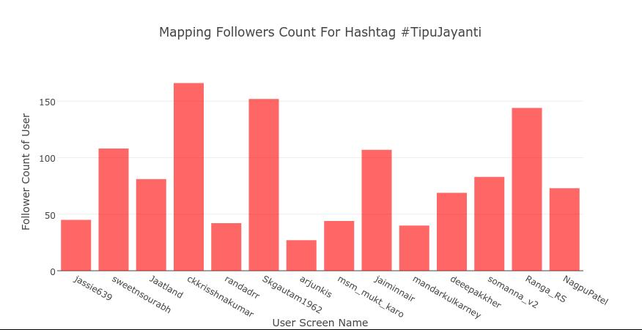
Analysis – Followers Count Vs Influence

Slide 13
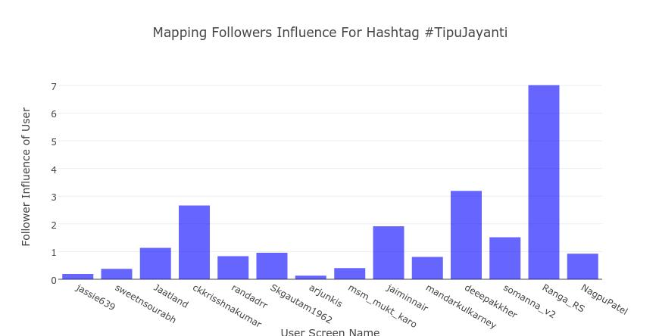
Analysis – Followers Count Vs Influence
In inference of the outputs obtained, we can clearly see that the count of the followers is not a clear indicator of a user’s influence.

Slide 14
Conclusion and Extension
TRank can be used to find the most influential Twitter users on a given topic, as it provides results that are more reasonable than the one obtained by mechanisms based on the sole magnitude of data.
Extension Work Done:
Obtained expansive datasets based on condition such as followers' count, retweet count, favourites count, hashtags(covering types like product luanches, popular local news, tips and tricks of a trade, very popular movie series etc.)
Derived and implemented FI and FvI using our own method and compared the results with the actual formulas which proved to be nearly as accurate.

Slide 15
THANK YOU

