Slide 1
Music Moods Classification
Final Year, Major Project
Apurva Maheshwari, 0801IT141014
Ekta Raghuvanshi, 0801IT141030
Ashish Kumar Patel, 0801IT141018
Guided by:
Dr. Sunita Verma
HOD, Information Technology

Slide 2
Contents
Introduction
Problem Domain
Possible Solutions
Tools and Technologies
Challenges
Notes:
Will give u a brief about what our motivation is.

Slide 3
Introduction
From the drumbeats of our ancient ancestors to today’s unlimited streaming services, music is an integral part of the human experience. It inspires and motivates us. It helps elevating our mood.
We listen to music using our phones, walkman and computers. Individually we store around 300 to 1500 songs on our phones. A modern computer system can store more than million songs on its hard disk and using streaming services companies are offering possibly every song available in the world to us. With million of songs at our fingertips the challenge is how to manage these songs and how to find the right music to listen to as per our mood.

Slide 4
Features that determine mood
Tempo: the speed or pace of the piece, measured in beats-per-minute(BPM). This is a time domain feature which captures the rhythm of the song.
Energy: obtained by integrating over the Power Spectral Density (PSD).
Mode: indicates if a piece is played in major or minor key.
Key: identifies which of the 12 keys the song has been played.
Harmony: relative weighting between notes, characterized as chords or modes.
Notes:
First of all lets see how mood is determined.

Slide 5
So what we intend to do?
With the use of machine learning techniques a classifier can be trained using the previously discussed features to classify a song as Happy / Sad.

Slide 6
How will we do it?
We will need to go through the following steps to achieve our classifier:
Get the Dataset (Million Song Dataset).
Get the labels for each song in the data set.
Extract features.
Try different approaches ( Models )
Train the model
Evaluate on test set
Build a simple web service to classify new songs.

Slide 7
Dataset
Like any other machine learning problem, data is the key to success.
The Million Song Database (MSD) we have planned to use is a freely-available collection of audio features and metadata for a million contemporary popular music tracks. The entire database of a million songs is 300GB in size. Downloading and unpacking the database alone may take several days, and crawling through the database within the timeframe of this project will turn out to be an infeasible task. Hence, we will largely operate with a subset of the database containing 10,000 songs.

Slide 8
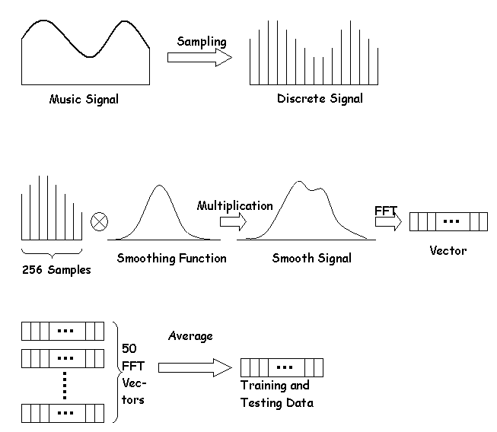
Preprocessing of audio clip to get the input data

Slide 9
Possible Approaches : SVM
Support Vector Machine is a supervised machine learning algorithm used for classification. In this algorithm, we plot each data item as a point in n-dimensional space (where n is number of features) with the value of each feature being the value of a particular coordinate. Then, we perform classification by finding the hyper-plane that differentiate the two classes very well.

Slide 10
Possible Approaches : CLUSTERING
K- Means Clustering is a type of unsupervised learning, which is used when you have unlabeled data (i.e., data without defined categories or groups). The goal of this algorithm is to find groups in the data, with the number of groups represented by the variable K. The algorithm works iteratively to assign each data point to one of K groups based on the features that are provided. Data points are clustered based on feature similarity.

Slide 11
Possible Approaches : NEURAL NETWORKS
An Artificial Neural Network is an information processing paradigm that is inspired by the way biological nervous systems work. It is composed of a large number of highly interconnected processing elements (neurones) working in unison to solve specific problems. ANNs, like people, learn by example. Learning in biological systems involves adjustments to the synaptic connections that exist between the neurones. This is true of ANNs as well.

Slide 12
Tools
We plan to build our classifier in Python, by using its powerful libraries like pandas, scikit-learn,NumPy, etc.
Any algorithms we manually implement will also be in python.
For data preparation and inspection audio tools like Audacity may be used.
Visual Analysis of the results may be done using Matlab.
For web service MEAN stack or Flask may be used.

Slide 13
Challenges
Dealing with a large data set consisting of approximately 10,000 songs would be a difficult task.
To generate accurate Happy/Sad labels for the songs contained in the training set.
Having the domain knowledge of music related to the problem is required.

Slide 14
Thank You

