Slide 1
Music Moods Classification
Final Year, Major Project
Apurva Maheshwari, 0801IT141014
Ekta Raghuvanshi, 0801IT141030
Ashish Kumar Patel, 0801IT141018
Guided by:
Dr. Sunita Verma
HOD, Information Technology

Slide 2
Contents
Introduction
Problem Domain
Proposed Solution
Tools and Technologies
Conclusion
Notes:
Will give u a brief about what our motivation is.

Slide 3
Introduction
From the drumbeats of our ancient ancestors to today’s unlimited streaming services, music is an integral part of the human experience. It inspires and motivates us. It helps elevating our mood.
We listen to music using our phones, walkman and computers. Individually we store around 300 to 1500 songs on our phones. A modern computer system can store more than million songs on its hard disk and using streaming services companies are offering possibly every song available in the world to us. With million of songs at our fingertips the challenge is how to manage these songs and how to find the right music to listen to as per our mood.

Slide 4
So what we intend to do?
With the use of machine learning techniques a classifier can be trained using features (are to be discussed) to classify a song as Happy / Sad.

Slide 5
Dataset
Like any other machine learning problem, data is the key to success.
The Million Song Database (MSD) we have planned to use is a freely-available collection of audio features and metadata for a million contemporary popular music tracks. The entire database of a million songs is 300GB in size.
Labels for the supervised learning will be collected from last.fm

Slide 6
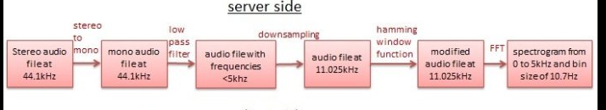
Representation of Data

Slide 7
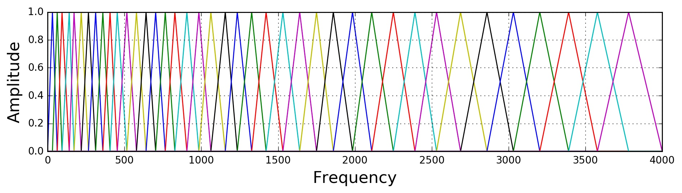
Adding the human perception : Mel-scale
Notes:
http://haythamfayek.com/2016/04/21/speech-processing-for-machine-learning.html

Slide 8
Features that determine mood
Tempo: the speed or pace of the piece, measured in beats-per-minute(BPM). This is a time domain feature which captures the rhythm of the song.
Energy: obtained by integrating over the Power Spectral Density (PSD).
Mode: indicates if a piece is played in major or minor key.
Key: identifies which of the 12 keys the song has been played.
Harmony: relative weighting between notes, characterized as chords or modes.
Notes:
First of all lets see how mood is determined.

Slide 9
But…….. The problem is
Its hard to have the domain knowledge of the music and at the same time. what if some other feature that we don’t know is more important he ones listed previously.
SO the solution is Feature Learning

Slide 10
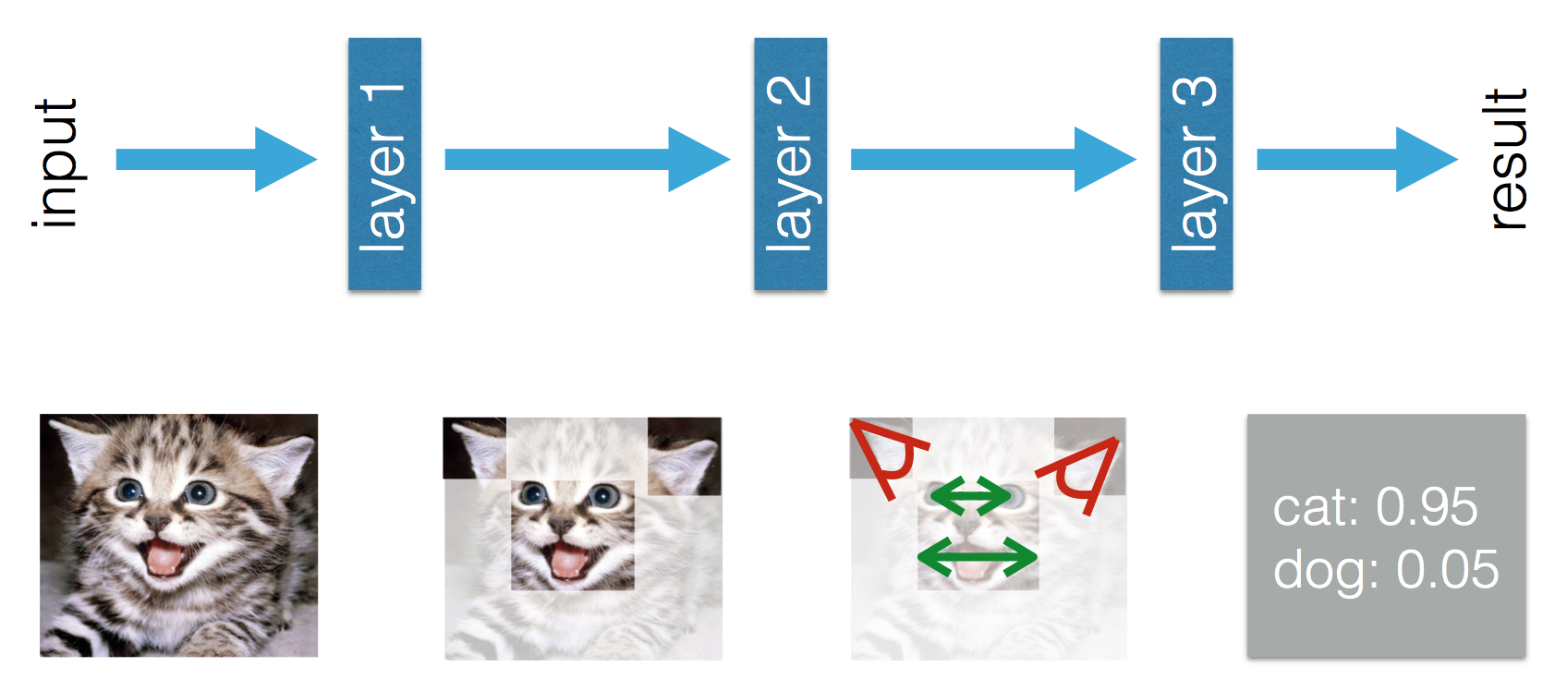
Feature Learning Example: Using RNN

Slide 11
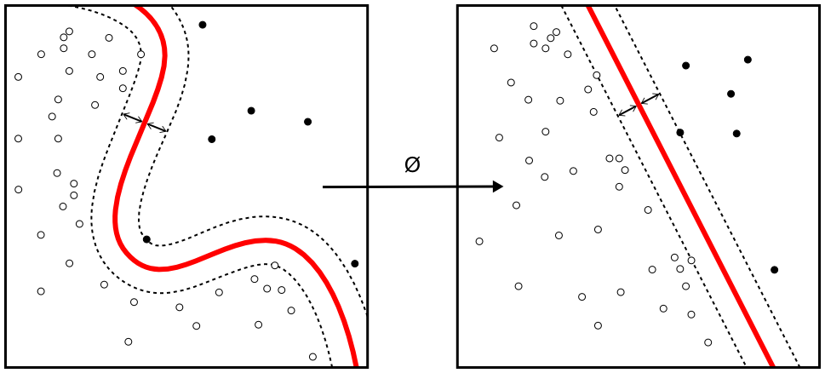
Classify

Slide 12
SVM
Support Vector Machine is a supervised machine learning algorithm used for classification. In this algorithm, we plot each data item as a point in n-dimensional space (where n is number of features) with the value of each feature being the value of a particular coordinate. Then, we perform classification by finding the hyperplane that differentiate the two classes very well.

Slide 13
How will we do it?
We will need to go through the following steps:
Get the Dataset (Million Song Dataset).
Get the labels for each song in the data set.
Do FFT
Train to earn features using RNN, save the weight matrix
Train classifier using SVM, save the weight matrix
Serve the user through the web api and browser.
Get the song through web request.
Apply FFT
Get features by applying the learned weight matrix, then feed to classifier
Classify using learned weights.
Send response to user

Slide 14
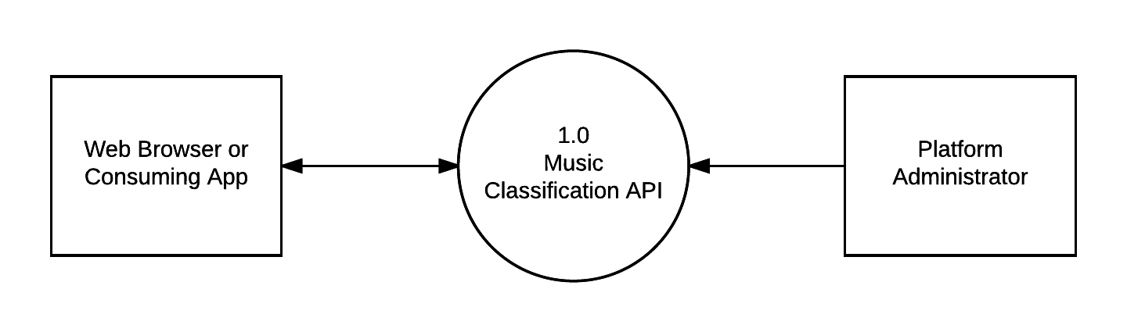
Our System

Slide 15
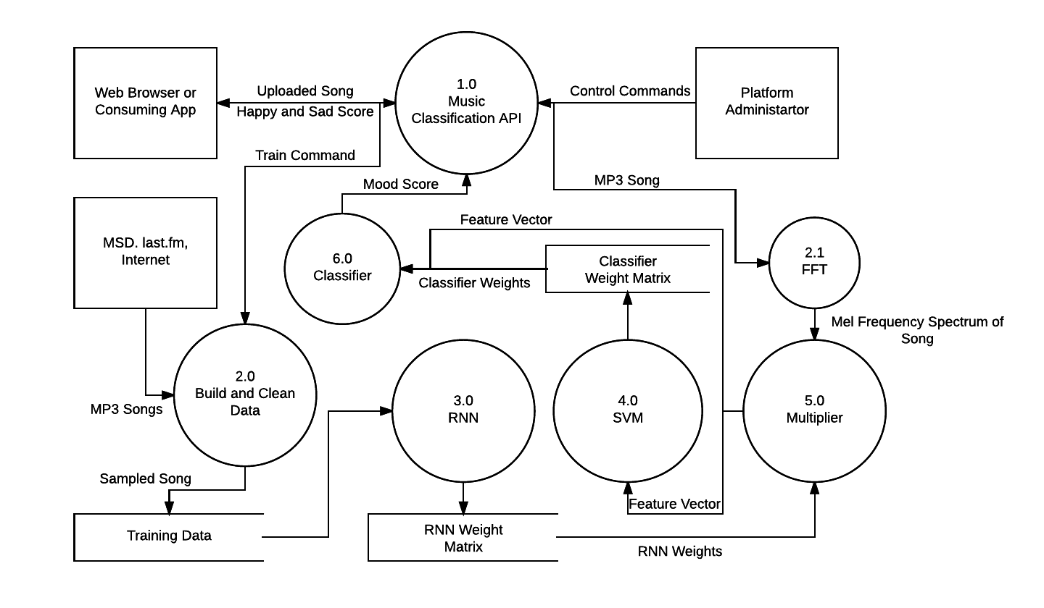
How things fit in it

Slide 16
Tools
We plan to build our classifier in Python, by using its powerful libraries like pandas, scikit-learn,NumPy, etc.
Librosa - audio processing library for Python
For data preparation and inspection audio tools like Audacity may be used.
For web service MEAN stack or Flask may be used.

Slide 17
Challenges
Dealing with a large data set consisting of approximately 10,000 songs would be a difficult task.
To generate accurate Happy/Sad labels for the songs contained in the training set.
Having the domain knowledge of music related to the problem is required.

Slide 18
Thank You

