Slide 1
Music Moods Classification
Final Year, Major Project
Guided by:
Dr. Satyendra Chauhan
Information Technology
Presented by:
Apurva Maheshwari, 0801IT141014
Ashish Kumar Patel, 0801IT141018
Ekta Raghuwanshi, 0801IT141030

Slide 2
The problem
Introduction
Motivation
Problem statement
Music is an integral part of the human experience.
Advances in storage technology and connectivity has enabled individuals to access million of songs for their use.
With million of songs at our fingertips how to find the right music to listen to as per our mood.
How to automate the cataloguing and increase discoverability in ever increasing music repositories.
To develop an Automated Smart System for classifying a song as either Happy or Sad by applying ML Techniques.

Slide 3
Challenges deep-dive
Data Acquisition
Feature Selection
Modeling and Evaluation
Removing attributes
Finding the right subset of features to solve the problem.
Increase accuracy
Finding the right algorithm to solve the problem.
Tuning the hyper-parameters to increase efficiency.
Labels and Features
Crowdsourcing the labels associated with songs to eliminate subjectivity of one’s perception.
Calculating features that represent physical nature of song

Slide 4
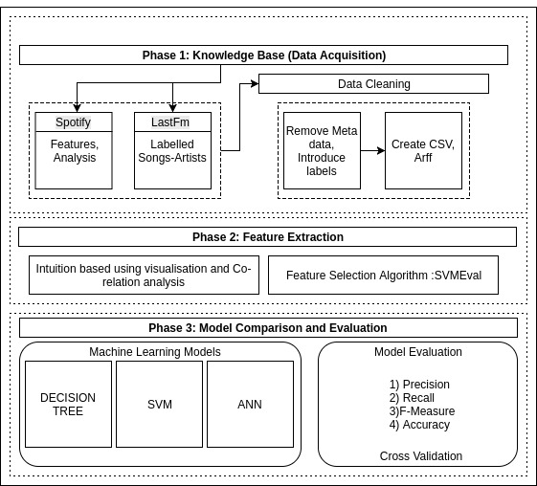
Architecture
of the system

Slide 5
Data Acquisition
Sources:
Spotify, to get features
LastFm, to get labels
Tools:
NodeJS
MongoDB

Slide 6
Features: 26 in number
Time_Signature - An estimated overall time signature of a track. The time signature(meter) is a notational convention to specify how many beats are in each bar (or measure).
Acousticness - A confidence measure from 0.0 to 1.0 of whether the track is acoustic. 1.0 represents high confidence the track is acoustic.
Speechiness -Speechiness detects the presence of spoken words in a track. The more exclusively speech-like the recording, the closer to 1.0 the attribute value.
and many more...

Slide 7
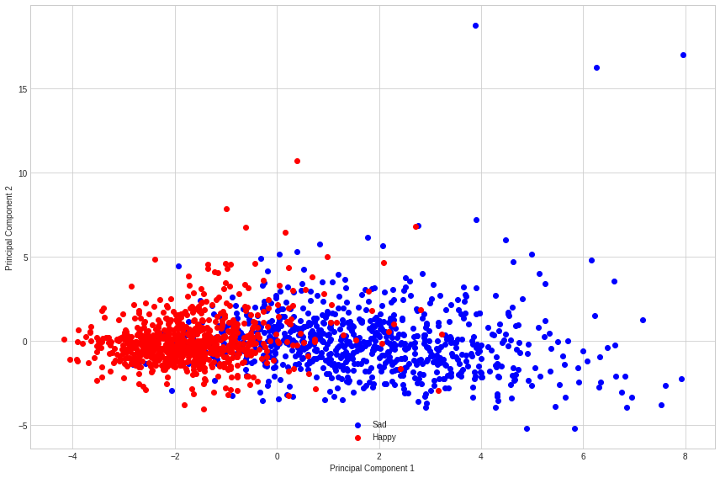
Visualization: PCA

Slide 8
Feature Selection
Intuition Based
CfsSubsetEval
SVM-RFE

Slide 9
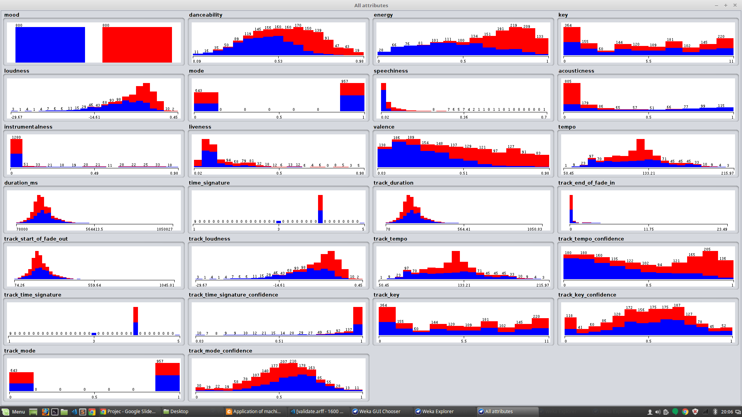

Slide 10
Intuition Based
& CfsSubsetEval
Danceability
Energy
Loudness
Speechiness
Valence

Slide 11
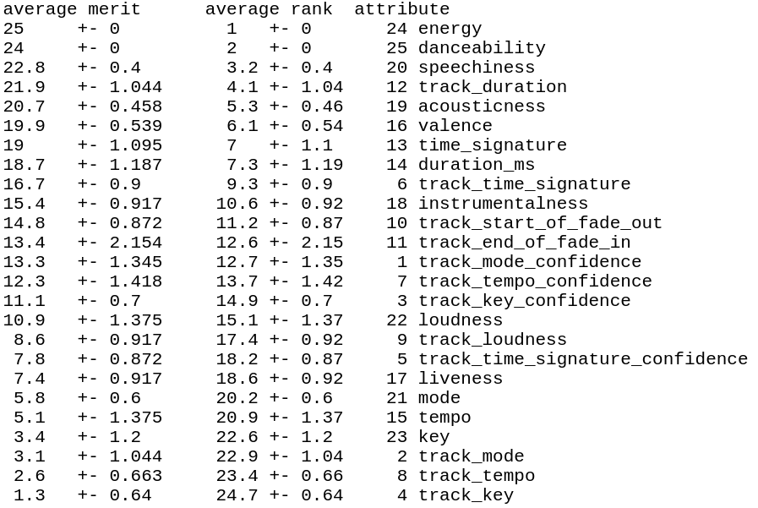

Slide 12
SVM-RFE
Energy
Danceability
Speechiness
Track_duration
Acousticness
Valence
Time_signature

Slide 13
Modeling
&
Evaluation
ANN
SVM
Decision Tree

Slide 14
Experiments
Total 1600 songs
Train : 800
Test: 600
Validation : 200
Tools:
Weka
Scikit (Python)

Slide 15
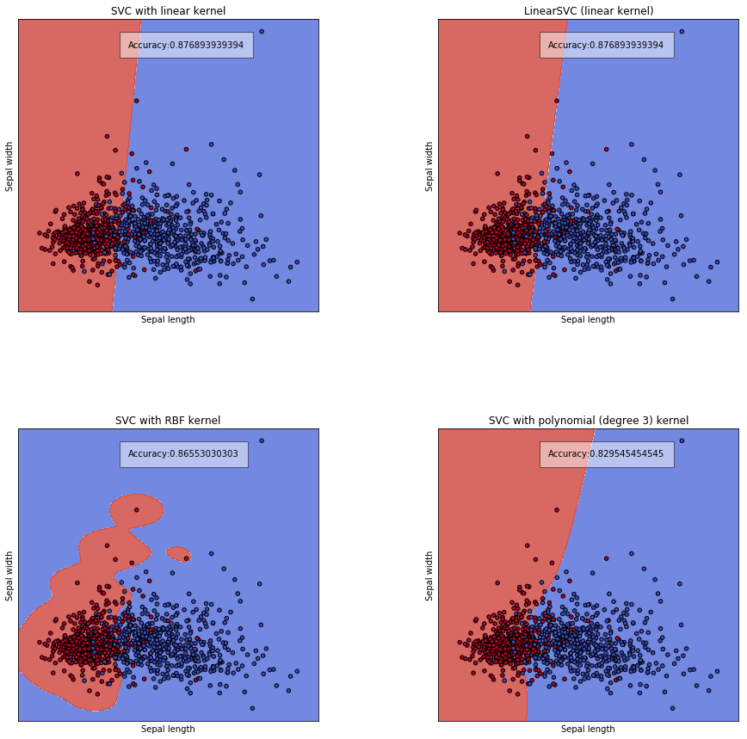
SVM on
Principal
Components

Slide 16
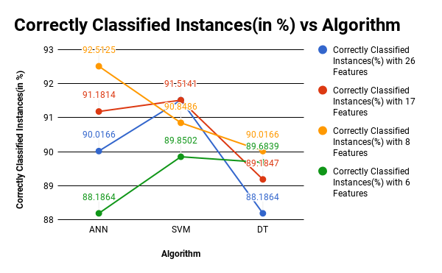
Comparison of Algorithms w.r.t. Feature sets

Slide 17
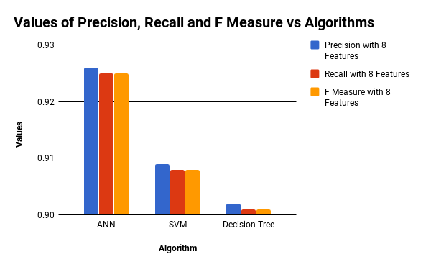
The best one: 8 Features using SVM-RFE

Slide 18
Validation

Slide 19
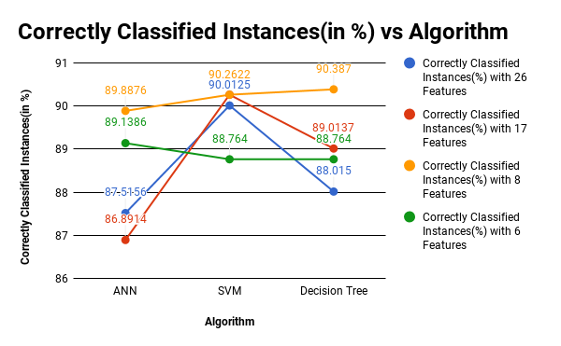
10-fold Cross Validation

Slide 20
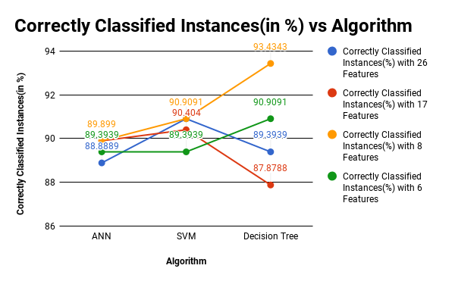
Validation Set

Slide 21
Results and Conclusion

Slide 22
Accuracy
90.387%
90.387% using Decision Tree

Slide 23
Future Work
Handling Multiple classes of moods.
Adding additional crowdsourced labelling platforms.
Probable Application : playlist generator using proposed algorithms.

Slide 24
Thank You!!

