Slide 1

Notes:
Before starting off with the presentation give the following task
Create a Student class with two attributes rollno and name and two methods acceptData() and displayData() and compile and execute to the trainees with one or two student objects – ( Give this program to the trainees as a task and then provide the solution . )
This module covers :
Primitive & Object Reference Types
Wrapper Classes
Java.lang.String,StringBuffer,StringBuilder classes
JVM
Garbage Collection Mechanism
Type Casting

Slide 2
Classification of Data Types in Java
Primitive Data Types
Object Reference Types

Slide 3
Primitives & Wrappers
Java has a wrapper class for each of the eight primitive data types:
Primitive Type | Wrapper Class |  | Primitive Type | Wrapper Class
boolean | Boolean |  | float | Float
byte | Byte |  | int | Integer
char | Character |  | long | Long
double | Double |  | short | Short
Notes:
Wrapper classes allow primitive data types to be accessed as objects. Specify that wrapper classes are members of the java.lang package.
Features of the Java wrapper Classes:
Wrapper classes convert numeric strings into numeric values.
The way to store primitive data in an object.
The valueOf() method is available in all wrapper classes except Character
All wrapper classes have typeValue() method. This method returns the value of the object as its primitive type.

Slide 4
Primitive Data Types - Size & Value
TYPE SIZE(bits) MIN VALUE MAX VALUE
byte 8 -128 127
short 16 -32768 32767
int 32 -2147483648 2147483647
long 64 -9.22 *10e18 9.22 *10e18
float 32 -3.402*10e38 3.402*10e38
double 64 -1.79*10e308 1.79*10e308
boolean True / False
char 16 0 65,536
Notes:
Size , Minvalue and Maxvalue of the primitive data types.

Slide 5
Data Type Default Value
byte 0
short 0
int 0
long 0l
float 0.0f
double 0.0d
char '\u0000‘
boolean false

Slide 6
Use of the Wrapper Classes
Java’s primitive data types (boolean, int, etc.) are not classes.
Wrapper classes are used in situations where objects are required, such as for elements of a Collection:
List<Integer> a = new ArrayList<Integer>();
Notes:
Dealing with primitives as objects is easier at times. Most of the objects collection store objects and not primitive types. Many utility methods are provided by wrapper classes.

Slide 7
Conversion of Primitives to Objects
Wrapper.valueOf() takes a value (or string) and returns an object of that class:
Integer i1 = Integer.valueOf(42);
Boolean b1 = Boolean .valueOf(true);
Long n1 = Long.valueOf(42000000L);

Slide 8
Conversion of Objects to Primitives
Each wrapper class Type has a method typeValue to obtain the object’s value:
Integer i1 = Integer.valueOf(42);
System.out.println(i1.intValue());
=>
42
Notes:
Specify that only wrapper classes have methods attached to them .
Eg Integer class has a set of methods attached to it but not an int primitive

Slide 9
String => value
The Wrapper class for each primitive type has a method parseType() to parse a string representation & return the literal value.
Integer.parseInt(“42”) => 42
Boolean.parseBoolean(“true”) => true
Double.parseDouble(“2.71”) => 2.71

Slide 10
Sample values:
Short shortObj = new Short(32000);
Integer intObj = new Integer(2000000);
Long longObj = new Long(500000000000000000L);
Float floatObj = new Float(1.42);
float f=1.2f;
Double doubleObj = new Double(1.42);

Slide 11
Each Number Wrapper has a MAX_VALUE constant:
byteObj = new Byte(Byte.MAX_VALUE);
shortObj = new Short(Short.MAX_VALUE);
intObj = new Integer(Integer.MAX_VALUE);
longObj = new Long(Long.MAX_VALUE);
floatObj = new Float(Float.MAX_VALUE);
doubleObj = new Double(Double.MAX_VALUE);

Slide 12
Some useful utility methods, e.g., for Integer:
int hashCode()
static String toBinaryString(int i)
static String toHexString(int i)
static String toOctalString(int i)
Notes:
Many useful utility methods, e.g., for Integer:
Wrapper classes provide methods to manipulate on the data.

Slide 13
Unique Feature of char datatype in Java
Characters in C are ASCII characters. There are only 256 different characters in the ASCII character set, and so 8-bits are enough to store this data.
Characters in Java are 16-bit Unicode characters (65536 different characters), so twice as much storage is needed to store the extra characters.This feature is added to support internationalization in java
Notes:
Characters in Java are 16-bit Unicode characters (65536 different characters), so twice as much storage is needed to store the extra characters.This feature is added to support internationalization in java

Slide 14
Comparison of Primitives & Object Ref Types
Primitives are not objects they store only one value.
Objects not only store more than one value, they also store more than one different data type including other objects. For eg a Car object can also store an Engine object.
Object reference types have a set of methods attached to them unlike primitive types.
Notes:
Class objects, including method code and static fields Objects, including instance fields are stored in heap. Local variables and calls to methods are in stack.
But the point to be noted is that if there is no memory space for creating new object in Heap JVM throws OutOfMemory Error . Also stress on the fact that unnecessarily creating object types when primitives will suffice will lead to the above error. Any objects created has to be assigned null when no more used in the application to make it eligible for garbage collection .

Slide 15
Java .lang.String
Under Java, a string is a unique object, which has its own set of methods
String str = "abc"; is equivalent to:
char data[] = {'a', 'b', 'c'};
String str = new String(data);
String uses 16-bit Unicode characters that represents an immutable string
Notes:
Demo Program Provided – EqualTest.java
Explain the functionality of a String in java when every time the content in a String object changes , the updated String is stored in a new memory location.
Differentiate between String s=”Hello” and String s=new String(“Hello”) where in the first one the String is stored in the constant memory pool in heap.
where as in the second one a new object is created
Differentiate between applying equals() method for 2 Strings and == operator between two Strings.
String in java is stored as an array of characters and is stored in Unicode format.

Slide 16
More String methods
char charAt( int index)
String concat( String addThis )
int compareTo( String otherString )
boolean endsWith( String suffix )
boolean equals( Object obj )
boolean equalsIgnoreCase( String s )
int indexOf( char c )
int lastIndexOf( char c )
int length()
String replace( char old, char new )
boolean startsWith( String prefix )
String substring( int startIndex )

Slide 17
a few more
String toLowerCase()
String toString()
String toUpperCase()
String trim()

Slide 18
Java .lang.StringBuffer
represents a String which can be modified
and can grow dynamically
StringBuffer append( String s )
StringBuffer append( Object obj )
StringBuffer insert( int offset, String s )
StringBuffer reverse()
StringBuffer setCharAt( int offset, char c )
StringBuffer setLength( int newlength )
String toString()
Notes:
Demo Program Provided – StringBufferDemo.java
eg.
String myString = “Hello”;
Next, you want to append “Guest” to the same String.
myString = myString + ” Guest”;
In case of String object , the appended String will be stored in a new memory location
When you print the contents of myString the output will be “Hello Guest” stored internally in a new String Object which is a performance issue. Since StringBuffer is mutable , “HelloGuest “ will be stored in the same memory location.

Slide 19
String vs StringBuffer
A string buffer implements a mutable sequence of characters.
A string is like a String Buffer, but is immutable where the length and content of the sequence can be changed through certain method calls.

Slide 20
Java.lang.StringBuilder
StringBuilder was introduced in Java 1.5 so it won't work with earlier JVMs.
The difference between StringBuffer and StringBuilder is StringBuffer is synchronized while StringBuilder is not.
Hence StringBuilder is faster than StringBuffer .
Notes:
Specify that if a immutable String has to be handled in the application String is best , otherwise StringBuffer and if synchronization is not an issue in the application String Builder is apt.

Slide 21
What is JVM ?
Is a virtual machine within a machine enabling java byte code to be executed in any op. system.
When pgms are carried over the internet JVM’s play an important role
Is a virtual machine within a machine which enables java byte code to be executed on any op. system.

Slide 22
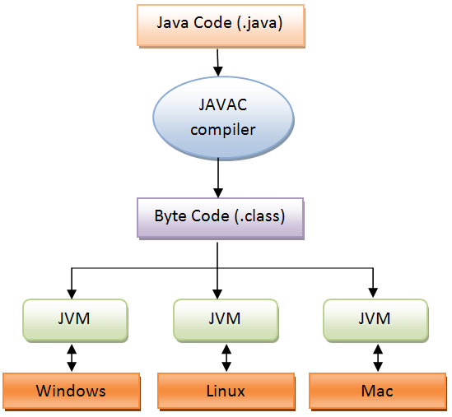
Role of JVM

Slide 23
Diagram for Java Memory Structure
Heap Memory
Non Heap Memory
Notes:
All Memory for JVM are categorized as follows :
Heap Memory, which is the storage for Java objects ,Instance and Static fields
Non-Heap Memory, which is used by Java to store loaded classes and other meta-data, Local variables,method calls etc.

Slide 24
Garbage Collection
Garbage collection is a mechanism provided by Java Virtual Machine to reclaim heap space from objects which are eligible for Garbage collection
Garbage collection relieves java programmer from memory management which is essential part of C++ programming and gives more time to focus on business logic.
Garbage Collection in Java is carried by a daemon thread called Garbage Collector.
Notes:
Demo Program Provided – Garbage_Collection.java
In the above demo program , Runtime.getRuntime().gc() is used where Runtime is a class which returns the runtime environment which has a gc() method . ///ly we can use System.gc() . Both of these only suggest to the JVM to do garbage collection and is not a forceful command to do GC.
Garbage collection relieves java programmer from memory management which is essential part of C++ programming and gives more time to focus on business logic.
JVM command line options –Xmx and -Xms is used to setup starting and max size for Java Heap. Ideal ratio of this parameter is either 1:1 or 1:1.5 . for example either both –Xmx and –Xms can be 1GB or –Xms 1.2 GB and –Xmx 1.8 GB.
eg. java -Xmx60m classfile
By using the -Xms flag, you can set your minimum heap size to the same as the maximum heap size to guarantee that the JVM won’t waste time growing the heap.
There is no manual way of doing garbage collection in Java.

Slide 25
Garbage Collection
A Java programmer cannot force Garbage collection in Java; it will only trigger if JVM thinks it needs a garbage collection based on Java heap size.
There are methods like System.gc () and Runtime.gc () which is used to send request of Garbage collection to JVM but it’s not guaranteed that garbage collection will happen.
Notes:
To enable verbose GC output use the following java options when starting the JVM:
-verbose:gc
eg java -verbose:gc classfile
The output looks like this (and can vary slightly from different version of the JVM):
[GC 46336K->3775K(129664K), 0.2158256 secs]
This line represents a partial GC, as can been seen by the first part of the line:
[GC
if this GC had been a full GC, the first part of the output would be:
[Full GC
The other fields are as follows:
46336K->3775K -- size before and after the GC
(129664K) -- total available space, not counting the space in perm
0.2158256 secs-- time the GC took

Slide 26
The finalize () Method
Sometimes an object will need to perform some action when it is destroyed.
To handle such situations, java provides a mechanism called finalization.
By using finalization, you can define specific actions that will occur when an object is just about to be reclaimed by the garbage collector.
Notes:
finalize() method of the Object class is used to perform clean up code. For example, if an object is holding some non-java resource such as a file handle or window character font, then you might want to make sure these resources are freed before an object is destroyed.
finalize() is equivalent to destructors in C++

Slide 27
Memory Generations
VM’s garbage collector uses generational garbage collection. It separates the JVM’s heap memory into young generation and old generation.
Young Generation
Young generation memory consists of two parts, Eden space and survivor space. Short lived objects will be available in Eden space. Every object starts its life from Eden space. When GC happens, if an object is still alive and it will be moved to survivor space and other de-referenced objects will be removed.

Slide 28
Memory Generations
Old Generation – Tenured and PermGen
Old generation memory has two parts, tenured generation and permanent generation (PermGen).
GC moves live objects from survivor space to tenured generation. The permanent generation contains meta data of the virtual machine, class and method objects.

Slide 29
How JVM claims memory?
JVM tries to find space for a newly created object in Eden
Otherwise, go to next step
JVM tries to release not active objects (1 or Partial GC). If there is still not enough space, puts active objects into Survivor.
Survivor part is used as exchange space for Eden and Old .If Old space is big enough, objects in Survivor will be moved into Old space.
If Old part does not have enough space, JVM will perform full GC (0 level)
After full GC, if Survivor and Old parts still cannot hold the objects from Eden, there is the “Out of Memory Error”.
[ Full GC is where the GC thread runs making all the application threads to pause for some time ]
Notes:
Garbage Collection is done through a daemon thread which is a system thread called Garbage Collector.
This thread is a low priority thread ie it runs when the other applications are idle but it becomes a high priority thread when there is very little space in the heap . This is when your application hangs time after time ( Note the last point in [ ] in the slide )

Slide 30
How Object are created
class Student{
int a;
int b;
public void setData(int c,int d){
a=c;
b=d;
}
public static void main(String args[]){
Student s1 = new Student();
Student s2 = new Student();
s1.setData(1,2);
s2.setData(3,4);
// Student s3;
//s3=s2; -----------→Line 10
s2=null;
s3=null;
}
}
Notes:
In the sample program explain through the diagram how s1 and s2 objects are created in the heap space in JVM .
Show how in line 10 when s3 =s2 , the heap memory transforms to what is shown in slide 32

Slide 31
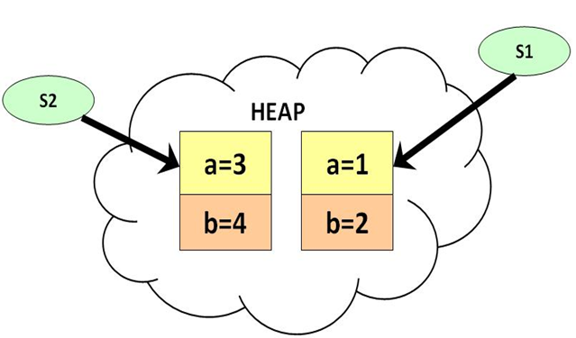
How Object are created

Slide 32
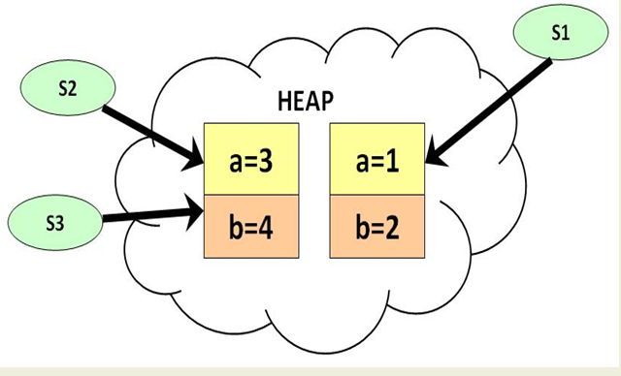
How Object are created

Slide 33
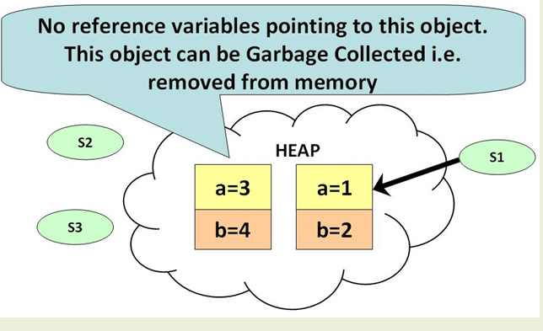
How Object are created
Notes:
When s2=null and s3=null ( sample program in slide 30 ) , show how as in the above slide the object is an eligible candidate for garbage
collection. In java there is no explicit command to force JVM to perform garbage collection . The JVM will decide the time of garbage collection comparing the CPU cost with the space available space in the heap.If there is enough space in the heap it will postpone garbage collection .

Slide 34
TYPE CASTING
It is sometimes necessary to convert a data item of one type to another type.
For example when it is necessary to perform some arithmetic using data items of different types (so called mixed mode arithmetic).
Under certain circumstances Type casting can be carried out automatically, in other cases it must be "forced" manually (explicitly).

Slide 35
TYPE CASTING-Automatic Conversion
In Java type conversions are performed automatically when the type of the
expression on the right hand side of an assignment operation can be safely
promoted to the type of the variable on the left hand side of the assignment.
Thus we can safely assign: byte -> short -> int -> long -> float -> double.
For example :
long myLongInteger; //64 bit long integer
int myInteger; //32 bit long integer
myLongInteger=myInteger;
The extra storage associated with the long integer, in the above example,will simply be padded with extra zeros.

Slide 36
Explicit Conversion (Casting)
The above will not work the other way round. For example we cannot automatically convert a long to an int because the first requires more storage than the second and consequently information may be lost.
To force such a conversion we must carry out an explicit conversion (assuming of course that the long integer will fit into a standard integer). This is done using a process known as a type cast :
myInteger = (int) myLongInteger
This tells the compiler that the type of myLongInteger must be temporarily changed to a int when the given assignment statement is processed. Thus, the cast only lasts for the duration of the assignment.
Notes:
Demo Program : TypeCast.java

Slide 37
Check Your Understanding
1. Java's primitive data types are classes. Yes/No
No
2. concat, equals, indexof are _______methods.
String
3. JVM is ________.
Java Virtual Machine
4. ________ is a daemon thread in java used for memory management by JVM.
Garbage Collector
5. ________ method is used to perform some action when it is destroyed.
Finalize()
6. Converting a data item from one type to another is called _______.
Type casting
7. Automatic type casting does not occur in java. Yes/No
No
8. Size of long data type is ____.
64
9. wrapper.valueof() returns _________ of that class.
object
10. StringBuilder is faster than StringBuffer. Yes/No
Yes

